Slide 1
Computer Architecture Code CSE 332 Project 1

Slide 2
Group Introduction Group Riot Club Members Jawad Ibn Ahad 2022190642 Abdur Rahman Faruk Khan 2021794642 Ferdous Hasan Zihad Akash 2021309642

Slide 3
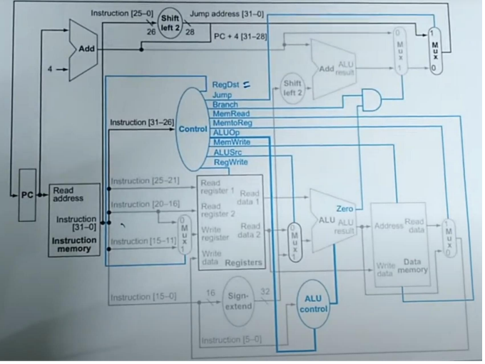
R-Type Data Path

Slide 4
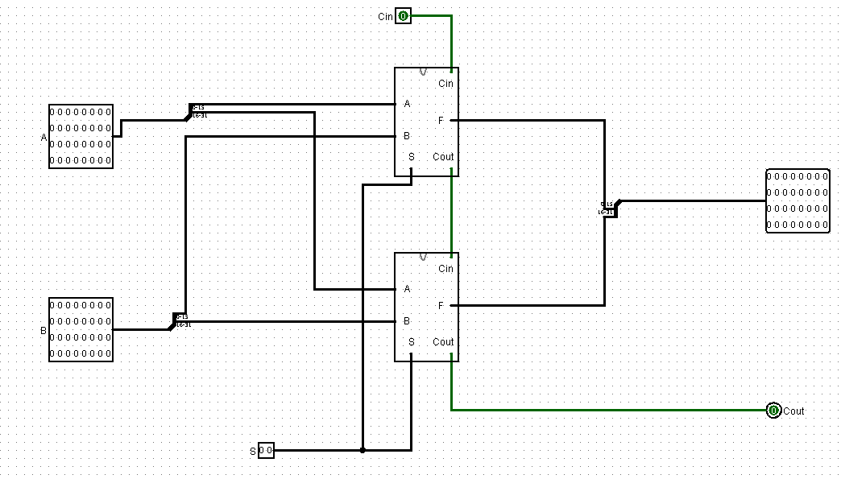
32 bit ALU with 2 select bits
Basic ALU
2*16 bit ALU
2 Select Bits
Can perform 4 basic Arithmetic operations
Problem with this circuit is
for subtraction the carry has to
be given manually
S1 S0 Operation
0 0 AND
0 1 OR
0 ADDITION
1 1 SUBTRACTION

Slide 5
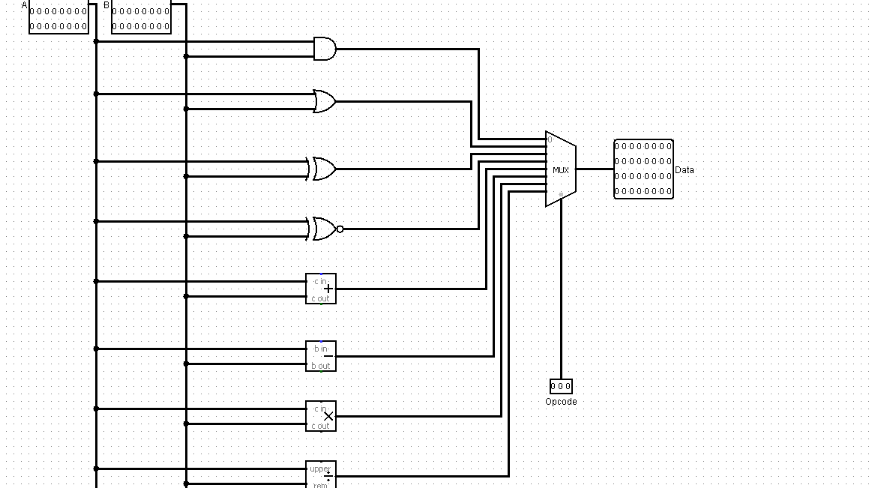
Modified ALU
S2 S1 S0 Operation
0 0 0 AND
0 0 1 OR
0 1 0 XOR
0 1 1 XNOR
1 0 0 ADDITION
1 0 1 SUBTRACTION
1 1 0 MULTIPLICATION
1 1 1 DIVISION
Can perform 8 basic Arithmetic operations
Tis circuit uses individual arithmetic units
to perform each operation. Can Work Without Carry

Slide 6
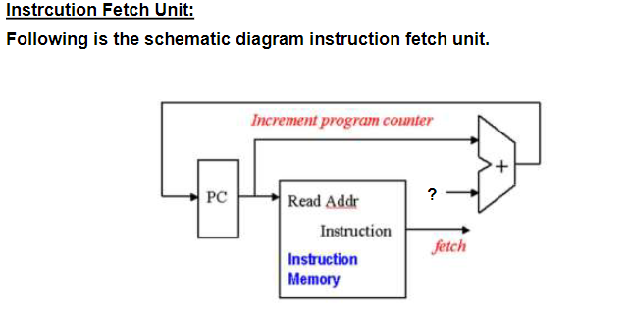
Block Diagram
Basic Instruction fetch unit

Slide 7
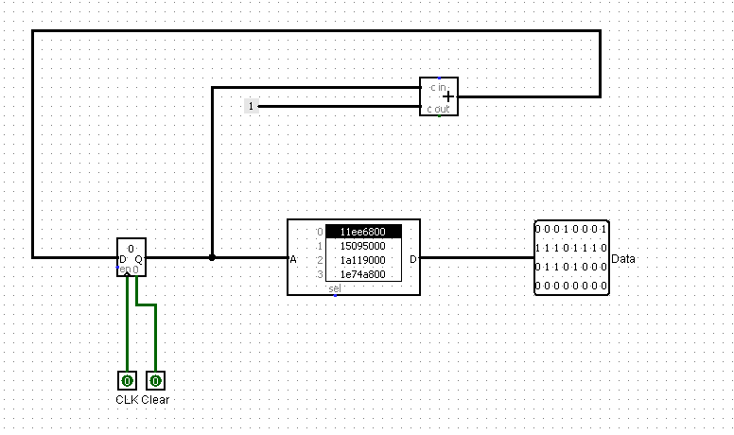
Instruction Fetch Unit
2 bit Register
Adder
Circuit
32 bit ROM
PC using a 2 bit register file, adder circuit and a 32 bit ROM
The ROM can store 4 MISP( 32 bit ) instructions

Slide 8
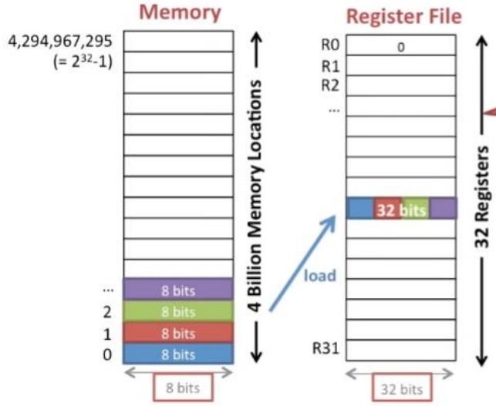
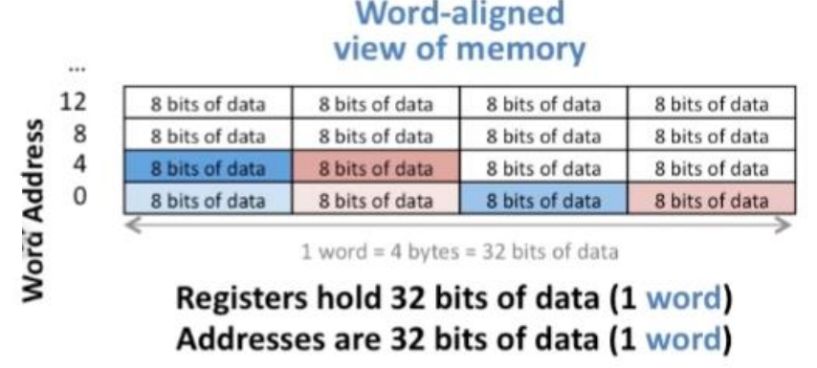
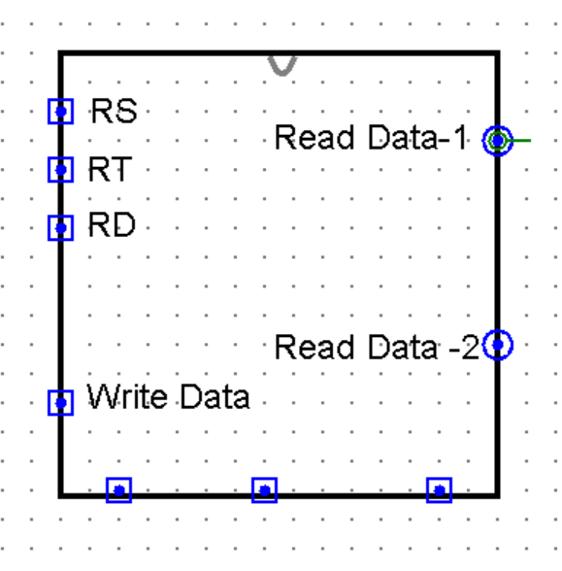
Register File
We have followed MIPS architecture for designing register file. Our Register File contains 32 registers numbered from 0-31. Each of the Registers can hold 32 bit of data. So 1 word is equal to 32 bit of the Register file.

Slide 9
R-Type DataPath
Output

Slide 10
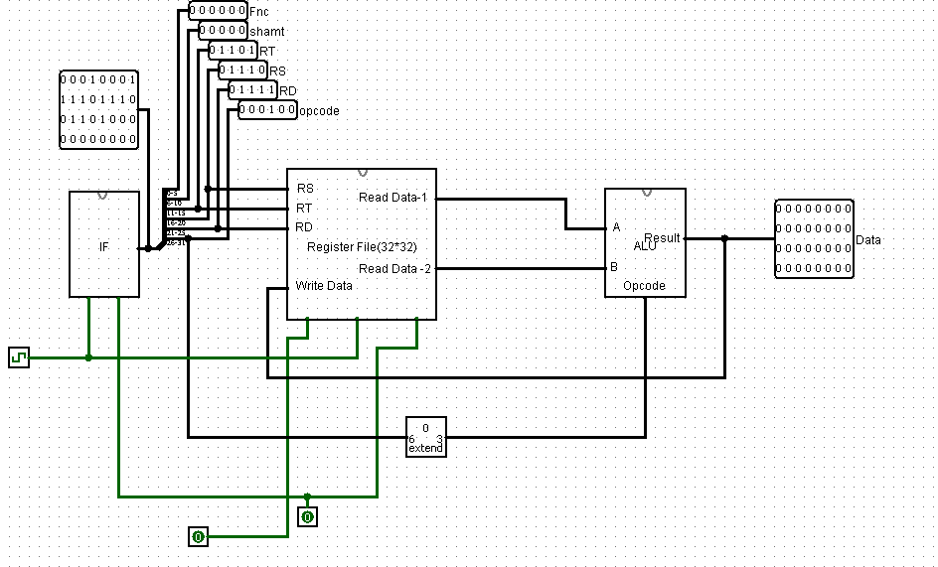
R-Type DataPath
Register File
Output

Slide 11
R-Type Instruction Format
Opcode | RD | RS | RT | Shamt | Function
6 bits | 5 bits | 5 bits | 5 bits | 5 bits | 6 bits
For 2 bit Opcode
Example
RD
RT
AND $S0, $S1, $S2
Opcode
RS
AND | $S0 | $S1 | $S2
0 | 16 | 17 | 18 | 0 | 0
000000 | 10000 | 10001 | 10010 | 00000 | 000000
0 2 | 1 | 1 | 9 | 0 0 | 0

Slide 12
In the same way………
For 2 bit ALU 4 Instructions
AND $S0,$S1,$S2
1.B (00000010000100011001000000000000)
OR $S3,$S4,$S5
2.B (00000110011101001010100000000000)
ADD $T0,$T1,$T2
3.B (00001001000010010101000000000000)
4. SUB $T3, $T4,$T5
B (00001101011011000110100000000000)
(02119000) H
(067410800) H
(09095000) H
(0136126800) H

