Slide 1
DATA PREPARATION AND ANALYZING OF ENERGY CONSUMPTION

Slide 2
TABLE OF CONTENT
EXPLANATION OF DATA CHOSEN
DATA PREPARATION
DATA ACCESS
DATA FORMATTING
DATA CLEANING
DATA QUERYING

Slide 3
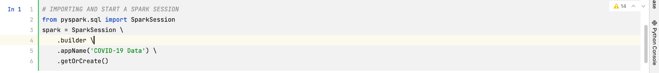
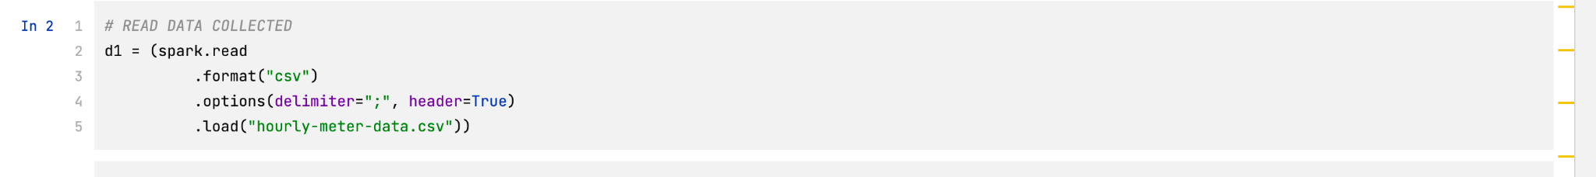
DATA PREPARATION- ACCESS
To access the data and prepare it for analysis, we made use of Apache spark which is used for big data processing and includes SQL for querying

Slide 4
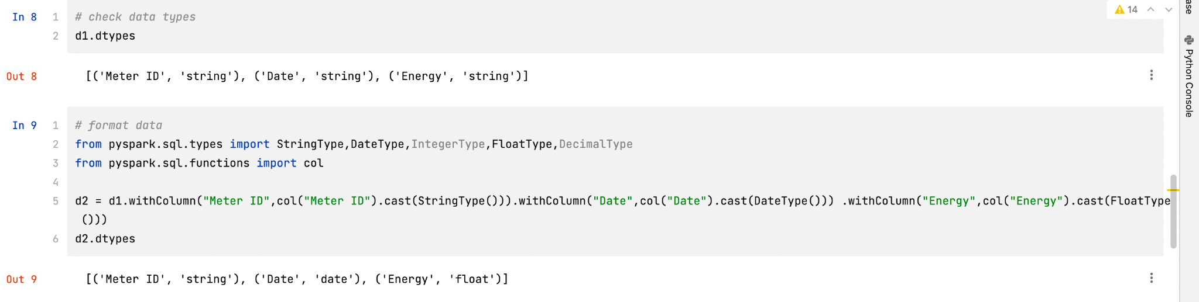
DATA PREPARATION- FORMATING
In other to prepare data for analysis, it has to undergo some stages. First, we find out if come columns have the wrong data type and assign to it the correct one.

Slide 5
DATA QUERYING
We are making use of Apache Spark SQL to query the data. Spark SQL works just like SQL

Slide 6
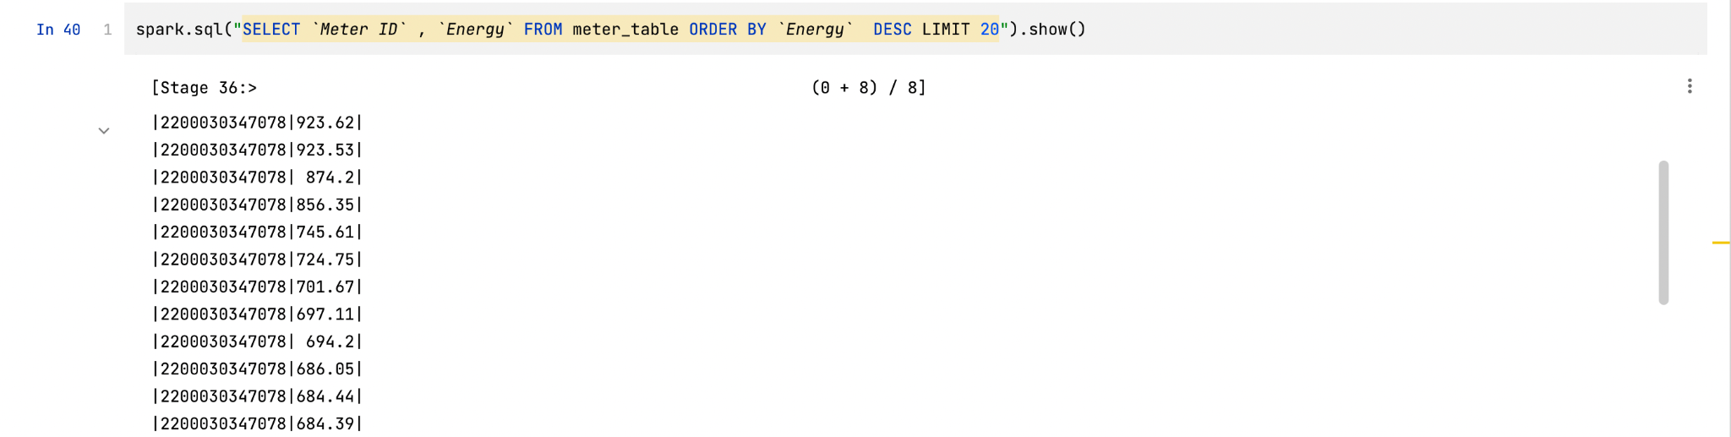
To find Meter ID with highest consumption

Slide 7
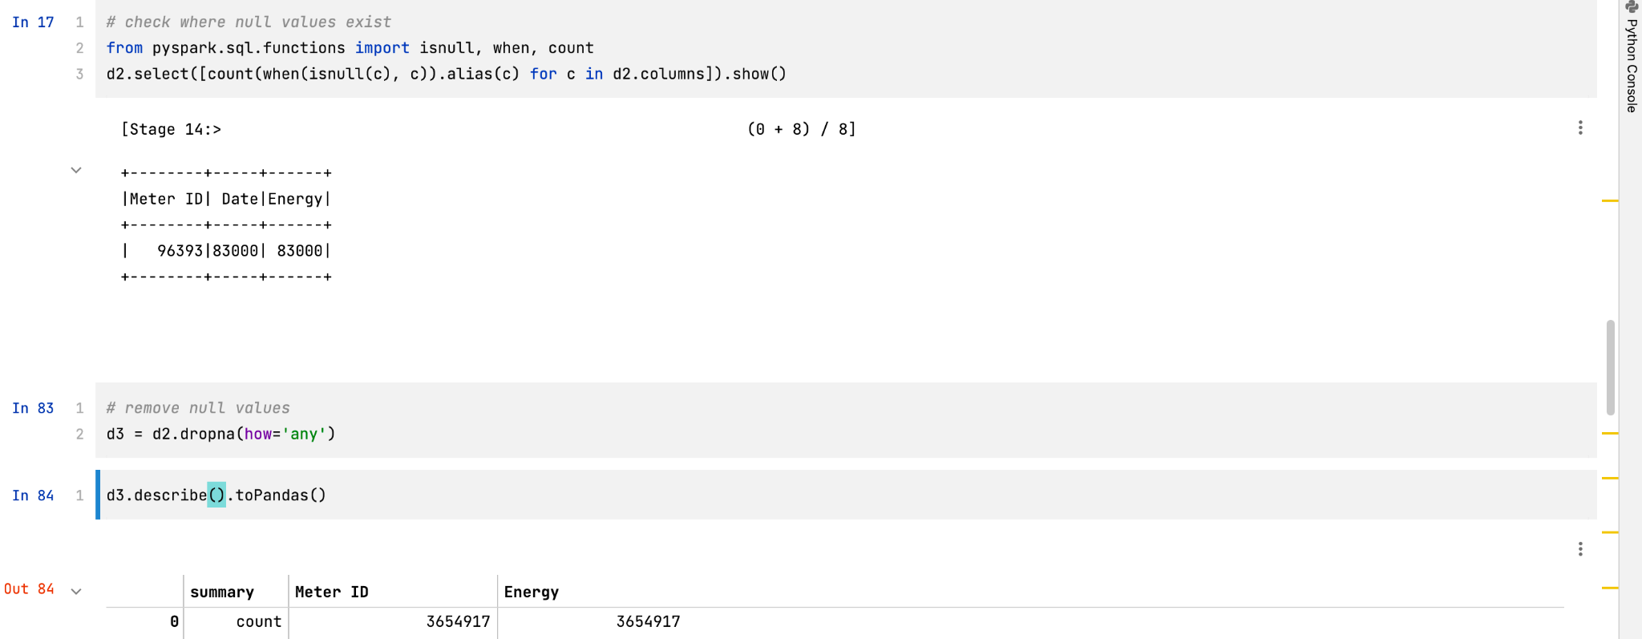
To give a provide useful information on our data , we need to rid of incorrect , corrupt or duplicate data

Slide 8
Data in its raw form doesnt have meaning. It has to be processed and provided with context
Meter ID;Date;Energy
2200015266516;2020-03-10T18:00:00+00:00;1.454
2200015266516;2020-03-11T15:00:00+00:00;2.254
2200015266516;2020-03-12T01:00:00+00:00;0.525
2200015266516;2020-03-13T07:00:00+00:00;0.587
2200015266516;2020-03-13T08:00:00+00:00;0.594
2200015266516;2020-03-13T10:00:00+00:00;1.165
2200015266516;2020-03-13T15:00:00+00:00;2.067
2200015266516;2020-03-13T21:00:00+00:00;0.515
2200015266516;2020-03-13T23:00:00+00:00;0.604

Slide 9
To find Meter ID with highest consumption

Slide 10
Information
Meter ID 2200030347078 containing the top 20 position consumed the most Energy
Knowledge
Most likely an office or industrial site to consume most energy

Slide 11
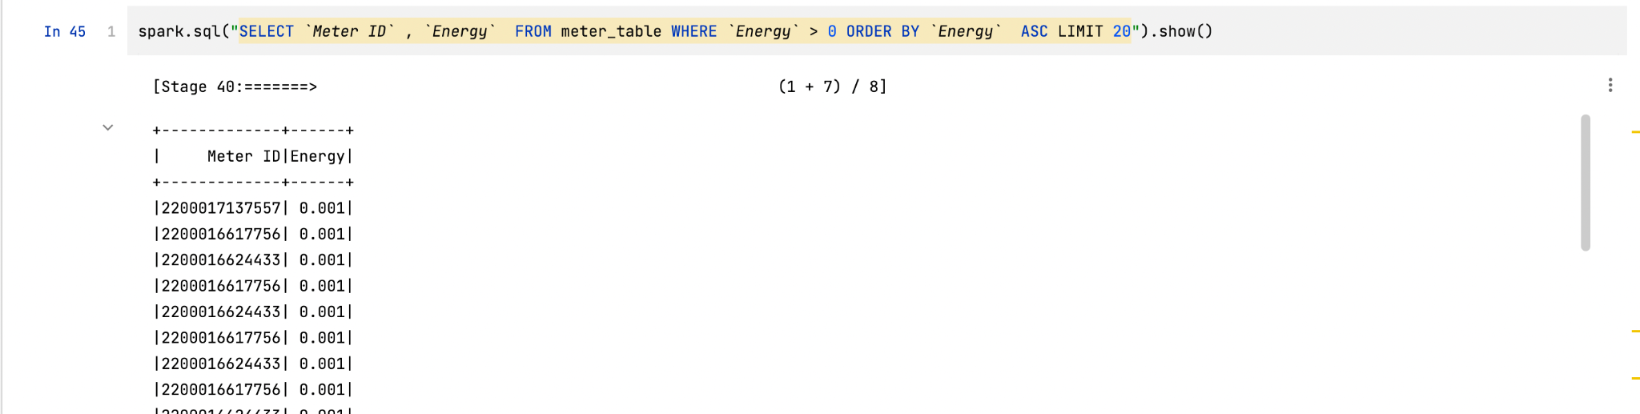
To find Meter ID with lowest consumption

Slide 12
Information
Meter ID 2200016617756 occupies the bottom 20 the most in least occupied energy
Knowledge
most likely a metered id with only lights on or energy meter has been tampered with.

Slide 13
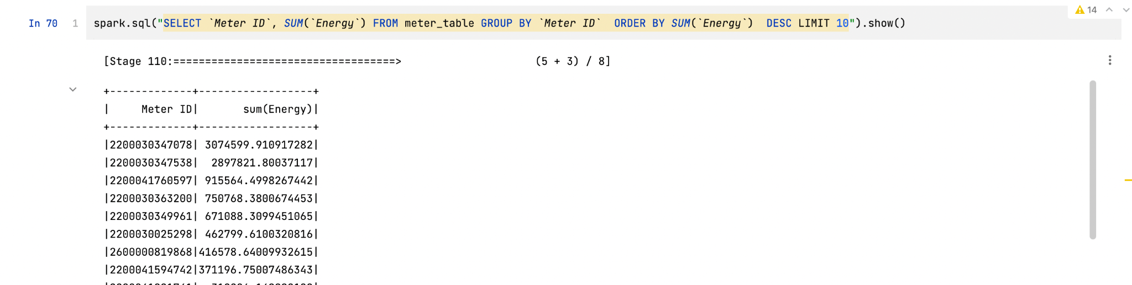
To find Meter ID with highest total amount of consumption

Slide 14
Information
Overall , 2200030347078 consumed the most energy
Knowledge
Meter 2200030347078 is most likely owned by an industrial company.

Slide 15
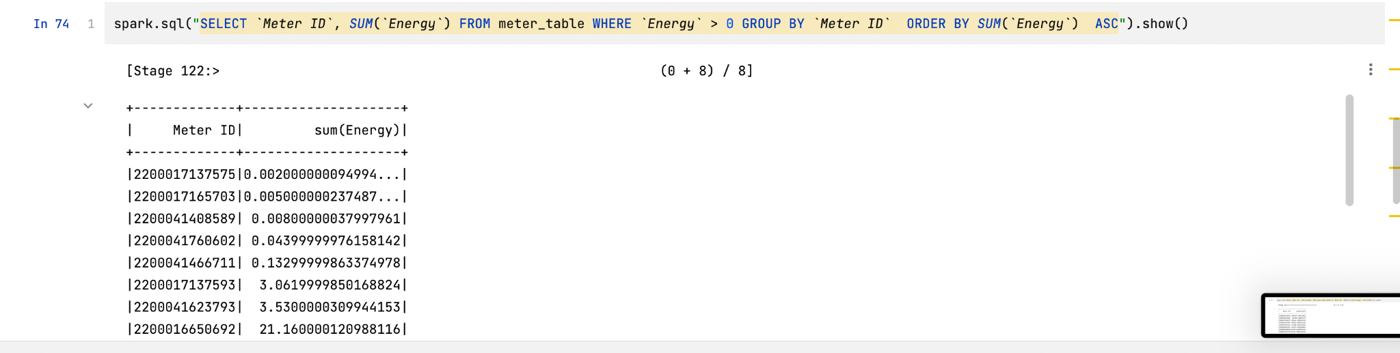
To find Meter ID with lowest total amount of consumption

Slide 16
Information
Overall , 2200017137575 consumed the least energy
Knowledge
Meter 2200017137575 is most likely an an abandoned house with a meter or it has been tampered with.

Slide 17
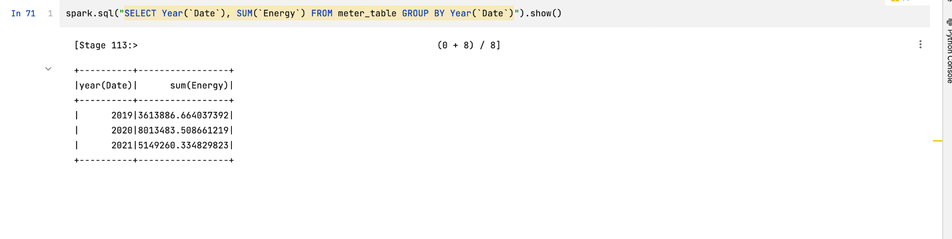
To find total energy consumed by year

Slide 18
Information
2020 had the most amount of energy used
Knowledge
This is due to households being at home due to COVID

