Slide 1





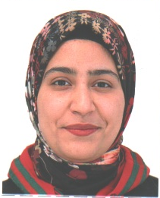

People's Democratic Republic of Algeria
Ministry of Higher Education and Scientific Research
Tahri Mohamed University of Bechar
AI Techniques and Tools - Mini Project
Binary classification: predict kidney disease presence
Chronic kidney disease - UCI dataset
F.Younes Informatique
A.Abderrahmen Etudes linguistiques
F. Mohammed Etudes linguistiques
G.Fatma Zahra Etudes linguistiques
D.Aicha Etudes linguistiques
M.Faiza Langue anglaise
Academic Year 2025/2026

Slide 2
Project Agenda
01
Problem Introduction
06
Data Splitting
02
Dataset Search & Description
07
Algorithm Selection & Training
03
Generative AI + Data Augmentation
08
Evaluation & Results
04
Data Preparation
09
Conclusion
05
Feature Engineering (PCA, LDA)

Slide 3
01 | Problem Introduction
What is Chronic Kidney Disease?
10%
Progressive and irreversible decline in kidney function
Sustained over more than 3 months
Often asymptomatic in early stages - hard to detect
Can progress to End-Stage Renal Disease (ESRD)
of world population
affected by CKD
Problem Statement
Given 24 medical measurements per patient (creatinine, hemoglobin, blood pressure...),
predict whether the patient has CKD (1) or is healthy (0) → Binary Classification Task
CKD
250 sick
NotCKD
150 healthy

Slide 4
02 | Dataset Search & Description
400
24
2
UCI
Patients
Features
Classes
Source
Top Predictive Features
Feature | Description | Importance
sc | Serum Creatinine | ~28%
pcv | Packed Cell Volume | ~22%
hemo | Hemoglobin | ~18%
sg | Specific Gravity | ~8%
rbcc | Red Blood Cell Count | ~6%

Slide 5
03 | Generative AI + Data Augmentation
Generative AI : Dataset 2
Data Augmentation Result
100 synthetic patients generated
Based on real medical thresholds
sc > 5 mg/dL → CKD
hemo < 8 g/dL → CKD
Fully privacy-compliant — no real data used

Slide 6
04 | Data Preparation
Step 1
Step 2
Step 3
Step 4
Strip Whitespace
Remove Duplicates
Impute Missing Values
Label Encoding
Remove extra spaces:
"ckd " → "ckd"
Delete repeated patient records
Numeric → Median
Categorical → Mode
Convert text to numbers:
"yes"→1, "no"→0
Missing Values per Feature
Result: 500 patients × 25 columns | Missing values: 0 | All features numeric ✓

Slide 7
05 | Feature Engineering
StandardScaler → Normalize all features: mean=0, std=1 | Ensures equal weight for every variable
PCA
LDA
RF Importance
Principal Component Analysis
Linear Discriminant Analysis
Random Forest Feature Selection
Unsupervised
Supervised
Supervised
24 → 20 components
24 → 1 component
24 → Top 10 features
Finds max variance directions.
Preserves 95% of information.
Maximizes class separation.
Uses CKD/NotCKD labels.
Ranks by Gini impurity.
sc, pcv, hemo = top 3.

Slide 8
06 | Data Splitting
Technique 1 : Train / Validation / Test Split (500 patients)
Full Dataset: 500 patients (100%)
Train + Val: 400 (80%)
Test: 100 (20%)
Train: 300 (60%)
Val: 100
Technique 2 : Fold Stratified Cross Validation
F1
F2
F3
F4
F5
stratify=y ensures CKD/NotCKD ratio is preserved equally in all splits and folds

Slide 9
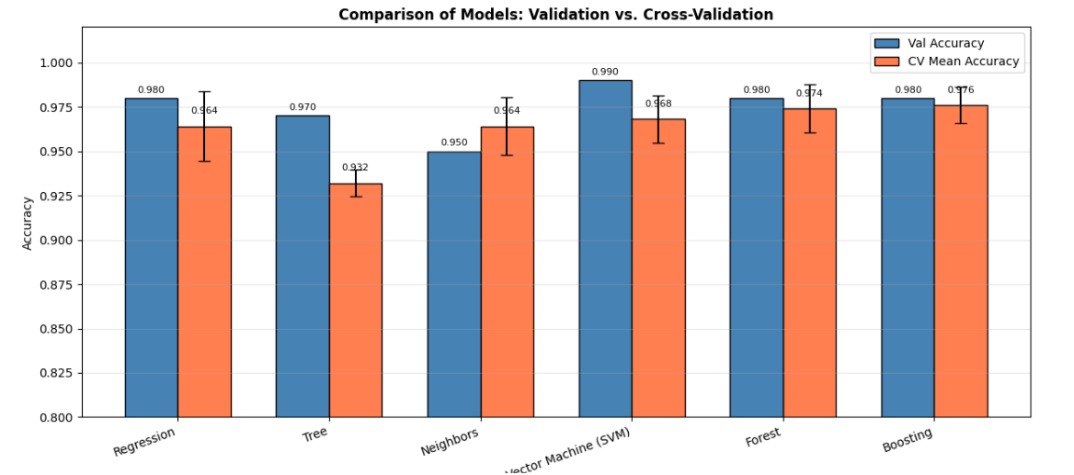
07 | Algorithm Selection & Training
Logistic
Regression
Decision
Tree
K-Nearest
Neighbors
Support
Vector M.
Random
Forest
Gradient
Boosting
ML
ML
ML
ML
ML
Ensemble
Cross-Validation Accuracy per Model (%)

Slide 10
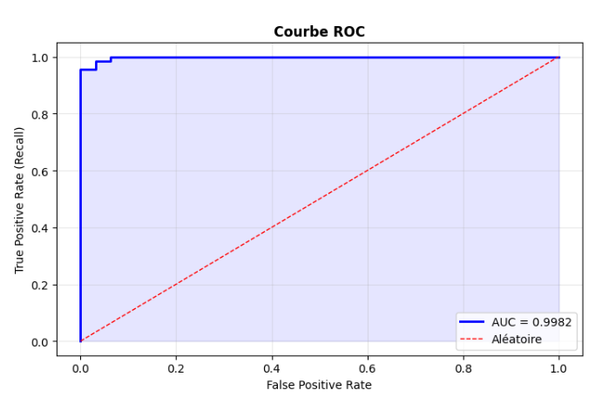
08 | Evaluation & Results
Best Model: Gradient Boosting | CV Mean = 99% | Test Accuracy = 100%
98%
0,9982
0,9853
1
Accuracy
AUC-ROC
F1-Score
FN
Confusion Matrix
Pred: NotCKD
Pred: CKD
TN = 31 ✓
FP = 1 ✓
FN = 1 ✓
TP = 67 ✓

Slide 11
Conclusion
Achieved High Accuracy: The final tuned model achieved an accuracy of approximately 98%, demonstrating extreme reliability in distinguishing between healthy patients and those with CKD.
Recall: The model reached a 99% recall rate, which is critical for medical screening to ensure that almost all sick patients are correctly identified and no cases are missed.
Synthesized Data Utility: The integration of synthetic data (Generative AI) helped balance the dataset, allowing the model to better generalize across different patient profiles and medical scenarios.

Slide 12
Thank you for your attention | Questions?
100% Accuracy
AUC = 1.00
FN = 0
No patient missed
sc, pcv, hemo
Top 3 features
+25% more data
via Augmentation

