Slide 1







People's Democratic Republic of Algeria
Ministry of Higher Education and Scientific Research
Tahri Mohamed University of Bechar
🍲
Fundamentals and Technique of Programming — Mini Project
شا نطيب
🥕🧅🍅
🫙🥩🌿
🫒🧄🌶️
Sha Ntieb
An application that provides recipe recommendations based on available ingredients using a web API
Our Team :
F.Younes Informatique
A.Abderrahmen Etudes linguistiques
F. Mohammed Etudes linguistiques
G.Fatma Zahra Etudes linguistiques
D.Aicha Etudes linguistiques
M.Faiza Langue anglaise
University year : 2025-2026

Slide 2
📋 Presentation Structure
01
🎯 Introduction to Problem
02
📐 Program Design & Structure
Theme • Problem Definition • Input/Output • Hypotheses
Flowchart • Application Logic • Main Functions
03
💻 Source Code Structure
04
📸 Results & Interpretation
Code • Data Structures • Libraries • GitHub Link
Screenshots • Execution Examples • Results
05
⚡ Code Enhancement
06
🏁 Conclusion
pytest • flake8 • Performance Improvements
Summary • Difficulties • Areas for Improvement
8P
07

Slide 3
Part 1 : Introduction to Problem
Theme: نظام اقتراح الوصفات الجزائرية / Algerian Recipe Recommendation System
❓ Problem Definition:
Many people have ingredients at home but don't know what recipes to cook. There is no dedicated application for Algerian traditional cuisine that can intelligently suggest recipes based on available ingredients.
📥 Input Data
📤 Output Data
💭 Hypotheses
List of available ingredients (Arabic/English)
Suggested recipes sorted by match %
User has at least 1 ingredient available
User authentication credentials
Missing ingredients for each recipe
Recipes stored in MySQL database
Recipe data (via CSV or manual form)
Recipe details (ingredients, preparation steps)
AI engine works without internet
Rating score (1-5 stars)
AI similarity score per recipe
CSV file encoded in UTF-8

Slide 4
Part 2 : Program Design: Flowchart
🟢 START
⚙️ Application Logic
User enters ingredients
1. Input:
User types ingredients separated by commas
Logged in?
2. Auth Check:
Verify JWT token exists in localStorage
No →
🔐 Redirect to Login
Yes ↓
Redirect to Login
3. API Call:
POST /api/recipes/ai-search with ingredients list
AI Engine processes ingredients
4. AI Processing:
TF-IDF + Cosine Similarity calculation
Calculate match % for each recipe
5. Scoring:
Each recipe gets an AI score (0-100%)
Sort & return top 10 results
6. Sorting:
Results sorted by score descending
Display recipe cards
7. Display:
Recipe cards shown with match percentage
🔴 END

Slide 5
Part 2 : Main Functions Used
⚙️ normalize(text)
⚙️ simple_match_score()
ai_engine.py
Normalizes Arabic/English text by lowercasing and replacing similar Arabic chars (أإآ→ا, ةه→ه)
Calculates simple match between user ingredients and recipe ingredients with partial matching
⚙️ tfidf_similarity()
⚙️ ai_recommend()
Builds TF-IDF vectors for both ingredient lists and computes cosine similarity score
Main AI engine: combines all levels, queries DB, scores all recipes and returns sorted top-N
⚙️ import_csv()
⚙️ hash_password() / verify_password()
Reads uploaded CSV, detects encoding/separator, imports recipes + ingredients to MySQL
bcrypt-based password hashing and verification with 12 rounds for secure authentication

Slide 6
Part 3 : Source Code Structure
📁 Project Structure
📦 Libraries Used
sha-ntieb/
├── 📁 backend/
│ ├── app/
│ │ ├── api/routes/
│ │ │ ├── auth.py
│ │ │ ├── recipes.py
│ │ │ └── admin.py
│ │ ├── core/
│ │ │ ├── config.py
│ │ │ ├── database.py
│ │ │ └── security.py
│ │ ├── models/
│ │ ├── schemas/
│ │ ├── services/
│ │ │ └── ai_engine.py
│ │ └── main.py
│ └── requirements.txt
├── 📁 frontend/src/
└── recipes.csv
📌 FastAPI:
REST API Framework
📌 SQLAlchemy:
ORM for MySQL
📌 Pandas:
CSV Processing
📌 Passlib/bcrypt:
Password Hashing
📌 python-jose:
JWT Tokens
📌 pydantic:
Data Validation
🔗 https://github.com/feredj/sha-ntieb

Slide 7
Part 3 : Source Code Structure
Fast API
Password hashing
MySql
FastAPI is a modern, fast (high-performance), web framework for building APIs with Python based on standard Python type hints.
Password hashing transforms user passwords into secure, fixed-length, one-way cryptographic strings, ensuring passwords are not stored in plaintext.
MySQL is a widely used relational database management system (RDBMS).
MySQL is free and open-source.
MySQL is known for being fast, reliable, scalable, and easy to use, and is ideal for both small and large applications.
Pandas
JSON Web Token (JWT)
A JSON Web Token (JWT) is an open, industry-standard (RFC 7519) method for securely representing claims between two parties, commonly used for authorization and authentication in web apps. It is a compact, URL-safe, self-contained string comprising a header, payload, and signature, allowing servers to verify user identity without database lookups.
Pandas is a Python library.
Pandas is used to analyze data.
🔗 https://github.com/feredj/sha-ntieb

Slide 8
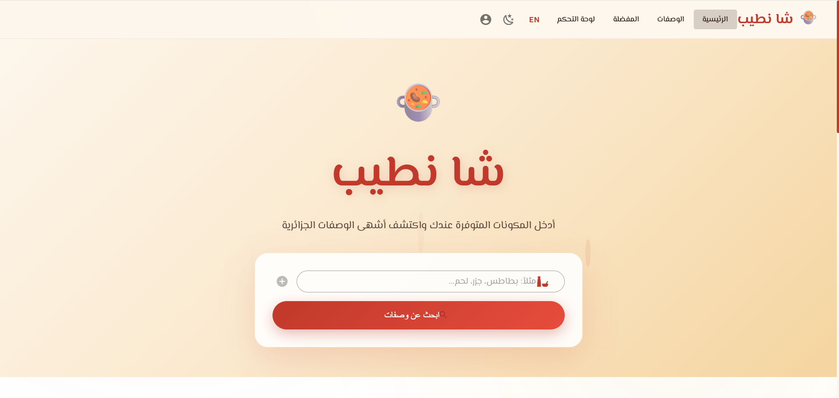
Part 4 : Results & Interpretation
🏠
Home Page

Slide 9
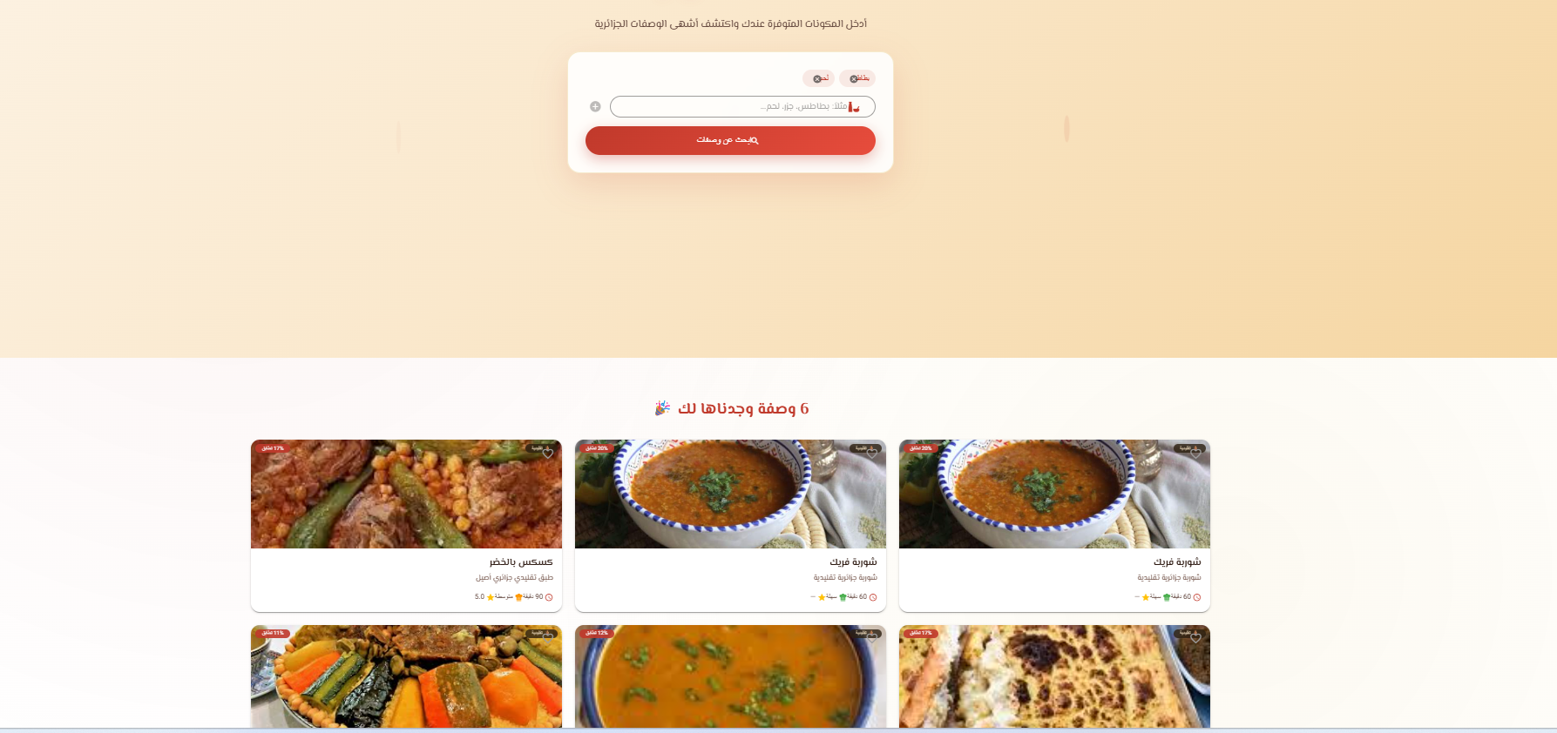
Part 4 : Results & Interpretation
🔍
Search Results
Home Page

Slide 10
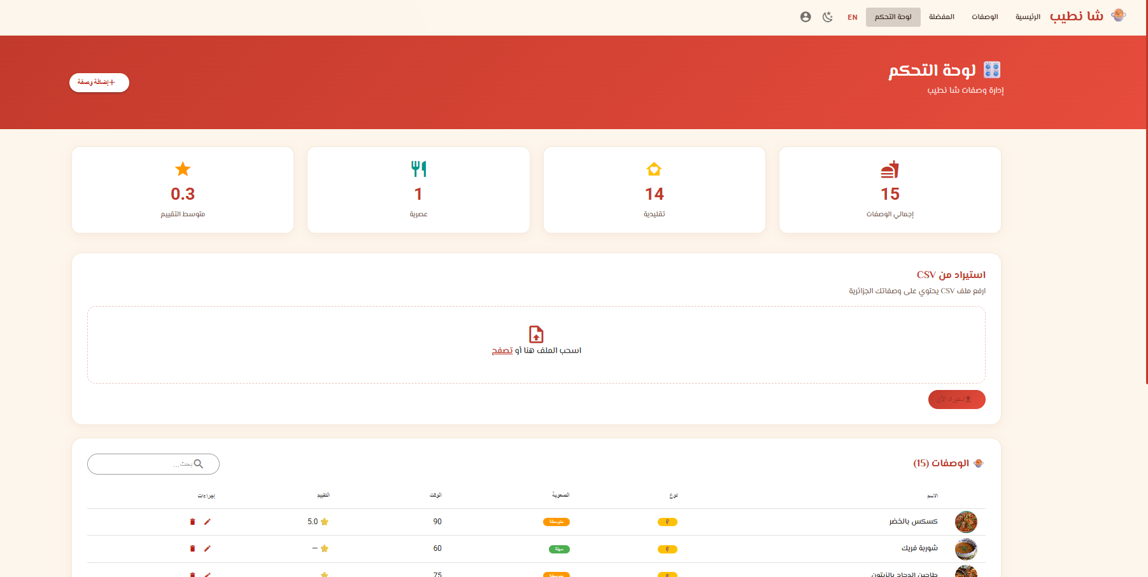
Part 4 :Results & Interpretation
🎛️
Admin Dashboard

Slide 11
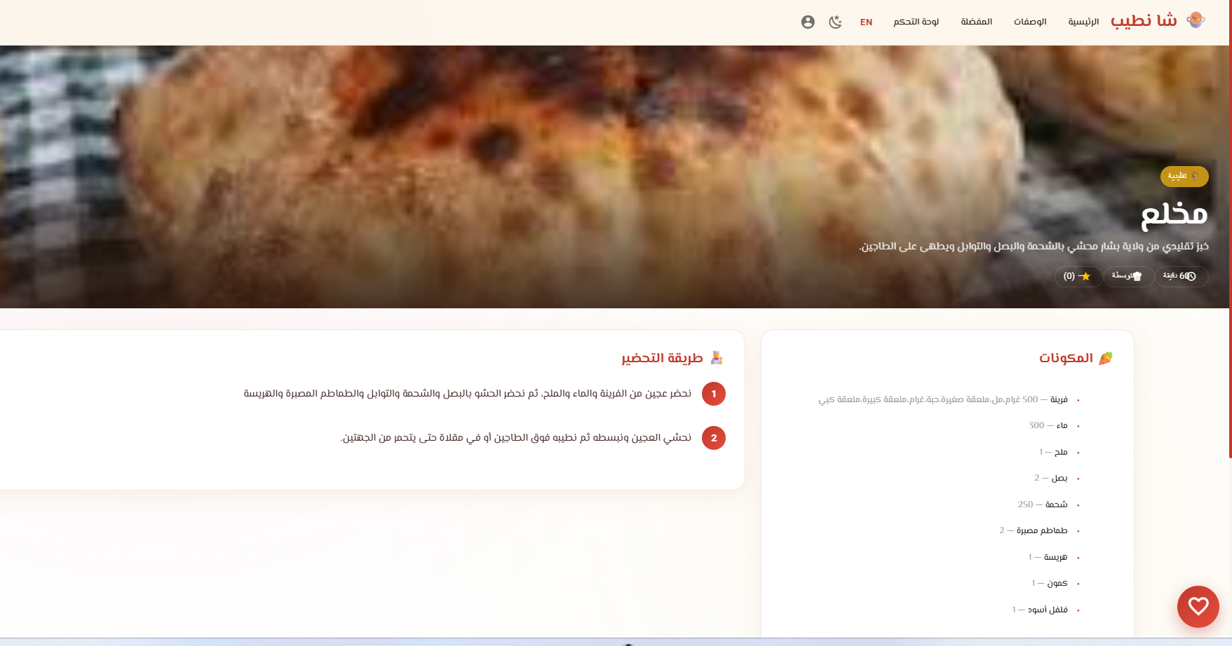
Part 4 : Results & Interpretation
📖
Recipe Detail

Slide 12
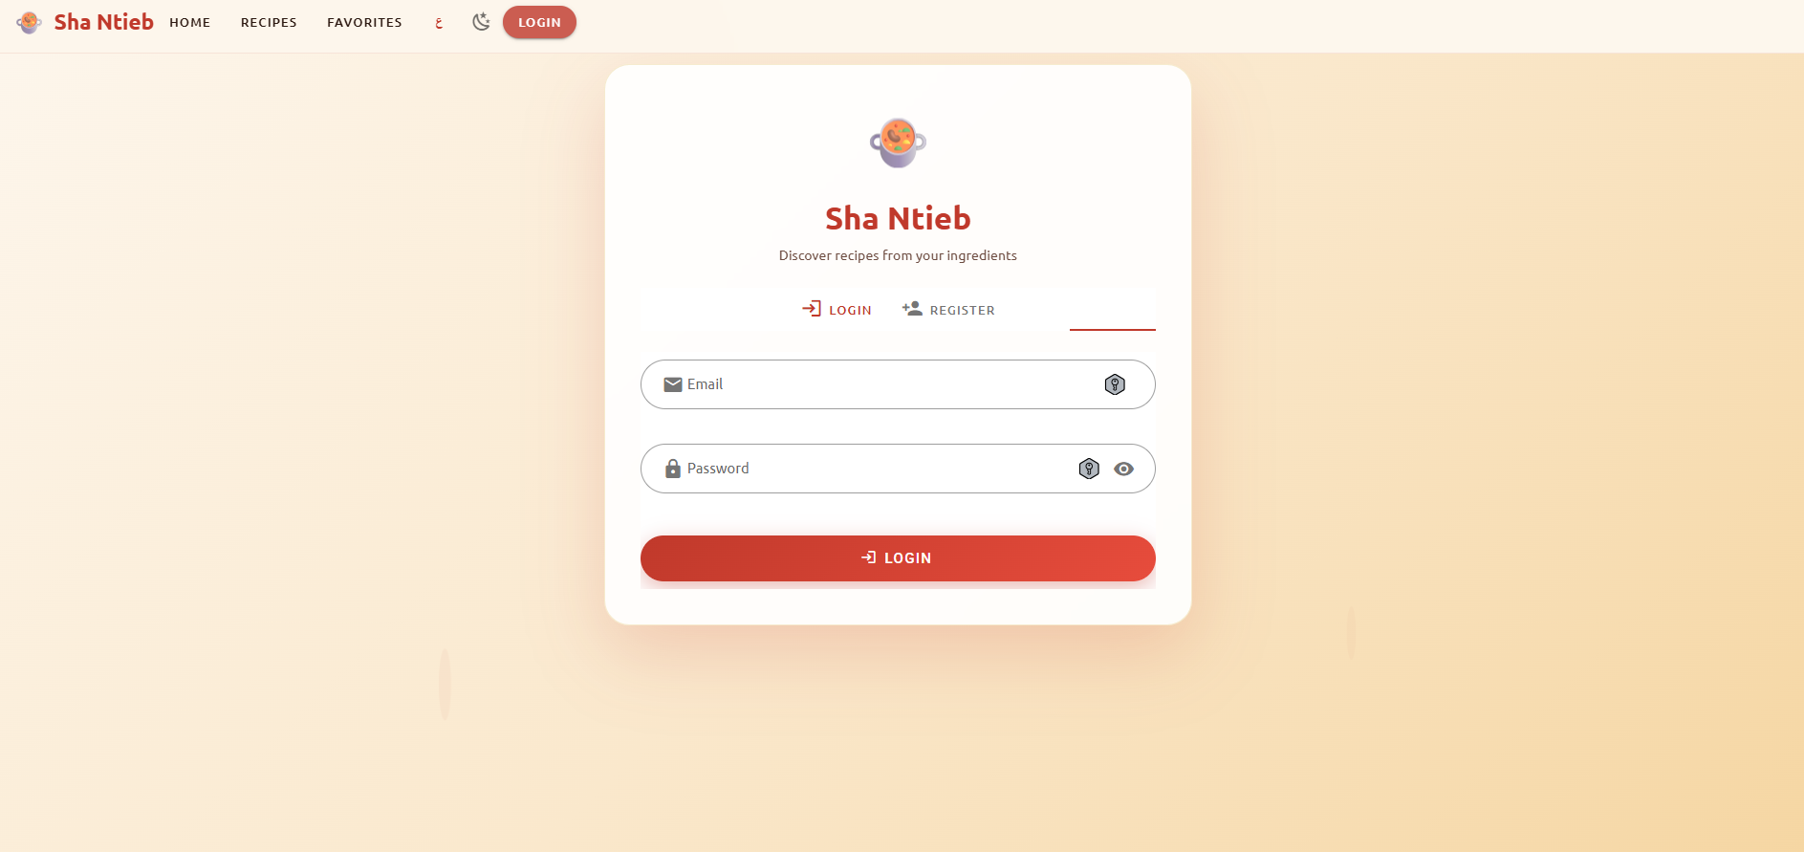
Part 4 : Results & Interpretation
🔐
Login/Register

Slide 13
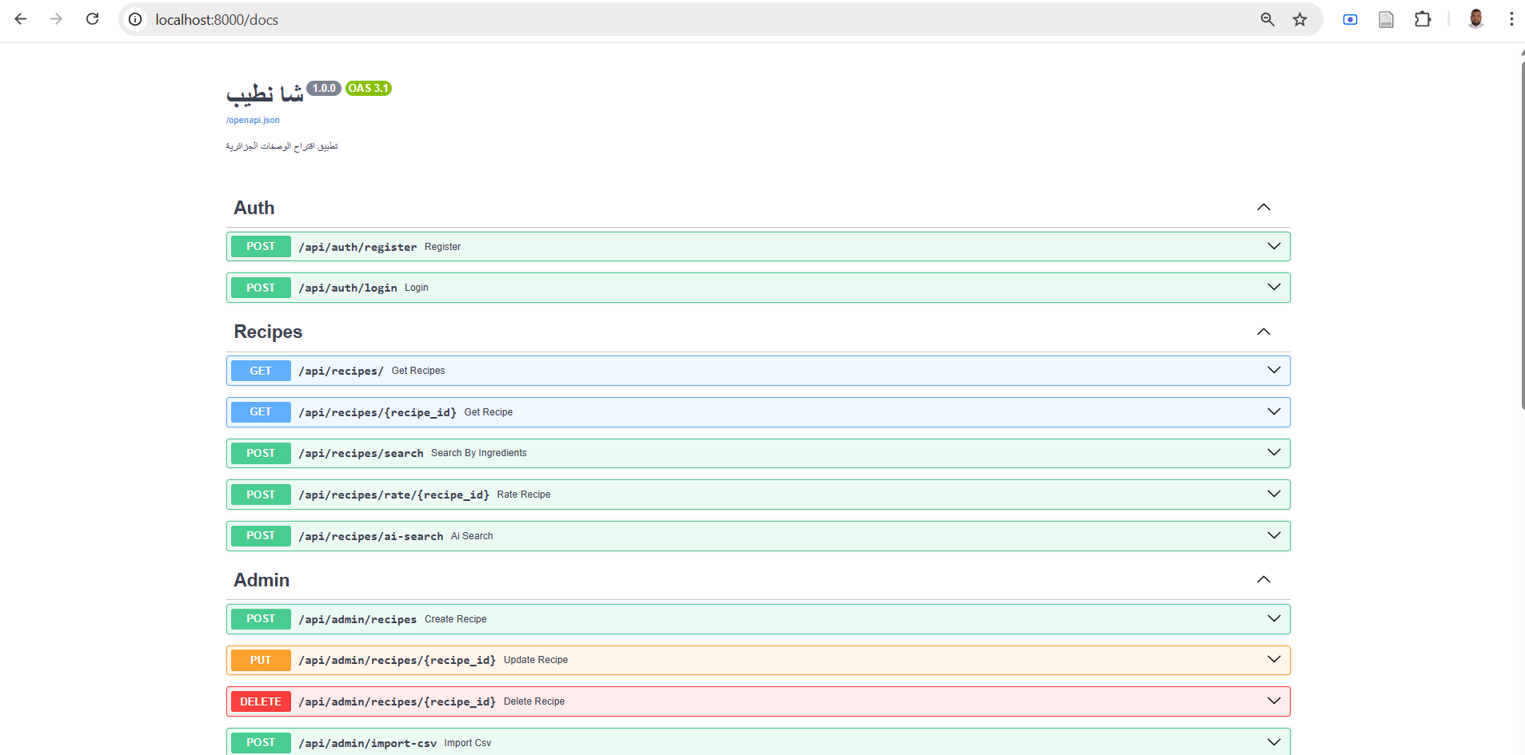
Part 4 :Results & Interpretation
📊
Swagger API Docs

Slide 14
Part 5 : Code Enhancement (pytest + flake8)
We used pytest to test the correctness of our AI functions, and flake8 to ensure our code follows Python best practices (PEP8)
pytest : Unit Testing
flake8 : Code Quality
pytest is a Python testing framework that automatically verifies that functions produce the correct output
flake8 is a code quality checker that enforces Python coding standards (PEP8) — detects unused imports, missing spaces, and long lines
# test_ai_engine.py
from app.services.ai_engine import (
normalize, simple_match_score,
tfidf_similarity
)
def test_normalize_arabic():
assert normalize("أحمد") == "احمد"
assert normalize("تمرة") == "تمره"
def test_simple_match():
user = ["جزر", "بطاطس"]
recipe = ["جزر", "بطاطس", "لحم"]
result = simple_match_score(user, recipe)
assert result["match_count"] == 2
assert result["match_percent"] == 67
PEP8 compliance check
Max line length: 100 chars
No unused imports
Proper indentation
No undefined variables
pip install autopep8
autopep8 --in-place --recursive app/

Slide 15
Part 6 : Conclusion
📋 Summary of Work
⚠️ Difficulties Encountered
🚀 Areas for Improvement
Built a full-stack web app for Algerian recipe recommendations
bcrypt version conflict with passlib library
Add Flutter mobile application for iOS/Android
Implemented 3-level AI engine: Simple Match + TF-IDF + Transformers
CSV encoding issues with Arabic text (BOM, UTF-8-sig)
Integrate GPT API for recipe explanation in Arabic
Created Admin Dashboard with CSV import functionality
MySQL foreign key constraints during data deletion
Calculate nutritional values and calories per recipe
Developed bilingual support (Arabic RTL + English LTR)
CORS configuration between FastAPI and Vue.js
Add voice search in Arabic using Speech Recognition
Secured with JWT authentication and bcrypt password hashing
Arabic text normalization for AI matching accuracy
Build community features for users to share recipes

Slide 16
🍲
شـا نـطـيـب
"أدخل مكوناتك... واكتشف المطبخ الجزائري الأصيل"
Thank you for your attention

