Slide 1
UU Carpool App Thomas Scully Nicholaus Ferguson Joe Trammel Ethan Watson

Slide 2
Application
Client: Unitarian Universalist Church of Columbia, Missouri
Local church in need of a Carpool system
Sign up for driving or needing a ride
Will be assigned a ride to events
Keep track of church groups and events
Keep track of statistics with events and groups

Slide 3
Technologies
PHP
Jquery/Jquery UI
Mysql / Mysqli
Google Maps API

Slide 4
Group
Thomas Scully
Back end design/DDL implementation
Nicholaus Ferguson
Front End/ APIs
Joe Trammel
Front end / DDL
Ethan Watson
Back end Design/ Login implementation

Slide 5
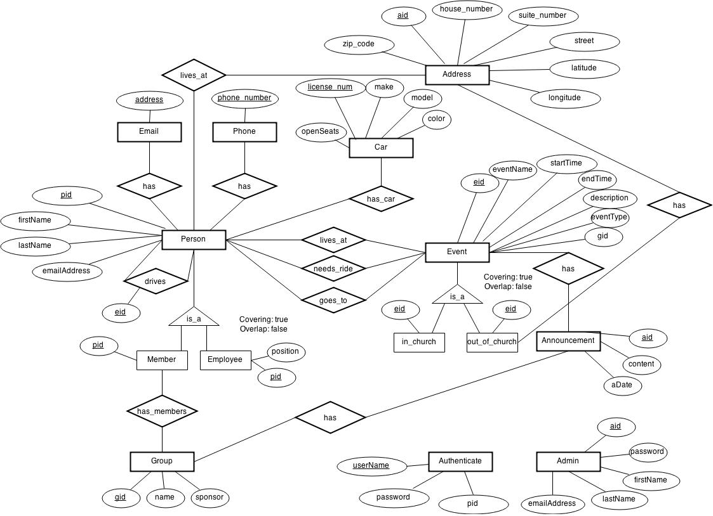
ERD

Slide 6
Live Demo

