Slide 1
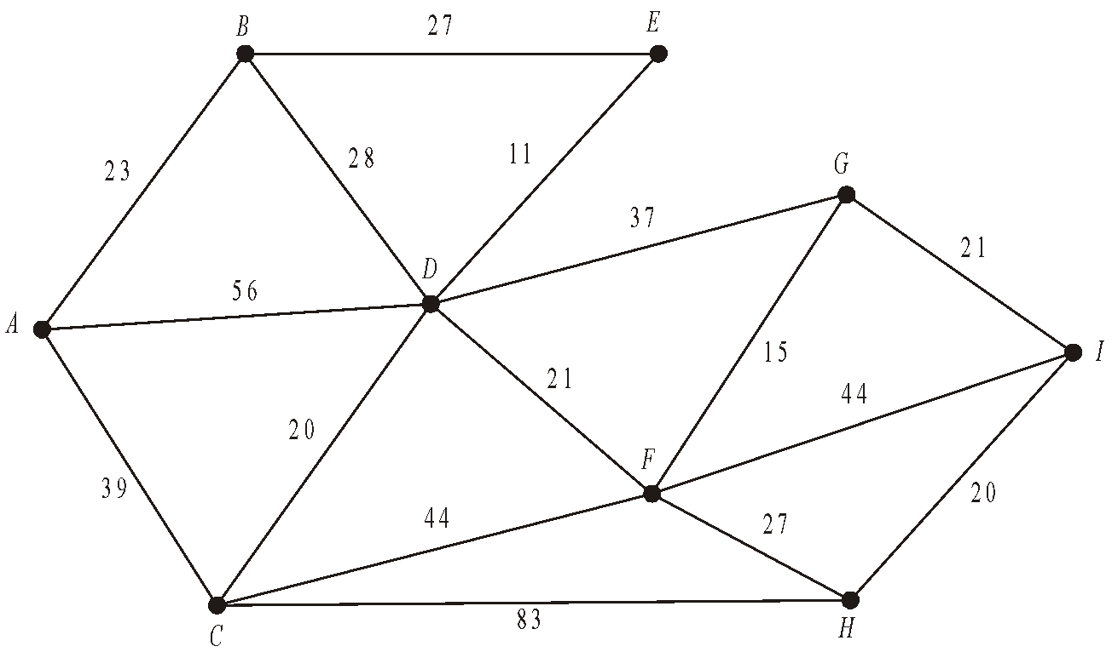
Dijkstra’s Algorithm
Dijkstra's algorithm is used to find the shortest path between two nodes(points) on a graph. It could represent railway stations and tracks between them so it is useful in working out the shortest journey from the start station to the destination. It is commonly used to find the shortest path to every node on the graph from a single node. It runs in a time of 0(n²).
(2)
Dijkstra’s algorithm finds the shortest route through a network

Slide 2
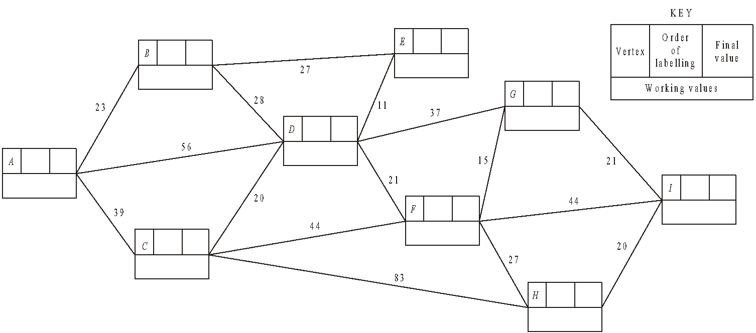
Dijkstra’s Algorithm
2
23
4
50
50
23
7
87
88
5
51
, 87
, 51
56
, 59
1
0
61
9
108
6
72
116
,108
,119
83
3
39
, 72
39
8
99
122
, 99
To find the route, trace back from end and include arc XY if Y already on the path and if the difference in final labels equals the length of arc
I
-21
G
-15
F
-21
D
-28
B
-23
A
Shortest path ABDFGI
Length 108

