Slide 1
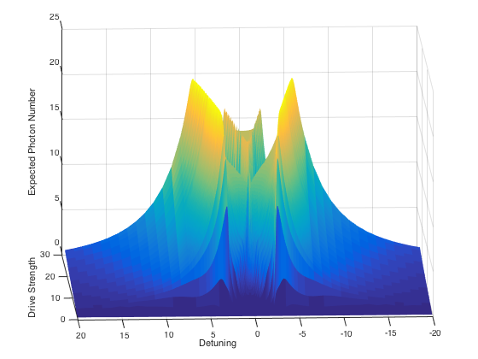
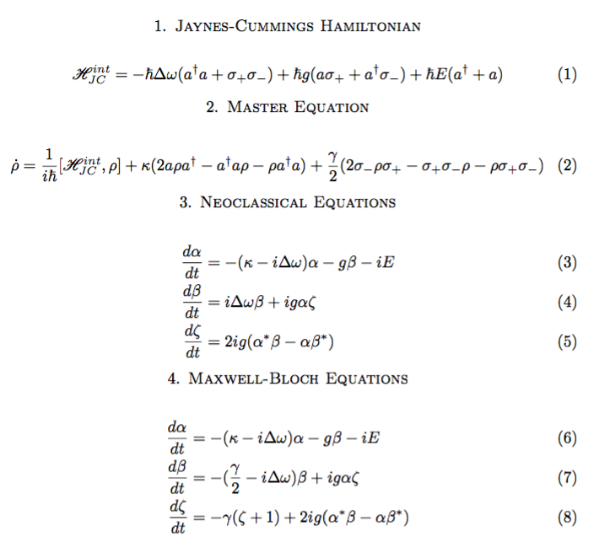
Steady state intracavity photon number expectation

Slide 2
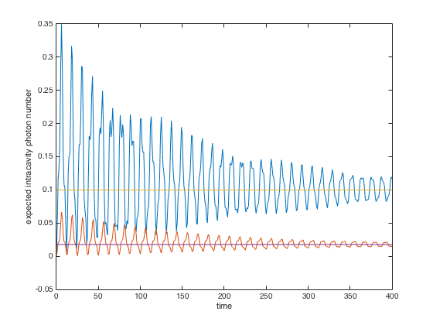
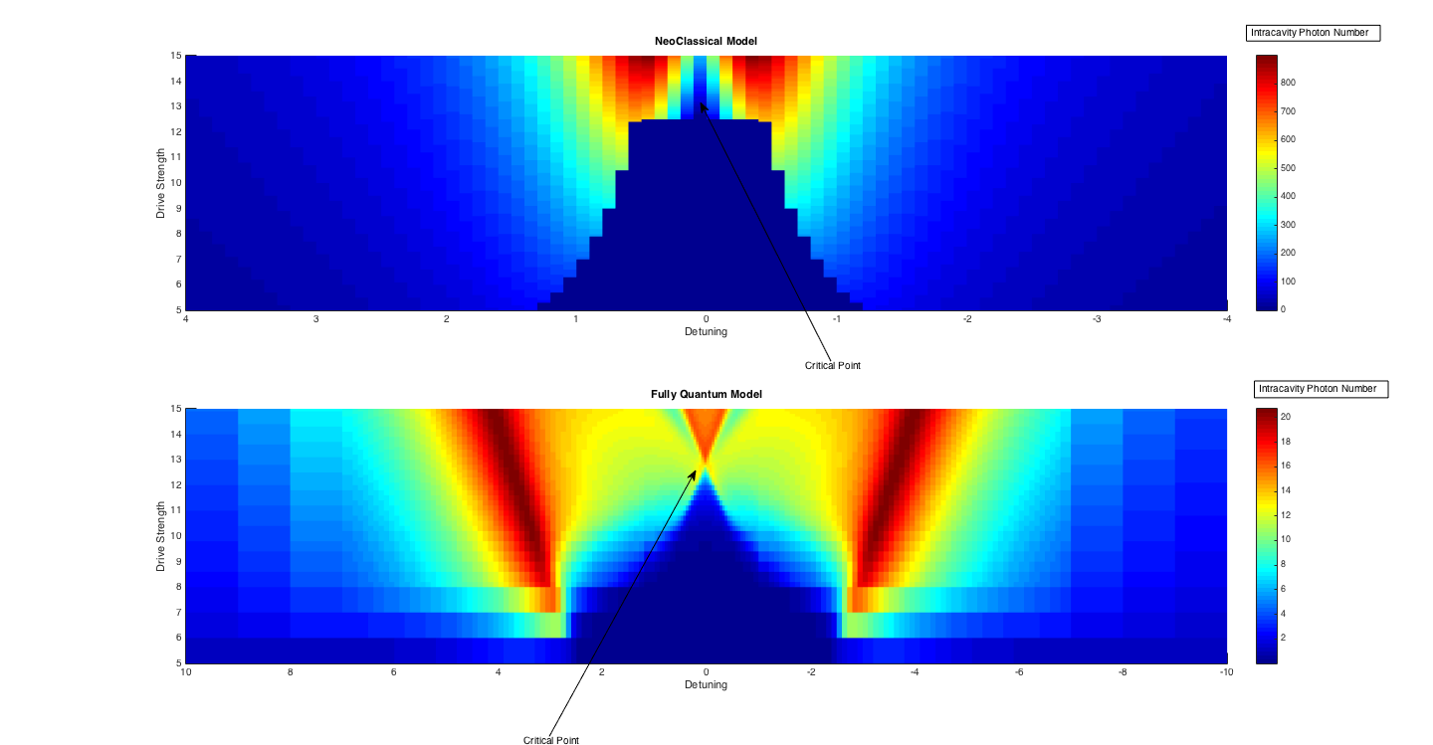
Critical Slowing Down
Mean-Field vs. Quantum Intracavity Photon Number

Slide 3
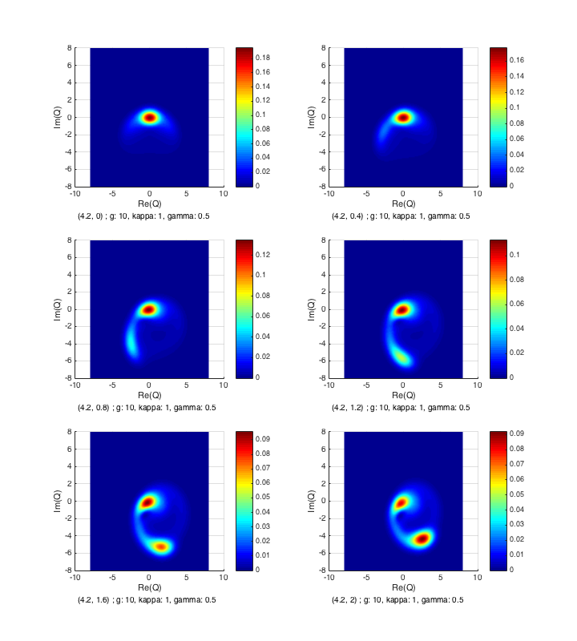
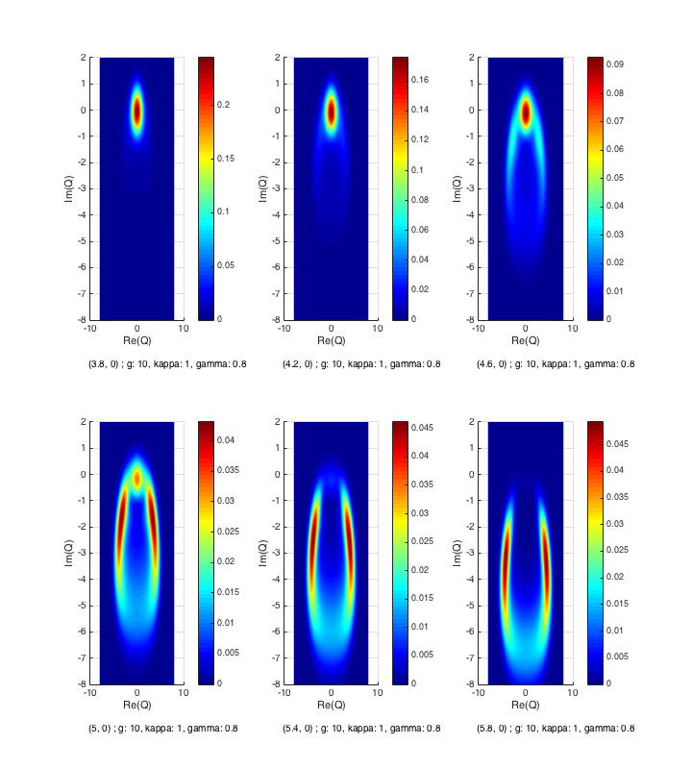
Spontaneous Dressed State Polarisation
Bistability w/ increased detuning

