Slide 1

Regex (puzzle time!)
Bianca Ackermann - Unsplash
Adapted from materials from Drs. Lalejini, Moore, and Bowman

Slide 2
Recall…

Slide 3

Recall…

Slide 4
Recall…

Slide 5
Advanced searching

Slide 6
Advanced searching
Regular expression (regex)

Slide 7
Advanced searching
Regular expression (regex)
Defines a set of strings

Slide 8
Advanced searching
Regular expression (regex)
Defines a set of strings
Basic strings can represent themselves

Slide 9
Advanced searching
Regular expression (regex)
Defines a set of strings
Basic strings can represent themselves
e.g., dog is just the string dog

Slide 10
Advanced searching
Regular expression (regex)
Defines a set of strings
Basic strings can represent themselves
e.g., dog is just the string dog
However, we also have special characters

Slide 11
Advanced searching
Regular expression (regex)
Defines a set of strings
Basic strings can represent themselves
e.g., dog is just the string dog
However, we also have special characters
These allow us to match multiple strings

Slide 12
The basics
a matches the string “a”

Slide 13
The basics
a matches the string “a”
a+ matches one or more “a”s

Slide 14
The basics
a matches the string “a”
a+ matches one or more “a”s
a* matches zero or more “a”s

Slide 15
The basics
a matches the string “a”
a+ matches one or more “a”s
a* matches zero or more “a”s
What does lo+l match?

Slide 16
The basics
a matches the string “a”
a+ matches one or more “a”s
a* matches zero or more “a”s
What does lo+l match?
Where does this differ from lo*l?

Slide 17
More basics
What does (ab)+ match?

Slide 18
More basics
What does (ab)+ match?
Parentheses can group characters

Slide 19
More basics
What does (ab)+ match?
Parentheses can group characters
Which ones of these wouldn’t match? Why?
“ab” “abab” “” “ba” “abababababab” “aba” “aab”

Slide 20
A common character
What does this command do?
cat file_*

Slide 21
A common character
What does this command do?
cat file_*
What if we want that wildcard functionality in regex?

Slide 22
A common character
What does this command do?
cat file_*
What if we want that wildcard functionality in regex?
. (a dot/period) - matches any character

Slide 23
A common character
What does this command do?
cat file_*
What if we want that wildcard functionality in regex?
. (a dot/period) - matches any character
How do we then match the same strings as the command above?

Slide 24
Applying restrictions
Example: what would (b.d)+ match? b.+d?

Slide 25
Applying restrictions
Example: what would (b.d)+ match? b.+d?
What if we want to restrict the wildcard to only match vowels?

Slide 26
Applying restrictions
Example: what would (b.d)+ match? b.+d?
What if we want to restrict the wildcard to only match vowels?
We use character classes [ ]

Slide 27
Applying restrictions
Example: what would (b.d)+ match? b.+d?
What if we want to restrict the wildcard to only match vowels?
We use character classes [ ]
b[aeiou]d

Slide 28
Applying restrictions
Example: what would (b.d)+ match? b.+d?
What if we want to restrict the wildcard to only match vowels?
We use character classes [ ]
b[aeiou]d
How do (ab)+ and [ab]+ differ?

Slide 29
Applying restrictions
Example: what would (b.d)+ match? b.+d?
What if we want to restrict the wildcard to only match vowels?
We use character classes [ ]
Note we can also use tr-like character classes: [[:digit:]] [a-z]

Slide 30
Applying restrictions
Example: what would (b.d)+ match? b.+d?
What if we want to restrict the wildcard to only match vowels?
We use character classes [ ]
Note we can also use tr-like character classes: [[:digit:]] [a-z] We can also invert them: [^[:digit:]] [^0]

Slide 31
Matching the forbidden characters
What does foo.txt match?

Slide 32
Matching the forbidden characters
What does foo.txt match?
What if we want it to only match “foo.txt”?

Slide 33
Matching the forbidden characters
What does foo.txt match?
What if we want it to only match “foo.txt”?
foo\.txt

Slide 34
Recall…

Slide 35
Recall…
donut|coffee

Slide 36
More counts
a matches the string “a”
a+ matches one or more “a”s
a* matches zero or more “a”s

Slide 37
More counts
a matches the string “a”
a+ matches one or more “a”s
a* matches zero or more “a”s
a? matches zero or one “a”s

Slide 38
More counts
a matches the string “a”
a+ matches one or more “a”s
a* matches zero or more “a”s
a? matches zero or one “a”s
a{n} matches n “a”s

Slide 39
More counts
a matches the string “a”
a+ matches one or more “a”s
a* matches zero or more “a”s
a? matches zero or one “a”s
a{n} matches n “a”s
a{n,m} matches between n and m “a”s

Slide 40
Final characters
^a matches “a”s at the beginning of the line
a$ matches “a”s at the end of the line

Slide 41
Some examples
What do these match?

Slide 42
Some examples
What do these match?
The (dog|cat) ra+n away$

Slide 43
Some examples
What do these match?
The (dog|cat) ra+n away$
^bee+s*

Slide 44
Some examples
What do these match?
The (dog|cat) ra+n away$
^bee+s*
[Ll][ol]{2}[ol]*

Slide 45
Some examples
Create a regex to:
Match “ab” “aba” “abb” “abba” “abab” “abbb” “abaa” and nothing else

Slide 46
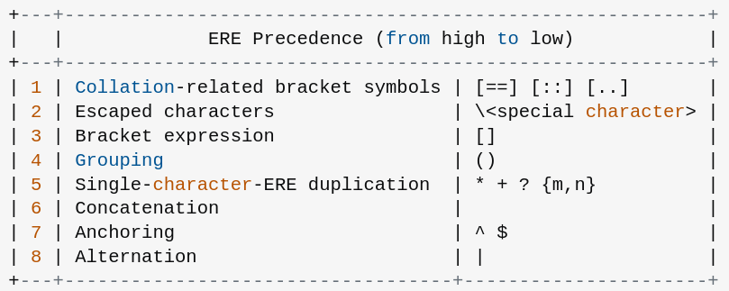
Order of operations
Table from POSIX docs, formatting from StackOverflow

Slide 47
Using regular expressions
We are using extended regular expressions (ERE)

Slide 48
Using regular expressions
We are using extended regular expressions (ERE)
You can use them with grep with -E:
grep -E “ab[ab]{2}” file.txt
Grep actually stands for “global regular expression print”

Slide 49
Using regular expressions
We are using extended regular expressions (ERE)
You can use them with grep with -E:
grep -E “ab[ab]{2}” file.txt
Grep actually stands for “global regular expression print”
Note that other commands use /pattern/ to denote regex!

