Slide 1
Distributed Parallel Systems Project
Truck Platooning
Ferhad Gulizada | 7216770
Negin Amiri | 7216441
Tao Zhao | 7216774
Raghuveer Dani | 7216427
Zaur Gurbanli | 7216615
Masters in Embedded Systems Engineering
Fachhochschule Dortmund
Dortmund, Germany

Slide 2
Table of Content
Introduction
Requirements
Literature review
Diagrams
Implementation
Simulation
Future scope
Conclusion
References

Slide 3
Introduction
A software-based approach to platooning a line of trucks
Driver truck and followers
Communication approach
Safety matters
Add or remove trucks

Slide 4
Requirements
Each truck equipped to sensors and microcontroller
Communication is established
2nd communication approach is established for safety assurance
Direct path and no turning is assumed for simplification

Slide 5
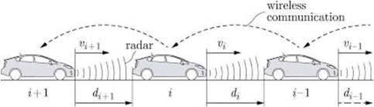
Literature review

Slide 6
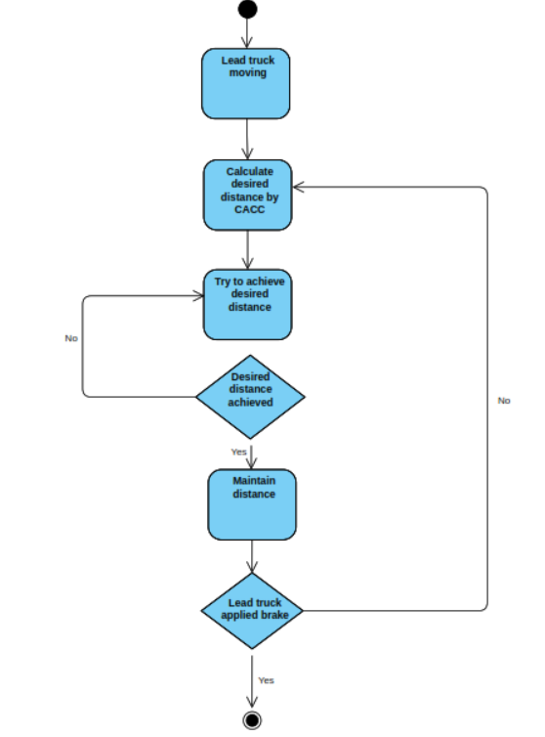
Activity Diagram

Slide 7
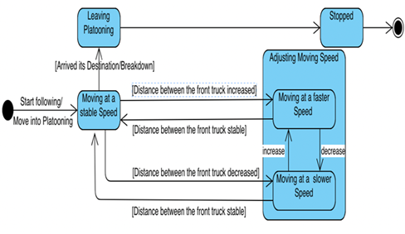
State Diagram

Slide 8
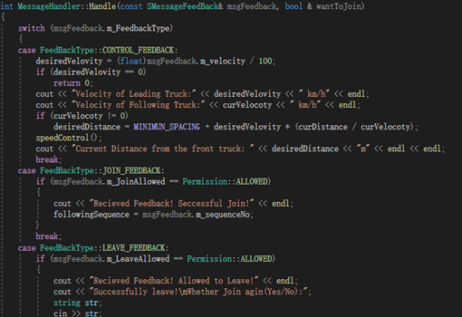
Implementation

Slide 9
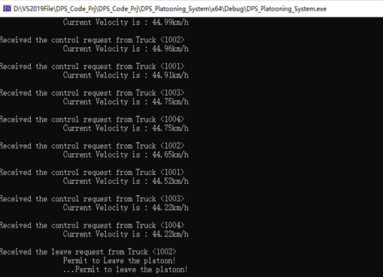
Simulation

Slide 10
Future scope

Slide 11
Conclusion
Implemented a multi-threaded system for platooning trucks, using networking protocols along with C++14 std::thread
Used synchronization primitives such as std::mutex and std::lock_gaurd to ensure thread-safety and avoid race conditions.
The proposed system includes a Meyer’s Singleton to manage shared resources, with a critical section protected by mutexes to guarantee synchronous access.
The server receives messages from each truck and handles them accordingly, while the client receives feedback from the server and adjusts the following truck's velocity to maintain a safe distance from the leading truck.
The system utilizes the CACC algorithm to keep a safe and self-adjusting distance varied with the velocity of the leading truck.
Overall, the system provides a flexible and manageable interface for communication and control of platooning trucks.

Slide 12
Main References
Ploeg, J., Semsar-Kazerooni, E., Lijster, G., Wouw, van de, N., & Nijmeijer, H. (2015). Graceful degradation of cooperative adaptive cruise control. IEEE Transactions on Intelligent Transportation Systems, 16(1), 488-497. https://doi.org/10.1109/TITS.2014.2349498
G. Naus, R. Vugts, J. Ploeg, R. van de Molengraft, and M. Steinbuch, “Cooperative adaptive cruise control, design and experiments,” in Pro- ceedings of the 2010 American control conference. IEEE, 2010, pp. 6145–6150.
R. Vugts, “String-stable CACC design and experimental validation,” Diss. Technische Universiteit Eindhoven, 2010.
Al-Mouhamed, Mayez A., Ayaz H. Khan, and Nazeeruddin Mohammad. "A review of CUDA optimization techniques and tools for structured grid computing." Computing 102, no. 4 (2020): 977-1003.

Slide 13
Thank You
Questions??

