Slide 1
COMPUTER TRAINING for VISUALLY IMPAIRED AUTOMATION TOOL
CMPE451: DEVELOPMENT IN SOFTWARE ENGINNERING
Second milestone presentation
GROUP 3
FERHAT ELMAS
EMMAR KARDESLIK
ERAY SALTIK
OZGE INAN
OSMAN SOKUOGLU

Slide 2
Contents
Introduction & Documentation Details
Project Summary
Challenges
What We Have Learnt
Details of The Code
Project Demo

Slide 3

Introduction
An automation tool to enlighten the world of visually impaired people by computer based training

Slide 4
Documentation
Document | Releases | Last Version
RAD | 4 | 3.0
ODD | 8 | 6.0
SDD | 3 | 1.2
DDD | 3 | 3.0
Schedule | 3 | 3.0
TD | 2 | 1.1
SPMP | 3 | 2.1
SCMP | 2 | 1.1
SVVP | 2 | 1.1
RMP | 1 | 1.0
QMP | 1 | 1.0
IUM | 2 | 1.1

Slide 5
What We Have Learnt
Documentation
Experience Long-Running Project
Software Development Lifecycle
Progress presentations bi weekly, two Milestone Presentations
Software Development Methodology
Extreme Programming
Team Project
Task Sharing
Design of a Real User Interface
Usable for Visully Impaired People

Slide 6
Challenges
No Experienced Member Involved In Big Projects
No Hardware Familiarity
Document Preparation and Revisions
Not Enough Team Members For the Project

Slide 7
After milestone
Audio manual support extended
Keyboard shortcut support extended
Test solving automation for action-based
Report support (pdf)

Slide 8
Structure
Automation (Test solving logic)
TestSolver
Common (Data structures)
User
Question
Test
DAO (Database Access Object)
SQLManager
ProjectEnlightenment (Main, UI forms, Utilities)
ProjectEnlightenmentInstaller

Slide 9
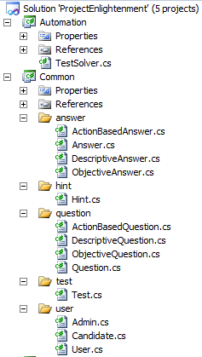
Automation & Common

Slide 10
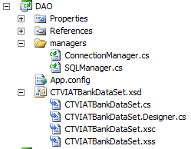
DAO (Db Access Object)

Slide 11
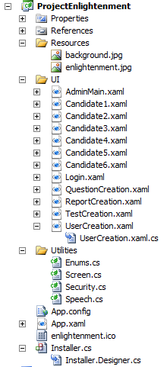
Project Enlightenment (Main)

Slide 12
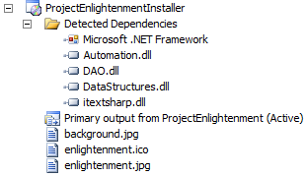
Installer

Slide 13
DEMO
Let’s see the CTVIAT

