Slide 1
COMPUTER TRAINING For VISUALLY IMPAIRED AUTOMATION TOOL
CMPE451: DEVELOPMENT IN SOFTWARE ENGINeERING
Third GrOUP
EMMAR KARDEŞLİK
ERAY SALTIK
FERHAT ELMAS
OSMAN SOKUOĞLU
ÖZGE İNAN

Slide 2
Project Status
Requirements Analysis Document (RAD) is prepared
RAD is reviewed with client and updated according to needs of client such as database, number of action-based applications
Software Project Management Plan(SPMP) and Software Verification and Validation Plan (SVVP)are also prepared
Initial designs are running and development environment is set up
Implementation will start at weekend

Slide 3
Methodology
Extreme Programming
More relax
Programming in pairs
Ambitious tester to test all code with unit tests
Responsive advisor to review progress, design, code, and changing and proposed requirements
Unfamiliar problem domain
Delay on some functionalities
Action-based questions will be supported for only Word and Windows Explorer at start, but at the end Excel, Internet Explorer, JAWS Help will also be supported

Slide 4
Roles and Organisation
Everybody will be participate in every phase.
Everybody has special features so each member will do much in her specialized task.
 | Documentation | Design | Analysis | Implementation | Testing
Emmar | 30 | 8 | 15 | 19 | 25
Eray | 20 | 10 | 18 | 38 | 18
Ferhat | 21 | 8 | 18 | 39 | 18
Osman | 20 | 8 | 18 | 39 | 18
Özge | 30 | 8 | 15 | 19 | 25

Slide 5
Roles and Organisation
Special areas
Eray -> Developer
Ferhat -> Developer
Osman -> Developer
Emmar -> Tester
Özge -> Designer

Slide 6
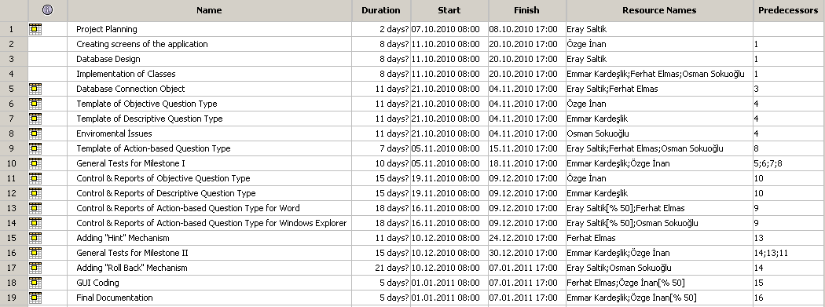

Slide 7
Planning
65 days expected
Expected days | Tasks
2 days | Project Planning
8 days | Design Phase
11 days | Initial Implementation(DAO, system requirements)
10 days | Action – based implementation and testing
15 days | Control, report and testing
21 days | Additional functionalities(Hint and Rollback) and testing
5 days | GUI and User manual and testing

Slide 8
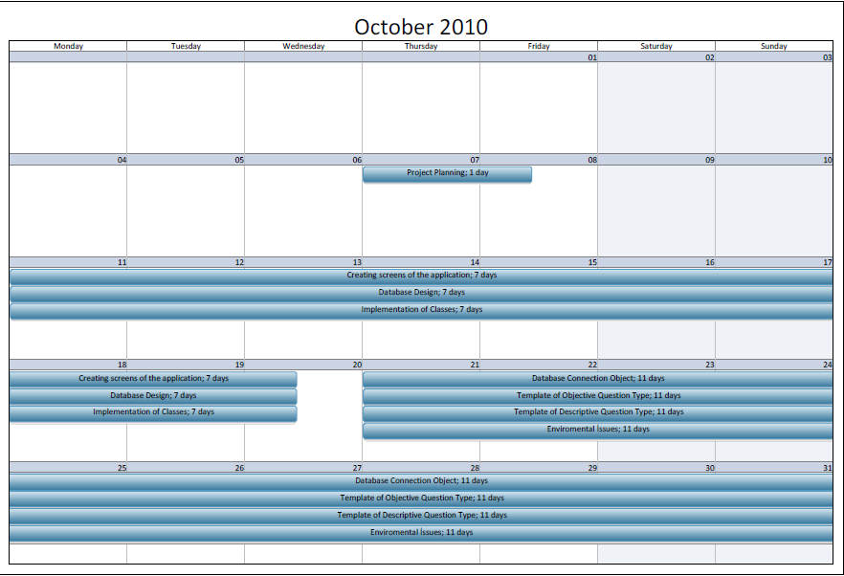

Slide 9
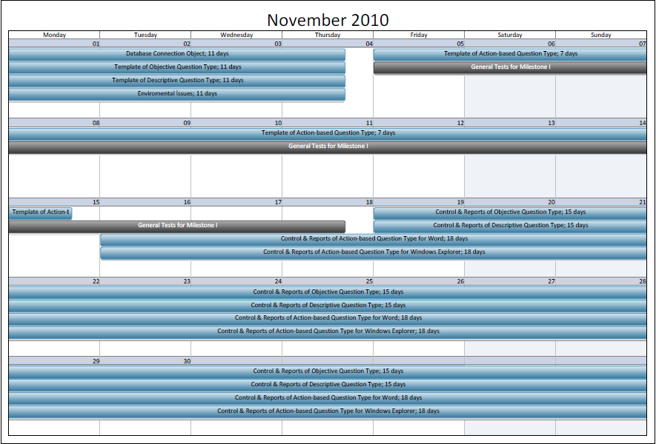

Slide 10
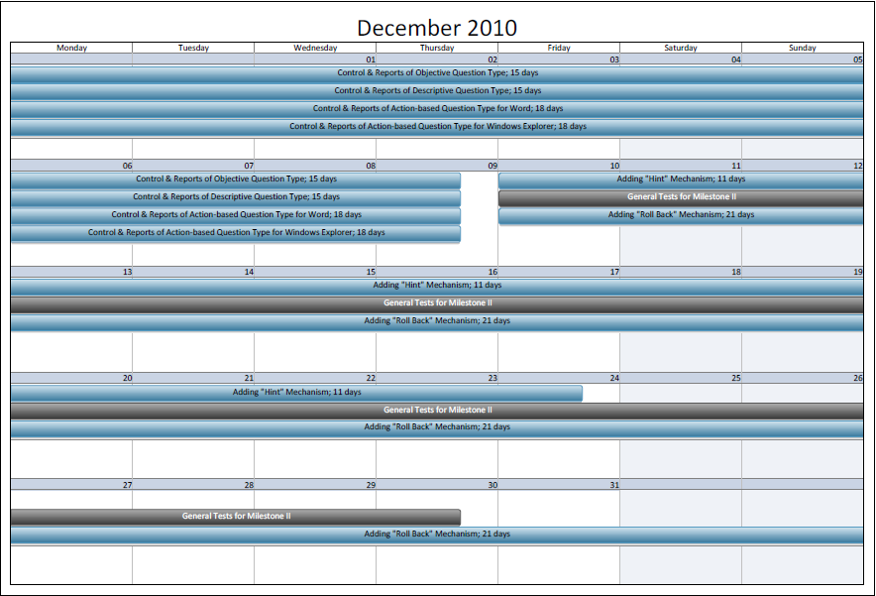

Slide 11
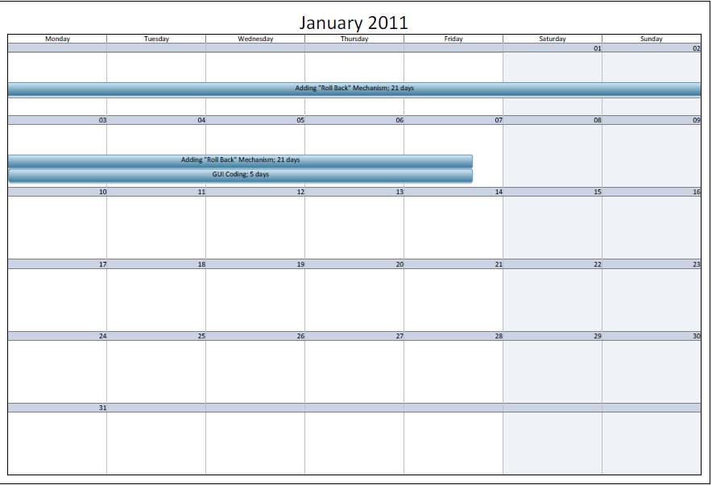

Slide 12
Budget
Workflow | Cost | Time
Requirements | 2400 TL | 4 days
Design | 3840 TL | 8 days
Analysis | 7680 TL | 25 days
Implementation | 14866 TL | 39 days
Testing | 4800 TL | 25 days
Total | 29376 TL | 65 days

Slide 13
Resources
Resource Type | Resource Name
Language | C#
API | .NET4, WinAPI, Office, IE and JAWS APIs
IDE | Visual Studio Ultimate
Database | Microsoft SQL Server
SVN | TortoiseSVN
Unit testing | NUnit and NUnitCop(C# version of JUnit )
System testing | Systin(C# version of Systir)
Logger | Log4net from Apache
Search | http://www.google.com/microsoft.html
GUI | Windows Presentation Foundation(WPF) DirectX
Training | code.google.com/intl/tr-TR / edu / tools101 / scm.html code.google.com/intl/tr-TR / edu / tools101 / mysql.html

Slide 14
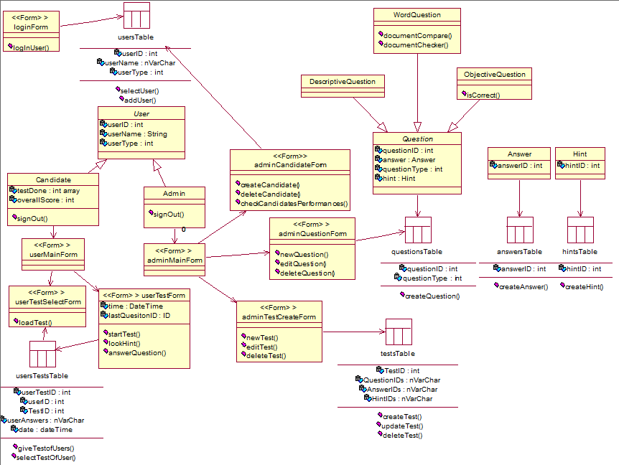

Slide 15
Verification & Validation
All code will be tested by unit test as a result of XP
Task | Input | Output
SVVP Generation | SPMP | SVVP
Change request | Proposed changes | Updated SVVP
Internal review | Team suggestions | Updated SVVP
External review | Kapil’s and your suggestions | Updated SVVP
Functional audit | Test case | Functional report
Process audit | Source code | Process report
Report | SVVP | SVVR

Slide 16
Future Activities
Display screen design
Database configuration
Implementation of classes
Database Access Object implementation and tests
System requirements and test
Question templates(Objective, Descriptive) and test
Question template (Windows Explorer) and test
Question template (Word) and test
Hint mechanism and tests
Rollback mechanism and tests
Gui and test
User manual and review

Slide 17
Risks
Difficult to use
Users are visually impaired
Hardware integration
Database
Server
Code integration
SVN

