Slide 1
COMPUTER TRAINING For VISUALLY IMPAIRED AUTOMATION TOOL
CMPE451: DEVELOPMENT IN SOFTWARE ENGINeERING
Third Group – Project Enlightenment
Presentation I
EMMAR KARDEŞLİK
ERAY SALTIK
FERHAT ELMAS
OSMAN SOKUOĞLU
ÖZGE İNAN

Slide 2
Roles and Organisation
Everybody will be participate in every phase.
Everybody has special features so each member will do much in her specialized task.
 | Documentation | Design | Analysis | Implementation | Testing
Emmar | 30 | 8 | 15 | 19 | 25
Eray | 20 | 10 | 18 | 38 | 18
Ferhat | 21 | 8 | 18 | 39 | 18
Osman | 20 | 8 | 18 | 39 | 18
Özge | 30 | 8 | 15 | 19 | 25

Slide 3
Resources
Resource Type | Resource Name
Language | C#
API | .NET4, WinAPI, Office, IE and JAWS APIs
IDE | Visual Studio Ultimate
Database | Microsoft SQL Server
SVN | TortoiseSVN
Unit testing | NUnit and NUnitCop(C# version of JUnit )
System testing | Systin(C# version of Systir)
Logger | Log4net from Apache
Search | http://www.google.com/microsoft.html
GUI | Windows Presentation Foundation(WPF) DirectX
Training | code.google.com/intl/tr-TR / edu / tools101 / scm.html code.google.com/intl/tr-TR / edu / tools101 / mysql.html

Slide 4
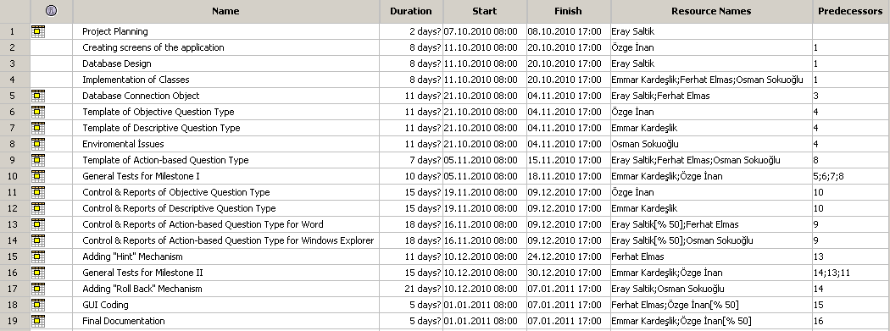

Slide 5
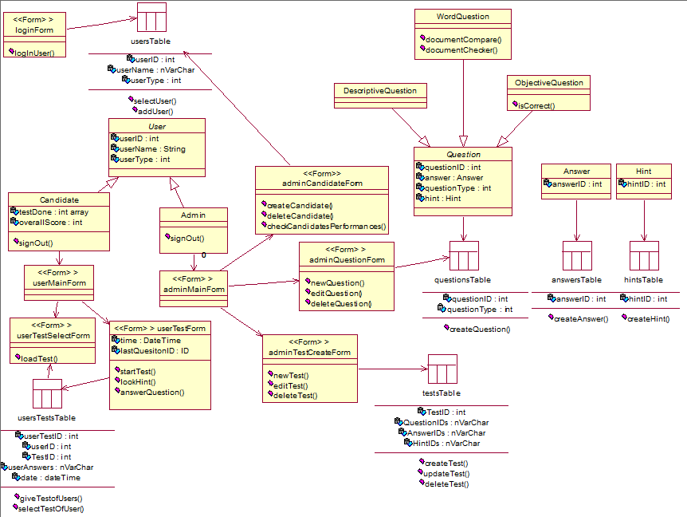

Slide 6
Thank You

