Slide 1
CTVIAT
CMPE451: DEVELOPMENT IN SOFTWARE ENGINNERING
GrOUP3
FERHAT ELMAS
EMMAR KARDESLIK
ERAY SALTIK
OZGE INAN
OSMAN SOKUOGLU

Slide 2
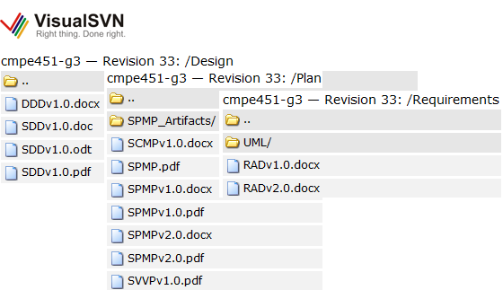
Progress Report
RAD v2.0
SPMPv2.0
SDDv1.0
DDDv1.0
ODDv1.0
SCMPv1.0
SVVPv1.0

Slide 3
Architecture & Design
Physical Architecture
Logical Architecture
Database Architecture
Implementation Decisions

Slide 4
Physical Architecture
MSSQL SERVER
LAN
CLIENT

Slide 5
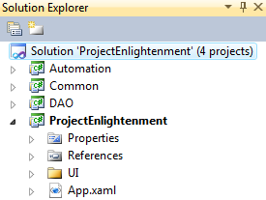
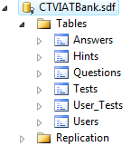
Logical Architecture
User Interface
Automation
Database Access Object
Database

Slide 6
Automation Layer
REPORT
ADMIN
QUESTION
DAO
TEST
CANDIDATE
HINT
DATABASE
ANSWER

Slide 7
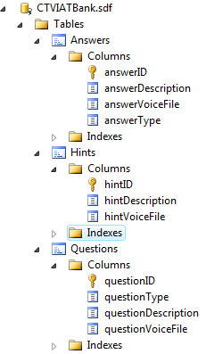
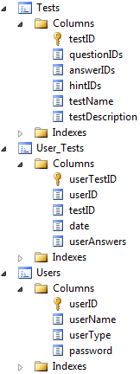
Database Architecture

Slide 8
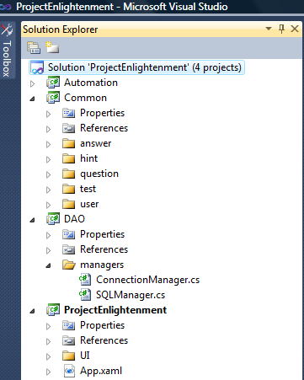
Implementation Decisions - Tools
Visual Studio 2010
Main functionality of CTVIAT
Common data structures
Database Connection and Management
.NET 4.0 Windows Presentation Foundation

Slide 9
Implementation Decisions - Concurrency
USER INTERFACE - DISPATCHER
BackgroundWorker is main thread of Automation module
AUTOMATION BACKGROUNDWORKER
AUTOMATION ANSWER
AUTOMATION HINT
DATABASE ACCESS OBJECT

Slide 10

Project Enlightenment

