Slide 1
CTVIAT
CMPE451: DEVELOPMENT IN SOFTWARE ENGINNERING
GrOUP3
FERHAT ELMAS
EMMAR KARDESLIK
ERAY SALTIK
OZGE INAN
OSMAN SOKUOGLU

Slide 2
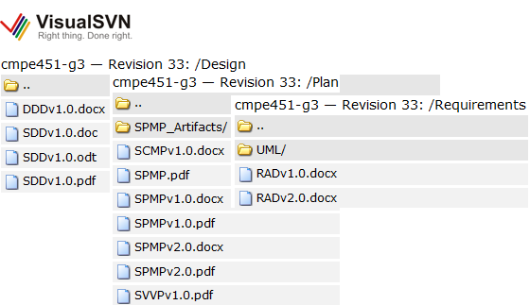
Progress Report
RAD v2.0
SPMPv2.0
SDDv1.0
DDDv1.0
ODDv1.0
SCMPv1.0
SVVPv1.0

Slide 3
What We Have Done?
Finishing Reports
Recreating the database in SQL Server
Creating Dataset of the database through ADO.NET
Creating development environment, and modular structure of classes
Creating Database Connection Object with its methods.
Basic GUI Examples for Demo

Slide 4
Implementation Decisions - Concurrency
USER INTERFACE - DISPATCHER
BackgroundWorker is main thread of Automation module
AUTOMATION BACKGROUNDWORKER
AUTOMATION ANSWER
AUTOMATION HINT
DATABASE ACCESS OBJECT

Slide 5
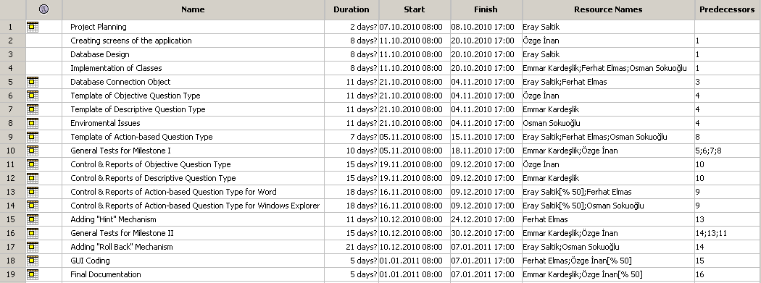

Slide 6
Project Enlightenment
Let’s See What We Have Done!

Slide 7
What We Will Do?
Creating Control Mechanisms
Creating Real User Interface

Slide 8

Project Enlightenment

