Slide 1
Emerging Distributed Architectures
Lausanne, March 22, 2012
by Tarek Benoudina, Ferhat Elmas and Kenny Lienhard

Slide 2
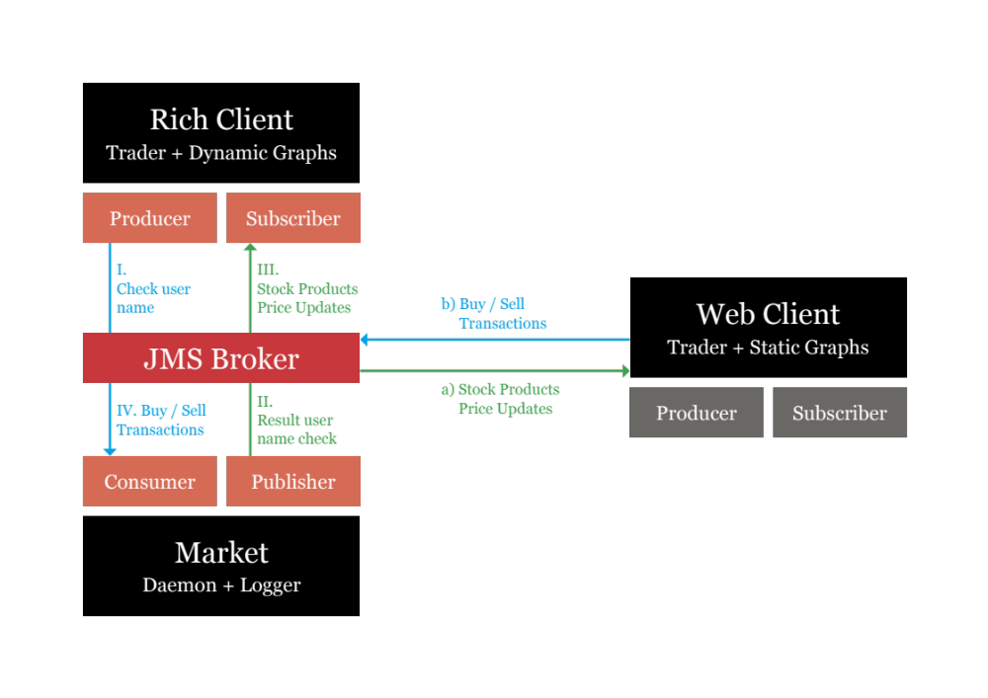

Slide 3
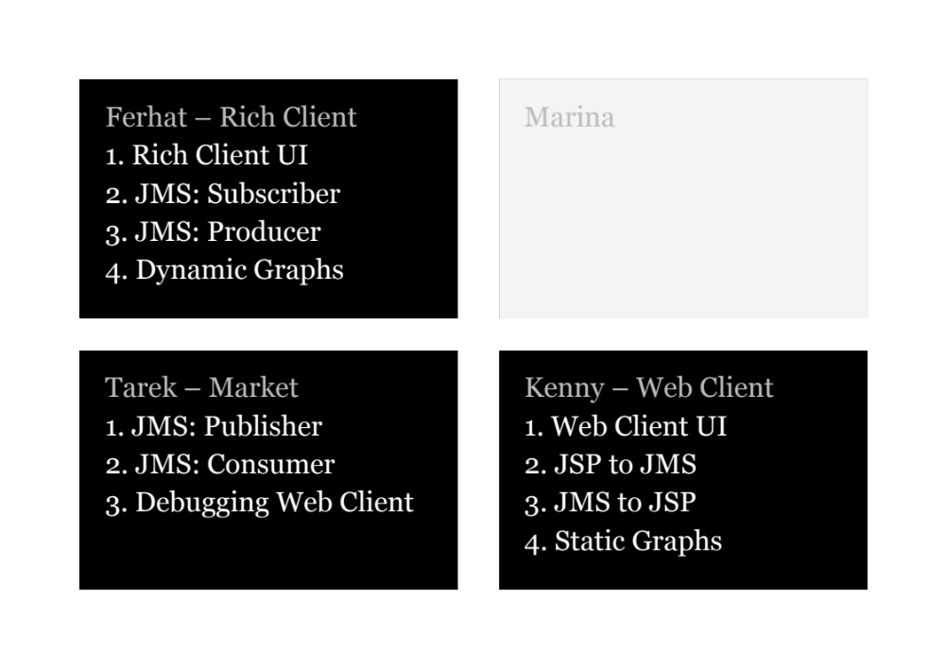

Slide 4
Thank you. |

