Slide 1
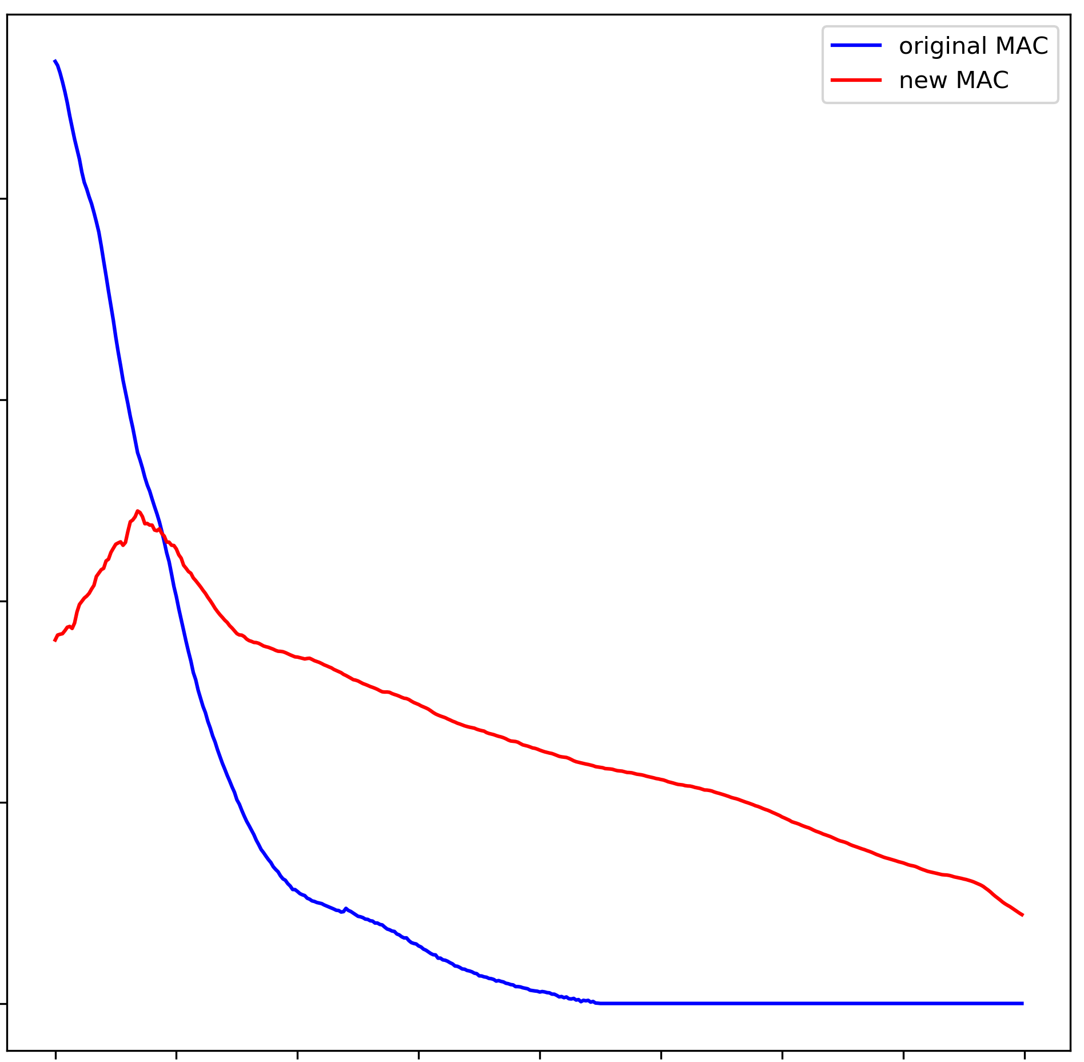
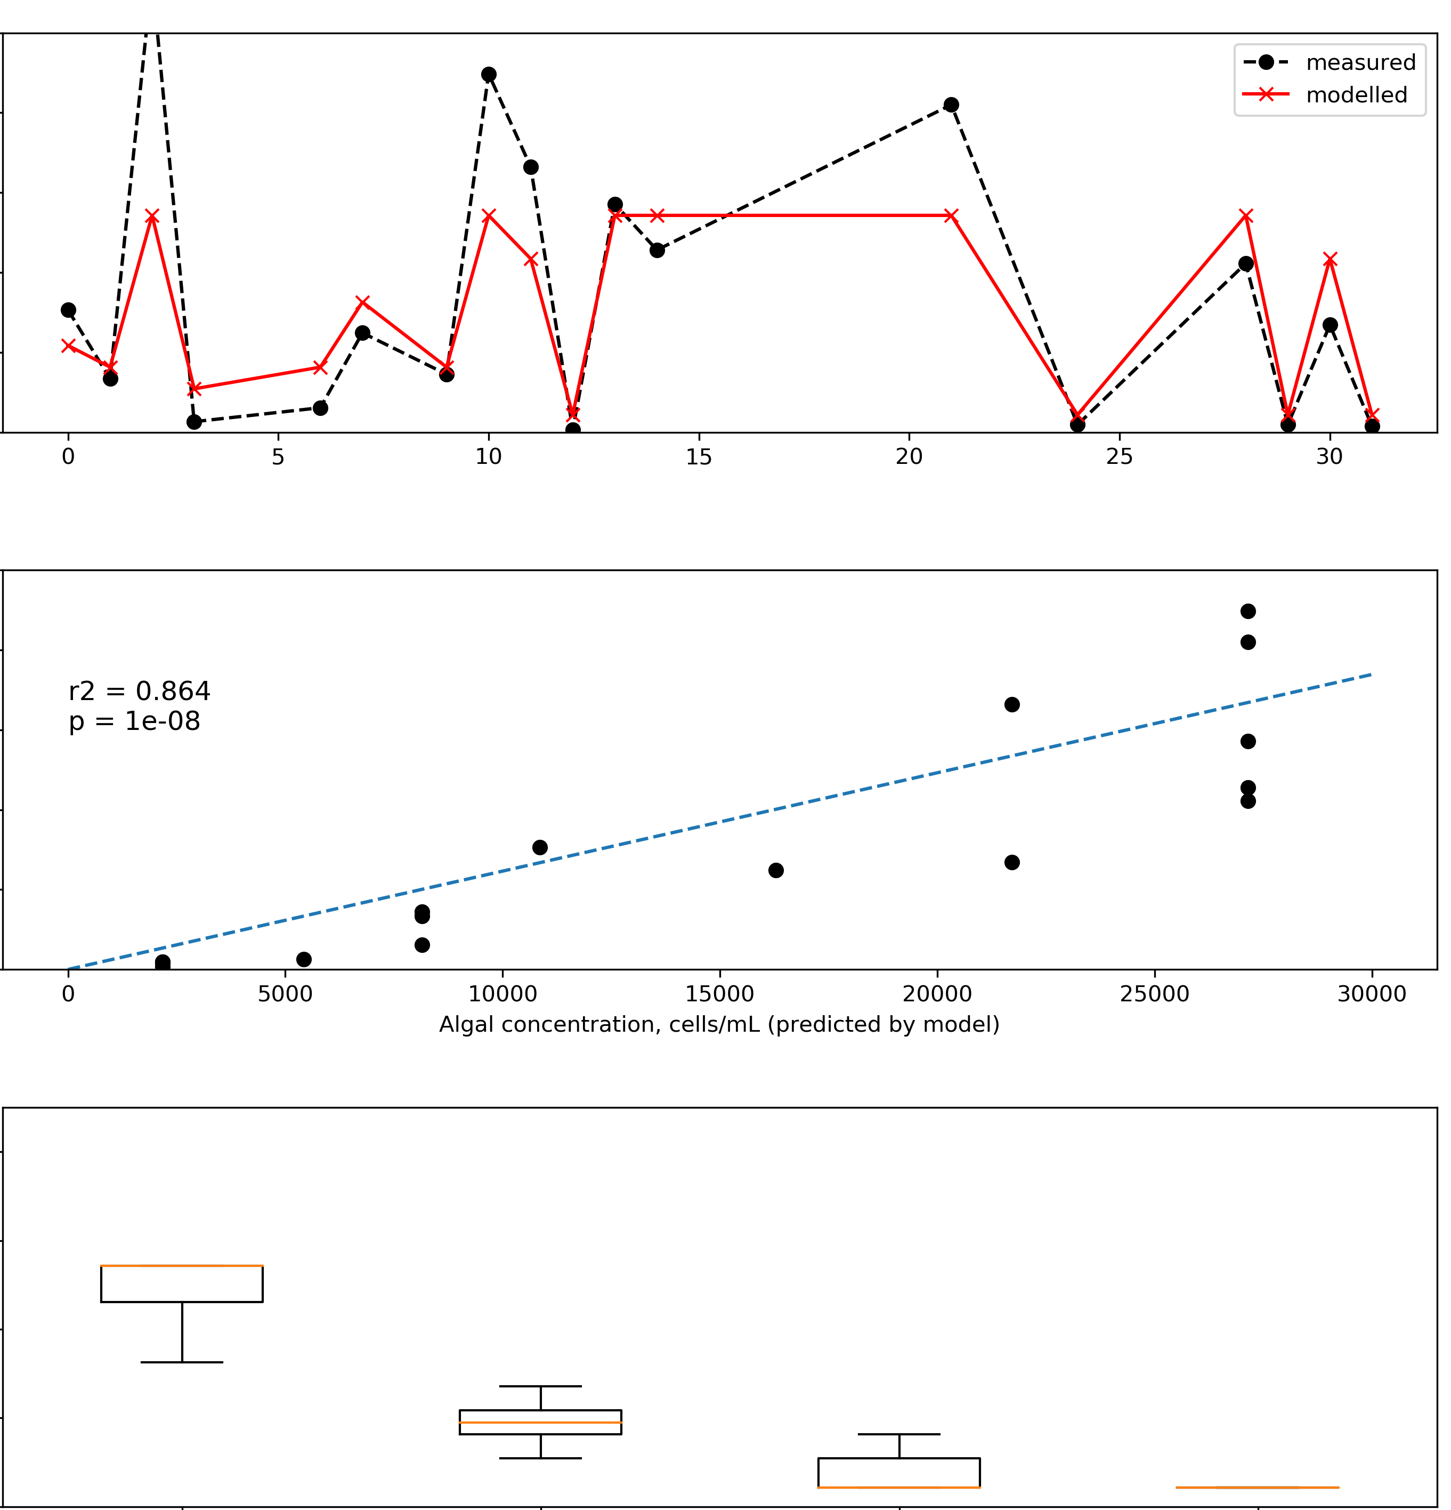
A
MAC (m²/mg)
50000
40000
B
Algal concentration
(cells/mL)
30000
0.4
20000
10000
0
0.3
50000
C
40000
Algal concentration
measured in field
(cells/mL)
30000
20000
0.2
10000
0
0
5000
10000
15000
20000
25000
30000
Algal concentration predicted by model (cells/mL)
0.1
40000
D
Algal concentration
Predicted by model
(cells/mL)
30000
20000
0
10000
0
0.3
0.4
0.5
0.6
0.7
HA
LA
CI
SN
Wavelength (μm)
Surface class from field notes

