Slide 1
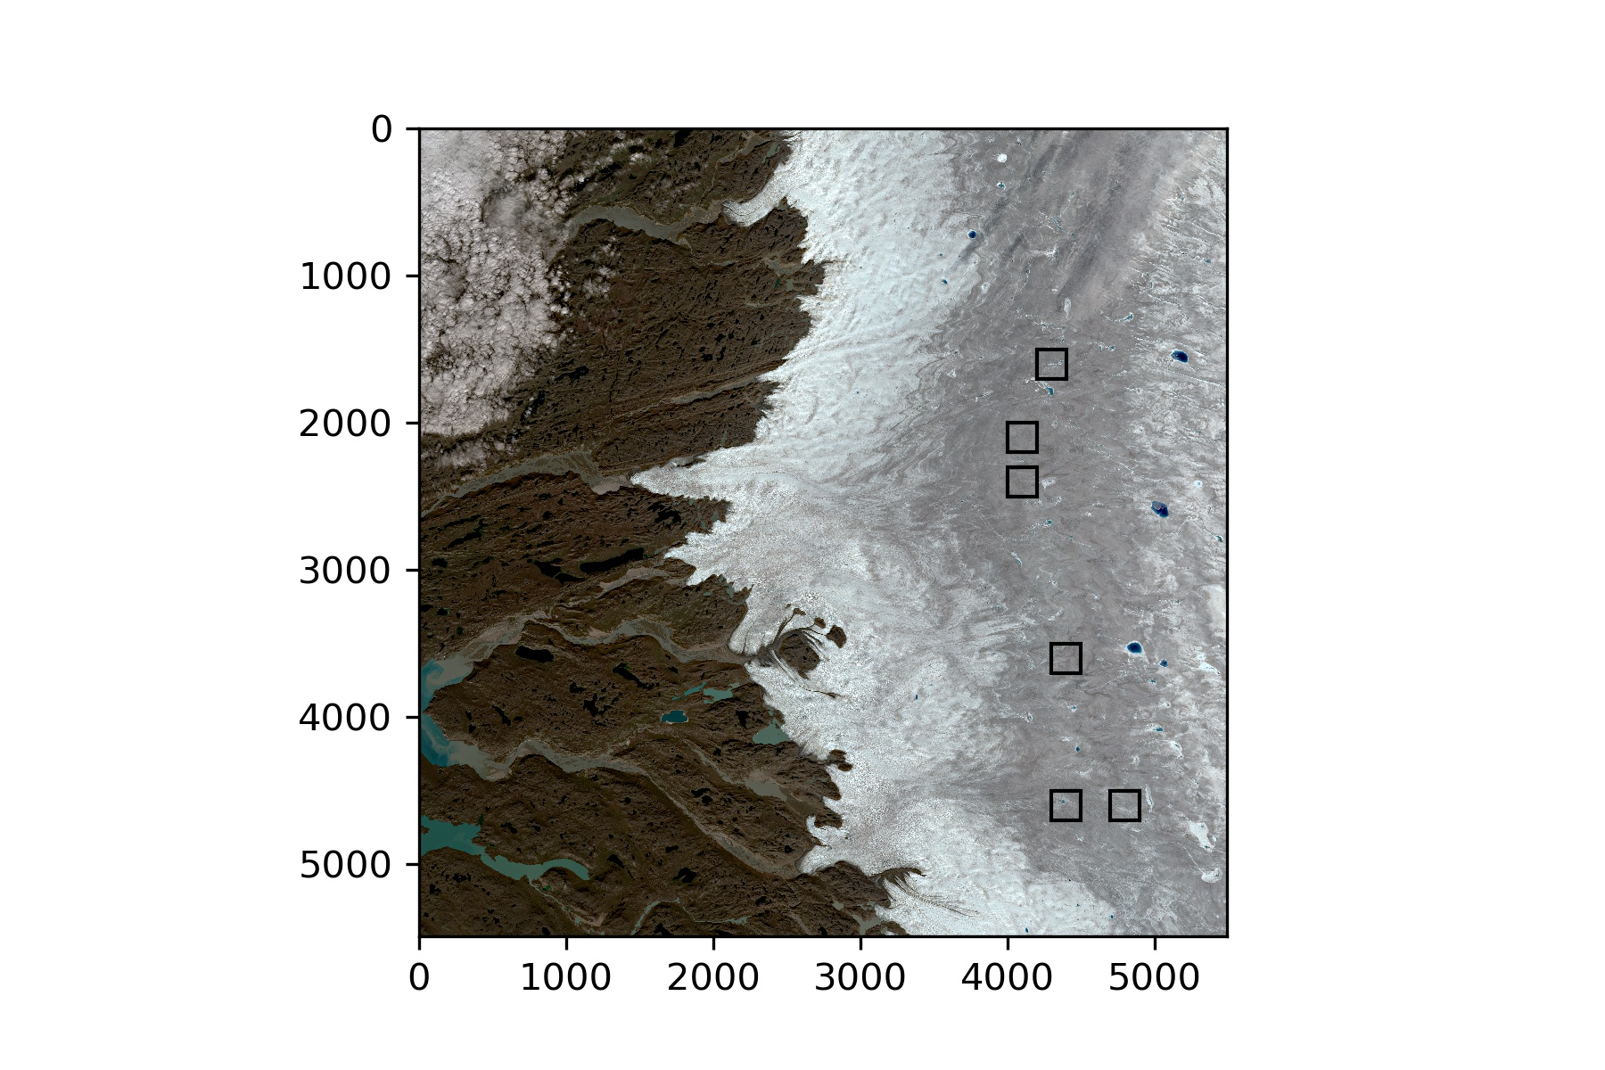
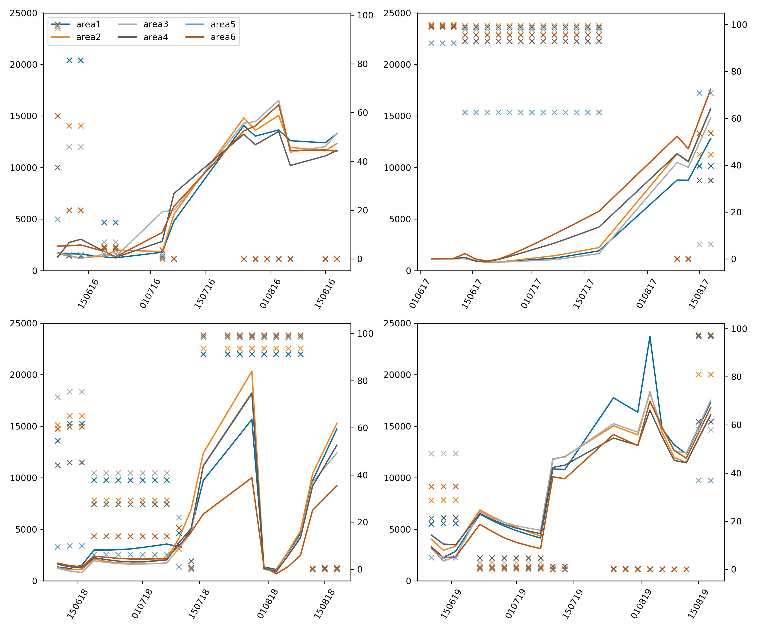
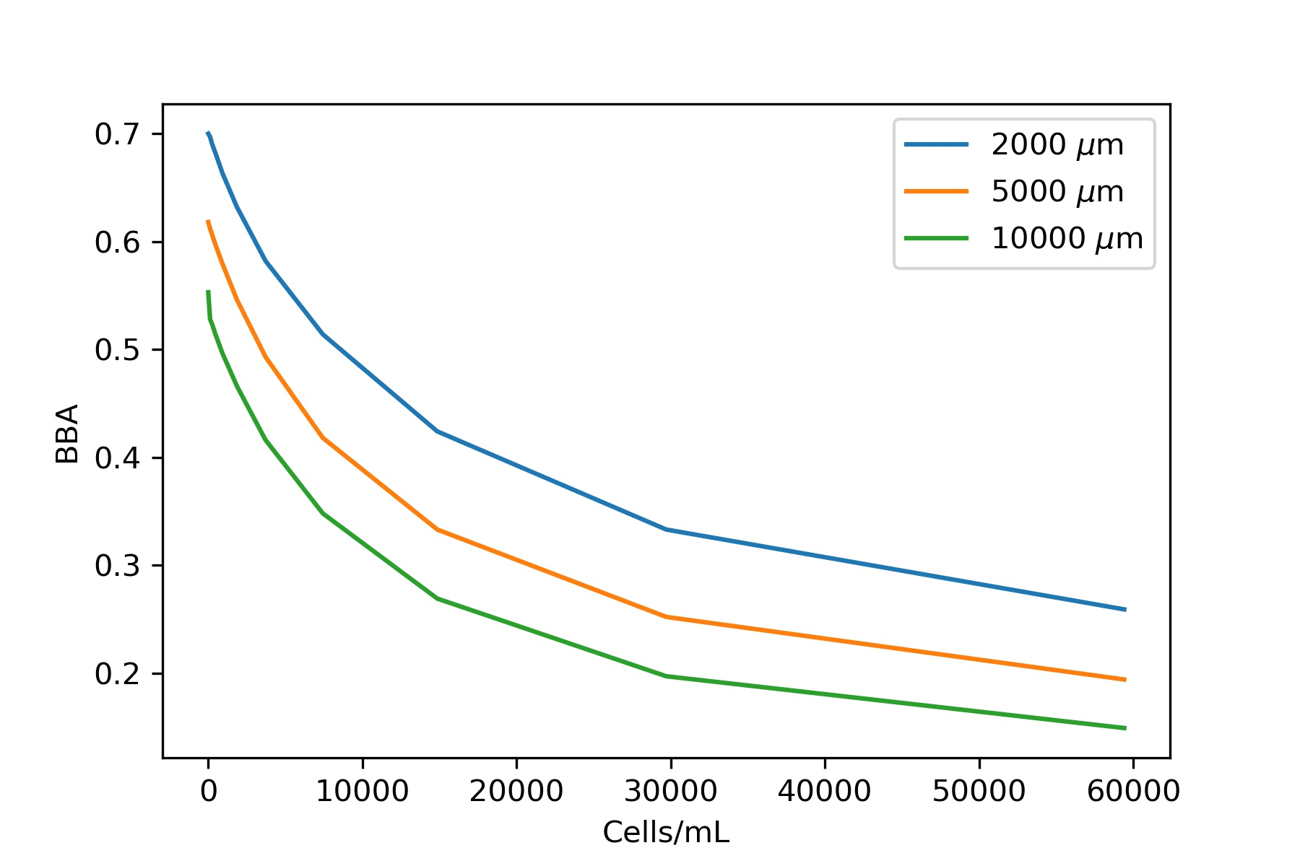
A
B
2016
2017
C
2018
2019
Algal concentration (cells/mL)
snow cover (%)
Date (dd/mm/yy)

