Slide 1
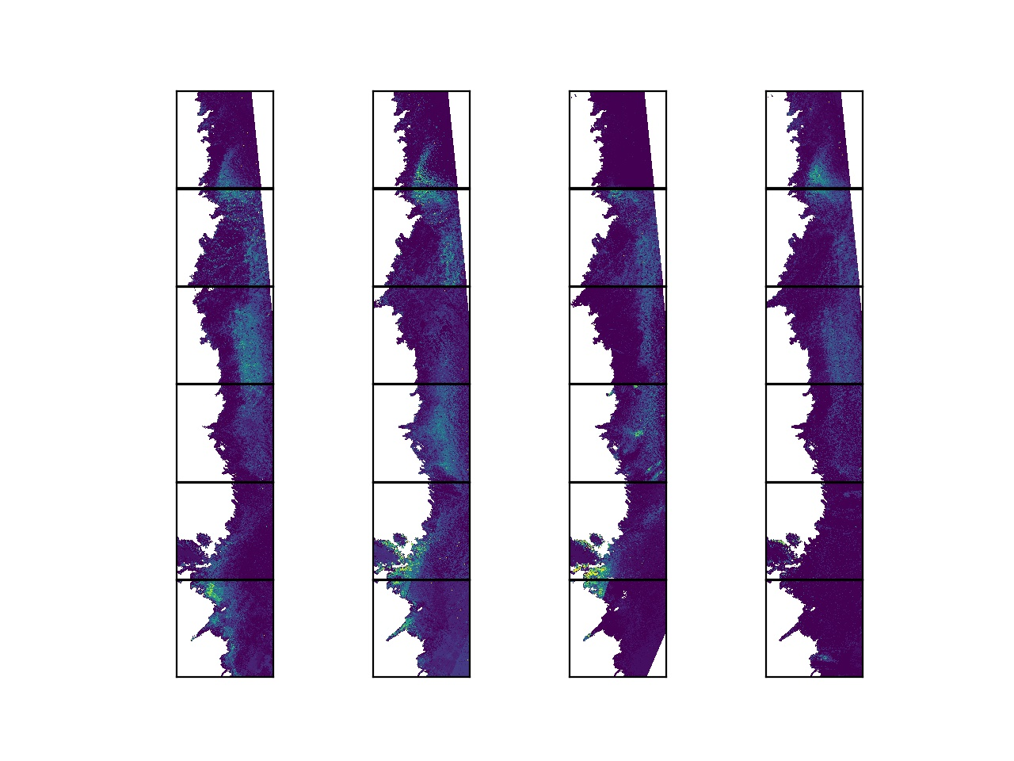
2016
2017
2018
2019
22WEC
22WEB
22WEA
22WEV
22WEU
22WET

