Slide 1
Study Report
The implemention of voxel cone tracing
Qingqin Hua

Slide 2
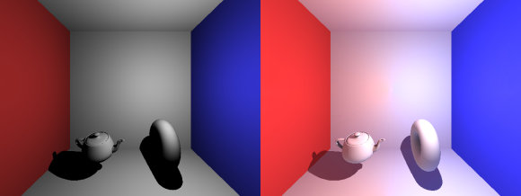
What is voxel cone tracing
Global : Indirect, Slow
Local : Direct Light sources, Fast
Local vs. Global Illumination
Notes:
wall reflect
global brighter

Slide 3
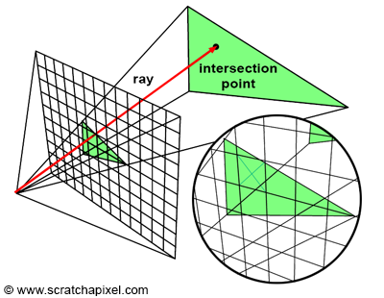
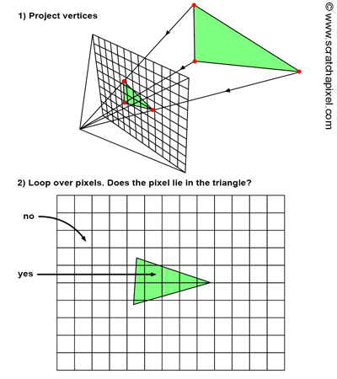
What is voxel cone tracing
Global Illumination method
Monte-carlo ray tracing
Photon Mapping
Instant Radiosity
...
Approximate method
Ambient Occlusion
Light Propagation Volumes
Voxel-based GI
...
ray-tracing
rasterization
Notes:
trace a ray through every pixel to find out the distance between the camera and any object this ray intersects

Slide 4
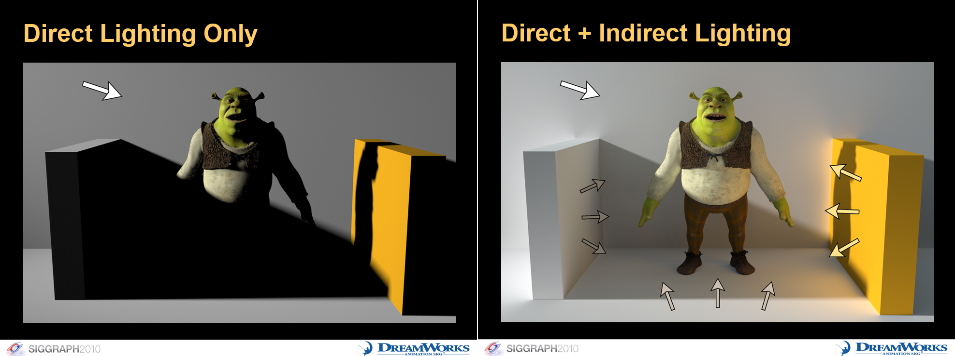
What is voxel cone tracing
Approximate GI method
Real-time
Direct Lighting+Indirect Lighting
Voxel-based
Notes:
trace a ray through every pixel to find out the distance between the camera and any object this ray intersects

Slide 5
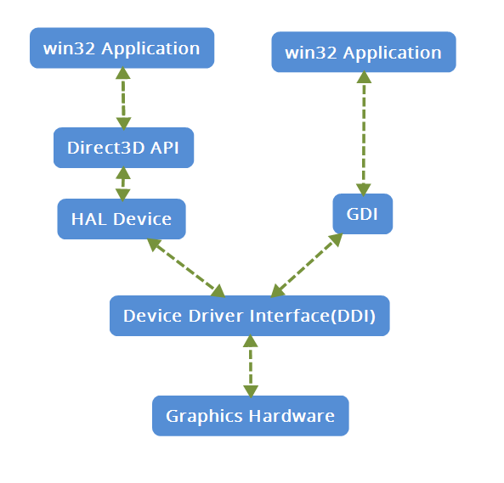
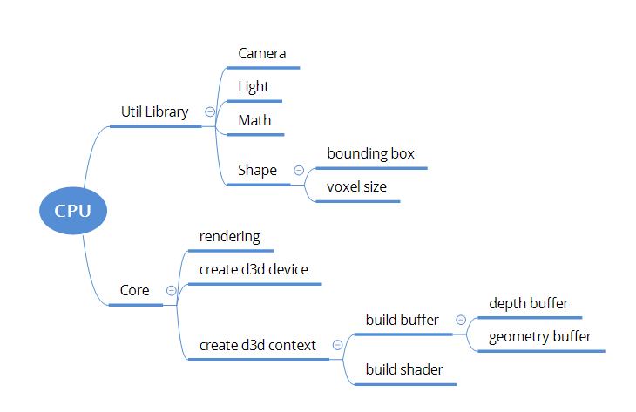
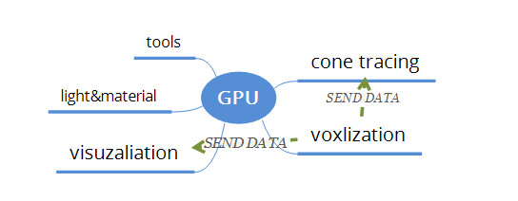
FrameWork
directx 3d pipeline

Slide 6
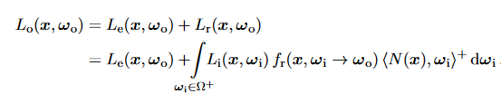
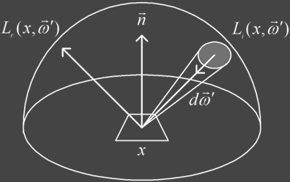
Direct Lighting-BRDF
Rendering Equation
L0: outgoing radiance
Le: emitted radiance
Li: incident radiance
fr: BRDF
Ndotw: weaken factor, Lambert Law
Notes:
light emit +reflect

Slide 7

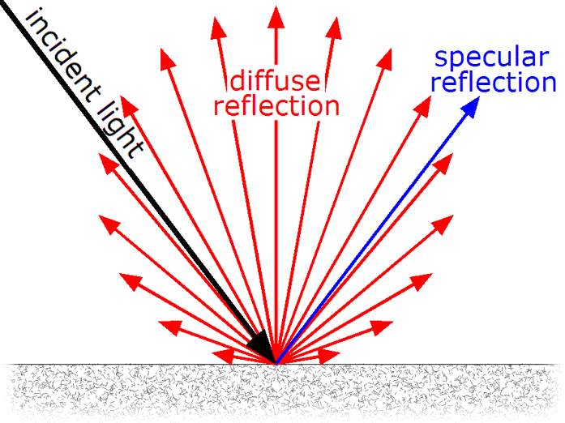

Direct Lighting-BRDF
Definition
Diffuse: LamBert
Specular: Cook-Torrence Microfacet
NDF: GGX
F: Fresnel equation
G: Schilick-GGX with Smith
the reflectance properties at a surface point x
when viewed from direction ωo
from (0,1)
Notes:
Fresnel: the amount of light that reflects
NDF:specular distribution

Slide 8
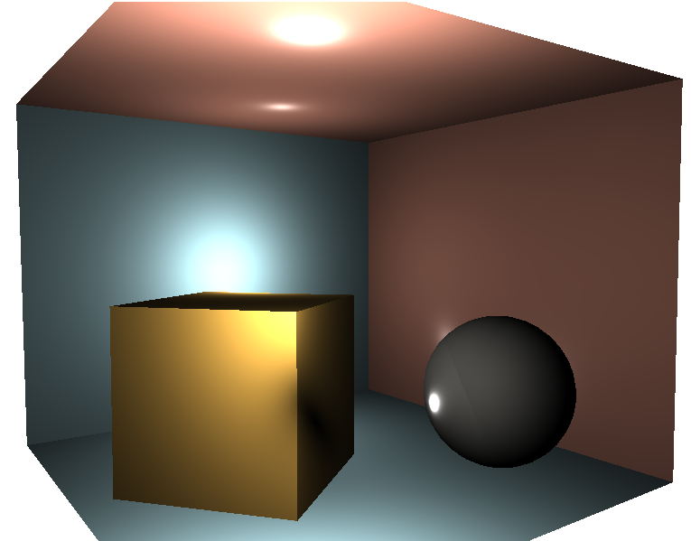
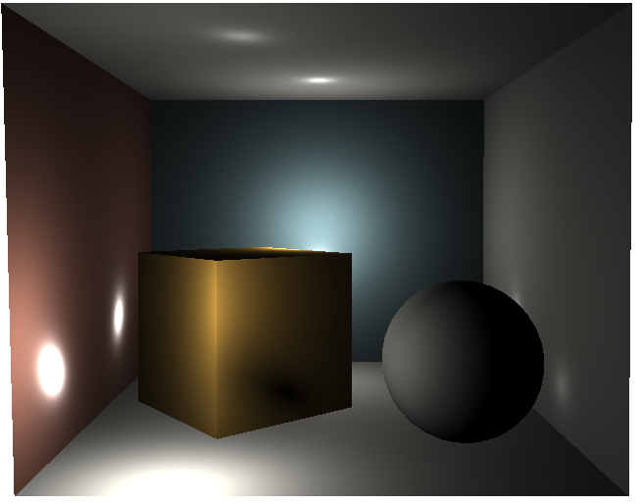
Result
Notes:
TWO POING LIGHTS

Slide 9
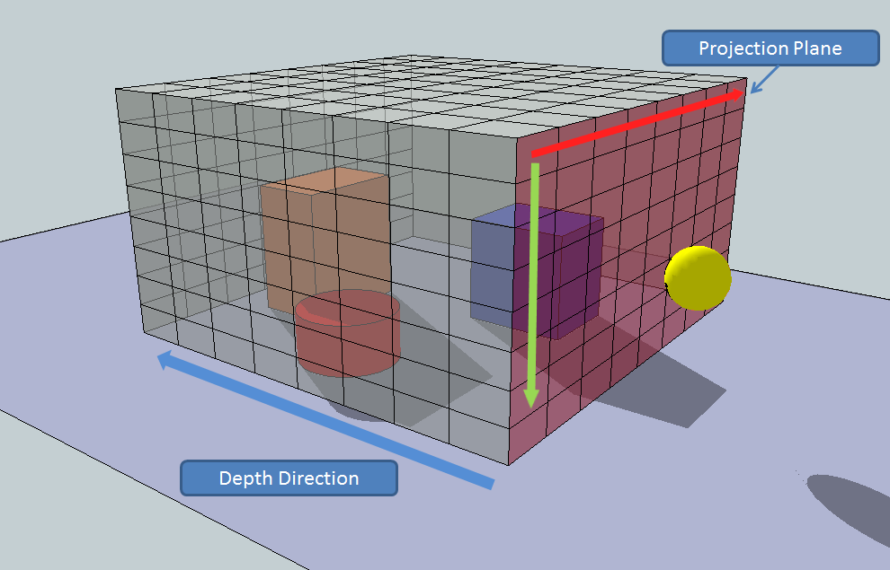

Indirect Lighting- voxel based
intersection
save lighting data
3D texture

Slide 10
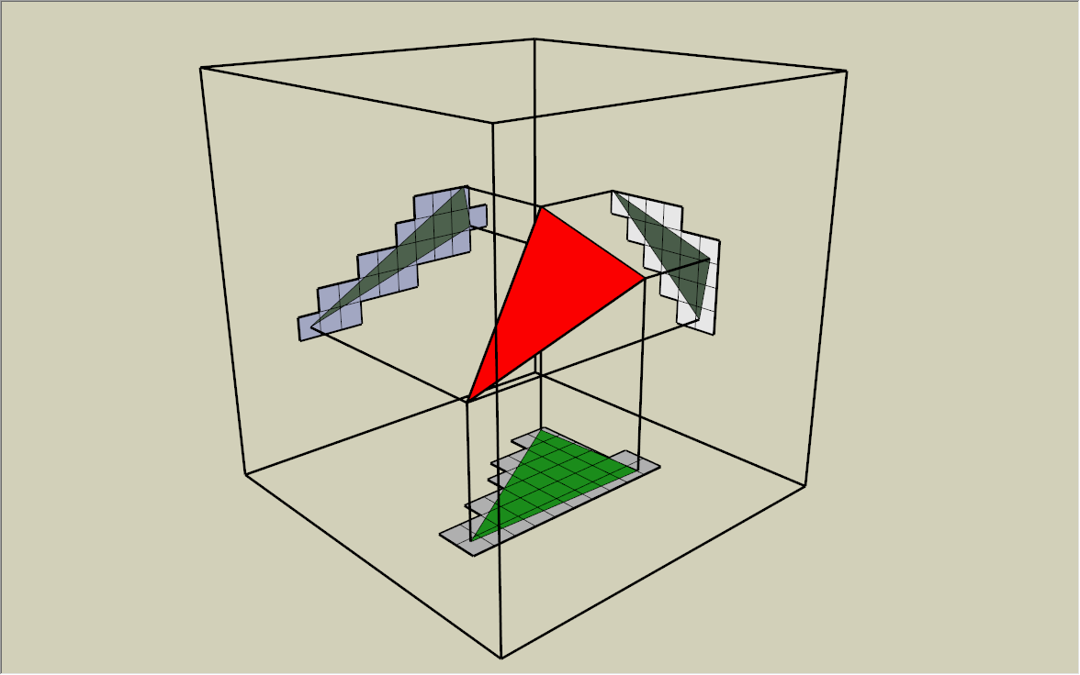
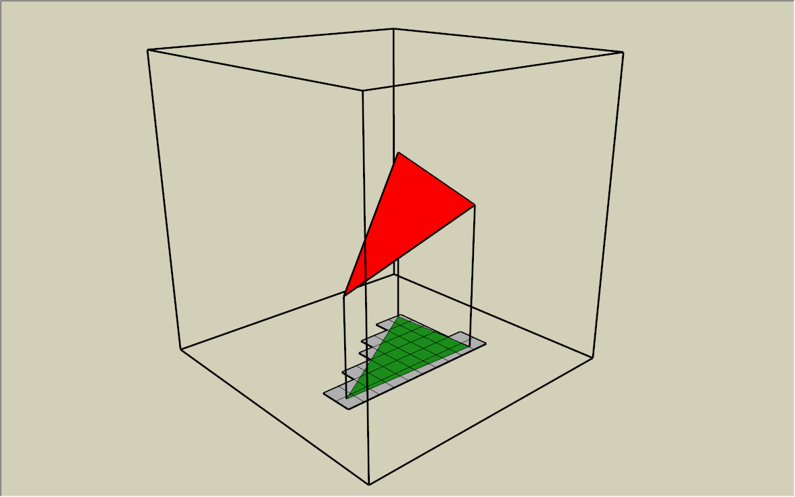
Voxelization
project triangle
dominant axis of normal
discrete points

Slide 11
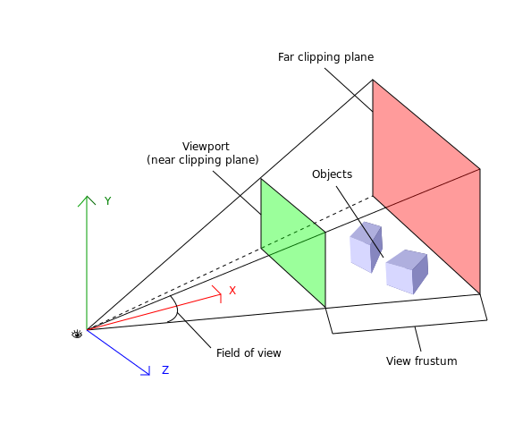
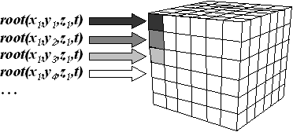
Voxelization
Information
position: same to viewport
Lighting: Blinn Phing

Slide 12
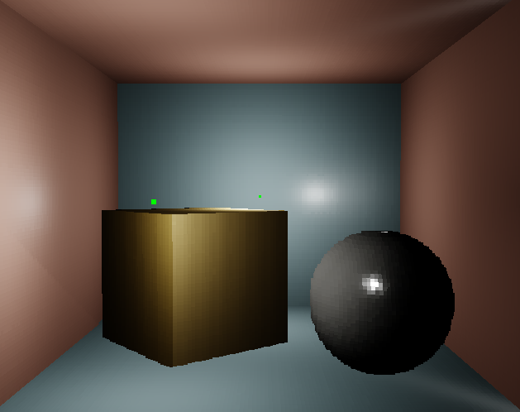
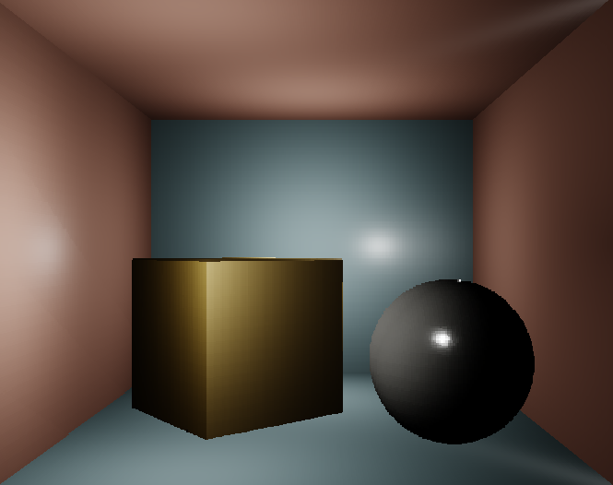
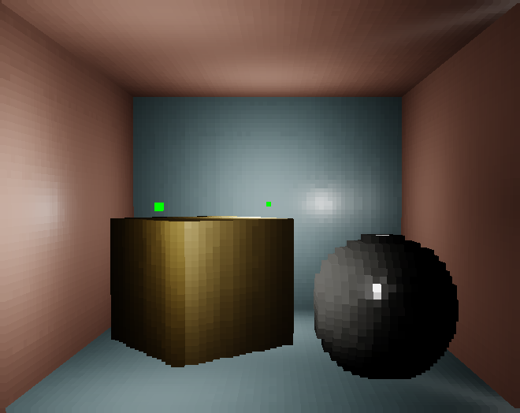
Result
128x128x128
256x256x256
64x64x64

Slide 13
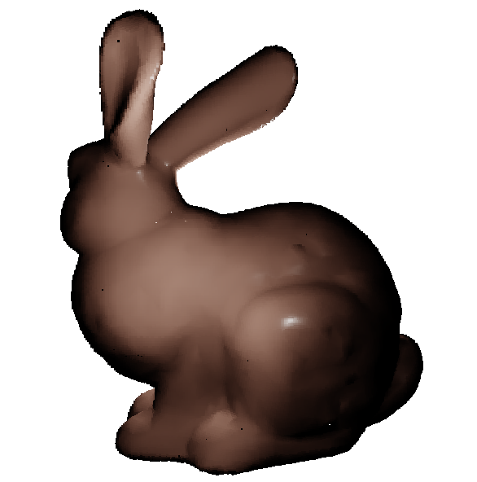
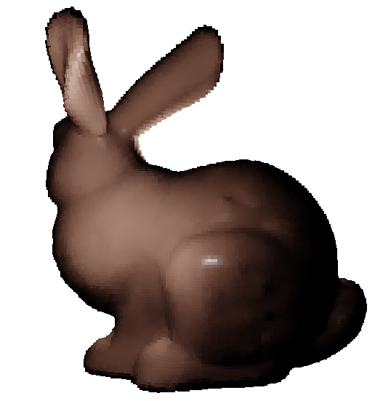
Result
256x256x256
128x128x128
64x64x64

Slide 14
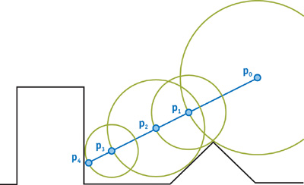
Cone Tracing
float depth = start;
for (int i = 0; i < MAX_MARCHING_STEPS; i++) {
float dist = sceneSDF(eye + depth * viewRayDirection);
if (dist < EPSILON) {
// We're inside the scene surface!
return depth;
}
// Move along the view ray
depth += dist;
if (depth >= end) {
// Gone too far; give up
return end;
}
}
return end
ray marching

Slide 15
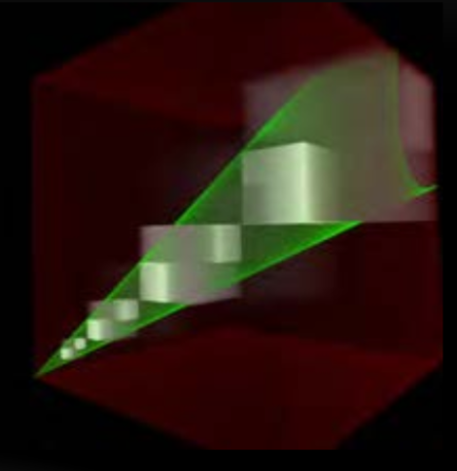
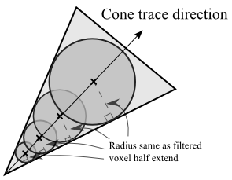
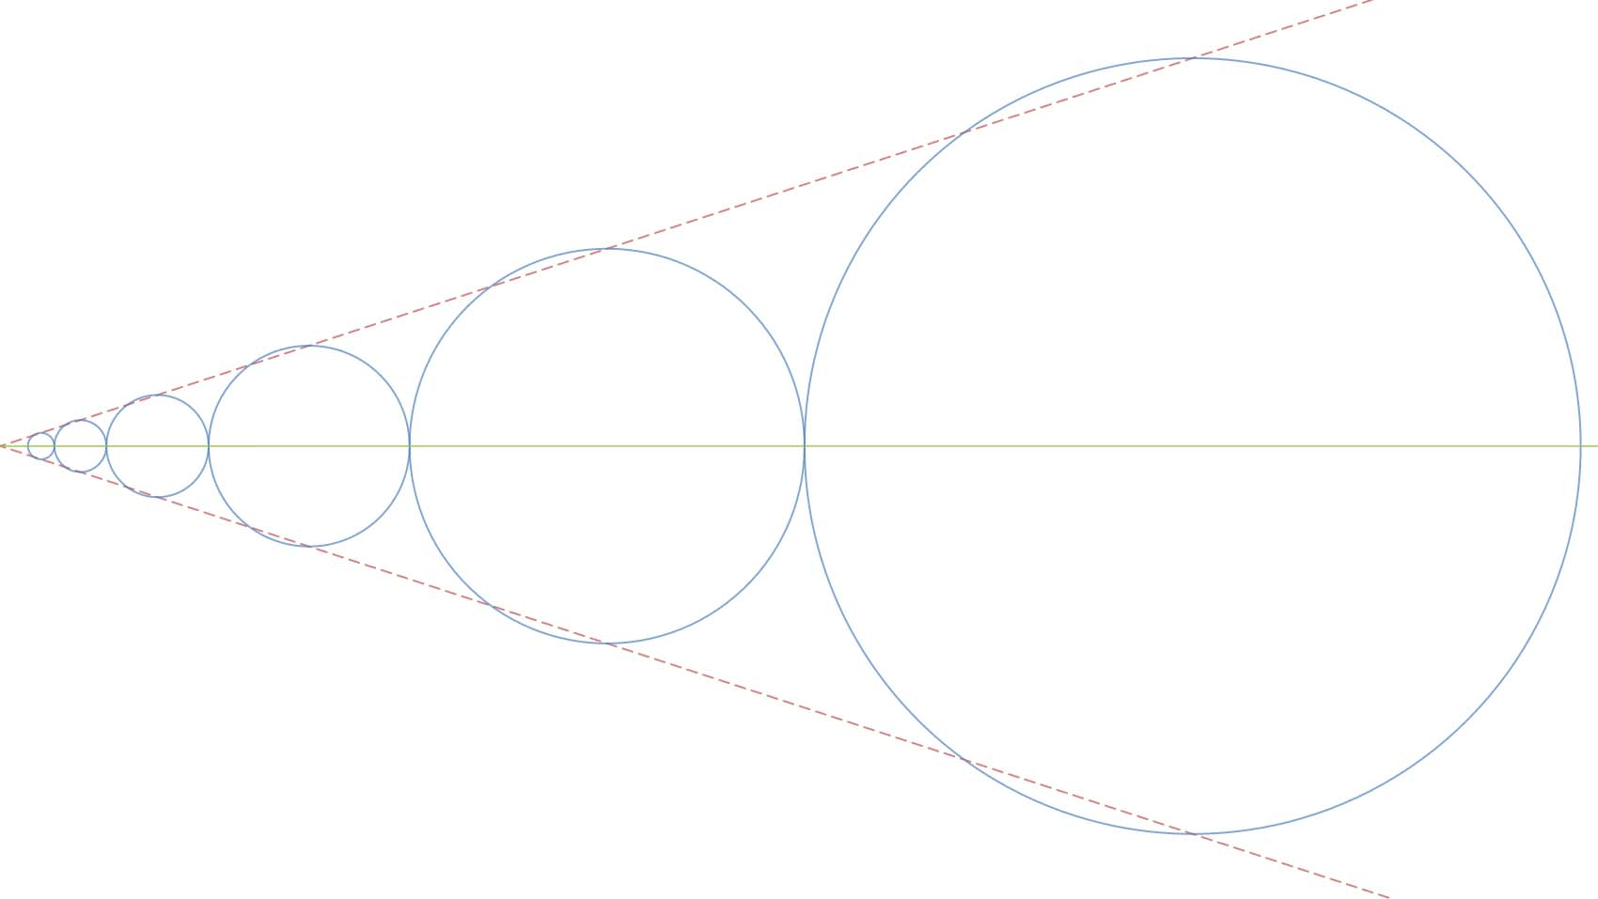
Cone Tracing
mipmap level

Slide 16
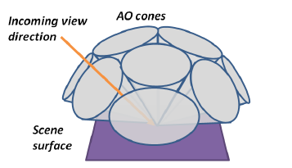
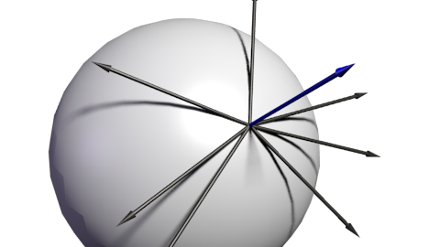
Cone Tracing
nine diffuse cones
1 normal
4 side corner
4 corner
one specular cone

Slide 17
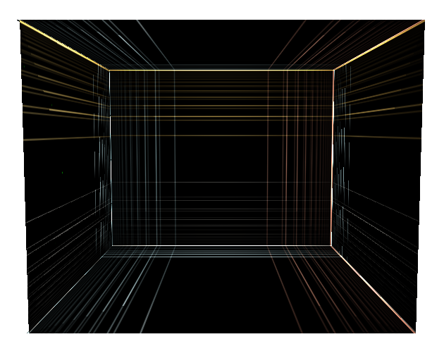
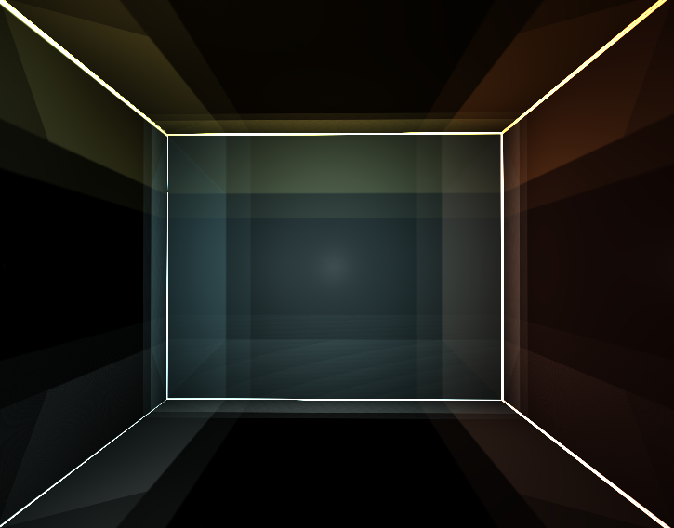
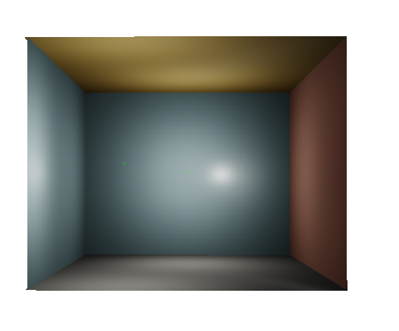
Cone Tracing
Problem unsolved
reference: direct lighting
indirect lighting channel1
indirect lighting channel2

Slide 18
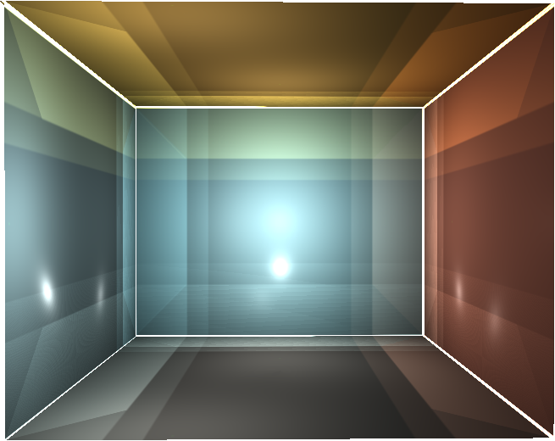
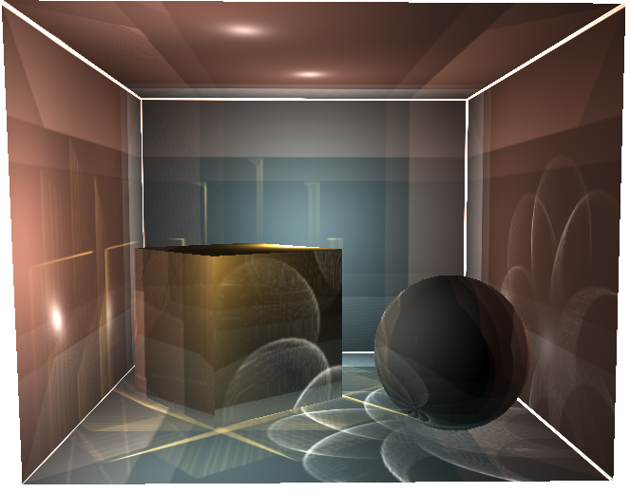
Final gathering
Problem unsolved
reference: direct lighting
result 1
result 2

Slide 19
Future Work
Solve the cone tracing problem
Replace BRDF to BSDF
DirectX application code optimization
More materials & complex scene
Add conservative rasterization in voxelization

Slide 20
Thank you for your listening

