Slide 1
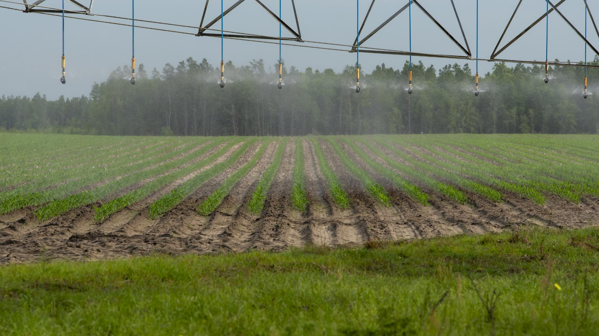

Technology Trends: Smart Irrigation
  Supervised by: Mrs Dziria
  Prepared by: Ferid Saad
  First Year DevOps
Academic Year: 2025/2026
Notes:
---

Slide 2
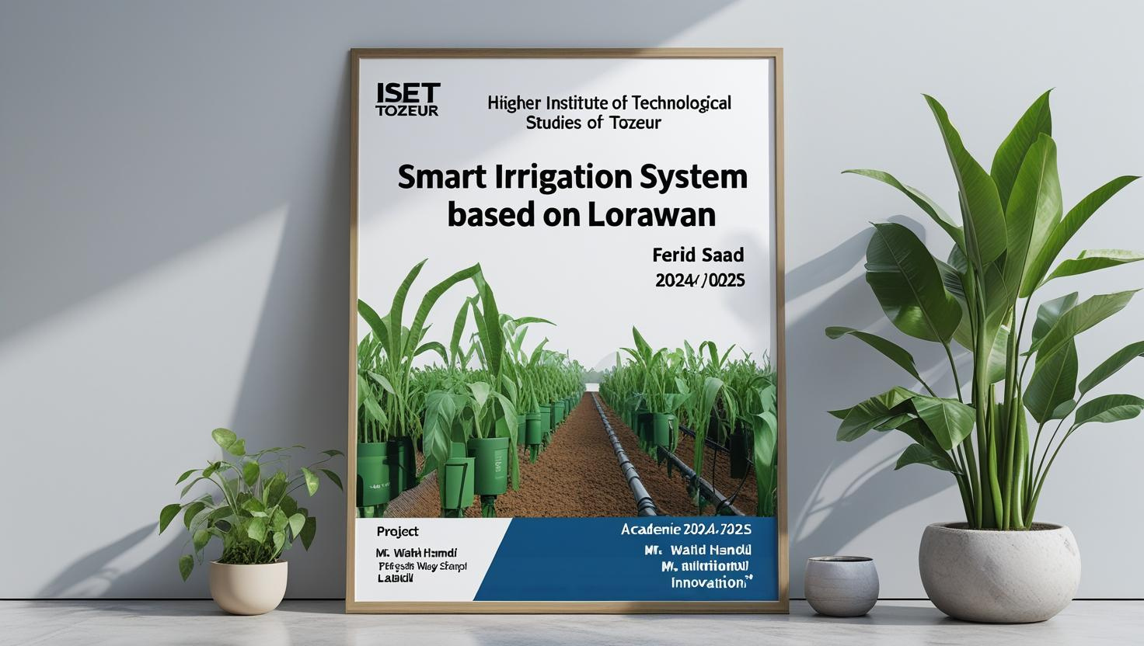
Overview of final year project
Notes:
Introduction, Why Smart Irrigation?

Slide 3
Overview of Smart Irrigation
Notes:
Introduction, Why Smart Irrigation?

Slide 4
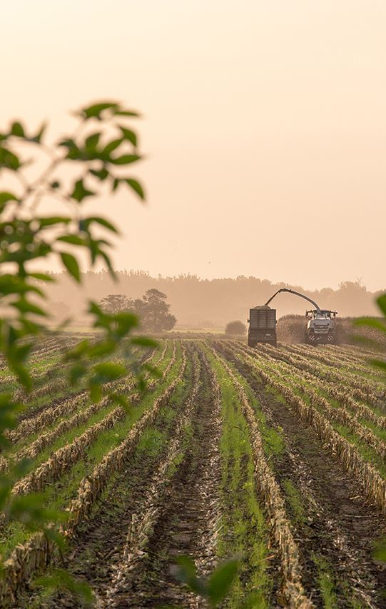
Introduction
Smart irrigation is a leading technology trend in agriculture. It uses IoT sensors, AI, and data analytics to optimize water use, reduce waste, and improve crop yields. With growing water scarcity and climate challenges, smart irrigation is essential for sustainable farming and aligns with global digital transformation in agriculture.
Notes:
Smart irrigation represents a transformative approach to agricultural water management, utilizing advanced technologies to optimize water usage. This method is increasingly vital in addressing global challenges such as water scarcity, climate change, and the growing demand for food production. By integrating digital tools and data-driven strategies, smart irrigation systems enable farmers to make informed decisions about when and how much to irrigate, thereby enhancing efficiency and sustainability. The concept is rooted in precision agriculture, where resources are managed with high accuracy to maximize productivity while minimizing environmental impact. As traditional irrigation methods often lead to water wastage and inconsistent crop yields, smart irrigation offers a promising alternative that aligns with modern agricultural needs.

Slide 5
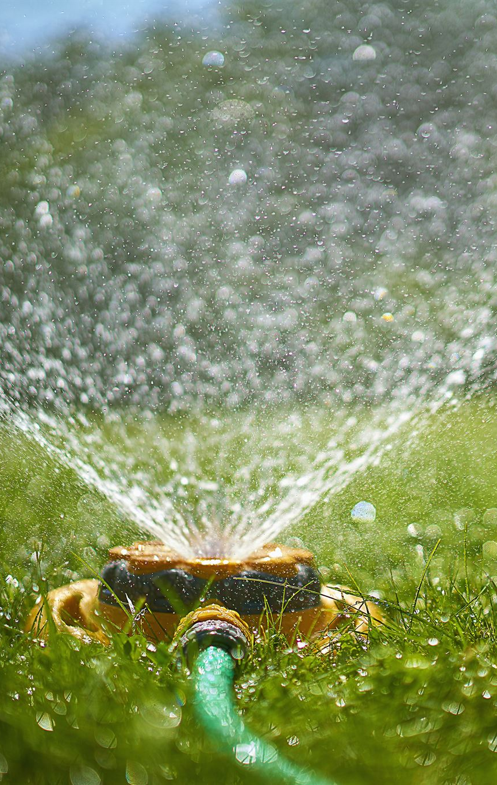
Why Smart Irrigation?
Water Scarcity Challenges
  Climate change and population growth increase water scarcity, demanding efficient water management in agriculture.
Sustainable Agriculture Needs
  Sustainable farming practices address environmental concerns and resource limitations effectively.
Rising Food Demand
  Growing global food demand requires innovative solutions to improve crop yields sustainably.
Adapting to Climate Variability
  Smart irrigation uses real-time data and adaptive controls to handle unpredictable weather patterns.
Notes:
The adoption of smart irrigation is driven by several critical factors. Firstly, increasing water scarcity due to climate change and population growth necessitates more efficient water management practices. Agriculture consumes a significant portion of freshwater resources, making it imperative to optimize usage. Secondly, the need for sustainable agriculture is more pressing than ever, as environmental concerns and resource limitations challenge traditional farming methods. Thirdly, the rising global demand for food production requires innovative solutions to boost crop yields without depleting natural resources. Lastly, climate change introduces variability in weather patterns, making it difficult for farmers to rely on conventional irrigation schedules. Smart irrigation addresses these issues by providing real-time data and adaptive control mechanisms, ensuring that water is used judiciously and effectively.

Slide 6
Technological Foundations
Notes:
Key Technologies in Smart Irrigation

Slide 7
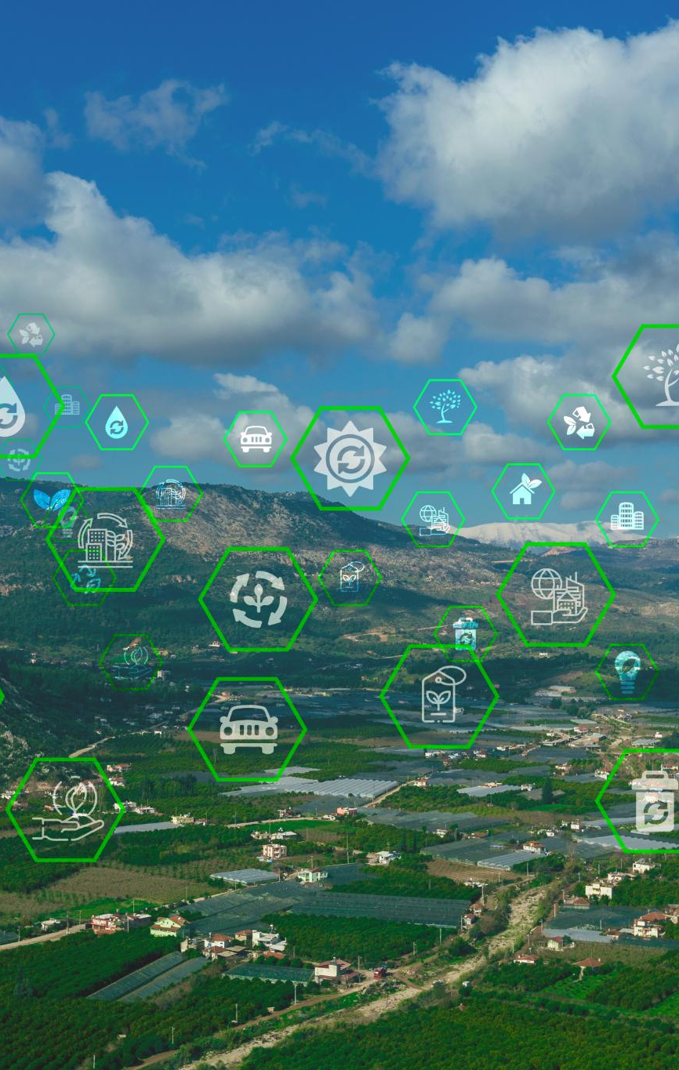
Key Technologies in Smart Irrigation
Internet of Things Connectivity
  IoT devices connect sensors, controllers, and actuators for seamless data exchange in irrigation systems.
Environmental Sensors Monitoring
  Sensors track soil moisture, temperature, and humidity to inform precise irrigation timing and volume.
Artificial Intelligence Analysis
  AI analyzes sensor data to predict irrigation needs and automate watering decisions effectively.
Cloud Computing Support
  Cloud platforms store data and enable remote monitoring and control of irrigation systems by farmers.
Notes:
Smart irrigation systems are built upon a suite of advanced technologies that work together to enhance water management. The Internet of Things (IoT) plays a central role by connecting various devices such as sensors, controllers, and actuators, enabling seamless communication and data exchange. Sensors are crucial for monitoring soil moisture, temperature, humidity, and other environmental parameters, providing the data needed for precise irrigation decisions. Artificial Intelligence (AI) adds a layer of intelligence by analyzing sensor data to predict irrigation needs and automate responses. AI algorithms can learn from historical data and adapt to changing conditions, improving accuracy over time. Cloud computing supports these technologies by offering scalable data storage and remote access, allowing farmers to monitor and control irrigation systems from anywhere. Together, these technologies create a robust framework for smart irrigation, transforming traditional practices into data-driven, efficient operations.

Slide 8
Impact and Challenges
Notes:
Benefits of Smart Irrigation, Challenges

Slide 9
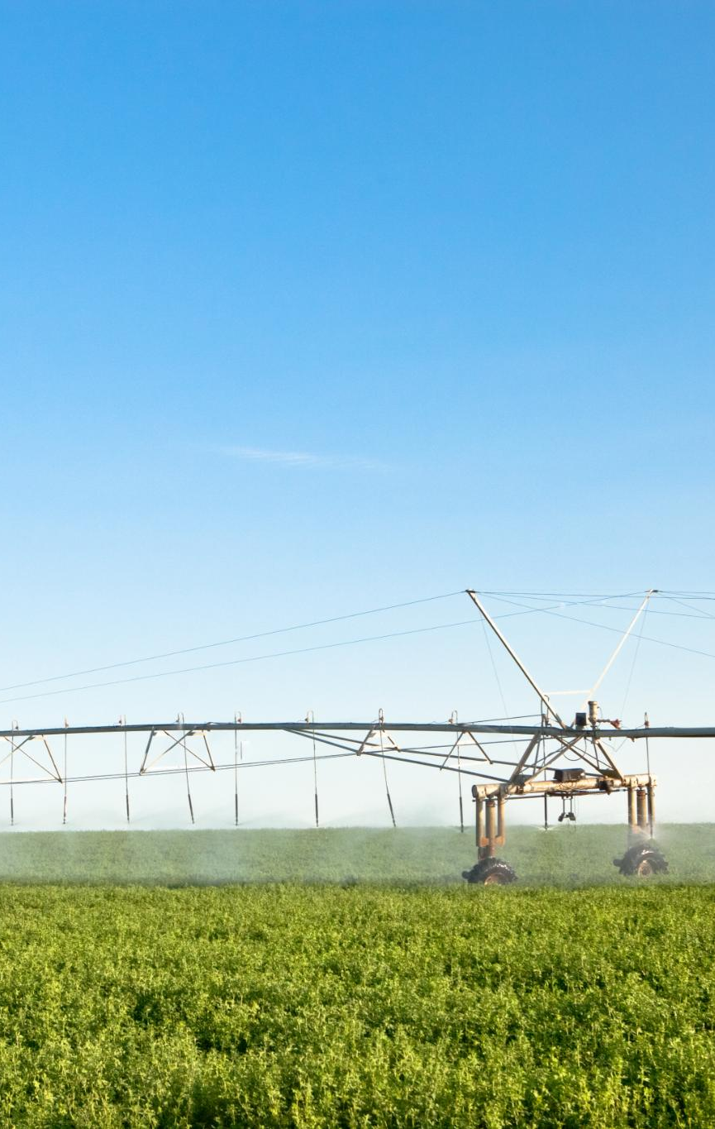
Benefits of Smart Irrigation
Efficient Water Usage
  Smart irrigation conserves water by precisely delivering it only when and where crops need it, reducing waste.
Improved Crop Yields
  Consistent and adequate hydration from smart systems enhances crop growth and productivity.
Cost and Labor Reduction
  Automation in smart irrigation lowers operational costs and reduces the need for manual labor.
Environmental Sustainability
  Smart irrigation supports sustainable agriculture, helping conserve resources and combat climate change.
Notes:
Smart irrigation offers numerous benefits that make it an attractive solution for modern agriculture. One of the most significant advantages is efficient water usage, which helps conserve a vital resource and reduce environmental impact. By delivering water precisely when and where it is needed, smart systems minimize waste and ensure optimal hydration for crops. This efficiency translates into improved crop yields, as plants receive consistent and adequate water supply. Additionally, smart irrigation reduces operational costs by automating processes and minimizing manual labor. Real-time monitoring and control capabilities allow farmers to respond quickly to changing conditions, enhancing resilience and productivity. Furthermore, the environmental sustainability of smart irrigation supports long-term agricultural viability, aligning with global efforts to combat climate change and promote responsible resource management.

Slide 10
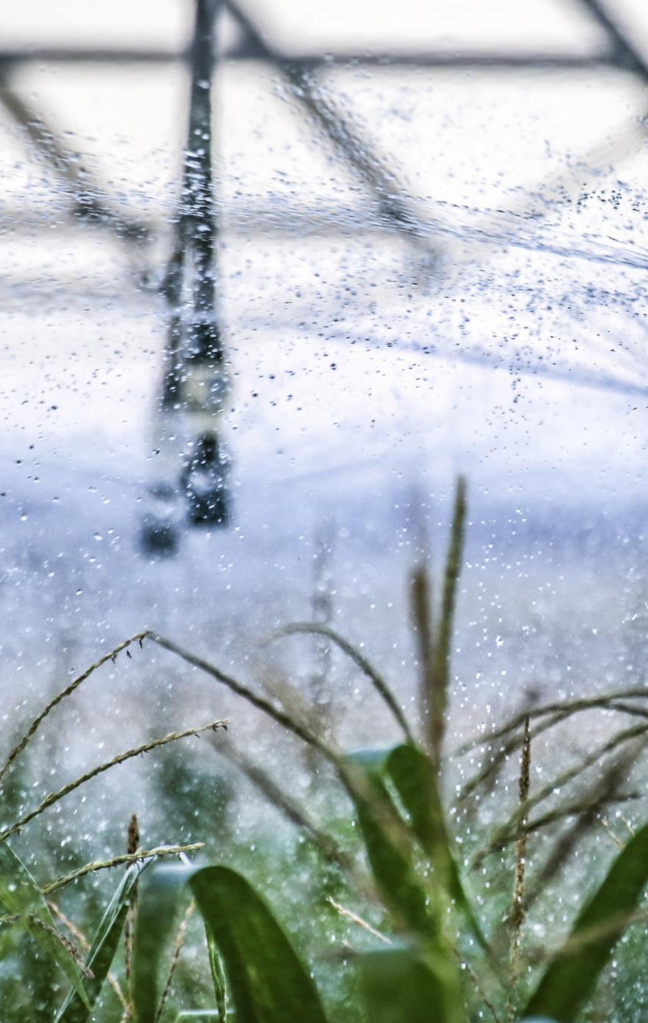
Challenges
High Initial Investment
  Smart irrigation requires costly equipment and infrastructure, limiting access for small-scale farmers.
Technical Complexity
  Advanced systems need specialized skills for integration and maintenance, posing a barrier to adoption.
Data Privacy and Security
  Protecting agricultural data integrity and confidentiality is vital to gain user trust.
Infrastructure Limitations
  Poor internet and power supply in rural areas restrict smart irrigation deployment.
Notes:
Despite its advantages, smart irrigation faces several challenges that can hinder its widespread adoption. One major obstacle is the high initial investment required for equipment and infrastructure, which may be prohibitive for small-scale farmers. Technical complexity is another issue, as the integration and maintenance of advanced systems demand specialized knowledge and skills. Data privacy and security concerns also arise, especially when sensitive agricultural data is stored and transmitted over digital networks. Ensuring the integrity and confidentiality of this data is crucial for user trust and system reliability. Additionally, limited infrastructure in rural areas, such as internet connectivity and power supply, can restrict the deployment of smart irrigation technologies. Addressing these challenges requires coordinated efforts from governments, technology providers, and agricultural stakeholders to create supportive environments and accessible solutions.

Slide 11
Future Outlook
Notes:
Future Trends

Slide 12
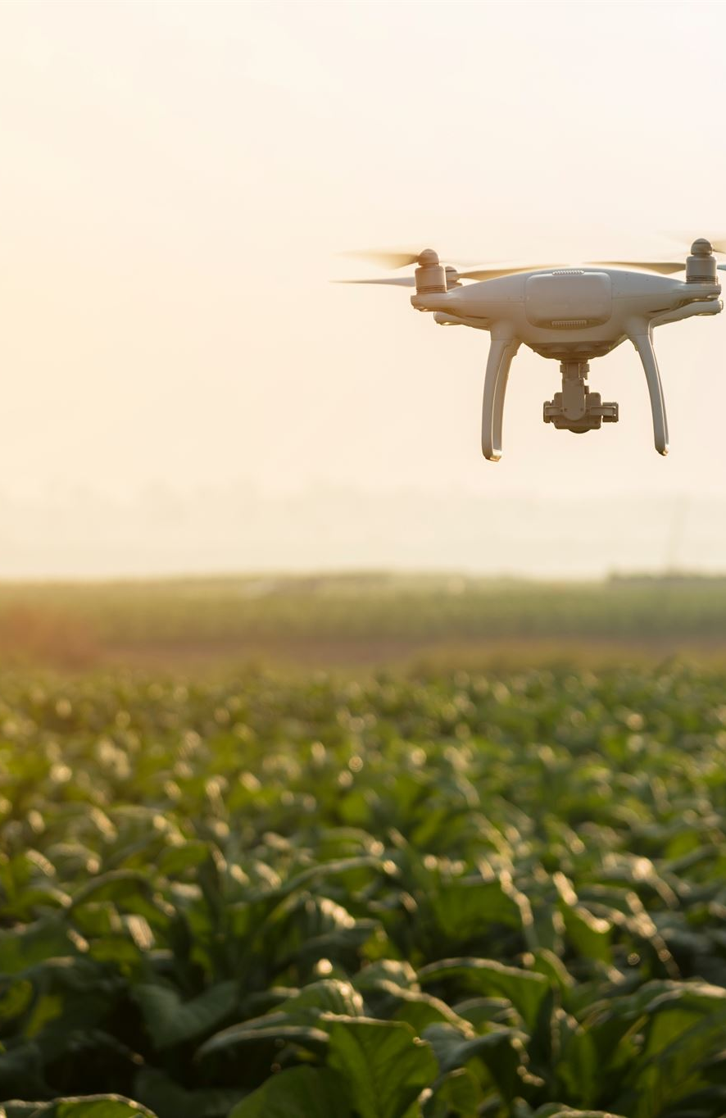
Future Trends
Drones and Satellite Imaging
  Integration of drones and satellite imaging provides detailed data on crop health and soil conditions for precise irrigation.
Advanced AI Systems
  AI-powered autonomous irrigation systems can learn, adapt, and make complex decisions without human input.
Blockchain for Data Integrity
  Blockchain technology ensures transparency and security in data management for supply chain and resource tracking.
Global Expansion and Sustainability
  Smart irrigation is expanding in developing regions to promote sustainable agriculture with international support.
Notes:
The future of smart irrigation is shaped by emerging trends that promise to further enhance its capabilities and accessibility. One notable development is the integration of drones and satellite imaging, which provide high-resolution data on crop health and soil conditions, enabling more precise irrigation planning. Advanced AI technologies are also expected to play a greater role, with autonomous systems capable of making complex decisions without human intervention. These systems can continuously learn and adapt, improving efficiency and responsiveness. Blockchain technology is gaining attention for its potential to ensure data integrity and transparency, particularly in supply chain and resource management. Moreover, the expansion of smart irrigation in developing regions is anticipated, driven by the need for sustainable agricultural practices and supported by international initiatives. These trends indicate a dynamic and promising future for smart irrigation, with ongoing innovation and broader adoption on the horizon.

Slide 13
Resources
Notes:
References

Slide 14
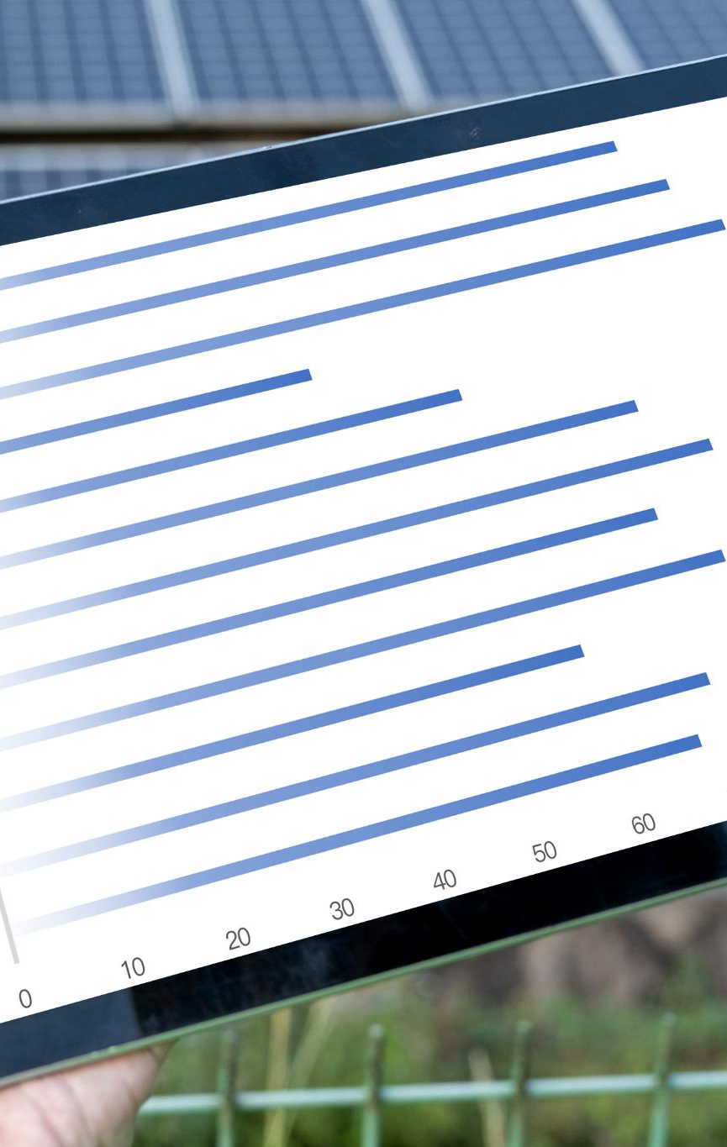
References
FAO Reports
  FAO provides extensive reports on smart agriculture and efficient water management practices.
IEEE Publications
  IEEE offers technical insights into IoT and AI applications within agricultural systems.
ResearchGate Papers
  ResearchGate hosts numerous academic papers on design and implementation of smart irrigation.
World Bank Data
  World Bank provides valuable data and analysis on water management impact in agriculture.
Notes:
To support the insights presented in this discussion on smart irrigation, several authoritative sources have been referenced. The Food and Agriculture Organization (FAO) provides comprehensive reports on smart agriculture and water management strategies. IEEE publications offer technical perspectives on the application of IoT and AI in agricultural contexts. ResearchGate hosts numerous academic papers detailing the design and implementation of smart irrigation systems. The World Bank contributes valuable data and analysis on water management technologies and their impact on global agriculture. These resources collectively offer a robust foundation for understanding the current state and future potential of smart irrigation technologies.

