Slide 1
Searching (Linear search,Binary searching,jump search)
Ad : FərId
Soyad : ƏhmədlI
Qrup:AF204

Slide 2
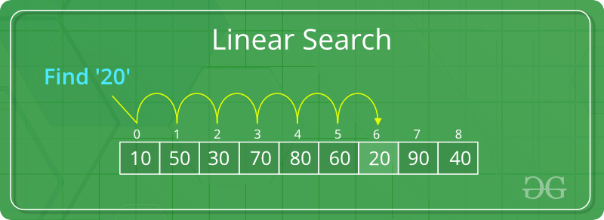
Based on the type of search operation, these algorithms are generally classified into two categories:
Sequential Search: In this, the list or array is traversed sequentially and every element is checked. For example: Linear search.
Linear Search to find the element “20” in a given list of numbers

Slide 3
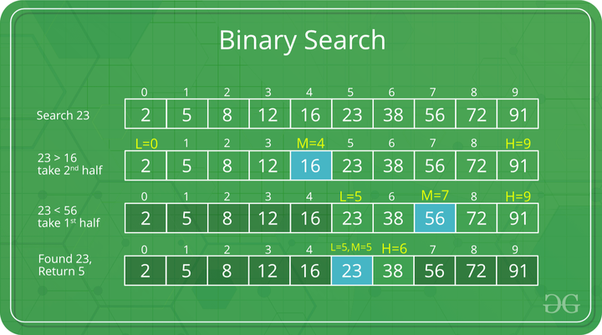
Interval Search: These algorithms are specifically designed for searching in sorted data-structures. These type of searching algorithms are much more efficient than Linear Search as they repeatedly target the center of the search structure and divide the search space in half. For Example: Binary Search.
Binary Search to find the element “23” in a given list of numbers

Slide 4
Like Binary Search, Jump Search is a searching algorithm for sorted arrays. The basic idea is to check fewer elements (than linear search) by jumping ahead by fixed steps or skipping some elements in place of searching all elements. For example, suppose we have an array arr[] of size n and a block (to be jumped) of size m. Then we search in the indexes arr[0], arr[m], arr[2m]…..arr[km] and so on. Once we find the interval (arr[km] < x < arr[(k+1)m]), we perform a linear search operation from the index km to find the element x.

Slide 5
Let’s consider the following array: (0, 1, 1, 2, 3, 5, 8, 13, 21, 34, 55, 89, 144, 233, 377, 610). The length of the array is 16. The Jump search will find the value of 55 with the following steps assuming that the block size to be jumped is 4. STEP 1: Jump from index 0 to index 4; STEP 2: Jump from index 4 to index 8; STEP 3: Jump from index 8 to index 12; STEP 4: Since the element at index 12 is greater than 55, we will jump back a step to come to index 8. STEP 5: Perform a linear search from index 8 to get the element 55.

Slide 6
Performance in comparison to linear and binary search:
If we compare it with linear and binary search then it comes out then it is better than linear search but not better than binary search.
The increasing order of performance is:
linear search < jump search < binary search

