Slide 1

HashSet LinkedSet TreeSet
AKHIL MURALI AMITHA MARY BENNY DEVIKA BIJO MEENAKSHI SAJEEVAN

Slide 2

HashSet
Uses hash table for storage
Inherits the AbstractSet class and implements Set interface
Time Complexity of HashSet Operations: O(1)
Declaration:
public class HashSet<E> extends AbstractSet<E> implements Set<E>, Cloneable, Serializable

Slide 3
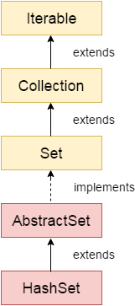
HashSet
Hierarchy

Slide 4
HashSet
Features
Stores the elements using hashing
Contains unique elements
Allows null value
Class is non synchronized
Doesn't maintain the insertion order
Best approach for search operations

Slide 5
HashSet
When to use
High-performance set operations
Elements that do not repeat and have no attribute order
Notes:
such as the intersection of two sets, the set of differences and so on.

Slide 6
HashSet
Advantages
Represents a set of values
Provides high-performance operations.

Slide 7
HashSet
Constructors
HashSet()
HashSet<E> hs = new HashSet<E>();
2. HashSet(int capacity)
HashSet<E> hs = new HashSet<E>(int initialCapacity);

Slide 8
HashSet
Constructors
3. HashSet(int capacity, float loadFactor)
HashSet<E> hs = new HashSet<E>(int initialCapacity, float loadFactor);
4. HashSet(Collection):
HashSet<E> hs = new HashSet<E>(Collection C);

Slide 9
HashSet
Methods
add(): used to add the specified element if it is not present.
hs.add("Geek");
remove(): remove the specified element if it is present.
hs.remove("B");
iterator(): return an iterator over the elements in this set.
Iterator itr = hs.iterator();

Slide 10
HashSet
Methods
clear(): remove all of the elements from the set.
clone(): return a shallow copy of this HashSet instance.
contains(object): return true if this set contains the specified element.

Slide 11
HashSet
Methods
isEmpty(): return true if this set contains no elements.
size(): return the number of elements in the set.
Spliterator(): To create a late-binding and fail-fast Spliterator over the elements in the set.

Slide 12
HashSet
LinkedHashSet
TreeSet

Slide 13
LinkedHashSet
Hashtable and Linked list implementation of Set interface
Contains unique elements
Provides all optional set operations and permits null elements
Non-synchronized
Maintains insertion order

Slide 14
Class Declaration
LinkedHashSet
public class LinkedHashSet<E> extends HashSet<E> implements Set<E>, Cloneable, Serializable
LinkedHashSet<String> set=new LinkedHashSet();

Slide 15
LinkedHashSet
Constructors
LinkedHashSet()
LinkedHashSet<E> hs = new LinkedHashSet<E>();
LinkedHashSet(Collection c)
LinkedHashSet<E> hs = newLinkedHashSet<E>(Collection c);

Slide 16
LinkedHashSet
Constructors
LinkedHashSet(int size)
LinkedHashSet<E> hs = new LinkedHashSet<E>(int size);
LinkedHashSet(int capacity, float fillRatio)
LinkedHashSet<E> hs = new LinkedHashSet<E>(int capacity, int fillRatio);

Slide 17
LinkedHashSet
When to use?
It contains only a unique element like HashSet
It maintains an insertion order
Whenever we want to store the unique elements with their insertion order, then we can use LinkedHashSet.

Slide 18
LinkedHashSet
Inserting Elements
add() - inserts the specified element to the linked hash set
addAll() - inserts all the elements of the specified collection to the linked hash set

Slide 19
LinkedHashSet
Methods
clear() - Removes all of the elements from this set.
size() - Returns the number of elements in this set.
equals(Object o) - Compares the specified object with this set for equality.
hashCode() - Returns the hash code value for this set.

Slide 20
LinkedHashSet
Methods
toArray() - Returns an array containing all of the elements in this collection.
toString() - Returns a string representation of this collection.
contains(element) -This method is used to check whether a specific element is present in the Set or not.

Slide 21
LinkedHashSet
Methods
iterator()- return the iterator of the set.
remove(element) - remove the given element from the set.
removeAll(collection) -remove all the elements from the collection which are present in the set.
retainAll(collection) -retain all the elements from the set .

Slide 22
HashSet vs LinkedHashSet
LinkedHashSet
Property | HashSet | LinkedHashSet
Data structure | Uses Hashtable | Uses HashTable and doubly linked list
Technique to store the elements | Hashing | Hashing
Declaration | HashSet obj = new HashSet(); | LinkedHashSet obj = new LinkedHashSet();
Implements | Set interface | Set interface
Insertion Order | Does not provide any insertion order | Provides an insertion order
Null elements | Only one null element | Only one null element

Slide 23
HashSet
LinkedHashSet
TreeSet

Slide 24
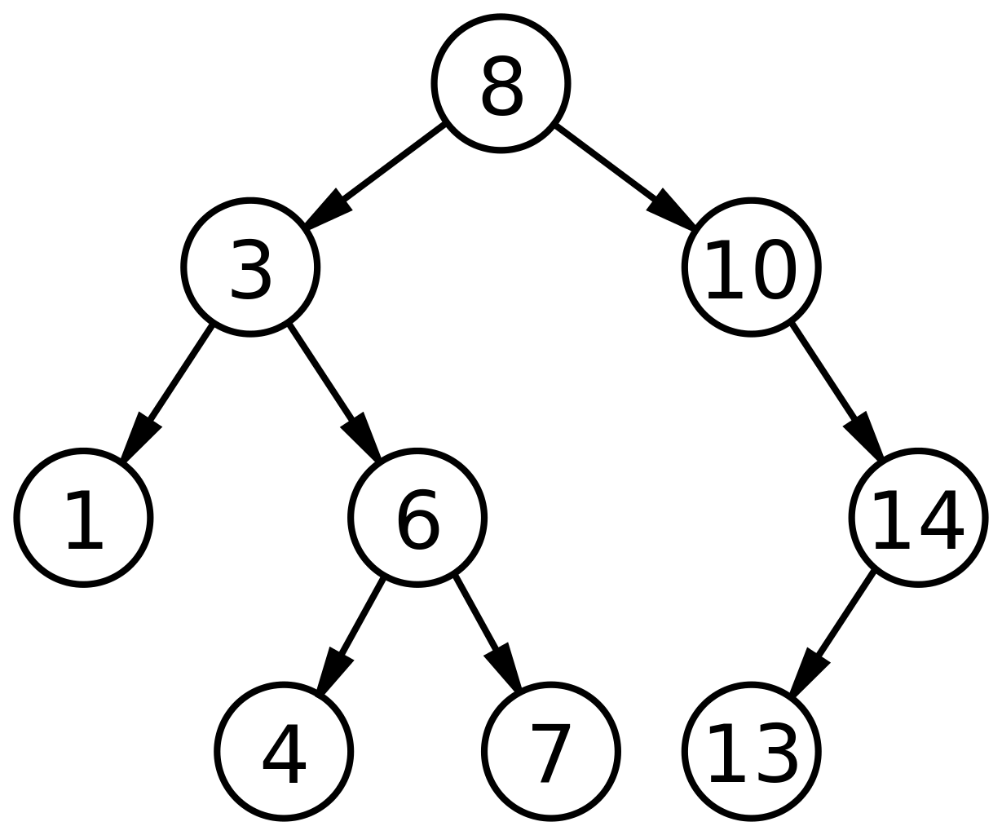


TreeSet

Slide 25
TreeSet
Balanced tree (BST)
Duplicate objects are not allowed
Insertion order is not preserved
Heterogeneous objects are not allowed
Null insertion is allowed, only once
Non synchronized

Slide 26
TreeSet
Initialization of TreeSet
Import java.util.TreeSet;
TreeSet<DataType> objectName = new TreeSet<>();
TreeSet<Integer> myPrimeNumbers = new TreeSet<>();

Slide 27
TreeSet
Constructors of TreeSet
TreeSet t = new TreeSet();
TreeSet t = new TreeSet(Comparator c);
TreeSet t = new TreeSet(Collection c);
TreeSet t = new TreeSet(SortedSet s);

Slide 28


TreeSet
CODE

Slide 29
TreeSet
When To Use
Unique elements
Faster access and retrieval of sorted info

Slide 30
HashSet
LinkedHashSet
TreeSet

Slide 31
THANK YOU
Akhil Murali (akhil.murali@ust.com)
Amitha Mary Benny (amitha.marybenny@ust.com)
Devika Bijo (devika.bijo@ust.com)
Meenakshi Sajeevan (meenakshi.sajeevan@ust.com)

