Slide 1
Managing the Linux file system

Slide 2
Managing the Linux file system
Describe the Linux file system
Complete common file system tasks
Manage disk partitions
Use removable media
Back up data

Slide 3
Describe the Linux file system
- The Role of the Linux File System
- The Hierarchical Structure of the Linux File System
- Types of Files Used by Linux
-

Slide 4
The Role of the Linux File System
- The data is organized and can be easily located (Các dữ liệu được tổ chức và có thể dễ dàng bảo quản ).
- The data can be easily retrieved at any later point in time (Các dữ liệu có thể dễ dàng truy xuất sau này tại bất kỳ điểm nào.)‏
-The integrity of the data is preserved (Sự tích hợp của dữ liệu được bảo tồn.)‏

Slide 5
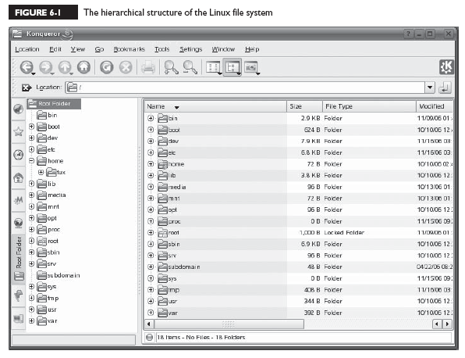
The Hierarchical Structure of the Linux File System

Slide 6
Notice that the topmost directory in the structure is the / directory, also called the root directory.
Beneath the root directory are a series of subdirectories. Specifications for how these directories are to be named are contained in the File system Hierarchy Standard (FHS)‏

Slide 7
/bin
This directory contains executable files necessary to manage and run the Linux system, including shells (such as bash) and file system management utilities such as cp and rm.

Slide 8
/boot
This directory contains your bootloader files, which are required to boot your system

Slide 9
/dev
This directory contains special files that are used to represent the various hardware devices installed in the system
EX: hda, hdb ...

Slide 10
/etc
This directory contains text-based configuration files used by the system as well as services running on the system. You can edit these files with a text editor to customize how Linux behaves

Slide 11
/home
This directory contains subdirectories that serve as home directories for each user account on your Linux system.

Slide 12
/lib
This directory contains code libraries used by programs in /bin and /sbin. Your kernel modules are also stored in the modules subdirectory of /lib.

Slide 13
/media
This directory is used by some Linux distributions (such as SUSE Linux) to mount external devices, including CD drives, DVD drives, and floppy drives.

Slide 14
/mnt
This directory is used by some Linux distributions (such as Fedora or Red Hat) to mount external devices, including CD drives, DVD drives, and floppy drives

Slide 15
/opt
This directory contains files for some programs you install on the system

Slide 16
/proc
This directory is a little different from the other directories in this list.
/proc doesn’t actually exist in the file system
Within /proc are a number of different subdirectories,Notice that each of these subdirectories is identified with a number, not a name. These numbers correspond to the process ID (PID) number of theassociated process running on the system

Slide 17
/root
This directory is the root user’s home directory. Notice that it is located separately from the home directories for other users in /home.

Slide 18
/sbin
This directory contains important system management and administration files, such as fdisk, fsck, ifconfig, init, mkfs, shutdown, and halt.

Slide 19
/srv
This directory contains subdirectories where services running on the system (such as httpd and ftpd) save their files.

Slide 20
/sys
This directory contains information about the hardware in your system.

Slide 21
/tmp
This directory contains temporary files created by you or by the system.

Slide 22
/usr
This directory contains application files. In fact, most of the application files used on your system are saved in a subdirectory of /usr

Slide 23
/var
This directory contains a variety of variable data, including your system log files

Slide 24
Types of Files Used by Linux
With a Windows file system you basically have two entry types in the file system: Directories & Files. You can have normal files, hidden files, shortcut files, word processing files, executable files, and so on.
With Linux, however, there are a variety of different file types used by the file system.

Slide 25
Linux File Types
Regular files: These files are similar to those used by the file systems of other operating systems - forexample, executable files, OpenOffice.org files, images, text configuration files, etc.
Links : These files are pointers that point to other files in the file system.

Slide 26
Linux File Types
FIFOs: FIFO stands for First In First Out. These are special files used to move data from one running process on the system to another. A FIFO file is basically a queue where the first chunk of data added to the queue is the first chunk of data removed from the queue. Data can only move in one direction through a FIFO.
Sockets: Sockets are similar to FIFOs in that they are used to transfer information between sockets. With a socket, however, data can move bi-directionally.

Slide 27
2. Complete Common File System Tasks
Navigating the file system
Managing files and directories
Running executable files
Searching the file system

Slide 28
With Linux, however, you should become proficient with the shell commands first and then use the GUI utilities for convenience
Reasons?
Most employers and co-workers won’t take you seriously as a Linux administrator if you can’t use the shell prompt. It just goes with the territory.

Slide 29
Many Linux systems, especially those deployed as servers, don’t run X Windows. Supporting a GUI environment requires a lot of CPU overhead. Many server admins prefer to devote those CPU cycles to system services instead of moving the mouse cursor on the screen. In this situation, you need to know how to do things from the shell prompt.
You need to know how to complete these tasks from the shell prompt to pass your Linux+ exam.

Slide 30
Navigating the File System
Pwd (Present Working Directory)‏
cd
ls

Slide 31
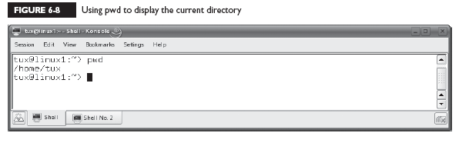
Using the pwd Command

Slide 32
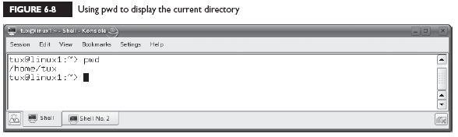
Using the cd Command

Slide 33
cd
If you enter cd at the shell prompt without specifying a path, it will automatically change directories to the home directory of the currently logged-in user.

Slide 34
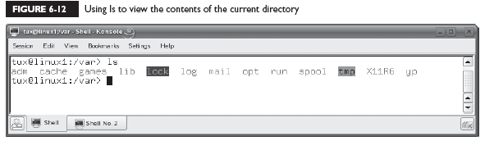
Using the ls Command

Slide 35
ls
–a Displays all files, including hidden files.
–l Displays a long listing of the directory contents. This is a very useful option. You can use it to see the file names, ownership, permissions, modification date, and size.
–R Displays directory contents recursively; that is, it displays the contents of the current directory as well as the contents of all subdirectories.

Slide 36
Managing files and directories
Creating files and directories
Viewing file contents
Deleting files and directories
Copying and moving files and directories
Creating links

Slide 37
Creating Files and Directories
touch new_file

Slide 38
Creating Files and Directories
mkdir new_directory

Slide 39
Viewing Text File Contents
cat
less
head
tail

Slide 40
cat
The cat filename command will display the specified text file on screen. This command doesn’t pause the output, so if you use it to view a long file, you may need to append |more to the command to pause the output a page a time.

Slide 41
less
The less filename command can also be used to display the specified text file on screen, much like cat. However, the less command automatically pauses a long text file one page at time.

Slide 42
head
The head filename command is used to display the first couple of lines of a text file on the screen.

Slide 43
tail
The tail filename command is used to display the last couple of lines of a text file on screen. The tail command is particularly useful when displaying a log file on screen. When viewing a log file, you probably only want to see the end of the file.
The tail command also includes the –f option, which is very useful. You can use this to monitor the file specified in the command

Slide 44
Deleting Files and Directories
rmdir
rm

Slide 45
rmdir
This utility can be used to delete an existing directory. To use it, simply enter rmdir directory_name—for example, rmdir MyFiles. Be aware, however, that rmdir requires that the directory be empty before it will delete it.

Slide 46
rm
The rm utility is a more powerful deletion utility that can be used to delete either a file or a populated directory. To delete a file, simply enter rm filename. To delete a directory, enter rm –r directory_name.

Slide 47
rm
Be careful with rm! By default, it won’t prompt you to confirm a deletion operation. It assumes that you really meant to delete the file or directory. If you want rm to prompt you before deleting a file or directory, include the –i option.

Slide 48
Copying and Moving Files and Directories
cp
mv

Slide 49
cp
This utility is used to copy files or entire directory structures from one location in the file system to another. For example, to copy a file named /tmp/schedule.txt to your home directory, you could enter
cp /tmp/schedule.txt ~.

Slide 50
mv
The mv command is used much like cp. However, it will copy the specified file to the new location in the file system and then delete the original. For example, to move a file named mylog.txt from /tmp to /var/log, you would enter mv /tmp/mylog.txt /var/log

Slide 51
mv
The mv command is also used to rename files. Simply enter mv followed by the file to be renamed and then the new file name. For example, to rename schedule.txt to schedule.old, you would enter
mv schedule.txt schedule.old.

Slide 52
Creating Links
Hard
Symbolic

Slide 53
Hard
A hard link is a file that points directly to the inode of another file. An inode stores basic information about a file in the Linux file system, including its size, device, owner, and permissions. Because the two files use the same inode, you can’t tell which file is the pointer and which is the pointee after the hard link is created.

Slide 54
Symbolic
A symbolic link file also points to another file in the file system. However, a file that is a symbolic link has its own inode. Because the pointer file has its own inode, the pointer and the pointee in the file system can be easily identified. For example, in the previous chapter, you saw that the vi file is symbolic-linked to the vim file.

Slide 55
syntax
ln pointee_ file pointer_file
Using ln without any options creates a hard link
If you want to create a symbolic link, you use the –s option

Slide 56
Running Executables
For example, you’ve used the man, vi, and cp
programs to accomplish various tasks on your system. These programs are executable files that exist in the Linux file system and are loaded into memory when you call them from the shell prompt
which command

Slide 57
You can view all of your environment variables by entering env |more or echo $PATH at the shell prompt.
To add the path to the executable to your PATH
environment variable. Enter
PATH=$PATH:new_path

Slide 58
For example, if you wanted to add a directory named apps in your vmk’s home directory to the
PATH variable, you would enter
PATH=$PATH:/home/vmk/apps
After adding the path, you must then export the new variable by entering export PATH at the shell prompt. You can then check your PATH variable by
entering echo $PATH at the shell promp

Slide 59
Searching the File System
Using find
Using locate
Using grep

Slide 60
Using find
The find utility is fantastic tool that you can use to search the Linux file system. To use find, enter at the shell prompt
find path –name “filename”
For example, suppose you wanted to find all of
the log files stored in your file system that have a .log extension. You could enter
find / –name “*.log”

Slide 61
The find utility is flexible. You can also use the –user “username” option to search for files owned by a specific user, or use the
–size “size” option to search for files of a specified size.
You can use a + sign before the size value to search for files larger than the specified size, or a – sign before the size value to search for files smaller than the specified size. The find utility has many other options

Slide 62
Using locate
The locate utility functions in much the same manner as find. However, it has one distinct advantage over find. Whenever you execute a search with find, it manually walks through each directory in the path you name in the command looking for the specified files. This process can take some time.

Slide 63
locate
Alternatively, the locate utility builds an index of the files in the file system. Then, when you execute a search, locate simply runs a query of the index. It doesn’t actually search the file system directly. The result is that locate runs much faster than find in most situations.To use locate, you must first install the findutils-locate package on your system.

Slide 64
With the index updated, you can search for files by simply entering:
locate filename
at the shell prompt. For example, if you wanted to search for a file named snmpd.conf, you could enter locate snmpd.conf

Slide 65
Using grep
Linux also provides a utility called grep that you can use to search for content within a file. Using grep, you can search through a file for a particular text string. To use grep, you would enter grep search_text file. For example, let’s suppose you want to want to search through your /var/log/messages file for any log entries related to the VNC service running on your Linux system. You would enter
grep vnc /var/log/messages

Slide 66
grep
options:
–i Ignores case when searching for the search text.
–l Doesn’t display the actual matching line of text. Only displays the names of the files that contain the matching text.
–r Searches recursively through subdirectories of the path specified.

Slide 67
3. Manage Disk Partitions
Using fdisk to create disk partitions
Building a file system with mkfs
Mounting a partition with mount
Checking the file system with fsck

Slide 68
Using fdisk to Create Disk Partitions
The fdisk utility is used from the command line to create or delete partitions at the shell prompt. To use fdisk to create a new partition, first open a terminal session. Then, at the shell prompt, change to your root account by entering su – followed by
your root user’s password.

Slide 69
fdisk
At the shell prompt, enter fdisk device. For example, if you wanted to create a partition on the third SCSI hard disk in your system, you would enter
fdisk /dev/sdc

Slide 70
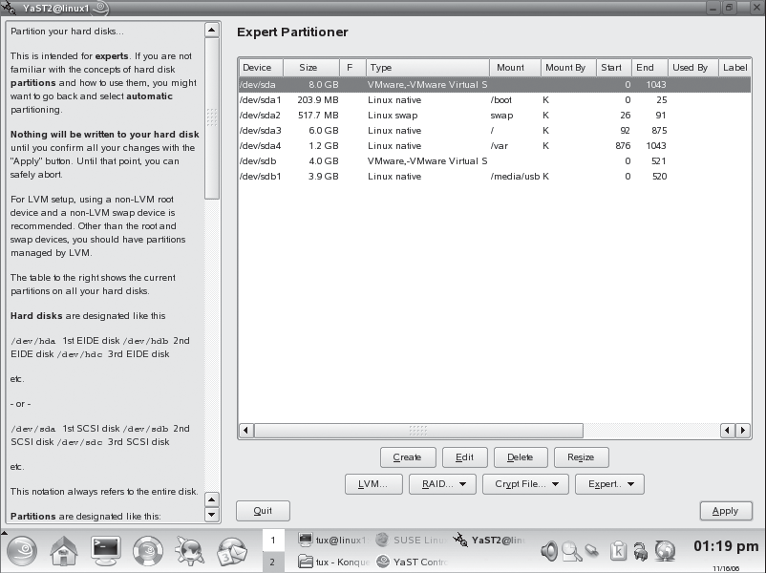

Slide 71
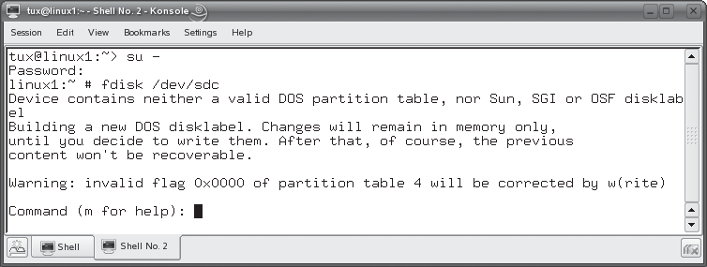
With fdisk running, you have a Command: prompt that you can use to enter fdisk commands

Slide 72
Before creating a partition, you should press P to view any existing partitions on the disk. This will help you determine if there is sufficient space and, if there is, what number must be assigned to a new partition created on the disk.
To create a new partition, you press N. You can then specify whether you want to create a primary disk partition or an extended disk partition.

Slide 73
To create a primary partition, press P when prompted.
To create an extended partition, press E
For example: You could press T and specify a partition ID of 82 if you wanted to change the
partition to a swap partition.

Slide 74
Building a file system with mkfs
Even though we’ve created a partition with fdisk, we can’t use it yet. That’s because it hasn’t been formatted with a file system yet. This is accomplished using one of the following commands:
mkfs
mkreiserfs

Slide 75
mkfs
This utility is used to make an ext2 or ext3 file system on a partition. You can even use it to create a FAT file system on the partition (which is used by Windows and DOS). You specify which file system you want to use by entering the –t option and the type of file system. For example, if you wanted to create an ext3 file system on the first partition on your third SCSI hard disk drive in your system, you would enter mkfs –t ext3 /dev/sdc1

Slide 76
mkreiserfs
This utility is used to make a Reiser file system on a partition. For example, if you wanted to create a Reiser file system on the first partition on your third SCSI hard drive in your system, you would enter
mkreiserfs /dev/sdc1
When you do, a screen is displayed and a proposal is presented. Many of these parameters can be customized using mkreiserfs options.

Slide 77
Mounting a Partition with mount
One of the key differences between Linux and other operating systems (such as Windows) is the fact that you need to mount a file system before you can use it. This is another one of those “gotchas” that trip up new Linux administrators. You even
have to mount CDs, DVDs, and floppies before you can use them!

Slide 78
Such as Windows, reference partitions on the
disk using a drive letter, such as C: or D ...
Not so with Linux! Linux instead uses a virtual file system (VFS) that creates a single hierarchy that encompasses all partitions on all storage devices in the system. Switching to the directory where the partition is mounted switches you to that partition.

Slide 79
mount
To use mount to mount a partition, first switch to your root account using su. Then enter
mount –t file_system_type device mount_point
at the shell prompt. For example,
mount –t reiserfs /dev/sdc1 /mnt/extraspace
If you don’t know what type of file system is used by the partition, you can use the –a option with mount instead of –t. This will cause mount to try to mount the partition using all supported file system types until one is successful.

Slide 80
umount
If, for some reason, you wanted to unmount a partition, you can use the umount command. To umount a partition, simply enter umount followed by the device or the mount directory for the partition. For example,
umount /dev/sdc1
or
umount /mnt/extraspace.

Slide 81
You can also use command-line utilities to create and mount swap partitions on your Linux system. You can create swap partitions using the mkswap command. First, create the partition that will be used as a swap partition using fdisk. Then enter mkswap device at the shell prompt. For example, to covert the second partition on the second IDE hard drive in your system to a swap partition, you would enter mkswap /dev/hdb2 at the shell prompt. After converting the partition to a swap partition, you need to enable it using the /sbin/swapon command.

Slide 82
Checking the File System with fsck
Syntax: fsck device
For example if you wanted to check the file system on the first partition of the third SCSI hard drive in your system, you would enter fsck /dev/sdc1. The utility will then check the file system and report any errors encountered (or the lack thereof)‏

Slide 83
4. Use Removable Media
Working with floppies
Working with optical devices
Working with USB and FireWire devices

Slide 84
Working with Floppies
Syntax: mount –t vfat device mount_point
On other distributions, such as Red Hat or Fedora, the default mount point for floppy diskettes is /mnt/floppy
EX: mount –t vfat /dev/fd0 /media/floppy

Slide 85
Therefore, you can simply enter mount /dev/fd0 at the shell prompt and the floppy will be automatically mounted using these parameters.
Before you remove a mounted floppy diskette from a drive, you must also unmount it. Just as with partitions, this is done using the umount command. To unmount a floppy, you enter umount device or umount mount_point. For example, to unmount your A: drive, you would enter umount /dev/fd0

Slide 86
Working with Optical Devices
/media/cdrom
/media/cdrecorder
/media/dvd

Slide 87
On distributions such as Red Hat or Fedora, your directories for mounting optical
devices are located in /mnt.
To mount a CD on a Linux system, insert it in your CD drive. Change to your root account and then enter mount –t iso9660 device mount_point. For example, mount –t iso9660 /dev/hdc /media/cdrom
As with any mounted file system, you should use umount to unmount a CD or DVD before ejecting it.

Slide 88
Working with USB and FireWire Devices
mount –t auto device mount_point
ex:
mount –t auto /dev/sdd /media/ THUMBDRIVE

Slide 89
5. Back Up Data
Selecting a backup medium
Selecting a backup strategy
Using Linux backup utilities

Slide 90
Selecting a Backup Medium
“old days”: floppies or a tape drive
Today, USB or FireWire hard drive

Slide 91
Selecting a Backup Strategy
Selecting a backup type
Selecting a backup schedule
Determining what to back up

Slide 92
Selecting a Backup Type
Full
Incremental: During an incremental backup, only the files that have been modified since the last backup (full or incremental) are backed up. After being backed up, each file is flagged as having been backed up.
Differential: only the files that have been modified since the last full backup are backed up

Slide 93
Selecting a Backup Schedule
You can use whatever backup schedule works best for you. However, most admins work on a weekly rotation, as discussed previously. Pick one day for your full backup and then the remaining days of the week for your incremental or differential backups. You should also schedule your backups to occur when the load on the system is at its lightest. Late in the evening or in the early morning are usually best, depending on your organization’s schedule.

Slide 94
Determining What to Back Up
/etc
/home
/opt
/root
/var
/srv

Slide 95
Using Linux Backup Utilities
Using tar
Using cpio

Slide 96
Using tar
The tar utility has been around for a very long time and is a very commonly used Linux backup tool. The acronym “tar” stands for tape archive. The tar utility takes a list of specified files and copies them into a single archive file (.tar). The .tar file can then be compressed with the gzip utility on your Linux system, resulting in a file with a .tar.gz extension.

Slide 97
tar
Syntax: tar –cvf filename directory
The –c option tells tar to create a new archive.
The –v option tells tar to work in verbose mode, displaying each file being backed up on screen.
The –f option specifies the name of the tar archive to be created.
Ex: tar –cvf /media/usb/backup.tar /home

Slide 98
To restore a tar archive, simply enter
tar –xvf filename
ex: tar –xvf /media/usb/backup.tar
If the archive has been zipped, you can also use the –z option to unzip the archive before extracting it

Slide 99
Using cpio
The cpio utility can also be used to make archive files just like tar. A key difference between tar and cpio is the fact that you must provide cpio with a list of files and directories to back up from the standard input
Syntax: cpio -ov file,directory > file.cpio
The –o option tells cpio to create a new archive. The –v option simply tells cpio to run verbosely, displaying the name of each file and directory as it’s processed

Slide 100
we could extract the archive we just created by entering cpio –iv < file.cpio

