Slide 1
Can We Improve It? Four Experiments
Idea 1 — TCMB shock filter ✓ works
• So any delta is the idea, not the engine.
• All on the full 560-ticker universe, committed capital,
real TÜİK CPI + real TCMB policy-rate history.
• Baseline here: Sharpe −0.39 (stricter full-universe cut).
Idea 5 — 3σ stop-loss ✓✓ strongest
Idea 2 — Real (CPI) prices ✗ fails
Idea 3 — Cross-listing ⚠ cautionary

Slide 2
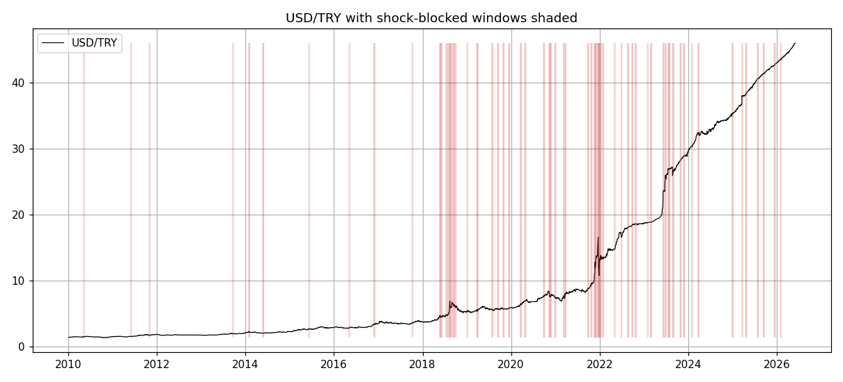
Idea 1 — TCMB Policy-Shock Filter
Concept
• GGR assumes the spread mean-reverts. That breaks during macro shocks: both legs gap the same way, the spread diverges and never reverts inside the 6-month window.
• Fix: block NEW entries for a few days after a shock — a TCMB rate surprise, a >3% USD/TRY day, or an unusually high CPI print. Positions already open are left to exit normally.
• Real data: TCMB rate history, the Survey of Market Participants (consensus), USD/TRY and TÜİK CPI. 8.2% of trading days end up blocked.
• Result: Sharpe −0.39 → −0.37, Max DD 69% → 67.6%, −147 trades.
Max DD −1.6 pts
Robust: cuts tail risk, returns intact

Slide 3
Idea 1 — Defining a “Shock” Rigorously
• A surprise is not a big move — it is a move the market did not expect. We use the TCMB Survey of Market Participants consensus: surprise = actual decision − consensus expectation (> 50 bp). No look-ahead — the consensus is published before the meeting.
• We also fixed the CPI trigger. A fixed “MoM > 2%” fires almost every month in 2022-23 (monthly inflation was 3-7%), so it just switches the strategy off in bad years. We made it RELATIVE — flag only prints unusually high versus the trailing-12-month trend.
• The more rigorously we define a shock, the smaller the measured benefit — the crude proxy was over-blocking: +0.037 → +0.029 → +0.017 Sharpe. The genuine, defensible benefit is modest and concentrated in drawdown.
• Why consensus matters — the 2023 “U-turn”: by magnitude it is a huge +650 bp hawkish shock. But the survey expected 17.6% and the bank delivered 15% — a −256 bp DOVISH surprise. Without consensus data, even the SIGN of the surprise is wrong.
+0.017 Sharpe (honest)
Rigor shrinks the number but makes it real — benefit is mostly in drawdown

Slide 4
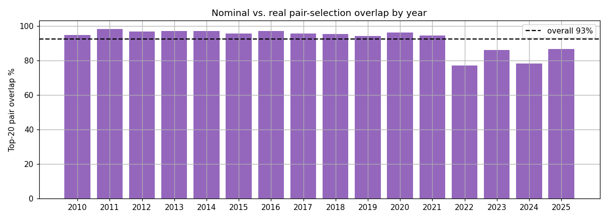
Idea 2 — Real (CPI-Adjusted) Pair Formation
Hypothesis
• On BIST, chronic inflation lifts every TRY price series, so two stocks can look tightly co-moving just because inflation pushed both up — a ‘phantom’ pair with no real economic link.
• Idea: deflate every price by CPI before ranking, so the SSD captures real (purchasing-power) co-movement instead of a shared inflation trend.
• Math finding: CPI is the SAME for all stocks, so it factors out of the spread as one time factor — deflation only TIME-WEIGHTS the SSD (down-weighting recent, high-CPI days). A common factor cannot remove a trend from a difference.
• Result: overlap with the nominal selection drops in high-inflation years (77% in 2022), so it does re-rank pairs — but they perform worse: Sharpe −0.39 → −0.43.
Negative result
…but we proved WHY, mathematically

Slide 5
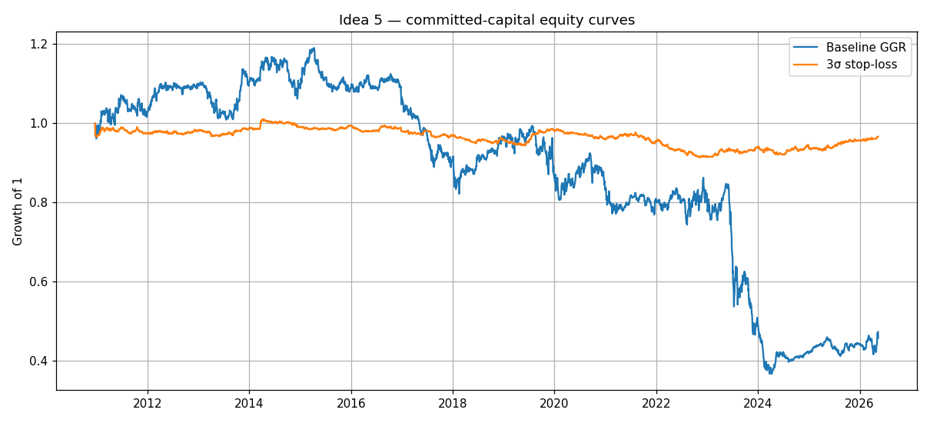
Idea 5 — 3σ Stop-Loss (the winner)
Concept
• GGR never stops out: a trade runs until the spread crosses zero or the 6-month window ends. A pair that blows out to 5-10σ bleeds for months.
• Do & Faff (2010): a pair that reaches 3σ is usually structurally broken (merger, shock), not a temporary mispricing.
• One rule added: close at 3σ for a loss AND stop re-trading that broken pair — otherwise it re-enters every bar while still beyond 3σ.
Stop-threshold sensitivity
2.5σ −0.07 | 3.0σ −0.11 | 3.5σ +0.15
Max DD 69% → 10%
3.5σ turns Sharpe POSITIVE (+0.15)

Slide 6
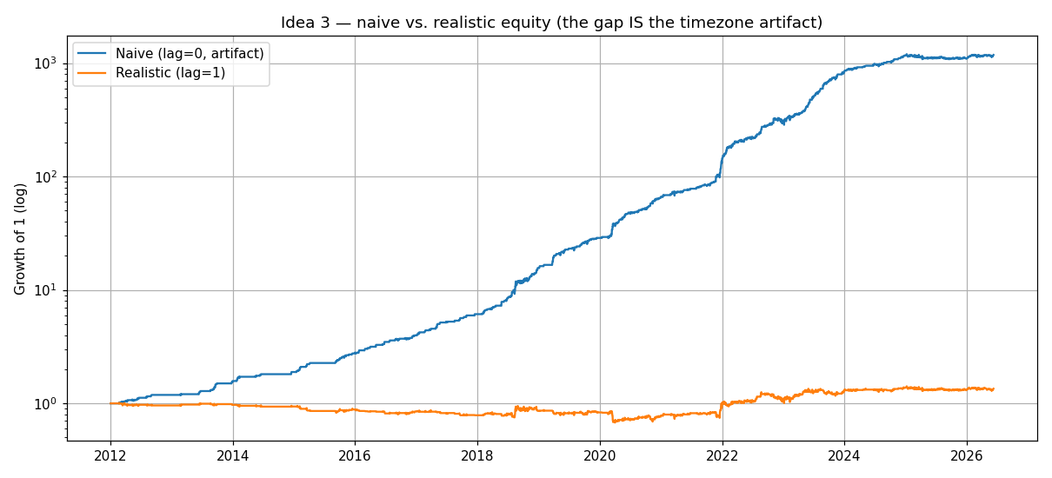
Idea 3 — Cross-Listing Arb (TCELL.IS vs TKC)
Concept
• Same company, two markets: BIST TCELL.IS (TRY) and its NYSE ADR TKC (USD), linked by USD/TRY. Parity: ADR = TCELL × ratio / USDTRY; the empirical ratio 2.445 ≈ the documented 2.5, which validates the data.
• Trap: a naive same-date backtest looks spectacular — Sharpe 3.7, 99% win, six-figure return. That is a TIMEZONE artifact: BIST closes ~5h before NYSE, so a same-date ‘gap’ is partly a stale BIST quote that ‘reverts’ the next day.
• Fix: execute on the next bar — you cannot trade at the stale close. The edge collapses; only wide (≥2%) thresholds leave a weak Sharpe ~0.3 with large FX-driven drawdowns.
Naive ≠ real
A naive backtest lies

Slide 7
What We Learned
✓ Idea 1 (shock filter) and Idea 5 (3σ stop) genuinely improve the strategy — the 3σ stop is the standout, cutting max drawdown from 69% to 10%.
✗ Idea 2 (real prices) fails — and we proved mathematically why: CPI deflation only re-weights the SSD in time, it cannot remove a shared inflation trend.
⚠ Idea 3 (cross-listing) is a cautionary tale: a naive same-date backtest manufactures a fake edge from non-synchronous closes.
→ Honest research means reporting the failures and understanding them. Because our engine is bit-identical to the baseline, every delta is real.

Slide 8
Data Limitations (and how we worked around them)
• Survivorship bias: Yahoo Finance only serves surviving tickers. We manually added delisted names (ROYAL, YGYO, …) from IsYatirim spreadsheets.
• No bid-ask on BIST: we cannot measure the real spread, so we approximate trading cost two ways — a one-day execution delay (paper’s Panel B) and an explicit per-trade commission (0/5/10/20 bps).
• No professional terminal: without Bloomberg/Refinitiv we could not get clean intraday or full point-in-time data — which is exactly why Idea 3 cannot be settled on daily closes.
• Implication: results are directionally trustworthy but not execution-ready; a real deployment needs clean, point-in-time, intraday data.

