Slide 1
Decision Point for Mediating API and Microservices Communication
Downloadable Figures
Steve Deng
Notes:
Presenter's Name
Presenter's Name

Slide 2
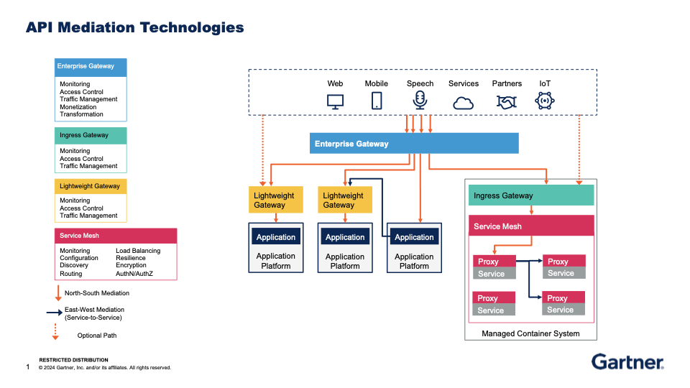
New Figure 1

Slide 3
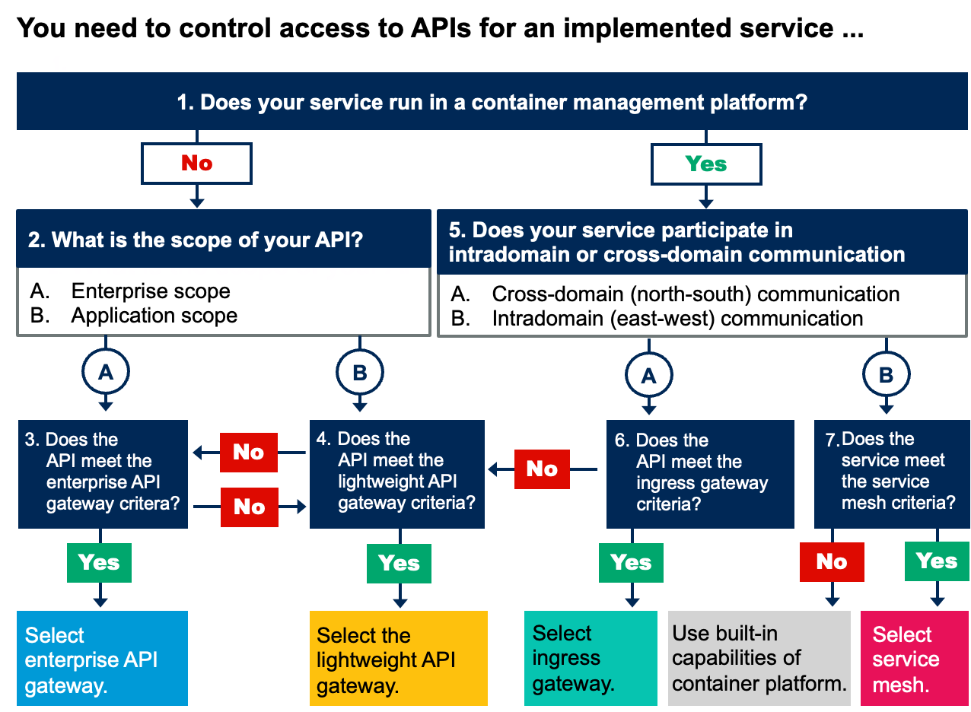
New Figure 2

Slide 4
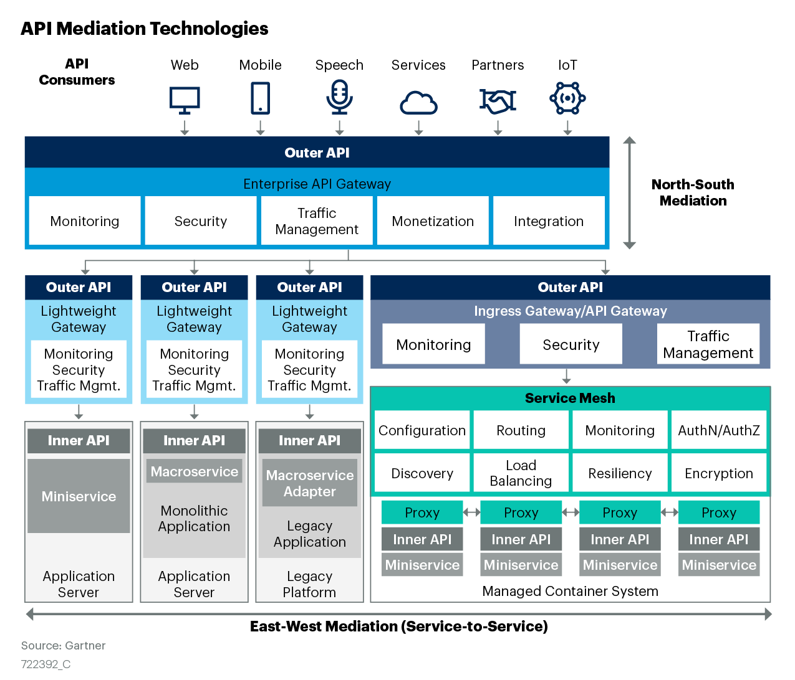
Figure 1

Slide 5
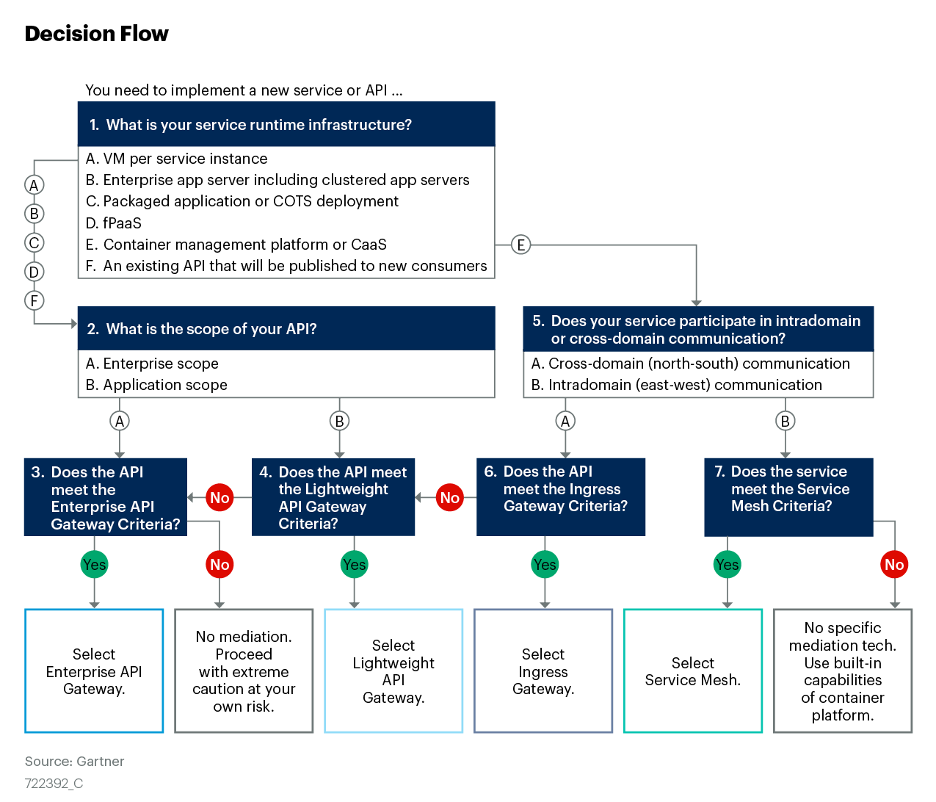
Figure 2

Slide 6
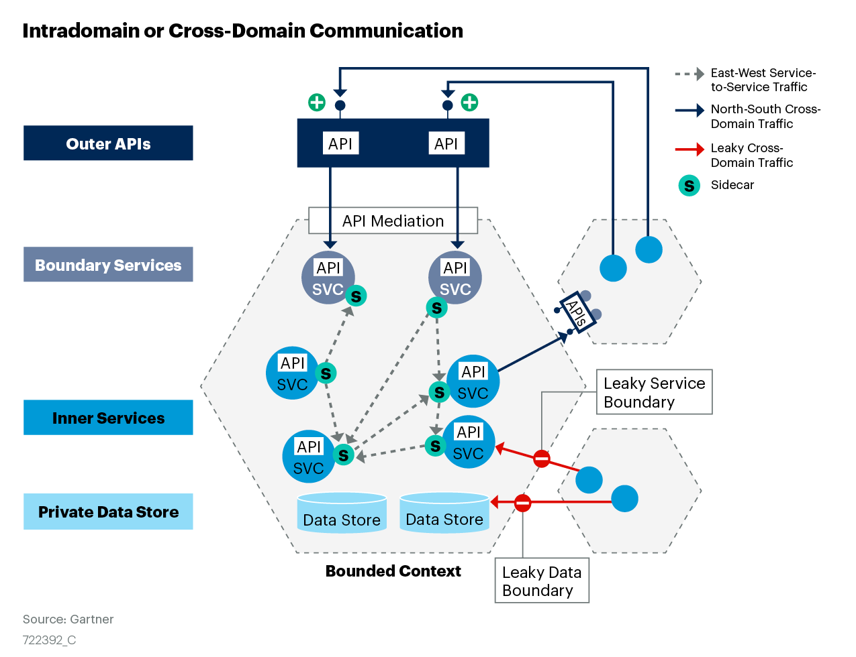
Figure 3

Slide 7
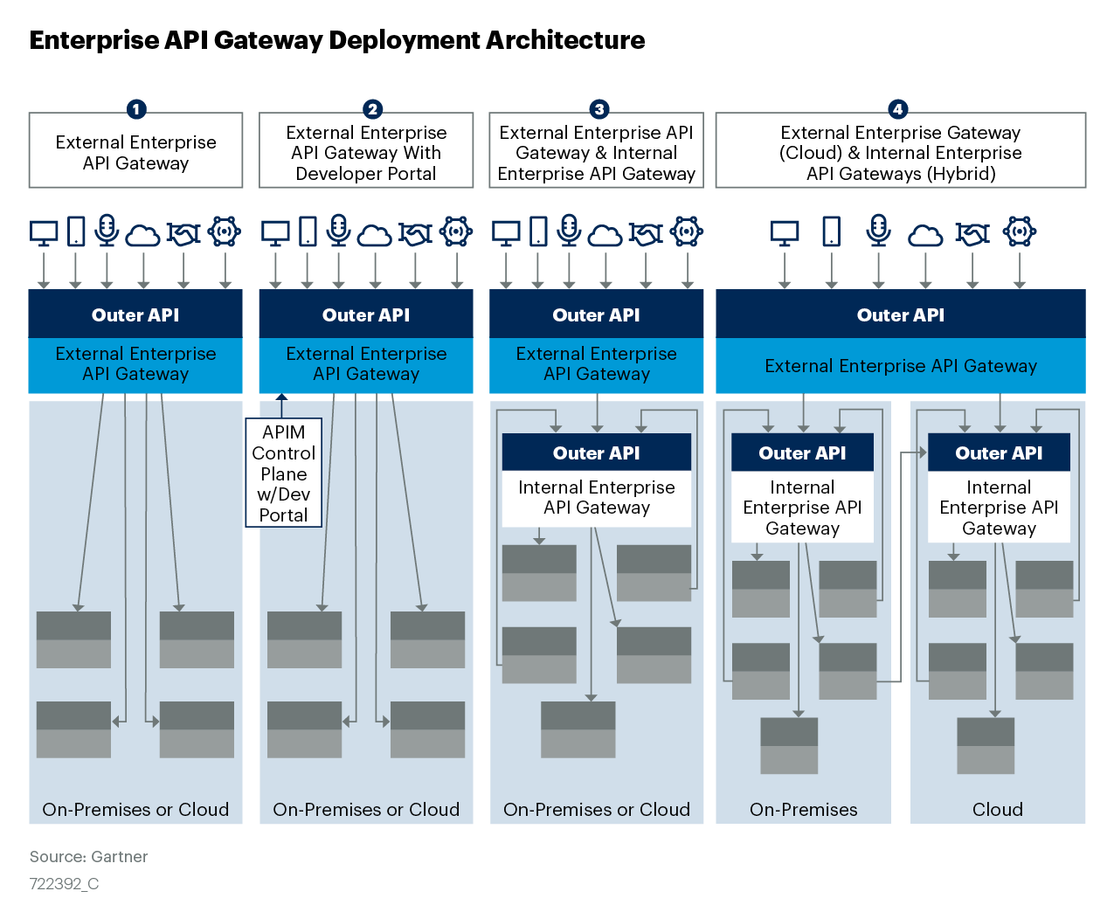
Figure 4

Slide 8
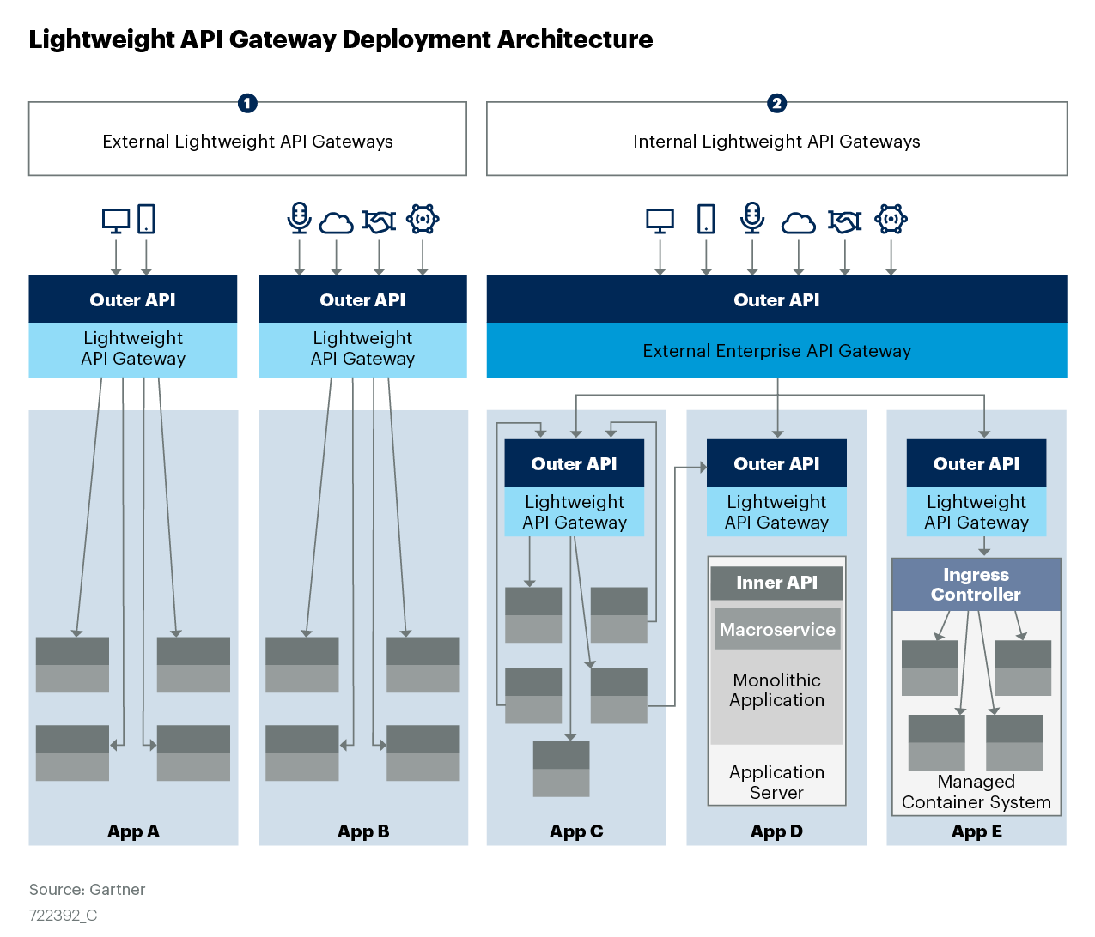
Figure 5

Slide 9
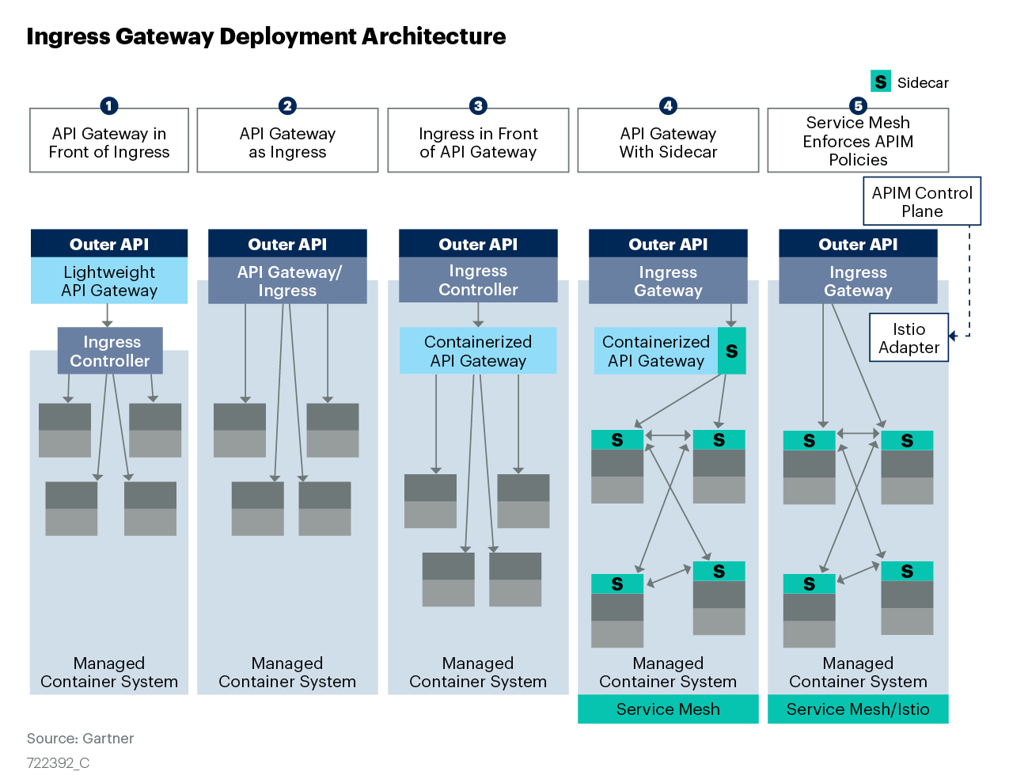
Figure 6

Slide 10
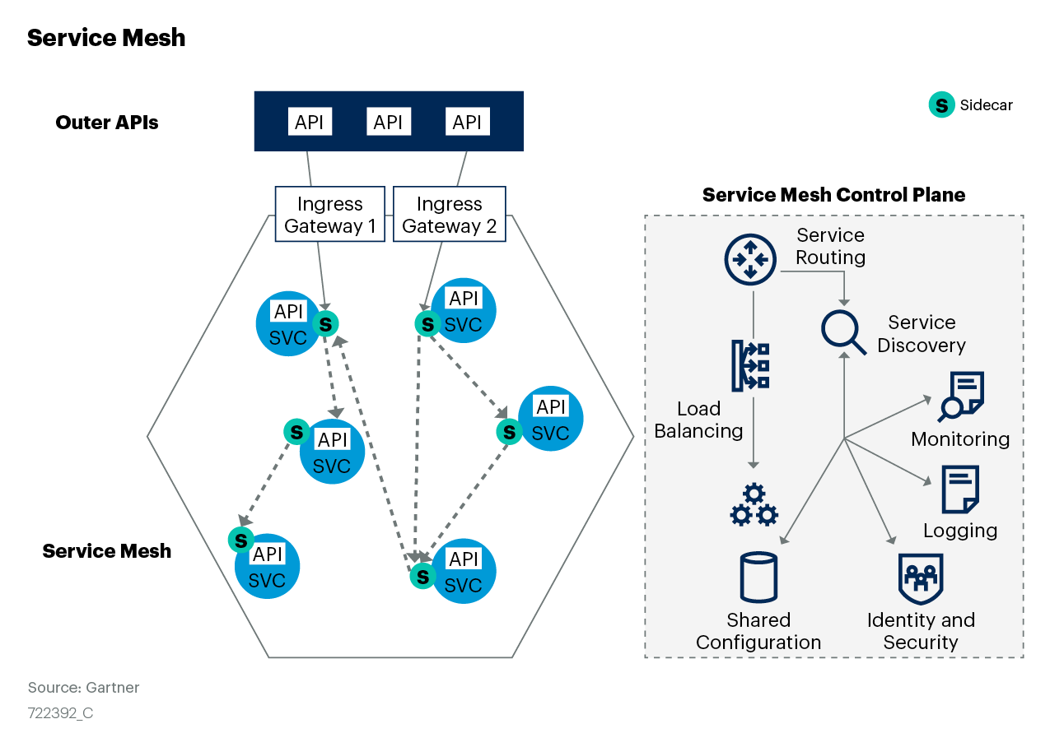
Figure 7

