Slide 1


Making documentation and teamwork easier

Slide 2
Index
Introduction
- The problem
- Some solutions
-Docufy
- Objectives
- Functionality and design:
- Mockups
- Conclusions

Slide 3
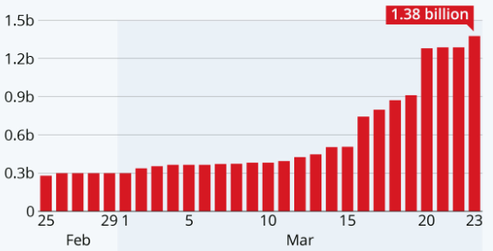
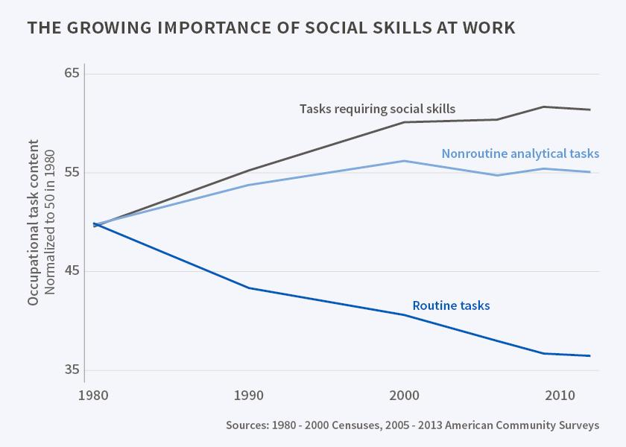
Introduction: The problem
Students affected by school closures due to covid
Tasks requiring social skills

Slide 4



Introduction: Some solutions

Slide 5

Introduction: Docufy
With Docufy, students from the EPS-UAM registered in Moodle will have the possibility to create teams, convocate meetings, develop their assignments and deliver them.
All on the same platform.

Slide 6




Objectives
User friendly
Create custom teams
Own schedule
Deliver files

Slide 7
Design: Mockups

Slide 8
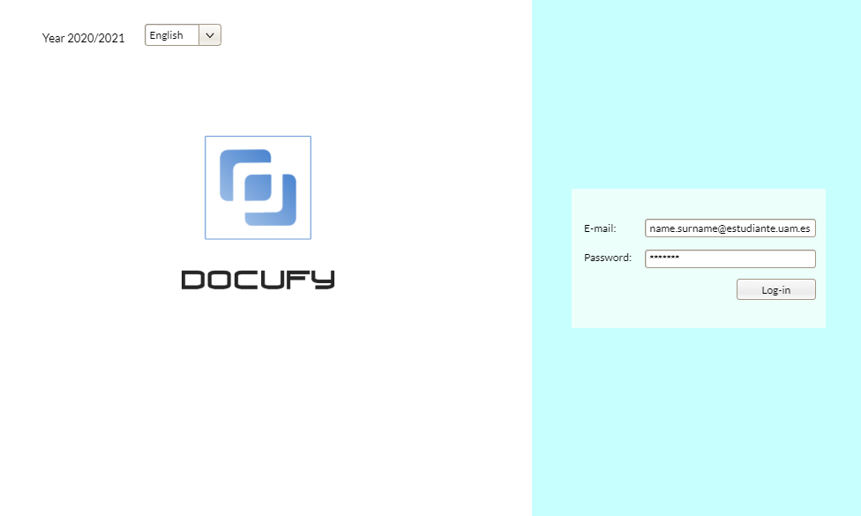

Slide 9
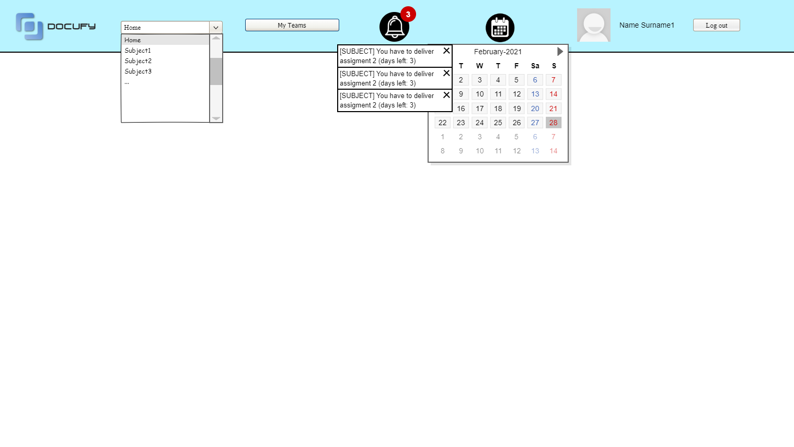

Slide 10
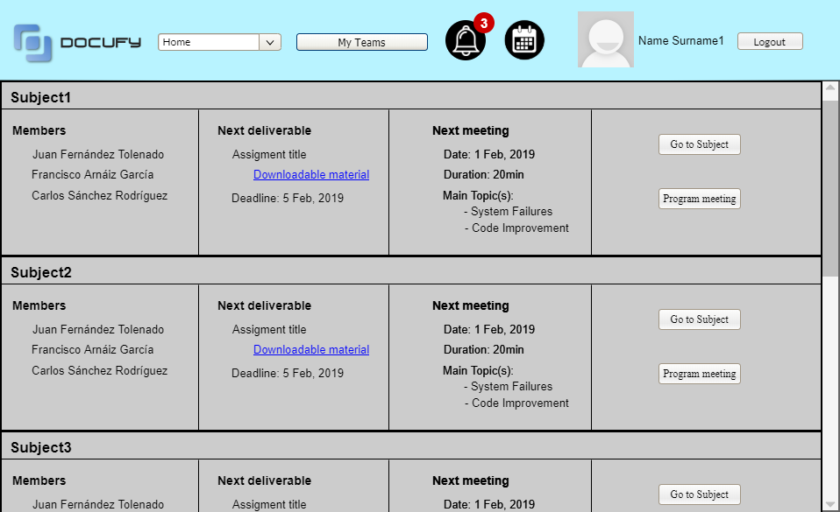

Slide 11
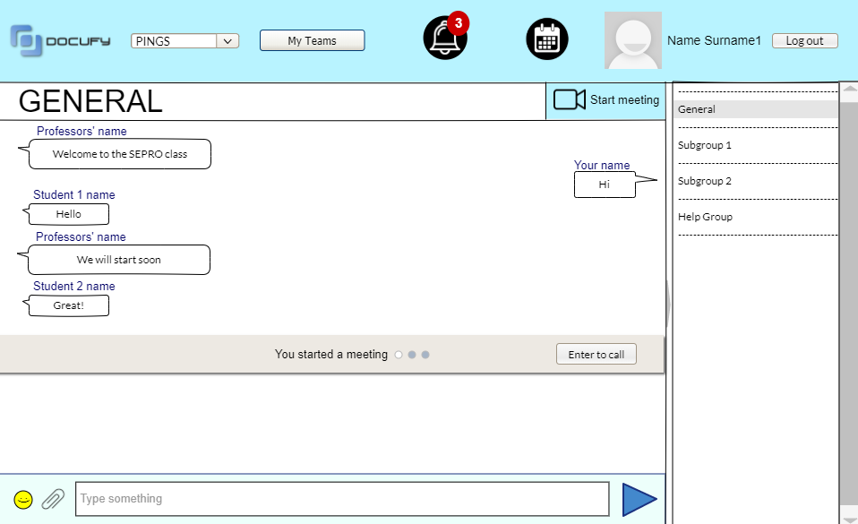

Slide 12
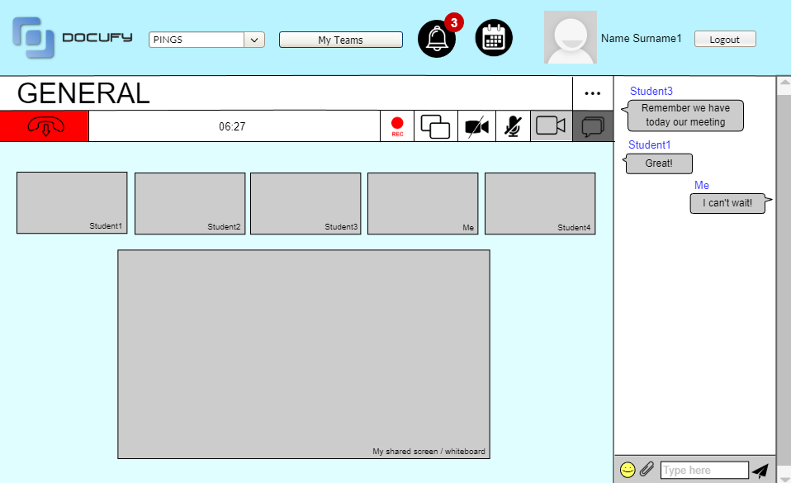

Slide 13
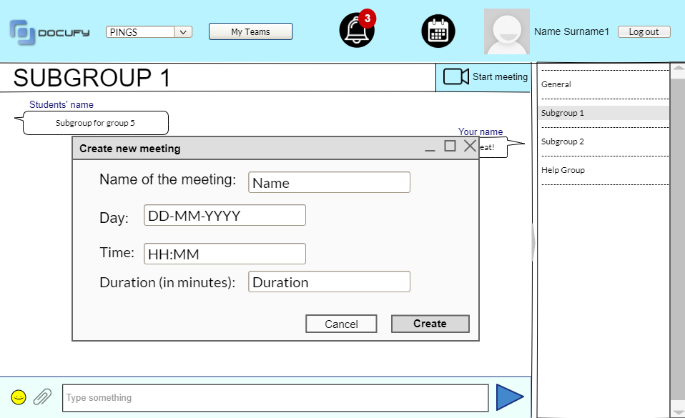

Slide 14
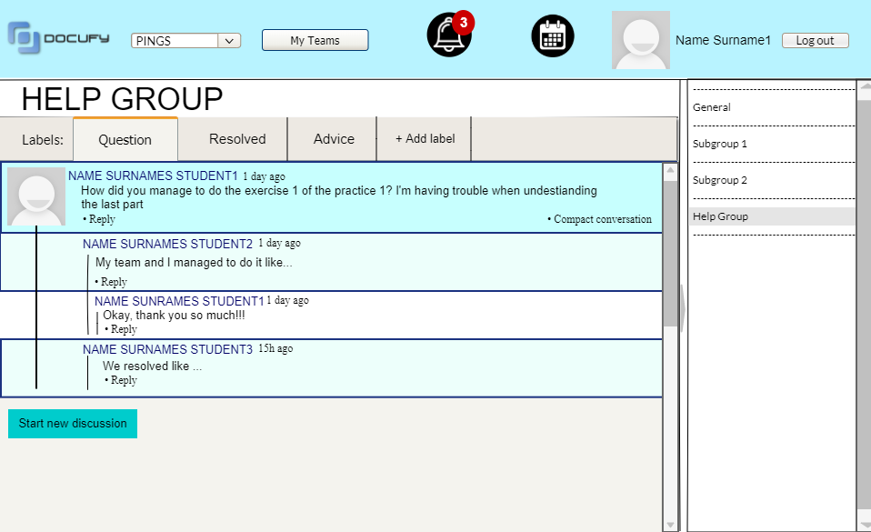

Slide 15
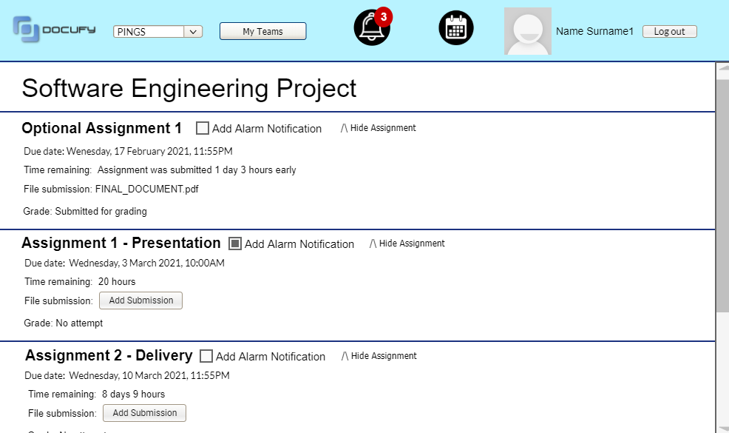

Slide 16
Conclusions
Software useful in our times
It will simplify and motivate teamwork
Facilitates students organization thanks to the schedules
Easier way to deliver assignments

