Slide 1
ACORN Nameserver Data structure review
Elaine Chandler and Dariusz Jarosz
Controls Group / Accelerator Systems Division
Advanced Photon Source
Argonne National Laboratory

Slide 2
Overview
Purpose
Gain clarity on types of data, data relations required in the nameserver
Present and review rough data schema for nameserver database
Focus on if schema meets functional requirements
Outline
Proposed data components
Database schema
Open questions

Slide 3
Nameserver data components
Location – physical location
Node – VM or host running a “device”
Device – entity that is a source/container of “channels”
Channel – data structure globally accessible by an address/name

Slide 4
Location
Each Location is assigned to one location type (building, room, rack, etc)
Each location can optionally have a parent location, giving flexibility to add hierarchy
Example:
Location with hierarchy
Building 01
Room 02
Cabinet 1
Room 04
Cabinet 5
Rack 01

Slide 5
Node
Each node is assigned a specific location
Each node entry includes metadata such as hostname, IP address
Each node can run one or many devices
Example:
Hostname: prod01
IP: 194.0.0.24
Location: Rack 2

Slide 6
Device
Device is either an ACNET or EPICS device
Device can have one to many channels
Device is located on a single node
Example:
Name: bpm1
System: EPICS
Channels: <list of channels>
Node: prod01

Slide 7
Channel
Channel can either be an EPICS PV or ACNET device property
Channel must have a globally accessible address/name
Each channel is provided by a single device
Channel can optionally have zero to many alarm configurations
Channel can optionally have access control configuration (RBAC). If no configuration is provided, a default configuration is used.
Channel may have zero to many transformations Channel can have rendering metadata
Name: BPM:01:x
System: EPICS
Device: bpm1
Alarm config: min:0,max:5,type:major
Access control: role:admin, read/write
Data unit: counter
Transforms: to microns: “x/1000”

Slide 8
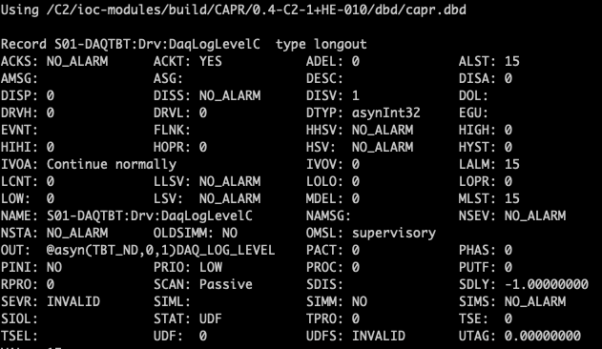
Other fields to consider
Node
Owner
Network
Device
Owner
Subsystem
Description
Status (Production/Test)
Channel
Description
Protocol
Data type
Unit
Input/output
Channel continued...
EPICS DB properties

Slide 9
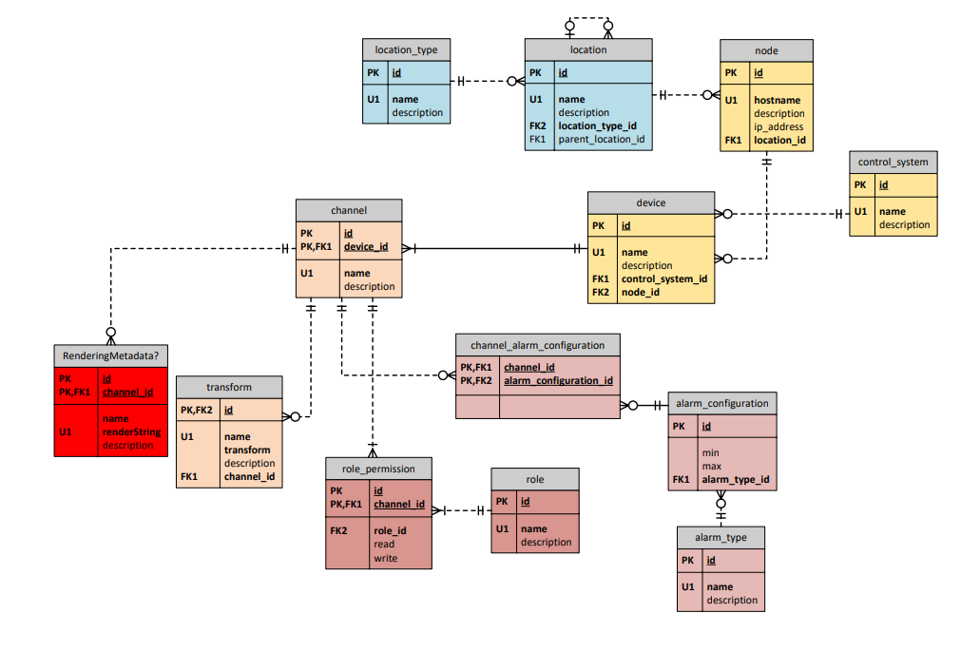
Database schema
Control System values are
either “EPICS” or “ACNET”

Slide 10
Open Questions
Do we need to include any additional information for nodes, device, channels, access control configuration, etc? Is there any other information missing?
Are there specific EPICS or ACNET properties needed for devices, channels, or alarm configuration (see slide 8 for examples of EPICS-specific fields)
What is rendering metadata? Can you provide an example?
Are transforms specific to a channel? Can multiple channels share the same transform?
What are the performance requirements?
How many clients roughly will be querying the server and how frequently? Is there an expected response time?
How many clients will be making updates to the server and how frequently?

