Slide 1
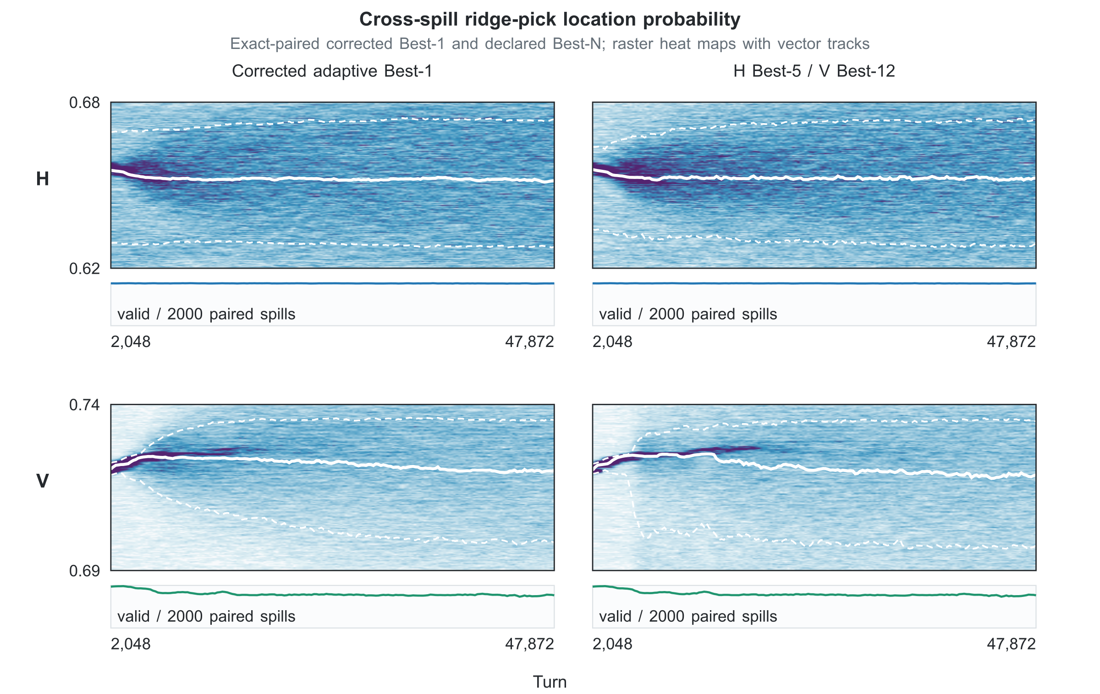
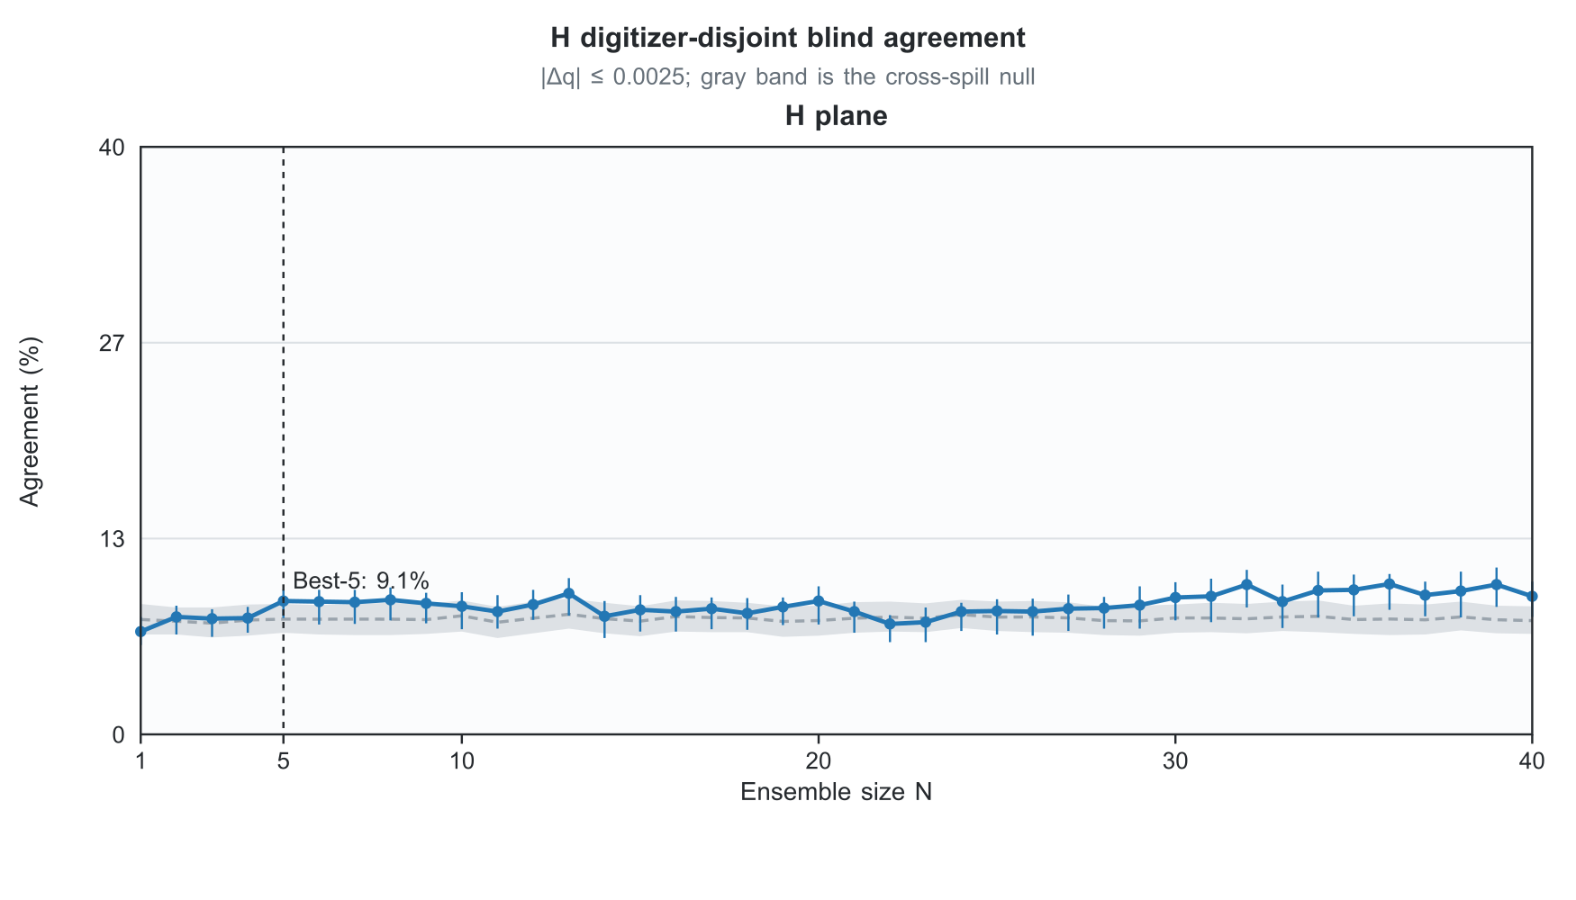
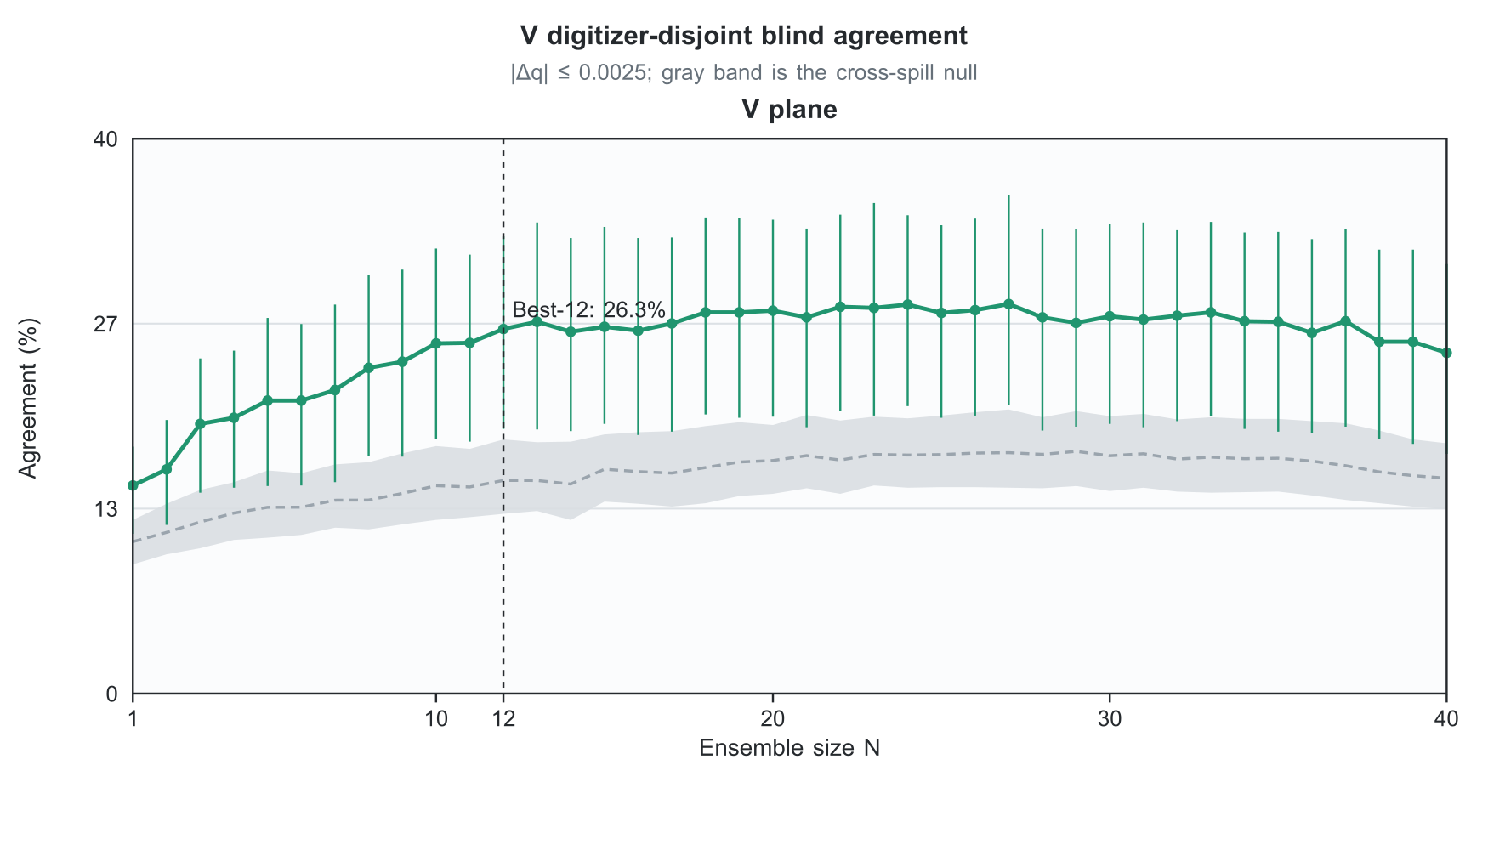
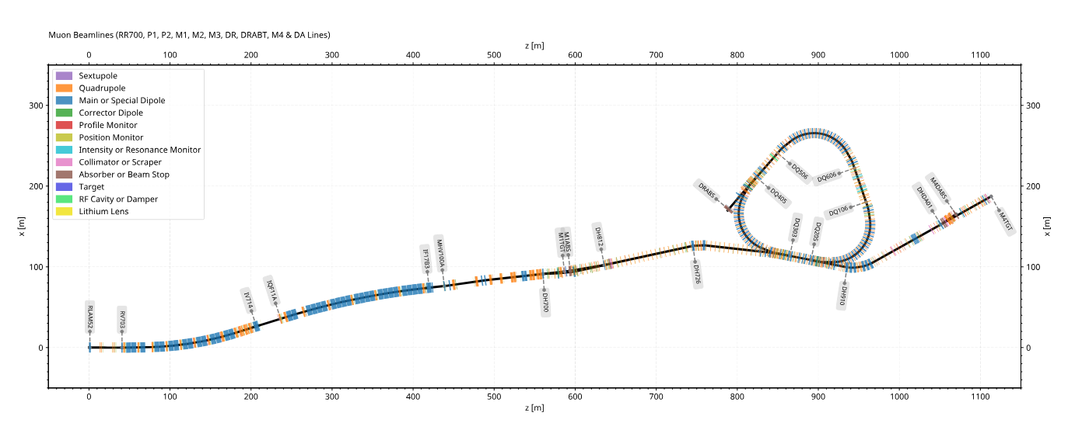
FERMILAB-POSTER-26-0268-AD
Which BPMs can we trust, spill by spill?
Adaptive turn-by-turn tune analysis in the Mu2e Delivery Ring
Derek Steinkamp | Fermi National Accelerator Laboratory
DOES THE CANDIDATE PERSIST FOR 50,000 TURNS?
THERE IS NO SINGLE BEST BPM
All 60 H and 60 V sources win at least once. Choose early; test later with held-out digitizers.
H: Best-5 reached 9.1%. The null band ends at 8.9% - promising, not decisive.
V: Best-12 reached 26.3%. The null band ends at 18.3% - a clear separation.
The loop at right is the Delivery Ring. Its position readouts do not behave equally.
WHAT DID WE LEARN?
H Best-5 narrows the ridge. V Best-12 agrees more strongly. All-channel aggregation remains competitive.
Useful operating points - not universal optima.
Is this the machine tune? Not yet. Next: change the tune on purpose (a controlled quadrupole scan) and ask whether the candidate follows.
This manuscript has been authored by FermiForward Discovery Group, LLC under Contract No. 89243024CSC000002 with the U.S. Department of Energy, Office of Science, Office of High Energy Physics.
Beamline layout courtesy of George Deinlein, Fermilab staff; used with permission.
Notes:
[Sources]
- Accepted paper evidence: publication/ibic2026/results_payload.json (poster evidence gate).
- H and V validation plus ridge-density graphics: publication/ibic2026/reports/publication_figures/poster/.
- Beamline map: Delivery Ring BPM Status 7-16-2026 - DAS .pptx, slide 2; George Deinlein, Fermilab staff; used with full permission confirmed 2026-08-19; extracted asset SHA-256 7422ad58a659d6149139180bd6d35cd1fc9bd05ba94af6314f9fceb069278ce6.
- Fermilab publication requirements: FERMILAB-POSTER-26-0268-AD; This manuscript has been authored by FermiForward Discovery Group, LLC under Contract No. 89243024CSC000002 with the U.S. Department of Energy, Office of Science, Office of High Energy Physics.
- Print submission: final PDF to Cindy Arnold <carnold@fnal.gov>.

