Slide 1
New CalDigi Data Flow
MC Data
CalSignalTool
(replaces CalDigiAlg PHASE I)‏
McIntegratingHist -> electronic diode signal
using optical gain and asymmetry calib
TriggerAlg / CalTrigTool
Convert Cal Signal Levels -> Cal Trigger Output
Trigger Bits
Trigger Engine /
Trigger Response Tables Sim
convert trigger
bits to readout mode info.
CalDigiAlg
(replaces CalDigi PHASE II)‏
Using readout info and crystal signal info,
generate appropriate CalDigi collection
Readout Mode
CalDigis

Slide 2
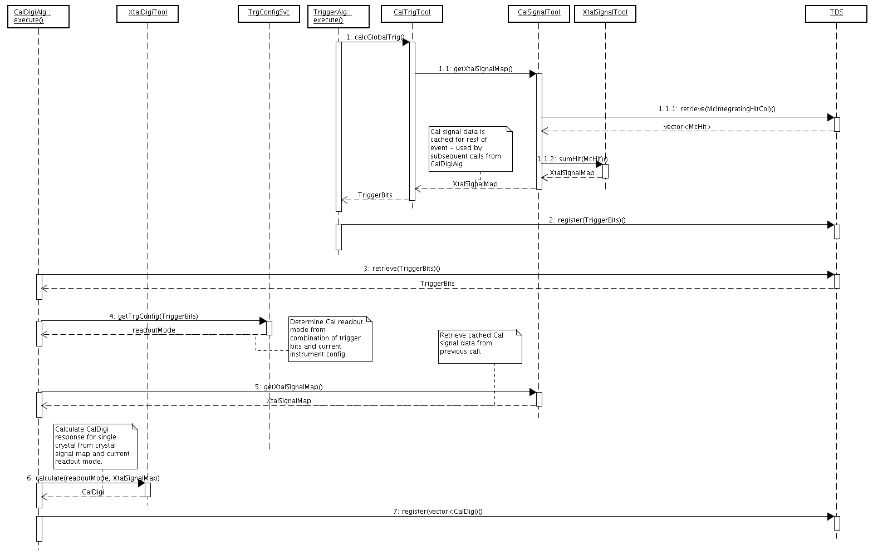
Cal Digi and Trigger – Sequence Diagram

Slide 3
