Slide 1


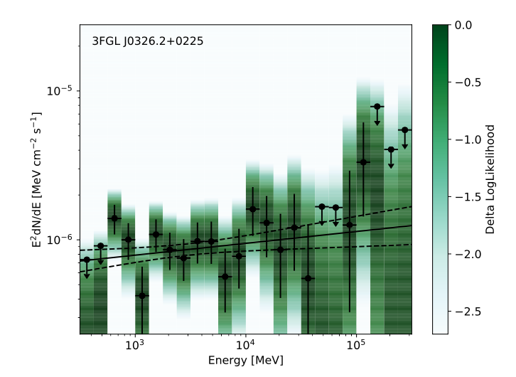
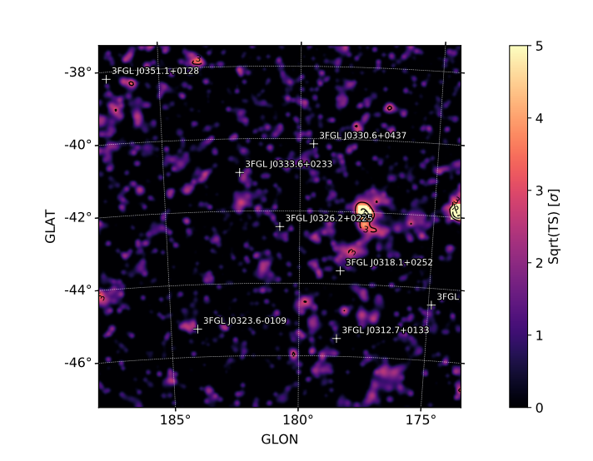
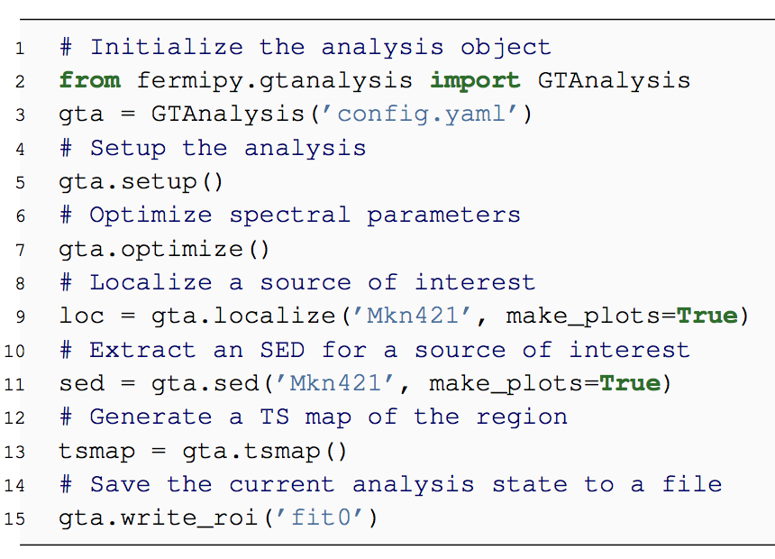
Fermipy: An open-source Python package for analysis of Fermi-LAT Data
Matthew Wood¹, Regina Caputo², Eric Charles¹, Mattia Di Mauro¹, Jeffrey Magill³, and Jeremy Perkins² on behalf of the Fermi-LAT Collaboration
¹SLAC/KIPAC, ²NASA/GSFC, ³UMD - College Park
Abstract: Fermipy is an open-source python framework that facilitates analysis of data collected by the Fermi Large Area Telescope (LAT). Fermipy is built on the Fermi ScienceTools, the publicly available software suite provided by NASA for the LAT mission. Fermipy provides a high-level interface for analyzing LAT data in a simple and reproducible way. The current feature set includes methods for extracting spectral energy distributions and lightcurves, generating test statistic maps, finding new source candidates, and fitting source position and extension. Fermipy leverages functionality from other scientific python packages including NumPy, SciPy, Matplotlib, and Astropy and is organized as a community-developed package following an open-source development model. We review the current functionality of Fermipy and plans for future development.
Fermipy Package
Fermipy is a python package built on the Fermi Science Tools that facilitates high-level analysis of LAT data. Fermipy is organized around an open-source development model:
Leverages large and growing ecosystem of open-source python libraries (Numpy, Scipy, Astropy, Matplotlib)
Developed on GitHub [1]
Easily installed with pip or conda package managers
Community input and contributions accepted via Pull Request and Github Issues
See the online documentation [2] for a complete description of the package as well as tutorials.
Advanced Features
Fermipy provides a number of methods for more complex analysis tasks:
Extracting Spectral Energy Distributions (sed)
Finding new source candidates (find_sources)
Localizing a source (localize)
Fitting spatial extension (extension)
Extracting a lightcurve (lightcurve)
Generating Test Statistic (TS) and residual maps (tsmap and residmap)
Analysis Workflow
To perform an analysis, a user composes a YAML configuration file and python script. The analysis is controlled with an analysis state object that manages the data and model preparation and provides a set of high-level methods. A basic analysis of a source can typically be performed with a 10-20 line python script. Analysis results can be serialized to FITS or numpy files for subsequent post-processing or visualization.
Left: Spectral Energy distribution generated with the sed method. Right: Test Statistic map generated with the tsmap method.
Conclusions and Future Outlook
Building on the excellent ecosystem of open-source python scientific libraries, Fermipy provides a powerful and flexible framework for LAT data analysis. Although the feature set is now relatively mature, development of Fermipy is still active. Future releases will
focus on the following areas:
Support for analyzing data pixelized with HEALPix.
Improved integration with other open-source gamma-ray analysis software such as Gammapy [3], 3ML [4], and Gammalib/ctools [5]
Functionality for propagating systematic uncertainties associated with the instrument response functions (effective area and PSF).
Better standardization of FITS output formats through the gamma-astro-data-formats effort [6].
We aim to make Fermipy a community-supported effort and to this end we welcome input and contributions from all members of the LAT scientific community.
Example of a python script using Fermipy to an analyze the gamma-ray source Mkn 421.
References
[1] https://github.com/fermiPy/fermipy
[2] http://fermipy.readthedocs.org/
[3] C. Deil et al. , Gammapy – A prototype for the CTA Science Tools, July, 2017.
[4] G. Vianello et al., The Multi-Mission Maximum Likelihood framework (3ML), July, 2015, 1507.08343.
[5] J. Knödlseder et al., GammaLib and ctools. A software framework for the analysis of astronomical gamma-ray data, A&A 593, Aug., 2016, A1, 1606.00393.
[6] https://gamma-astro-data-formats.readthedocs.io
Acknowledgements
The Fermi-LAT Collaboration acknowledges support for LAT development, operation and data analysis from NASA and DOE (United States), CEA/Irfu and IN2P3/CNRS (France), ASI and INFN (Italy), MEXT, KEK, and JAXA (Japan), and the K.A. Wallenberg Foundation, the Swedish Research Council and the National Space Board (Sweden). Science analysis support in the operations phase from INAF (Italy) and CNES (France) is also gratefully acknowledged.
Notes:
. For joint likelihood analyses using all four event types the impact of these systematics is reduced since the errors for each type
The larger systematic uncertainties for the PSF and EDISP types is directly related to the Data/MC greement of the variables that
The larger systematic uncertainties for the PSF and EDISP types can be attributed to
the larger number of variables that are used in the PSF and EDISP type selections versus the FRONT/BACK selection which depends only on the conversion layer.
To account for this larger uncertainty, the LAT team currently recommends a larger systematic uncertainty band (+/- 10% between 100 MeV and 10 GeV) for analyses using only a single PSF or EDISP event type.
allows for variation in the efficiency
Measured efficiencies are computed in a two-dimensional grid binned in both energy and incidence angle
The data to which R_{data} is fit are

