Slide 1
EP8900 – Integrated Assessment Modelling
SSP5

Slide 2
Background of SSP5
Low population growth
High GDP growth
High level of trade
High energy consumption
Rapid technology development
Low environmental focus
Policies are development oriented

Slide 3
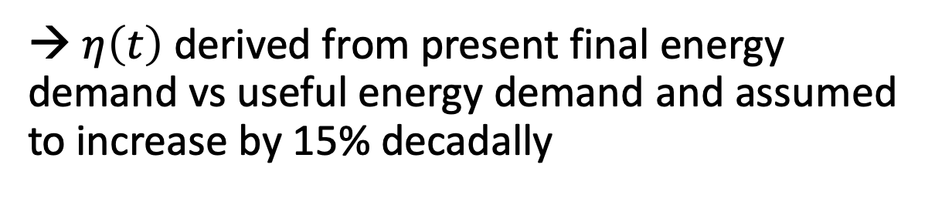
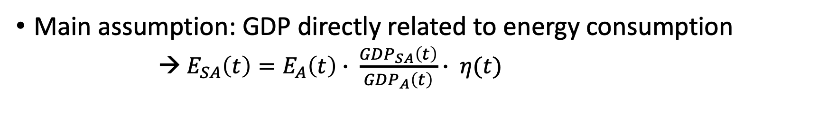
Calculating the Energy Demand
Main assumption: GDP directly related to energy consumption
→ $E_{SA}\left(t\right)=E_{A}\left(t\right)∙ \frac{GDP_{SA}\left(t\right)}{GDP_{A}\left(t\right)}∙ η(t)$
Useful energy demand in SA
Final demand in Africa
Efficiency
→ $η\left(t\right)$ derived from present final energy demand vs useful energy demand and assumed to increase by 15% decadally

Slide 4
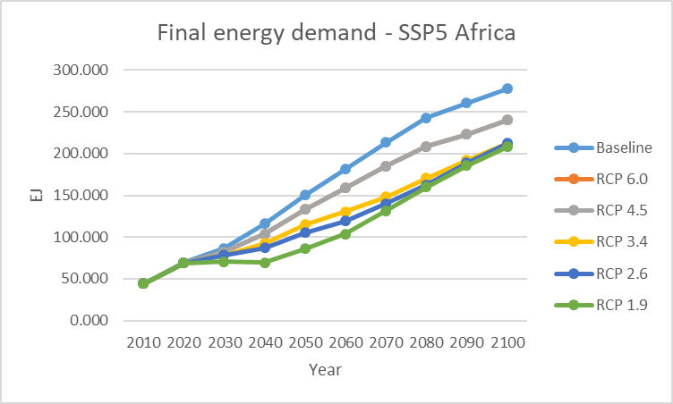

Slide 5
RCP Scenarios within SSP5

Slide 6
Trade

Slide 7
CO2eq Emissions

