Slide 2

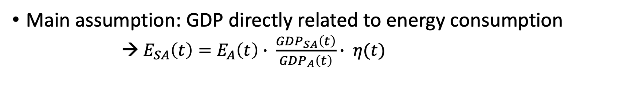
Calculating the Energy Demand
Main assumption: GDP directly related to energy consumption
→ $E_{SA}\left(t\right)=E_{A}\left(t\right)∙ \frac{GDP_{SA}\left(t\right)}{GDP_{A}\left(t\right)}∙ η(t)$
Useful energy demand in SA
Final demand in Africa
Efficiency
→ $η\left(t\right)$ derived from final energy demand vs useful energy demand and assumed to increase by 15% annually

Slide 3
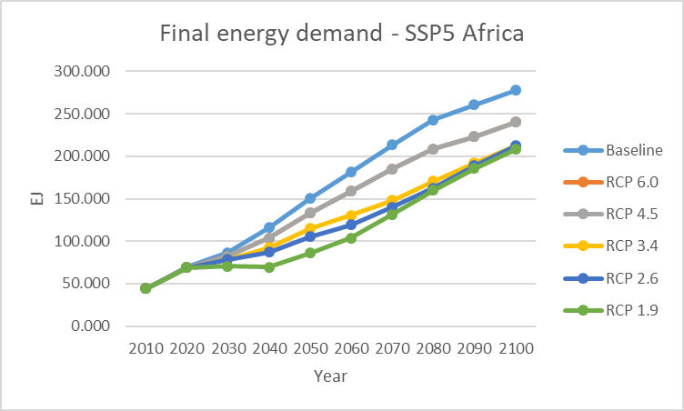

Slide 4
RCP Scenarios within SSP5

