Slide 1

Hotel Billing &
Payment System
Database Management Systems — Individual Project
Presented by: TUSIIME BETTY | Group 6 | May 2026
MBARARA UNIVERSITY OF SCIENCE AND TECHNOLOGY
FACULTY OF COMPUTING AND INFORMATICS
DATABASE SYSTEMS
INDIVIDUAL PROJECT PRESENTATION
Notes:
Click to add Notes

Slide 2
PRESENTATION OUTLINE
Business Case
System Design
Why build this system?
Entities, attributes & relationships
ER Daigram
Implementation
Entity Relationship Diagram
Database creation & data loading
Sample Queries
Conclusion
Key queries & results
Summary & reflections
Notes:
Click to add Notes

Slide 3
BUSINESS CASE
What the system does
Key benefits
Records guest check-ins and bookings
Generates invoices for room stays and services
Tracks payments (cash, card, mobile money)
Issues receipts as proof of payment
Monitors unpaid and partial balances
Eliminates manual billing errors
Faster payment processing
Real-time revenue monitoring
Improved guest satisfaction
Full audit trail for accountability
Notes:
Click to add Notes

Slide 4
SYSTEM DESIGN — ENTITIES
Guest
Room
Booking
( GuestID, full_name, Email, Phone, NationalID, Nationality, Address)
(RoomID, room_number, room_type, price_per_night, status, floor)
(BookingID, GuestID, RoomID, check_in, check-out, booking_date, status)
Service
Invoice
Invoice Item
( ServiceID, service_name, description, price)
( InvoiceID, BookingID, issue_date, amount, status)
(ItemID, ServiceID, Quantity, unit_price, sub_total)
Payment
Receipt
Staff
(PaymentID, InvoiceID, StaffID, amount_paid, date, method, transaction_ref)
(ReceiptID, PaymentID, issue_date, issued_by)
(StaffID, full_name, Role, Email, Phone)
Notes:
Click to add Notes

Slide 5
ENTITY RELATIONSHIPS
Entity A | Relationship | Entity B | Multiplicity
Guest | makes | Booking | 1 : M
Room | assigned to | Booking | 1 : M
Booking | generates | Invoice | 1 : 1
Invoice | contains | Invoice Item | 1 : M
Service | appears in | Invoice Item | 1 : M
Invoice | settled by | Payment | 1 : M
Staff | processes | Payment | 1 : M
Payment | generates | Receipt | 1 : 1
Staff | issues | Receipt | 1 : M
Notes:
Click to add Notes

Slide 6
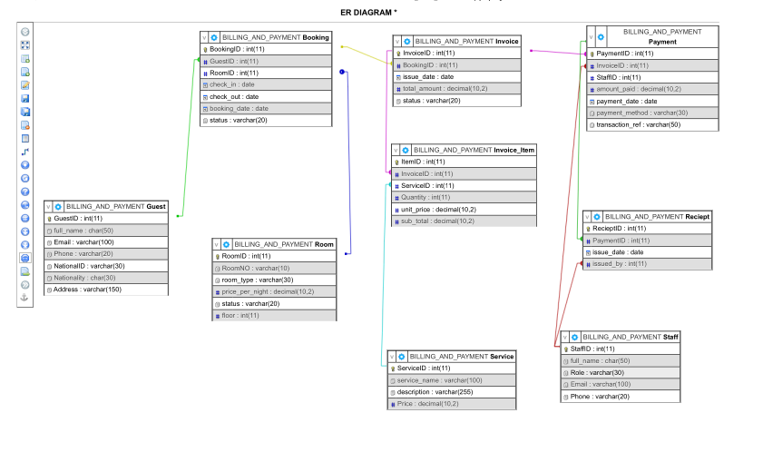
ENTITY RELATIONSHIP DIAGRAM (ERD)
Screenshot from MariaDB / draw.io ERD diagram
Notes:
Click to add Notes

Slide 7
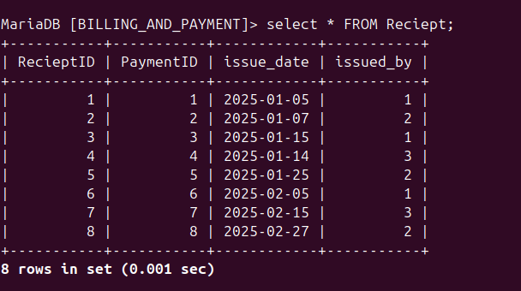
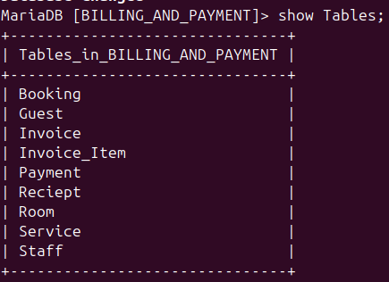
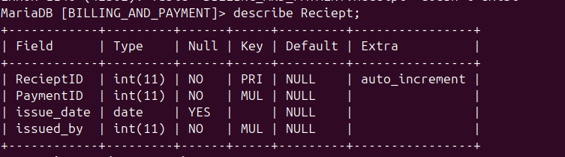
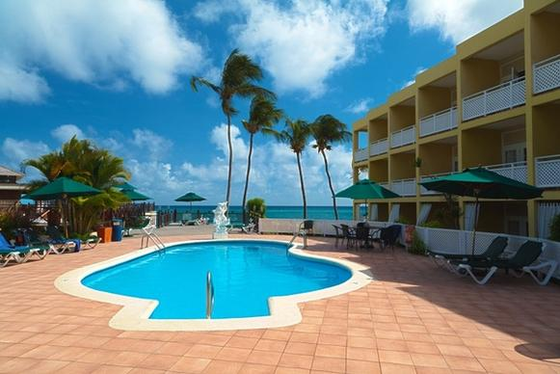
9
IMPLEMENTATION
Tables Created
Bookings Loaded
Total Records
Notes:
Click to add Notes

Slide 8
SAMPLE QUERIES
List all guests with booking status
Unpaid invoices with guest names
JOIN Guest, Booking, Room
WHERE status = 'Unpaid'
Total payments per payment method
Services used by a specific guest
GROUP BY payment_method
Multi-table JOIN
Notes:
Click to add Notes

Slide 9
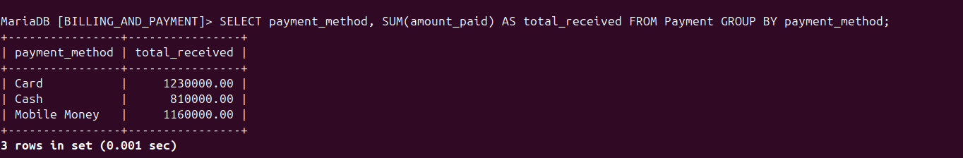
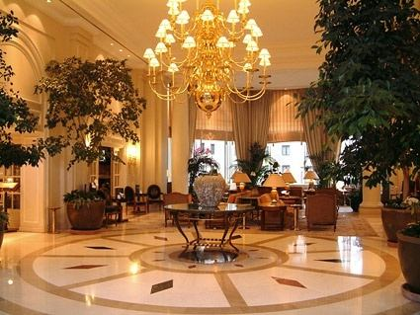
QUERY DEMONSTRATION
Query: Total payments per payment method
SELECT payment_method, SUM(amount_paid) AS total_received
FROM Payment GROUP BY payment_method;
Notes:
Click to add Notes

Slide 10
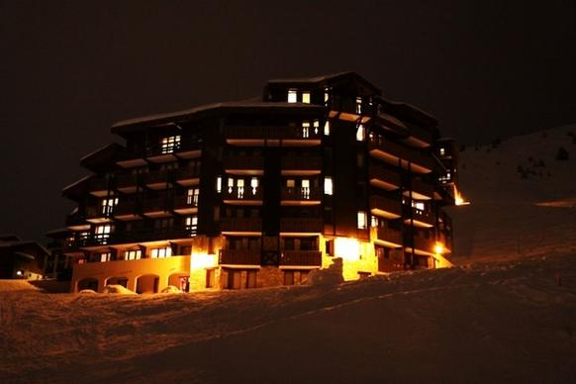
9 entities designed, implemented, and populated in MariaDB
All foreign key constraints enforced for data integrity
8 sample queries demonstrating real billing and reporting needs
System supports front desk, cashier, and management operations
CONCLUSION
Thank you | | Group 6 |
Notes:
Click to add Notes

