Slide 1
Controlling Non-Linear Dynamic Systems Through the Use of RNNs A Generic Methodology D7047E – Advanced Deep Learning
Amirhossein Nayebiastaneh & Fernando Labra Caso
https://github.com/fernand0labra/ltu-D7047E-project

Slide 2
Index
Introduction
Experimental Scenario
System Identification RNN
Closed Loop RNN
Open Loop RNN
Conclusion

Slide 3
Introduction
Hypothesis

Slide 4
What is a Dynamic System?
In mathematics, a dynamical system is a system in which a function describes the time dependence of a point in an ambient space, such as in a parametric curve.
In physics, a dynamical system is described as a "particle or ensemble of particles whose state varies over time and thus obeys differential equations involving time derivatives“.
Source: https://en.wikipedia.org/wiki/Dynamical_system

Slide 5
What is Control Theory?
Control theory is a field of control engineering and applied mathematics that deals with the control of dynamical systems in engineered processes and machines.
The objective is to develop a model or algorithm governing the application of system inputs to drive the system to a desired state.
Source: https://en.wikipedia.org/wiki/Control_theory

Slide 6
What is Control Theory?
To do this, a controller monitors the controlled process variable (PV) and compares it with the reference or set point (SP).
The difference between actual and desired value of the process variable, called the error signal (E), is applied as feedback to generate a control action (CA) to bring the controlled process variable to the same value as the set point.
Source: https://en.wikipedia.org/wiki/Control_theory

Slide 7
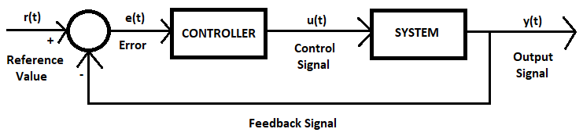
What is Control Theory?
Diagram of a Closed Loop Feedback with a Controller and Dynamic System
Set Point (SP) | Error (E) | Control Action (CA) | Process Variable (PV)
r(t) | e(t) | u(t) | y(t)

Slide 8
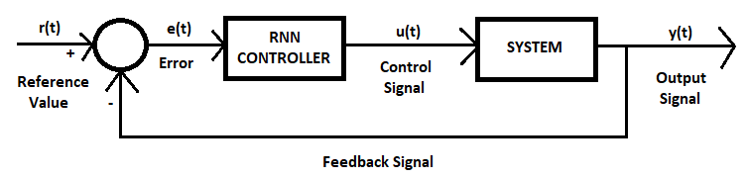
Hypothesis
Is it possible to model a controller by using RNN to control non-linear dynamical systems?
Proposed Closed Loop Feedback with an RNN Controller and Dynamic System

Slide 9
Hypothesis
To train the controller we need [Input: e(t), Output: u(t)], however we do not know the control signal u(t) beforehand.
The solution is to train another RNN for the system and train jointly both the system RNN with the weights frozen and the controller RNN.
Once the controller is trained, we can extract it and test it on the original system.

Slide 10
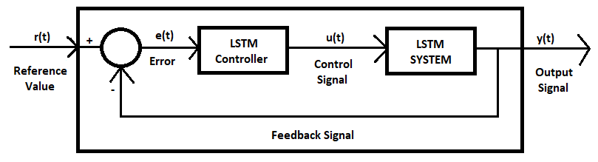
Hypothesis
Is it possible to model a controller by using RNN to control non-linear dynamical systems?
Diagram of a Closed Loop Feedback with an LSTM Controller and Dynamic System

Slide 11
Experimental Scenario
Non-Linear Dynamic System & Simple Controller

Slide 12
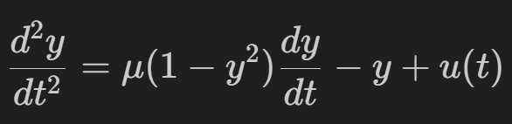
The Van der Pol Oscillator
The Van der Pol system is a nonlinear dynamical system that can be described by the following second-order ordinary differential equation:
Where u(t) and y(t) are the input and the output of the system respectively and µ is a parameter that controls the strength of the damping and the nonlinearity.

Slide 13
The PID Controller
A Proportional–Integral–Derivative controller (PID controller) is a control loop mechanism employing feedback that is widely used in industrial control systems.
A PID controller continuously calculates an error value as the difference between a desired setpoint (SP) and a measured process variable (PV) and applies a correction.
Source: https://en.wikipedia.org/wiki/PID_controller

Slide 14
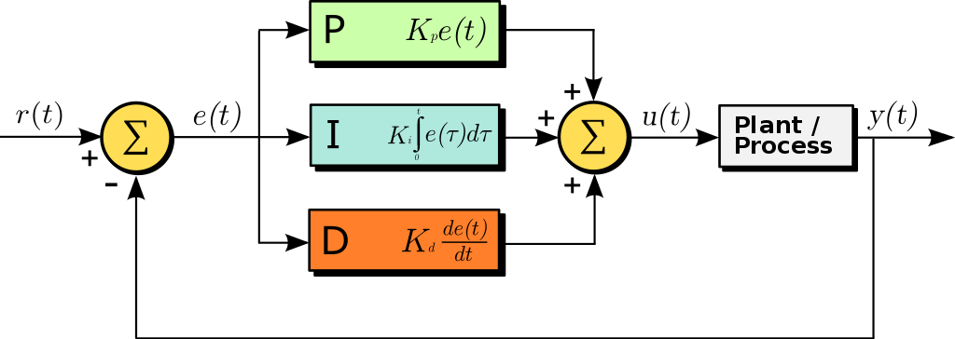
The PID Controller
A block diagram of a PID controller in a feedback loop.
r(t) is the desired process value or setpoint (SP), and y(t) is the measured process value (PV).
Source: https://en.wikipedia.org/wiki/PID_controller

Slide 15
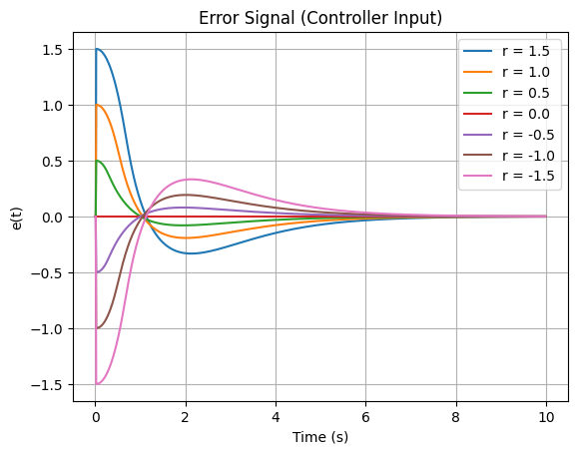
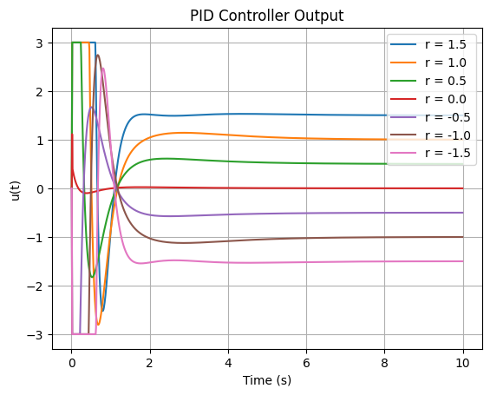
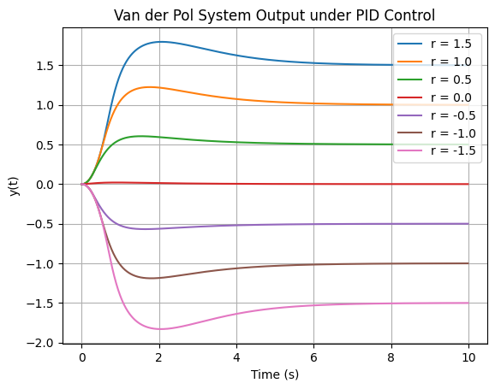
Experimental Scenario
A simple PID controller seems to converge to the set point r(t).
PID Input Signal e(t)
PID Output Signal u(t)
System Output Signal y(t)

Slide 16
System Identification RNN
Data, Models & Results

Slide 17
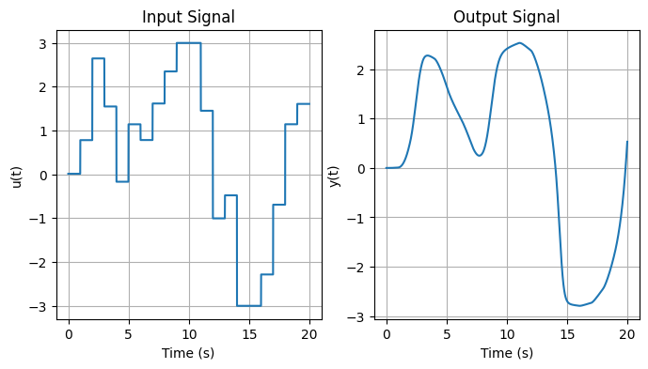
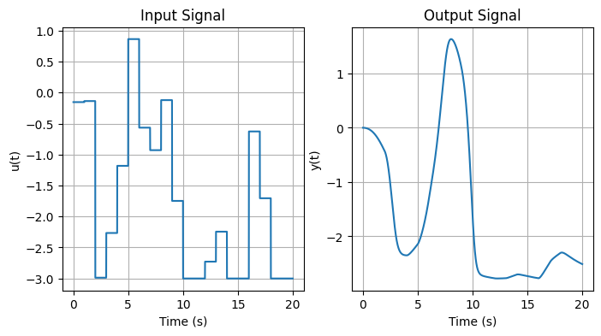
Dataset Generation
We used the second order differential equation of the Van der Pol system and from a generated input signal u(t), we obtained the respective output signal from the system y(t).
Input and Output Signals of the Van der Pol System

Slide 18
System RNN Architecture
We trained a first model with a Vanilla RNN and shifted to Long-Short Term Memory Unit (LSTM) due to underfitting.
The characteristics of both RNN and LSTM networks and the training procedure were:
Train, Validation, Test Size: [0.6, 0.2, 0.2]
N Epochs: 300 – Batch Size: 120 – Learning Rate: 0.001
N Layers: 1 – Input Size: 1 – Output Size: 1 – Hidden Size: 200
Activation Function: tanh Hyperbolic Tangent
Optimizer: Adam

Slide 19
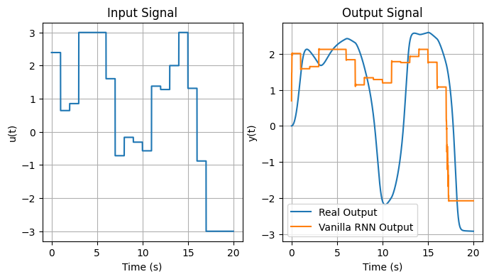
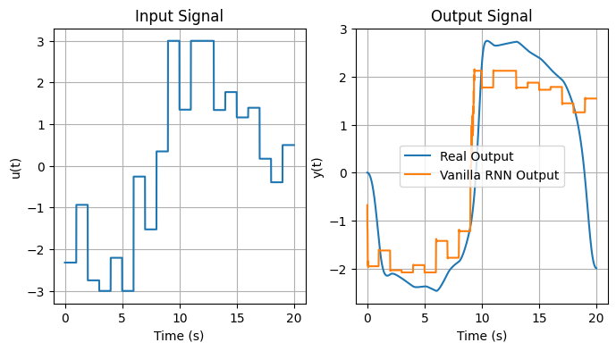
Vanilla RNN Results
Input and Output Signals of the Vanilla RNN Van der Pol System
Test Loss: 1.319

Slide 20
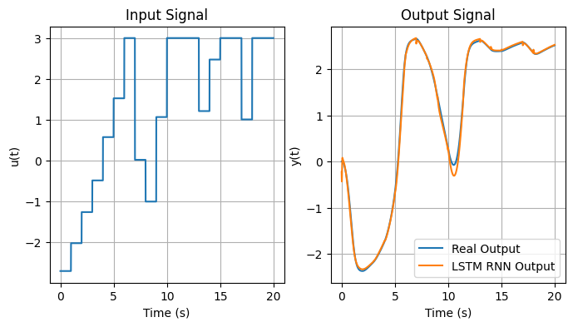
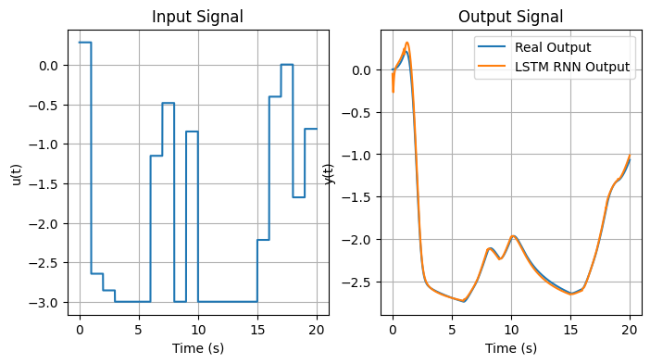
LSTM Results
Input and Output Signals of the LSTM Van der Pol System
Test Loss: 0.003

Slide 21
Closed Loop RNN
Data, Models & Results

Slide 22
Closed Loop RNN Architecture
Diagram of a Closed Loop Feedback with an LSTM Controller and Dynamic System

Slide 23
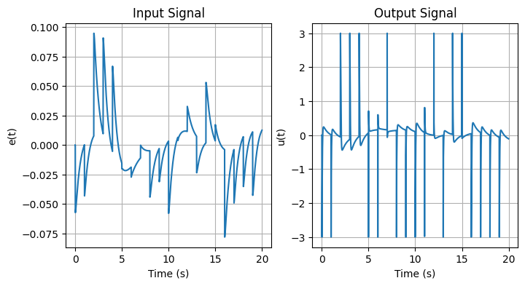
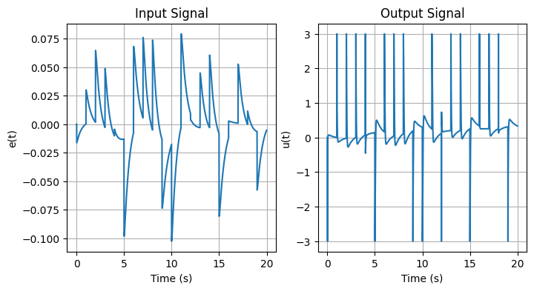
PID LSTM Dataset Generation
With the implementation of the PID controller we simulated the controlled system and obtained the error (input) and control (output) signals.
Input and Output Signals of the PID Controller

Slide 24
PID LSTM Architecture
We trained a model with the same structure as the Van der Pol LSTM to learn the PID behavior and fine tune it on the closed loop network.
The characteristics of the PID LSTM network and the training procedure were:
Train, Validation, Test Size: [0.6, 0.2, 0.2]
N Epochs: 300 – Batch Size: 120 – Learning Rate: 0.001
N Layers: 1 – Input Size: 1 – Output Size: 1 – Hidden Size: 200
Activation Function: tanh Hyperbolic Tangent
Optimizer: Adam

Slide 25
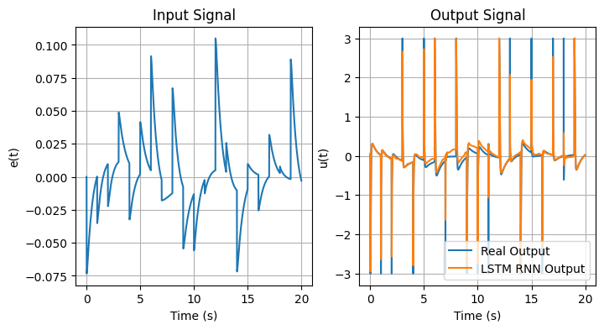
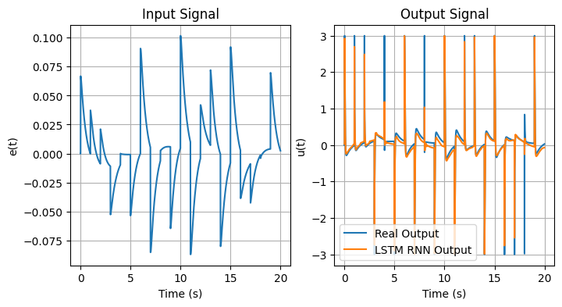
PID LSTM Results
Input and Output of the PID Controller RNN
Test Loss: 0.031

Slide 26
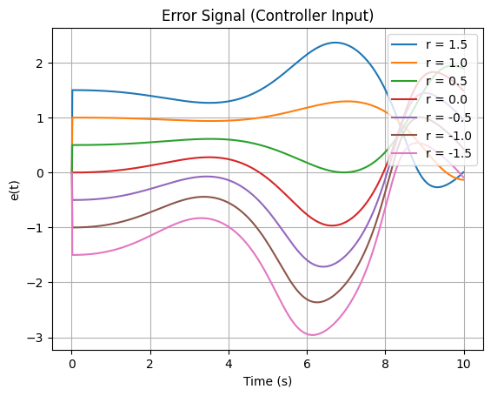
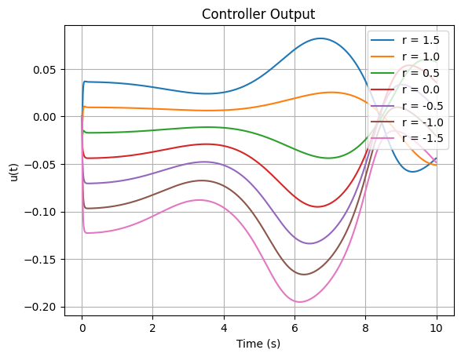
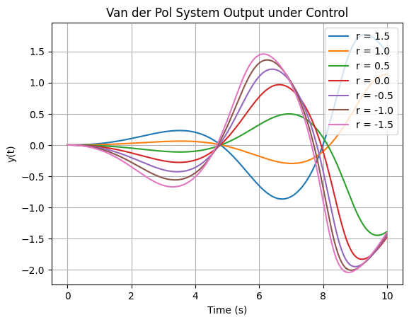
Experimental Scenario
The LSTM PID is not able to learn correctly with the provided data from the error and the output.
PID Input Signal e(t)
PID Output Signal u(t)
System Output Signal y(t)

Slide 27
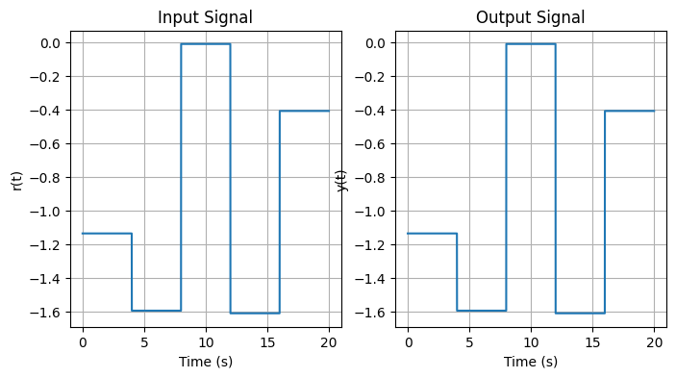
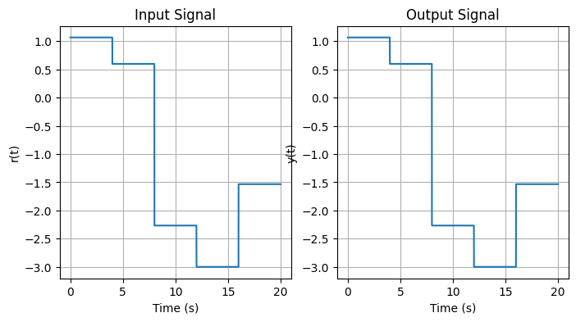
Closed Loop System - Dataset Generation
The input and output values should remain the same therefore we generated a set of random signals in the amplitude range of [-3, 3] and considered them for both input and output.
Input and Output Signals

Slide 28
Closed Loop System Architecture
We trained a model with two connected LSTMs, one defining the PID controller and another defining the system. The system was already trained and its weights were frozen.
The characteristics of the controller LSTM network and the training procedure were:
Train, Validation, Test Size: [0.6, 0.2, 0.2]
N Epochs: 500 – Batch Size: 120 – Learning Rate: 0.00001
N Layers: 1 – Input Size: 1 – Output Size: 1 – Hidden Size: 200
Activation Function: tanh Hyperbolic Tangent
Optimizer: Adam

Slide 29
Controller-System RNN Architecture
We had trained the Joint Controller-System RNN based solely on the error, which is computed within the forward function between the output signal from the system and the reference value.
However, due to a higher loss, we decided to input both the reference value and the error to the controller.

Slide 30
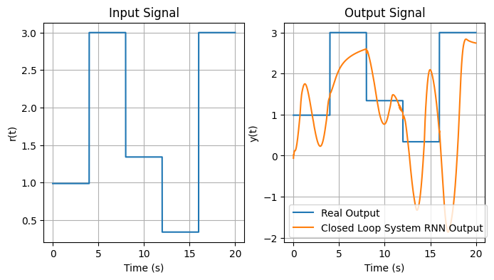
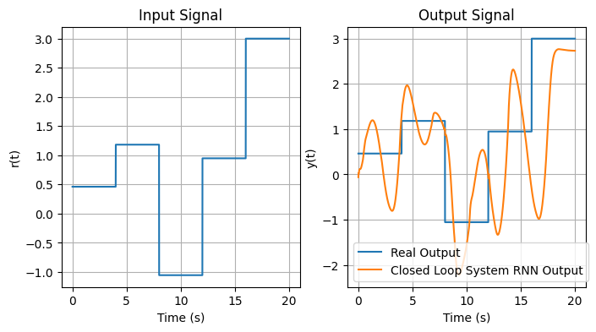
Closed Loop System Results
Input and Output Signals of the Joint Fine Tuned PID Controller-System RNN
Test Loss: 1.063

Slide 31
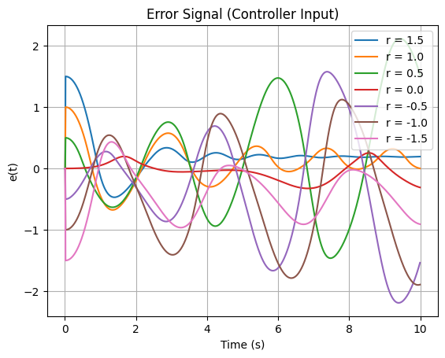
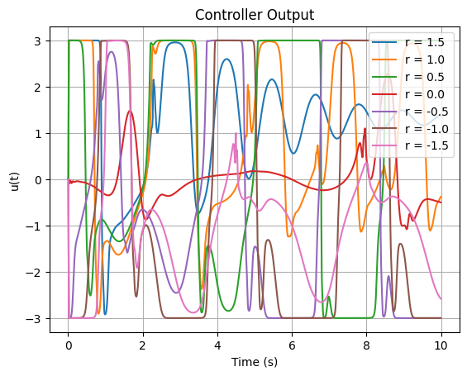
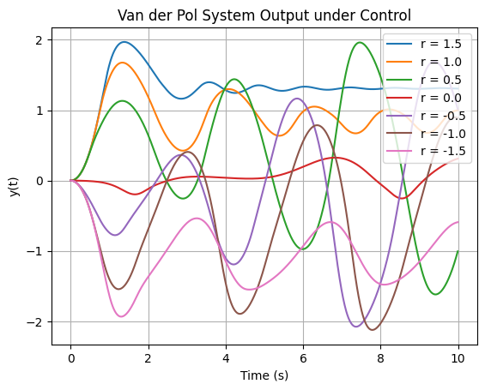
Experimental Scenario
The LSTM PID is not able to learn correctly with the provided data from the error and the output.
PID Input Signal e(t)
PID Output Signal u(t)
System Output Signal y(t)

Slide 32
Open Loop RNN
Models & Results

Slide 33
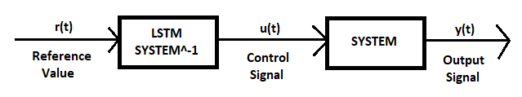
Inverse System RNN Architecture
Diagram of an Open Loop with LSTM Inverse Dynamic System

Slide 34
Inverse System RNN Architecture
As a final approach we implemented an open loop RNN with an inverse system acting as a controller having the real output signal as input and the real input signal as output.
The characteristics of the Inverse System LSTM network and the training procedure were:
Train, Validation, Test Size: [0.6, 0.2, 0.2]
N Epochs: 200 – Batch Size: 600 – Learning Rate: 0.01
N Layers: 1 – Input Size: 1 – Output Size: 1 – Hidden Size: 200
Activation Function: tanh Hyperbolic Tangent
Optimizer: Adam

Slide 35
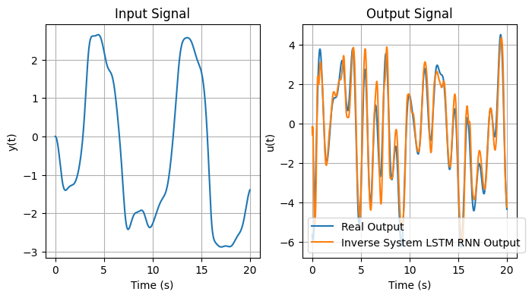
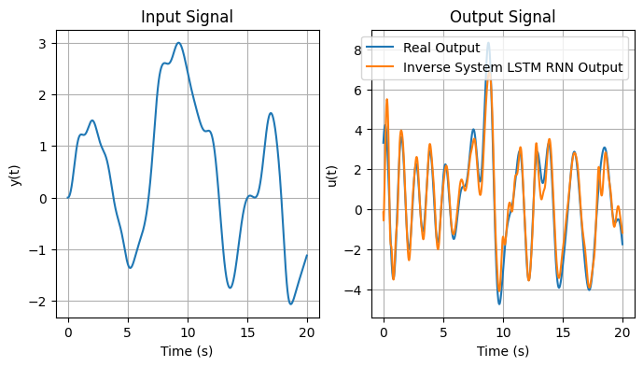
Inversed System LSTM Results
Input and Output Signals of the Inverse System RNN
Test Loss: 0.387

Slide 36
Conclusion

Slide 37
Key ideas from Project Work
The LSTM shows improved performance than the Vanilla RNN, solving the Vanishing Gradient Problem
It’s possible to model a non-linear system and PID controller through the use of LSTM
Ordinary supervised learning does not achieve the desired accuracy on RNNs for controlling non-linear systems
Reinforcement Learning seems to be the only training procedure that might achieve this

Slide 38
Thank you
Questions?

