Slide 1
Multiclass Classification for Detection of Pneumonia Infection in Chest X-Rays M7016H - AI In The Healthcare System
Tim Ufer : timufe-2 Robert Lindberg : oreile-9 Fernando Labra Caso : ferlab-1

Slide 2
Index
Introduction
Data Analysis
Network Architecture Design
Network Training & Evaluation
Results
Conclusion

Slide 3
Introduction
About Pneumonia

Slide 4
What is Pneumonia?
Pneumonia is an inflammatory condition of the lung primarily affecting the small air sacs known as alveoli.
Pneumonia is usually caused by infection with viruses or bacteria, and less commonly by other microorganisms.
Each year, pneumonia affects about 450 million people globally (7% of the population) and results in about 4 million deaths.
Source: https://en.wikipedia.org/wiki/Pneumonia

Slide 5
What does Pneumonia affect?
A pulmonary alveolus, is one of millions of hollow, cup-shaped cavities in the lungs where pulmonary gas exchange takes place.
Oxygen is exchanged for carbon dioxide at the blood–air barrier between the alveolar air and the pulmonary capillary.
Source: https://en.wikipedia.org/wiki/Pulmonary_alveolus

Slide 6
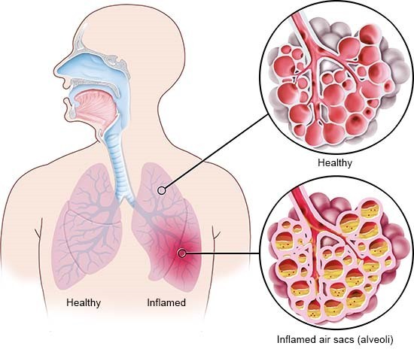
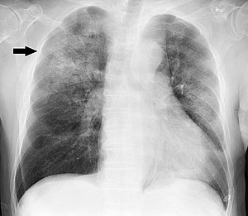
How does Pneumonia look like?
Graphical visualization of the Pneumonia effects on the alveoli
Source: informedhealth.org
Chest X-ray of a pneumonia caused by Haemophilus influenzae
Source: wikipedia.org/wiki/Pneumonia

Slide 7
Data Analysis
Class Distribution & Preprocessing Techniques

Slide 8
How does our data look like?
The dataset consists of high-resolution x-ray images of the lungs. There are two classes for pneumonia patients contracted with (1) COVID-19 and (2) other viruses as well as a class for (3) non-infected patients.
The images are not the same size and the number of instances on each class is different. The total number of instances is 137, 90 and 90 for respectively covid, viral and normal classes.

Slide 9
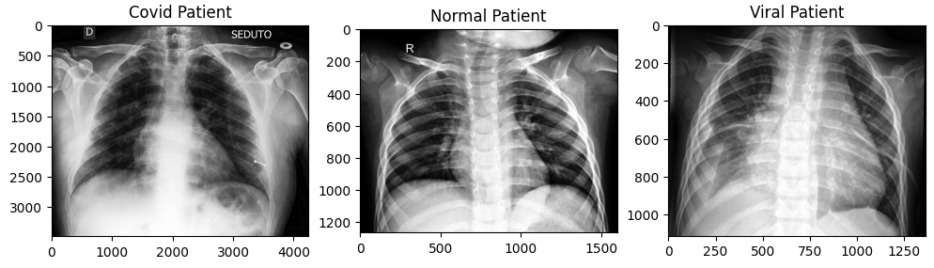
How does our data look like?

Slide 10
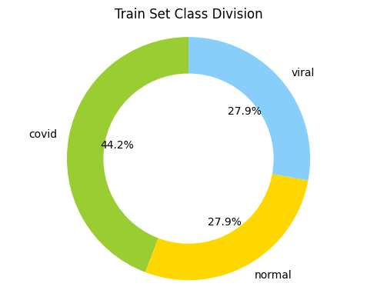
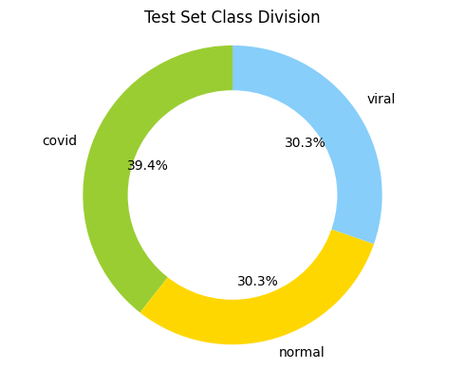
How did we divide the data?
Two datasets were given for training and testing, with variable number of instances for each class (approximately same ratio of train/test division).
 | Train | Test
Covid | 111 | 26
Viral | 70 | 20
Normal | 70 | 20
 | Train | Test
TOTAL | 251 | 66
% | 80% | 20%

Slide 11
Preprocessing Techniques
As preprocessing we resized the image to the 224x224 “standard” that is commonly used for CNN processing as it captures most of the image’s information without becoming too computationally expensive.
We tried Histogram Equalization, a method in image processing of contrast adjustment using the image's histogram. This technique is commonly used with X-Ray images.
Not optimal for every model
Source: https://en.wikipedia.org/wiki/Histogram_equalization

Slide 12
Preprocessing Techniques
To address the class imbalance we used a weighted loss function:
Compute the class weights from the training data
Pass the weights to the loss function
Train the model as usual
No need to make any changes to the data itself

Slide 13
Augmentation Techniques
We applied a simple augmentation technique based on the horizontal flipping of the images. Applying this to every image in our dataset we were able to duplicate the number of instances for each class.
We were able to decrease the bias of the network towards one side of the lung displaying more probability of belonging to a class.

Slide 14
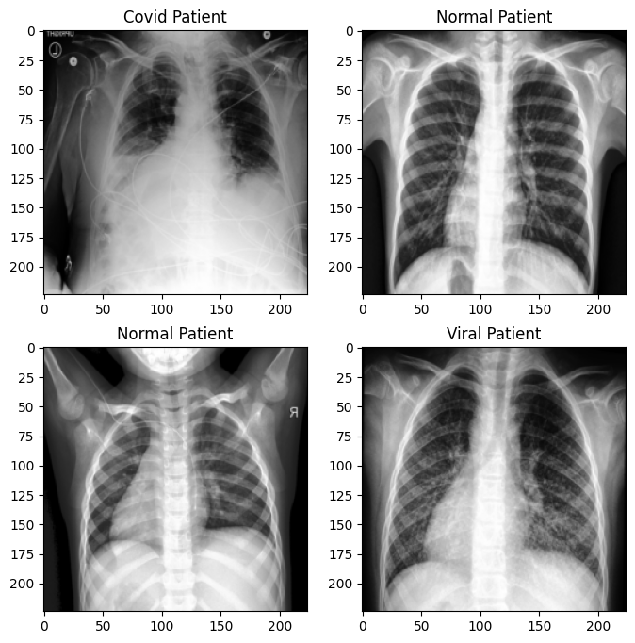
Augmentation Techniques

Slide 15
Network Architecture Design
Research Models & Proposed Solution

Slide 16

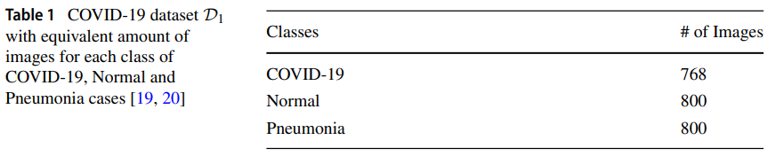
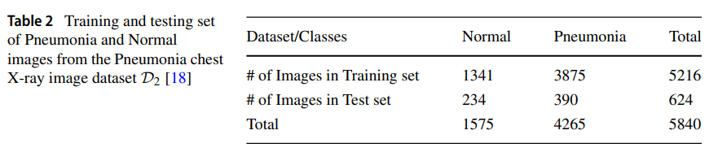
Classification of COVID-19 from chest x-ray images using deep features and correlation coefficient
Source: https://link.springer.com/article/10.1007/s11042-022-12500-3

Slide 17
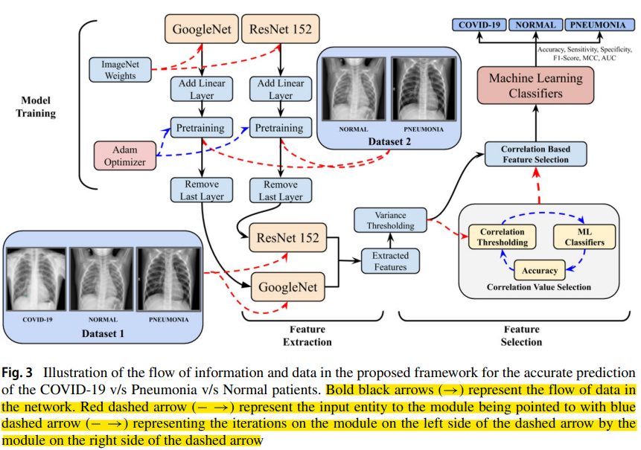
Classification of COVID-19 from chest x-ray images using deep features and correlation coefficient
Source: https://link.springer.com/article/10.1007/s11042-022-12500-3

Slide 18
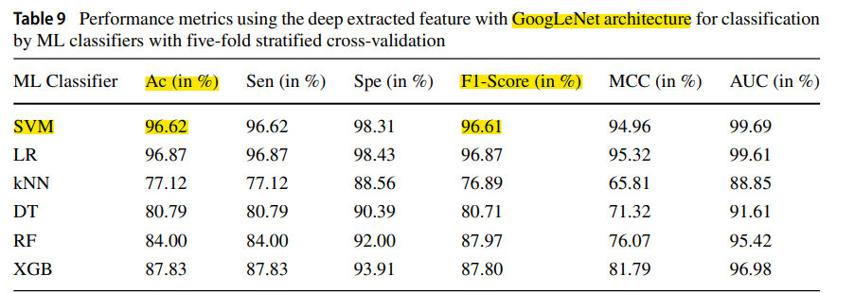
Classification of COVID-19 from chest x-ray images using deep features and correlation coefficient
Source: https://link.springer.com/article/10.1007/s11042-022-12500-3

Slide 19
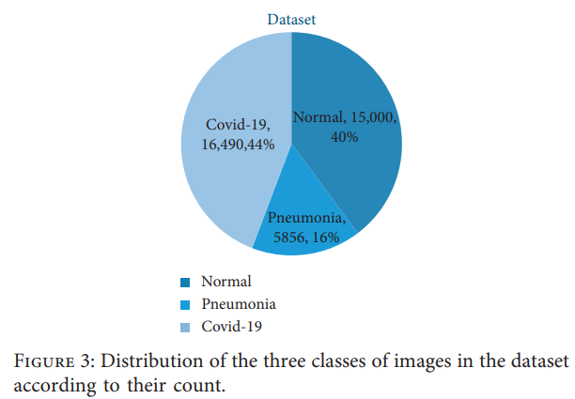
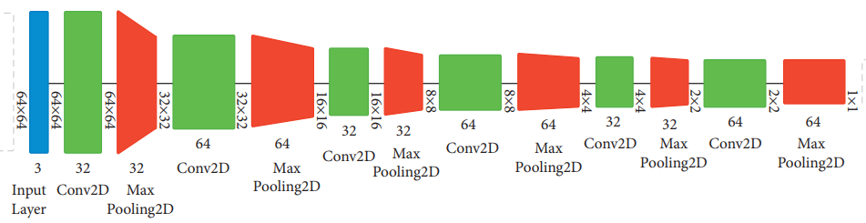
Multiclass Classification for Detection of COVID-19 Infection in Chest X-Rays Using CNN
Source: https://www.hindawi.com/journals/cin/2022/3289809/

Slide 20
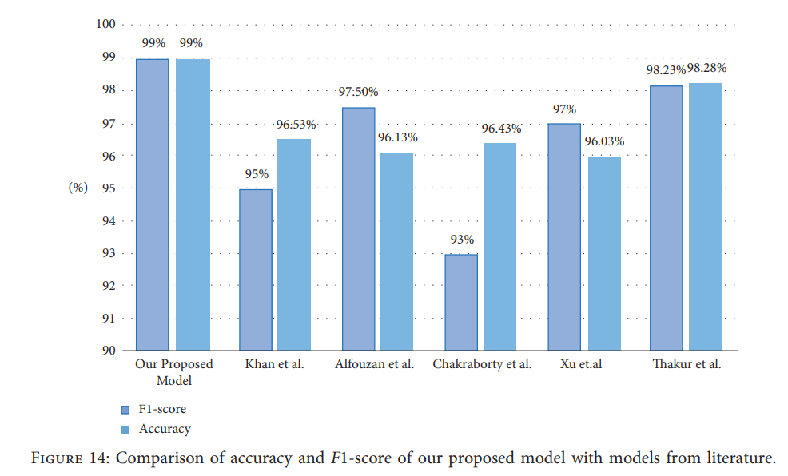
Multiclass Classification for Detection of COVID-19 Infection in Chest X-Rays Using CNN
Source: https://www.hindawi.com/journals/cin/2022/3289809/

Slide 21
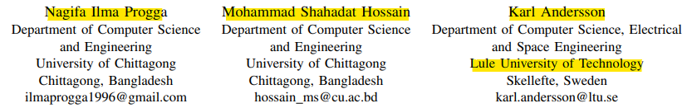
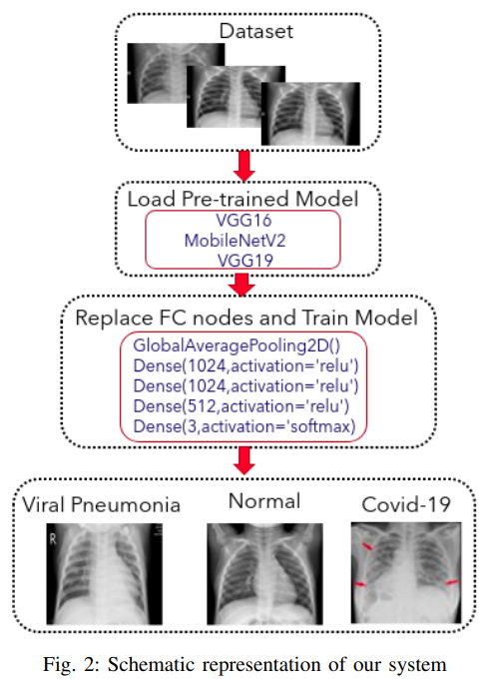
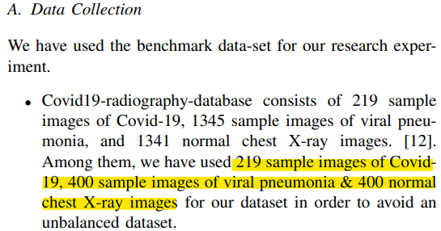
A Deep Transfer Learning Approach to Diagnose Covid-19 using X-ray Images
Source: https://ieeexplore.ieee.org/abstract/document/9398037

Slide 22
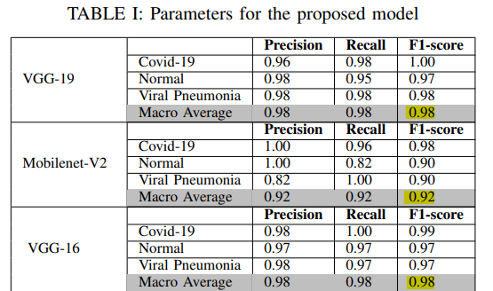
A Deep Transfer Learning Approach to Diagnose Covid-19 using X-ray Images
Source: https://ieeexplore.ieee.org/abstract/document/9398037

Slide 23
Proposed Solutions
TabukNet – Own Implemented Deep CNN
ChittagongNet – Transfer Learning
VGG19 – Feature Extraction
ResNet18 – Fine Tuning

Slide 24
Network Training & Evaluation
Training Procedure & Evaluation Metrics

Slide 25
Training characteristics
Hyperparameters:
Optimizer: Adam
Criterion: CrossEntropyLoss
Prediction: Softmax probabilities
Ground Truth: Class label
 | TabukNet | VGG19 | ResNet18
Number of epochs | 40 | 40 | 40
Batch Size | 64 | 64 | 64
Learning Rate | 0.001 | 0.001 | 0.0001

Slide 26
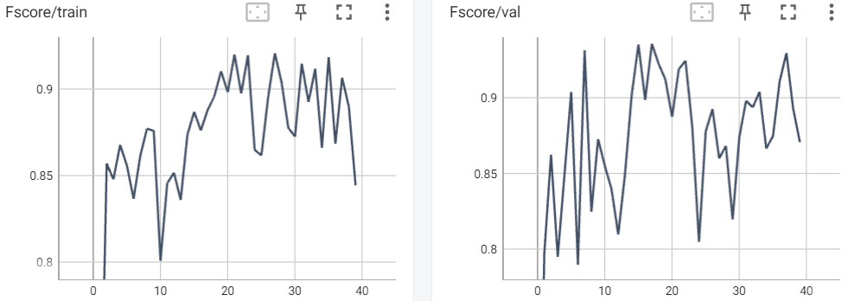
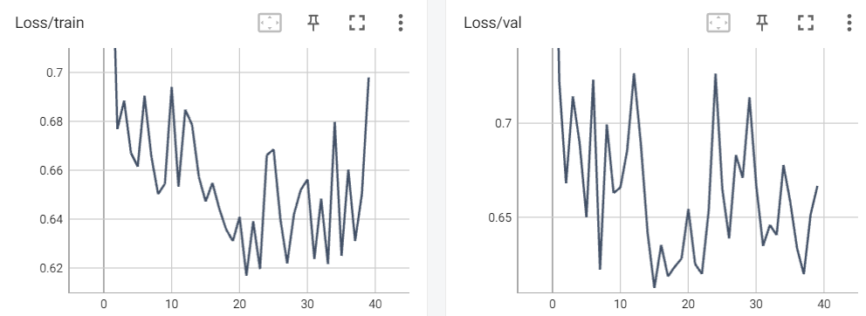
TabukNet
Train Set:
Accuracy: 0.89
Fscore: 0.89
Loss: 0.6472
Val Set:
Accuracy: 0.94
Fscore: 0.94
Loss: 0.6123
Test Set:
Accuracy: 0.61
Fscore: 0.56
Loss: 0.857

Slide 27
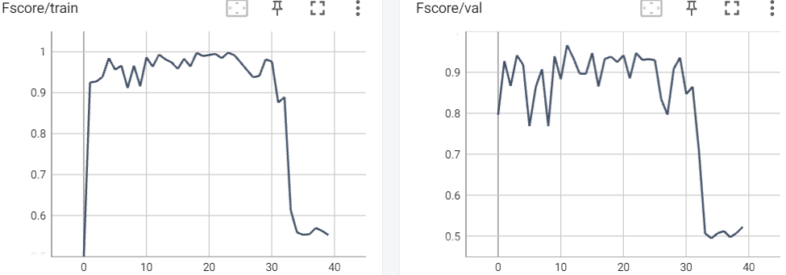
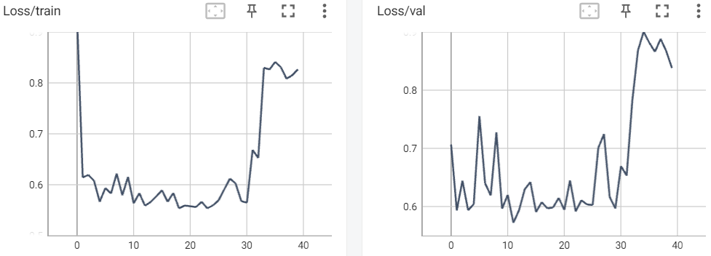
ChittagongNet/VGG16
Train Set:
Accuracy: 0.96
Fscore: 0.96
Loss: 0.5834
Val Set:
Accuracy: 0.98
Fscore: 0.97
Loss: 0.5271
Test Set:
Accuracy: 0.5
Fscore: 0.45
Loss: 0.950

Slide 28
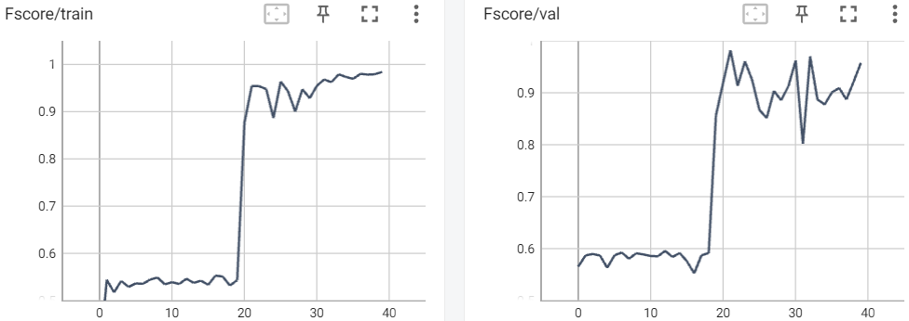
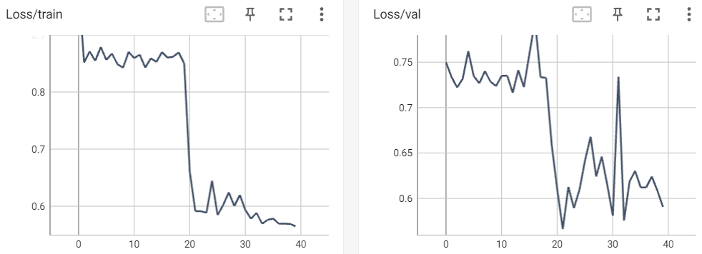
ChittagongNet/VGG19
Train Set:
Accuracy: 0.96
Fscore: 0.95
Loss: 0.5911
Val Set:
Accuracy: 0.98
Fscore: 0.98
Loss: 0.5663
Test Set:
Accuracy: 0.77
Fscore: 0.77
Loss: 0.614

Slide 29
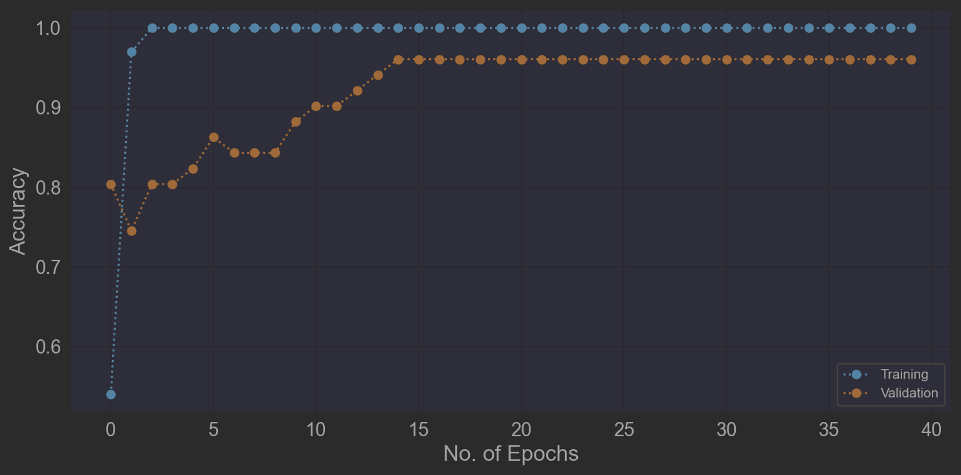
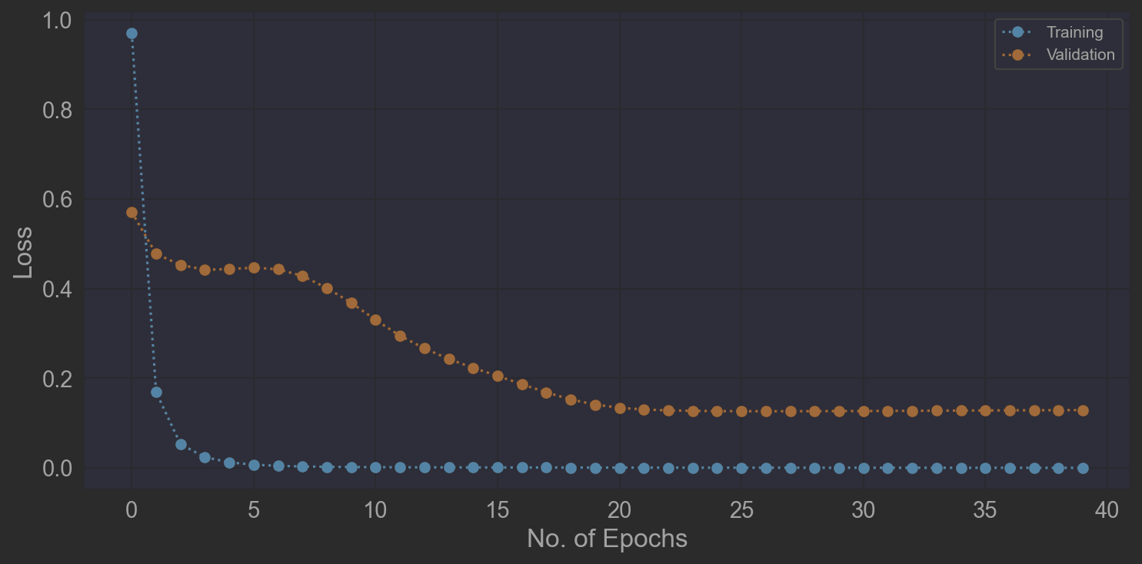
ChittagongNet/ResNet18
Train Set:
Accuracy: 1.0
Fscore:
Loss: 0.0005
Val Set:
Accuracy: 0.95
Fscore:
Loss: 0.13
Test Set:
Accuracy: 0.87
Fscore:
Loss: 0.46

Slide 30
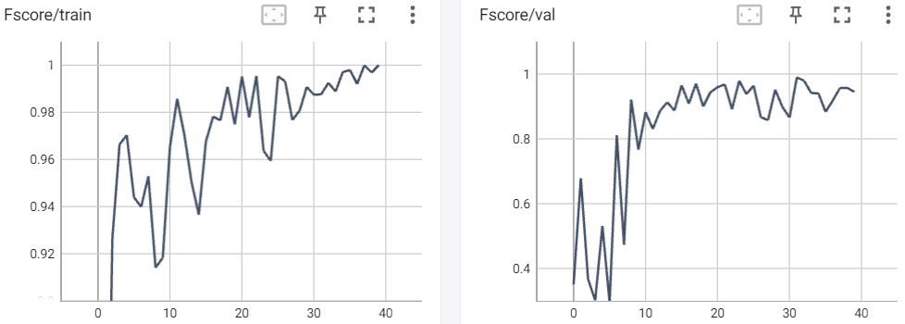
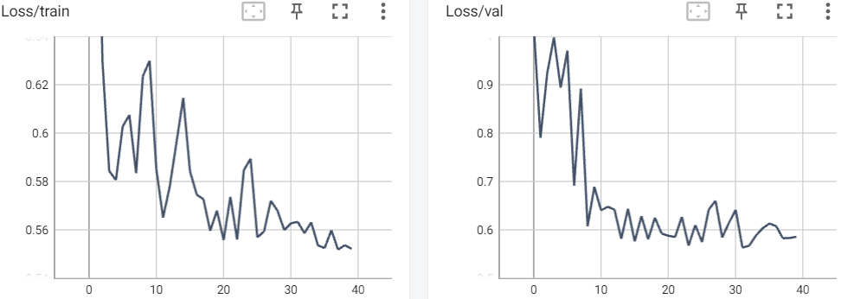
ChittagongNet/MobileNetV2
Train Set:
Accuracy: 0.9889
Fscore: 0.9877
Loss: 0.5633
Val Set:
Accuracy: 0.9936
Fscore: 0.9895
Loss: 0.5634
Test Set:
Accuracy: 0.615
Fscore: 0.615
Loss: 0.853

Slide 31
Results
What did our network learn?

Slide 32
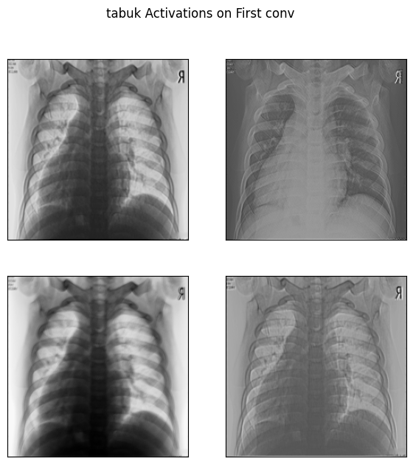
Feature Activations
Representation of the learned features within the input data.
The activation map highlights the presence and intensity of specific features within the input data

Slide 33
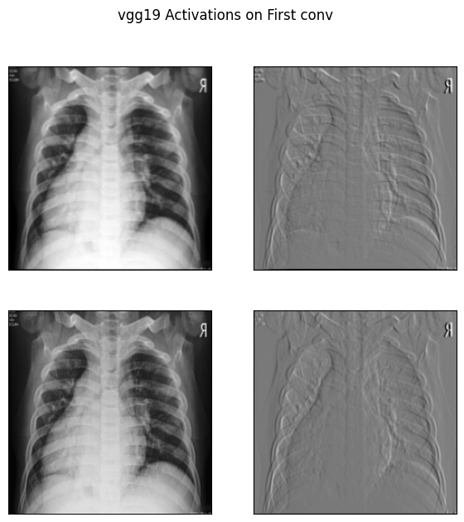
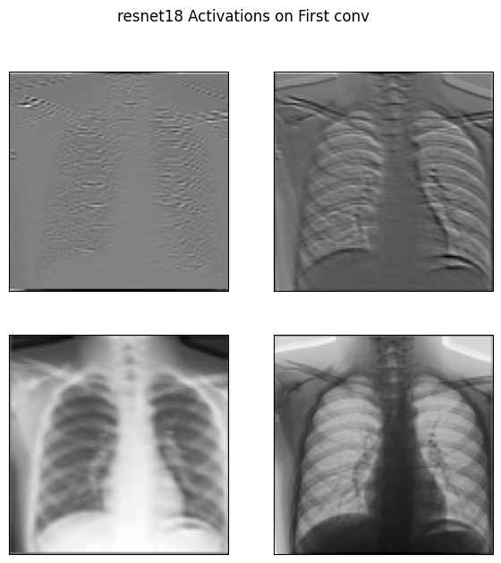
Feature Activations

Slide 34
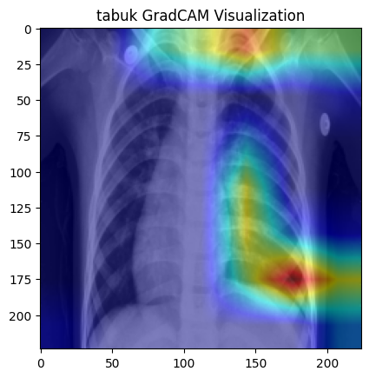
GradCAM – Gradient Visualization
Rate of change of the loss function with respect to the network's parameters.
The gradients indicate how sensitive the loss function is to changes in the parameters of the network

Slide 35
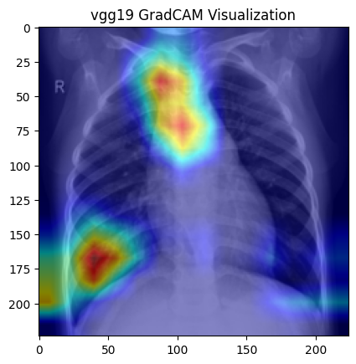
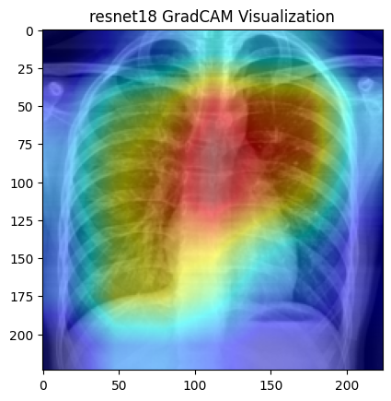
GradCAM – Gradient Visualization

Slide 36
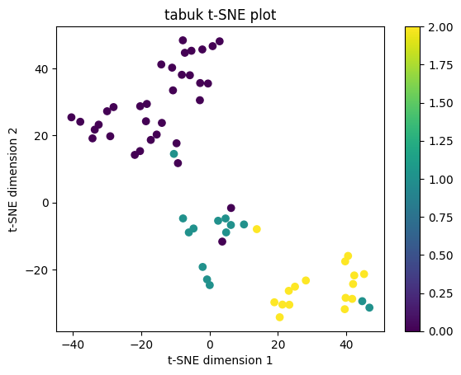
t-SNE – Feature Visualization
Map high-dimensional data points into a lower-dimensional space while preserving the similarities between the data points.
Cluster division of classes based on local similarity in the high-dimensional space.

Slide 37
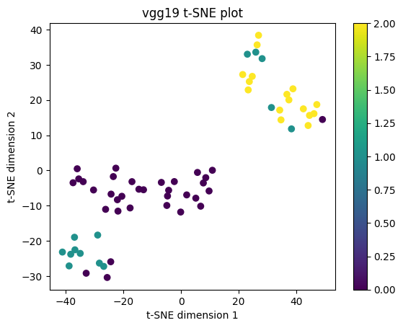
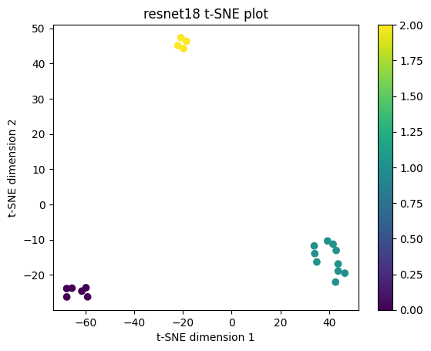
t-SNE – Feature Visualization

Slide 38
Conclusion

Slide 39
Key ideas from Project Work
It does seem a reachable task to train a CNN for identification of pneumonia on x-ray chest images.
Training and Validation Accuracy/Fscore higher than 95% on all models except TabukNet.
Testing Accuracy of 87% on ResNet18.
Better models might be achieved by increasing the dataset.

Slide 40
Thank you
Questions?

