Slide 1
Multiclass Classification for Detection of Pneumonia Infection in Chest X-Rays M7016H - AI In The Healthcare System
Tim Ufer : timufe-2 Robert Lindberg : oreile-9 Fernando Labra Caso : ferlab-1

Slide 2
Index
Introduction
Data Analysis
Network Architecture Design
Network Training & Evaluation
Results
Conclusion

Slide 3
Introduction
About Pneumonia

Slide 4
What is Pneumonia?
Pneumonia is an inflammatory condition of the lung primarily affecting the small air sacs known as alveoli.
Pneumonia is usually caused by infection with viruses or bacteria, and less commonly by other microorganisms.
Each year, pneumonia affects about 450 million people globally (7% of the population) and results in about 4 million deaths.
Source: https://en.wikipedia.org/wiki/Pneumonia

Slide 5
What does Pneumonia affect?
A pulmonary alveolus, is one of millions of hollow, cup-shaped cavities in the lungs where pulmonary gas exchange takes place.
Oxygen is exchanged for carbon dioxide at the blood–air barrier between the alveolar air and the pulmonary capillary.
Source: https://en.wikipedia.org/wiki/Pulmonary_alveolus

Slide 6
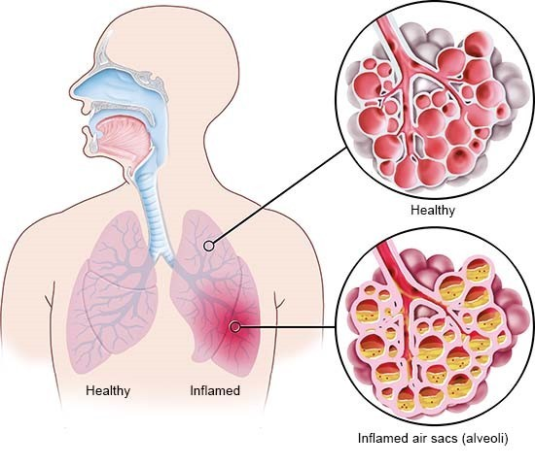
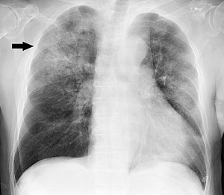
How does Pneumonia look like?
Graphical visualization of the Pneumonia effects on the alveoli
Source: informedhealth.org
Chest X-ray of a pneumonia caused by Haemophilus influenzae
Source: wikipedia.org/wiki/Pneumonia

Slide 7
Data Analysis
Class Distribution, Preprocessing & Augmentation Techniques

Slide 8
How does our data look like?
The dataset consists of high-resolution x-ray images of the lungs. There are two classes for pneumonia patients contracted with (1) COVID-19 and (2) other viruses as well as a class for (3) non-infected patients.
The images are not the same size and the number of instances on each class is different. The total number of instances is 137, 90 and 90 for respectively covid, viral and normal classes.

Slide 9
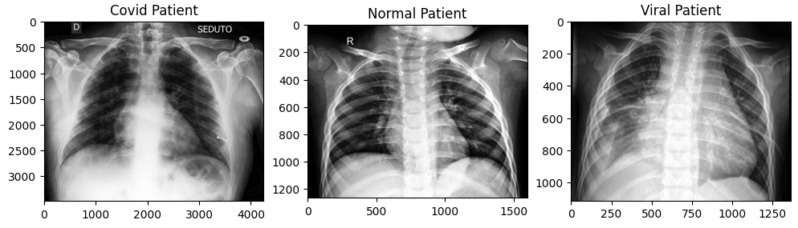
How does our data look like?

Slide 10
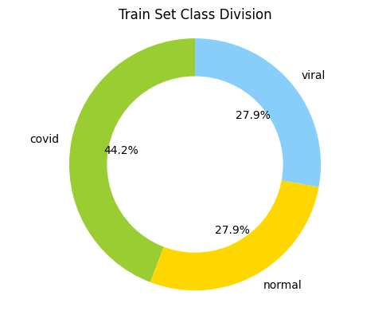
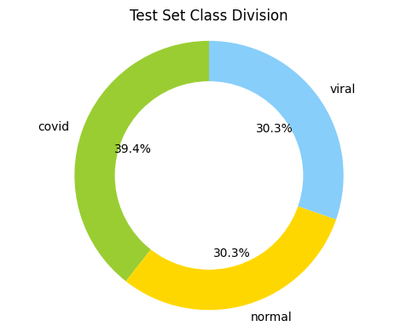
How did we divide the data?
Two datasets were given for training and testing, with variable number of instances for each class (approximately same ratio of train/test division).
 | Train | Test
Covid | 111 | 26
Viral | 70 | 20
Normal | 70 | 20
 | Train | Test
TOTAL | 251 | 66
% | 80% | 20%

Slide 11
Preprocessing Techniques
As preprocessing we resized the image to the 224x224 “standard” that is commonly used for CNN processing as it captures most of the image’s information without becoming too computationally expensive.
We also applied Histogram Equalization, a method in image processing of contrast adjustment using the image's histogram. This technique is commonly used with X-Ray images.
Source: https://en.wikipedia.org/wiki/Histogram_equalization

Slide 12
Augmentation Techniques
We applied a simple augmentation technique based on the horizontal flipping of the images. Applying this to every image in our dataset we were able to duplicate the number of instances for each class.
We were able to decrease the biasness of the network towards one side of the lung displaying more probability of belonging to a class.

Slide 13
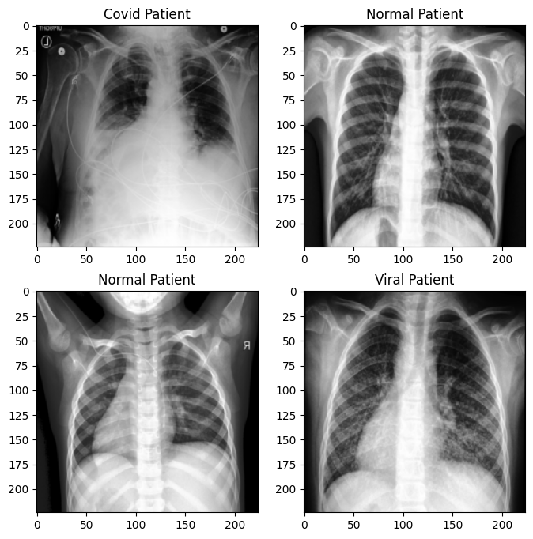
Augmentation Techniques

Slide 14
Network Architecture Design
Research Models & Proposed Solution

Slide 15

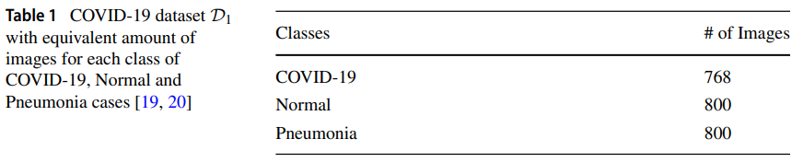
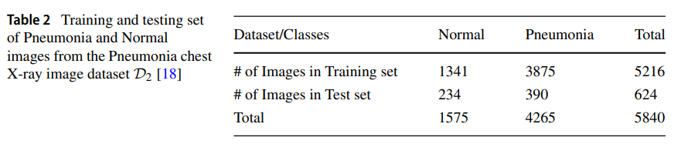
Classification of COVID-19 from chest x-ray images using deep features and correlation coefficient
Source: https://link.springer.com/article/10.1007/s11042-022-12500-3

Slide 16
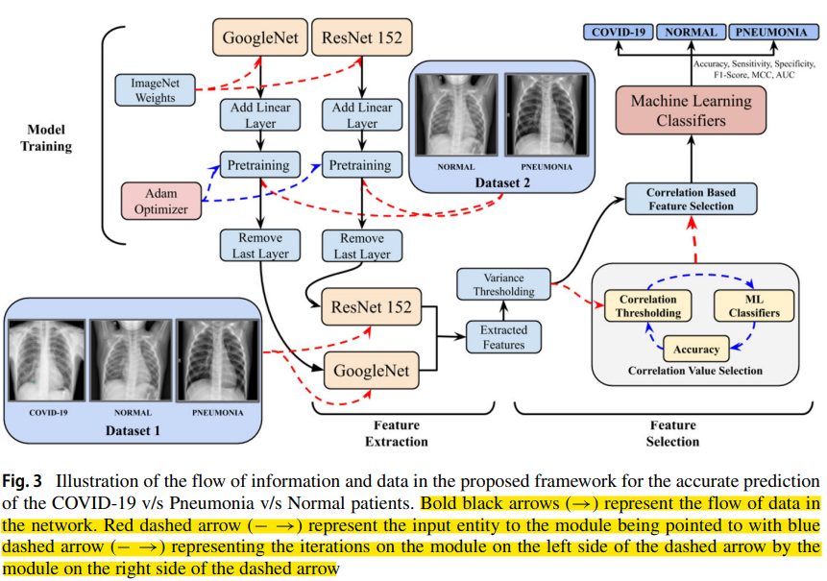
Classification of COVID-19 from chest x-ray images using deep features and correlation coefficient
Source: https://link.springer.com/article/10.1007/s11042-022-12500-3

Slide 17
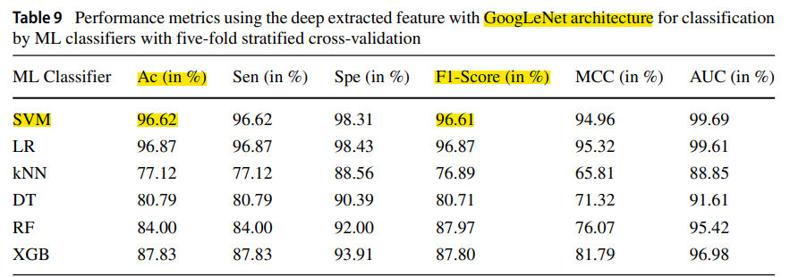
Classification of COVID-19 from chest x-ray images using deep features and correlation coefficient
Source: https://link.springer.com/article/10.1007/s11042-022-12500-3

Slide 18
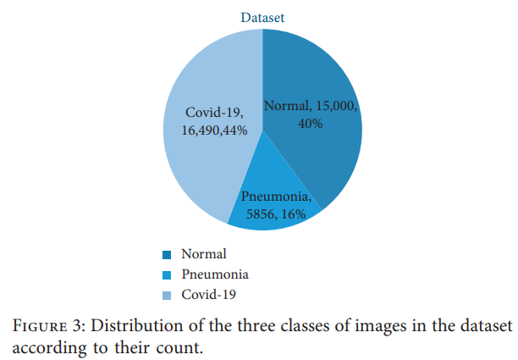
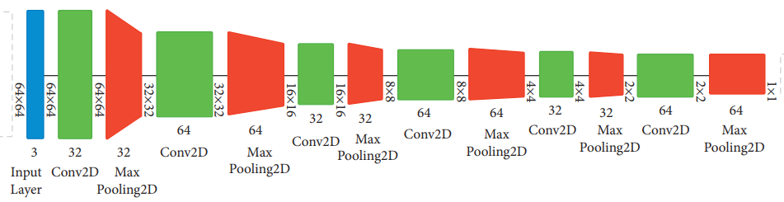
Multiclass Classification for Detection of COVID-19 Infection in Chest X-Rays Using CNN
Source: https://www.hindawi.com/journals/cin/2022/3289809/

Slide 19
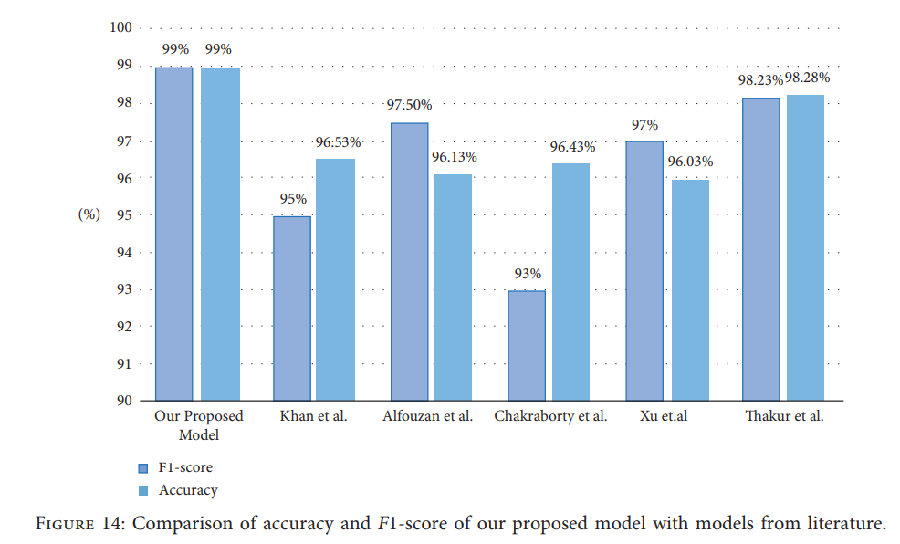
Multiclass Classification for Detection of COVID-19 Infection in Chest X-Rays Using CNN
Source: https://www.hindawi.com/journals/cin/2022/3289809/

Slide 20
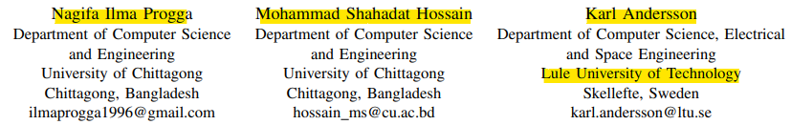
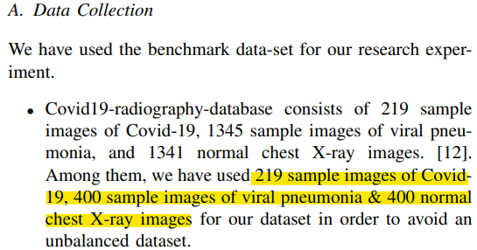
A Deep Transfer Learning Approach to Diagnose Covid-19 using X-ray Images
Source: https://ieeexplore.ieee.org/abstract/document/9398037

Slide 21
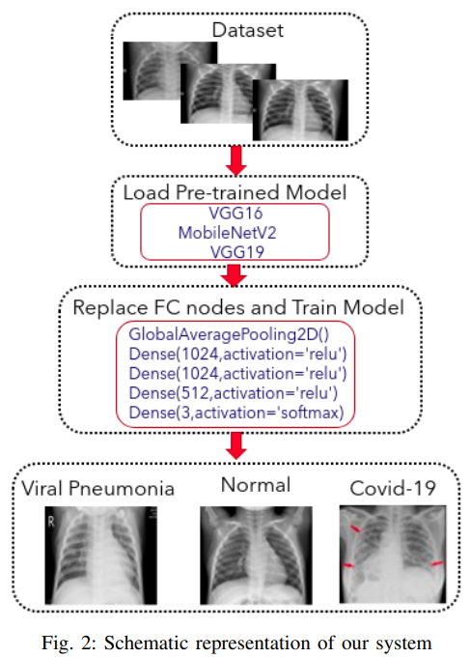
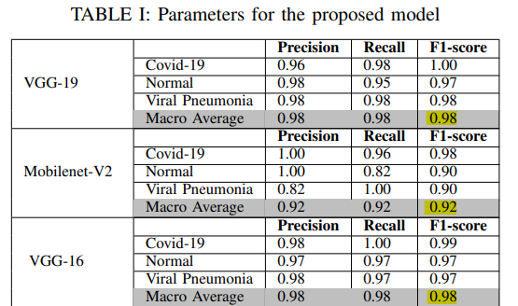
A Deep Transfer Learning Approach to Diagnose Covid-19 using X-ray Images
Source: https://ieeexplore.ieee.org/abstract/document/9398037

Slide 22
Proposed Solutions
TabukNet – Own Implemented Deep CNN
ChittagongNet – Transfer Learning
VGG16 / VGG19 / MovileNetV2
…

Slide 23
Network Training & Evaluation
Training Procedure & Evaluation Metrics

Slide 24
Training characteristics
Hyperparameters:
Number of epochs: 40
Batch size: 64
Learning rate: 0.001
Optimizer: Adam
Criterion: CrossEntropyLoss
Prediction: Softmax probabilities
Ground Truth: Class label

Slide 25
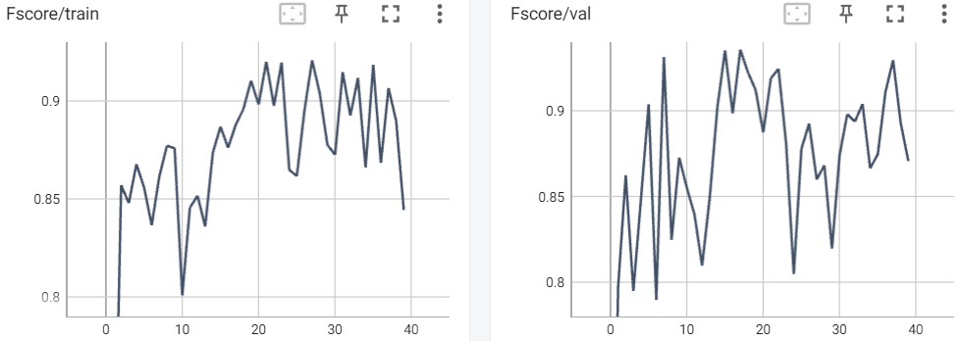
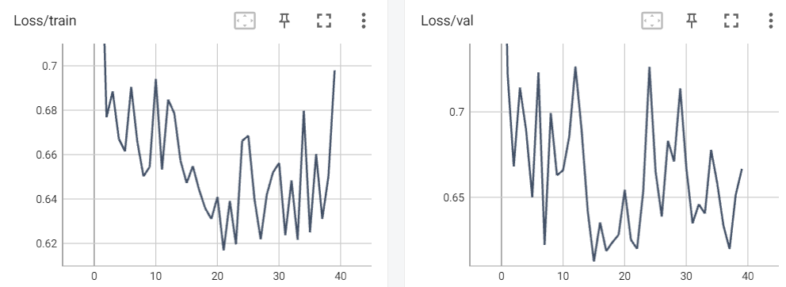
TabukNet
Train Set:
Accuracy: 0.891
Fscore: 0.8869
Loss: 0.6472
Val Set:
Accuracy: 0.9362
Fscore: 0.9352
Loss: 0.6123
Test Set:
Accuracy: 0.612
Fscore: 0.555
Loss: 0.857

Slide 26
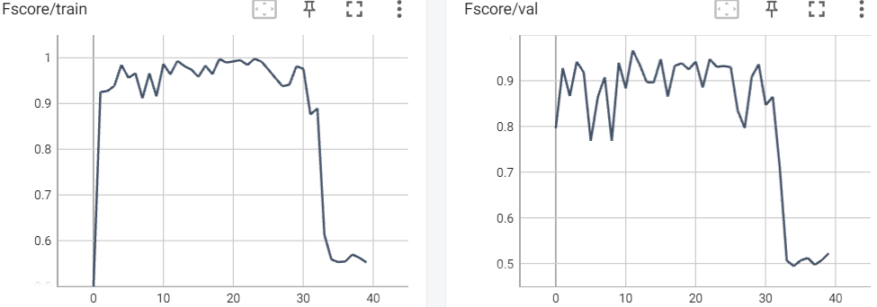
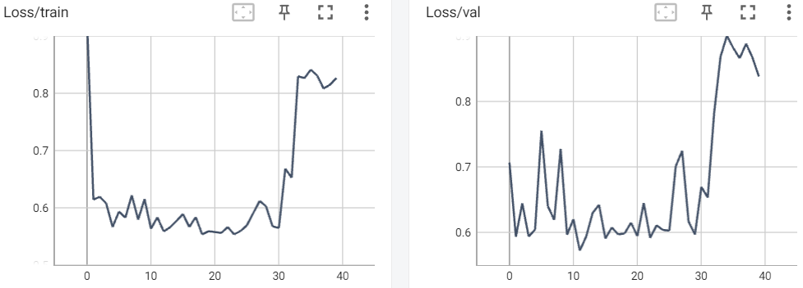
ChittagongNet/VGG16
Train Set:
Accuracy: 0.967
Fscore: 0.9638
Loss: 0.5834
Val Set:
Accuracy: 0.975
Fscore: 0.9665
Loss: 0.5271
Test Set:
Accuracy: 0.5
Fscore: 0.446
Loss: 0.950

Slide 27
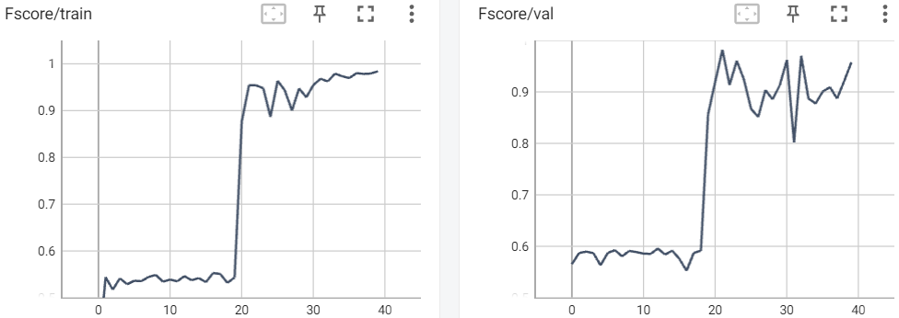
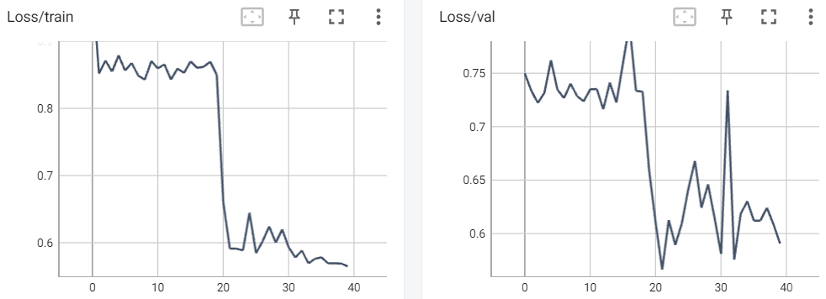
ChittagongNet/VGG19
Train Set:
Accuracy: 0.9588
Fscore: 0.9542
Loss: 0.5911
Val Set:
Accuracy: 0.9841
Fscore: 0.9819
Loss: 0.5663
Test Set:
Accuracy: 0.766
Fscore: 0.766
Loss: 0.614

Slide 28
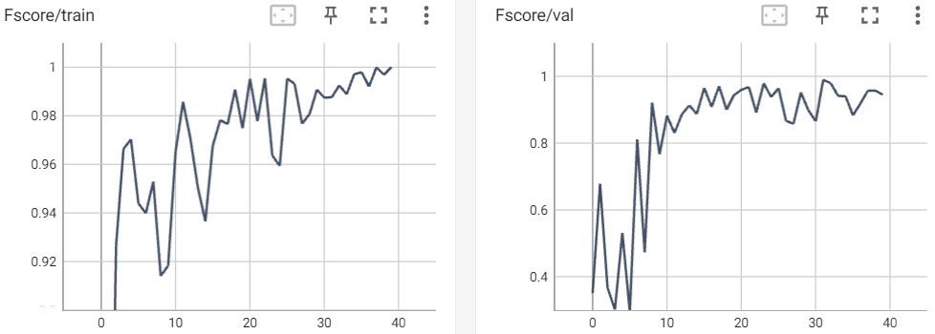
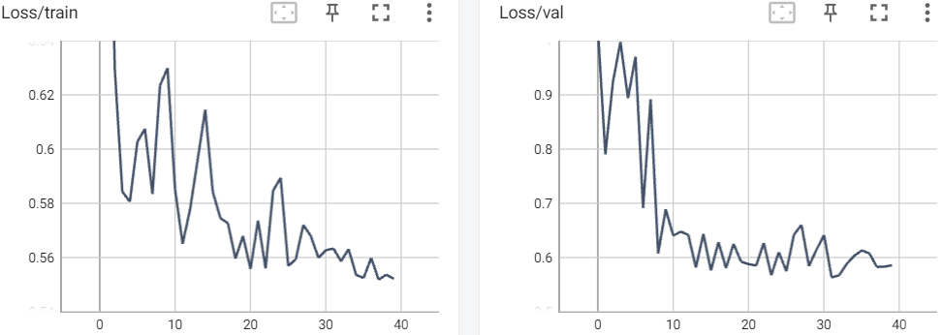
ChittagongNet/MobileNetV2
Train Set:
Accuracy: 0.9889
Fscore: 0.9877
Loss: 0.5633
Val Set:
Accuracy: 0.9936
Fscore: 0.9895
Loss: 0.5634
Test Set:
Accuracy: 0.615
Fscore: 0.615
Loss: 0.853

Slide 29
Results
What did our network learn?

Slide 30
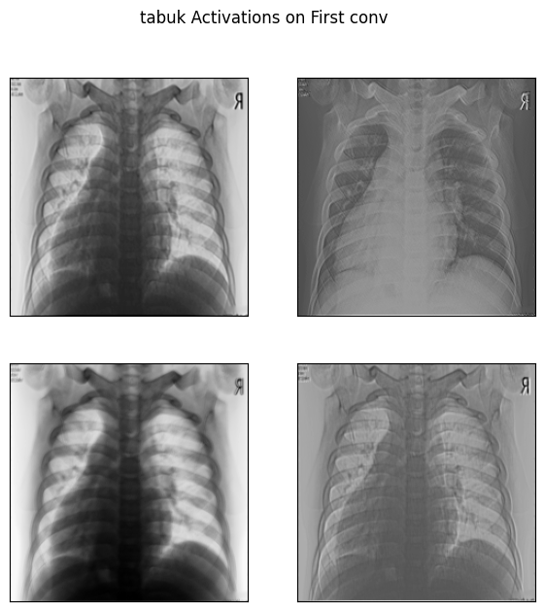
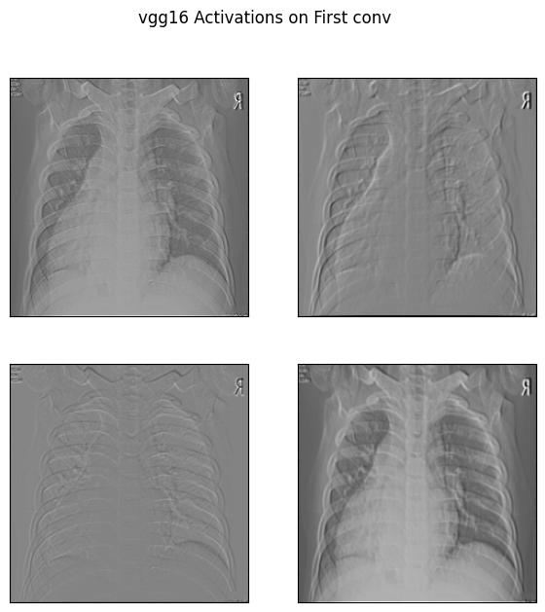
Feature Activations

Slide 31
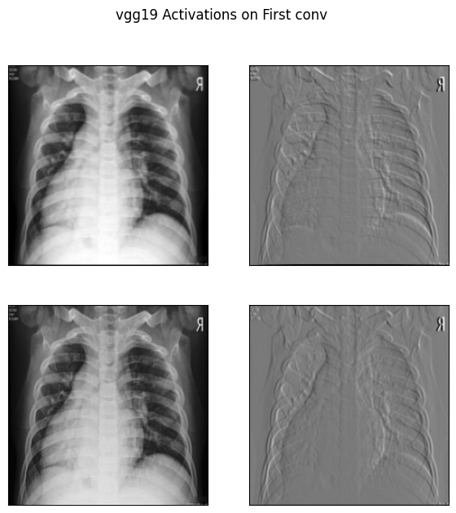
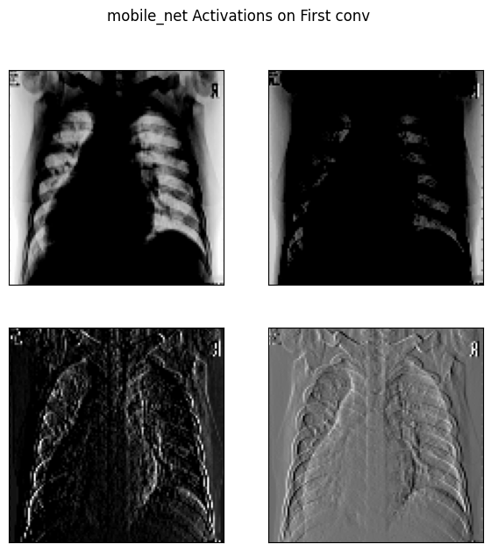
Feature Activations

Slide 32
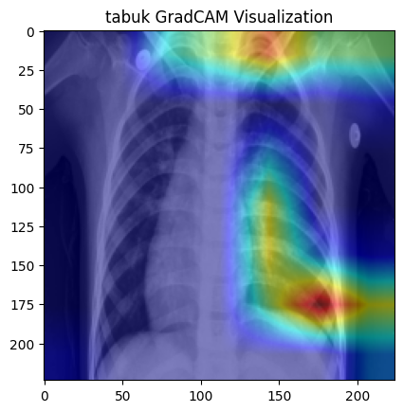
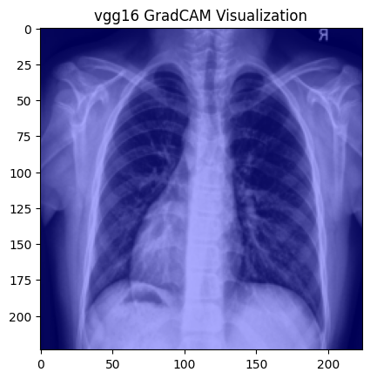
GradCAM – Gradient Visualization

Slide 33
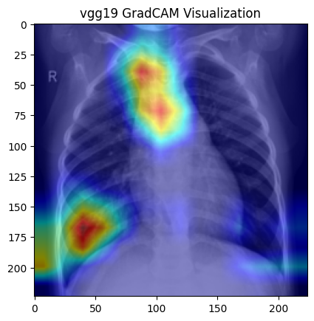
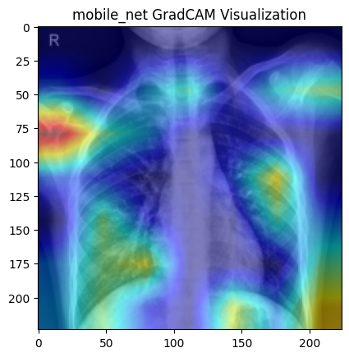
GradCAM – Gradient Visualization

Slide 34
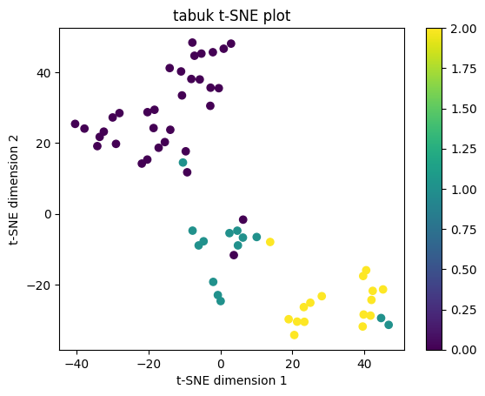
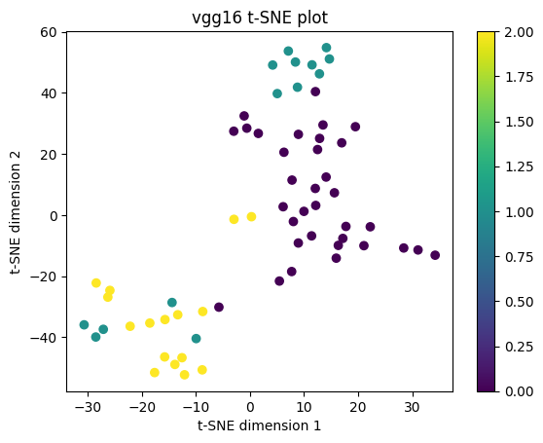
t-SNE – Feature Visualization

Slide 35
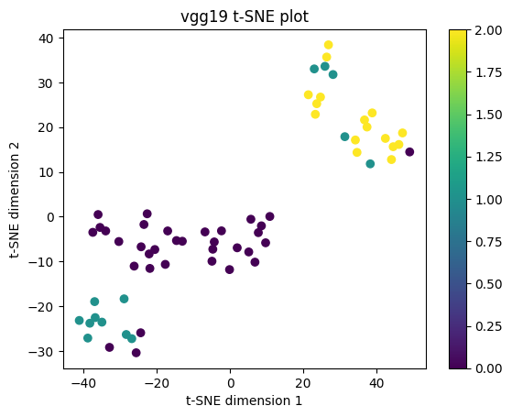
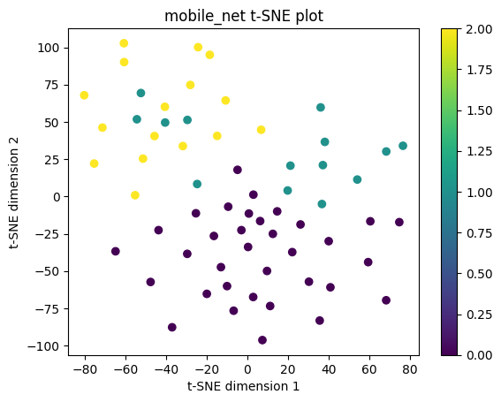
t-SNE – Feature Visualization

Slide 36
Conclusion

Slide 37
Key ideas from Project Work
It does seem a reachable task to train a CNN for identification of pneumonia on x-ray chest images.
Training and Validation Accuracy/Fscore higher than 95% on all models except TabukNet.
Testing Metrics do not seem as promising with a generalization Accuracy/Fscore of ~60%.
Better models might be achieved by increasing the dataset.

Slide 38
Thank you
Questions?

