Slide 1
Practical session. Coalescence and Relate
Oscar Lao

Slide 2
Model Ne changes
NePast
Coalescence rate?
time Change
NePresent
Coalescence rate?

Slide 3
Model Ne changes
Going backward
NePast
1/NePast
time Change
NePresent
1/NePresent

Slide 4
Model Ne changes
Going backward
NePast
1/NePast
time Change
Coalescence follows exponential with parameter 1/NePresent
NePresent
1/NePresent

Slide 5
Model Ne changes
Going backward
Coalescence follows
Exponential with parameter 1/NePast conditioned it did not reached coalescence in the previous Ne
NePast
1/NePast
time Change
NePresent
1/NePresent

Slide 6
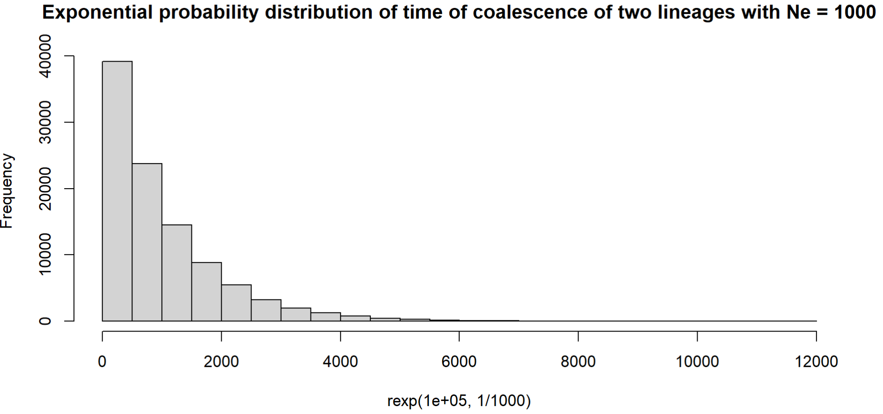
Model Ne changes
Going backward
Coalescence follows
time Change + Exponential with parameter 1/NePast conditioned it did not reached coalescence in the previous Ne
NePast
1/NePast
time Change
NePresent
1/NePresent

Slide 7
Pseudocode?

Slide 8
Model Ne bottleneck
NePresent
Going backward
time Change + duration of bottleneck
Coalescence follows
Time Change + Exponential with parameter 1/NePast conditioned it did not reached coalescence in the previous Ne
NePast
1/NePast
Duration of bottlenck
time Change
NePresent
1/NePresent

Slide 9
Model Ne bottleneck
Coalescence follows
Time Change +duration of bottleneck + Exponential with parameter 1/NePresent conditioned it did not reached coalescence in the previous Ne and NePast
NePresent
Going backward
time Change + duration of bottleneck
NePast
1/NePast
Duration of bottlenck
time Change
NePresent
1/NePresent

Slide 10
Model Ne Structured
NePresent
NePresent
NePresent

Slide 11
RELATE
🔹 Step 0: Install Relate
git clone https://github.com/relate/Relate.git
cd Relate
make
🔹 Step 1: Prepare Input Files
You need:
phased.vcf.gz: Phased and filtered VCF file
genetic_map.txt: Genetic map in 3-column format: chr pos cM
📦 Optional:
mask.bed: BED file to exclude low-quality or recombination-poor regions
Convert VCF to .haps and .sample:
RelateFileFormats/ConvertFromVcf \
--input phased.vcf.gz \
--output relate_input \
--sample sample_list.txt \
--haps-format \
--map genetic_map.txt

Slide 12
RELATE
🔹 Step 2: Run Relate (tree building + mutation inference)
Relate \
--mode All \
--haps relate_input.haps \
--sample relate_input.sample \
--map genetic_map.txt \
--output relate_output \
--threads 8
This will generate:
.anc = Ancestral recombination graph (trees)
.mut = Mutation placements
🔹 Step 3: Estimate Population Size History
EstimatePopulationSize/EstimatePopulationSize.sh \
-i relate_output \
-m 1.25e-8 \
-o popsize_output
Parameters:
-m: Per-base mutation rate (e.g., 1.25e-8 for humans)
-o: Output prefix
This produces:
popsize_output.coal = Coalescent rate summaries
popsize_output.Ne = Effective population size over time
Plotting scripts use this directly

Slide 13
RELATE
🔹 Step 4: Plot Population Size (Optional)
Visualize the Ne over time from popsize_output.Ne.
Simple example (in R):
popsize <- read.table("popsize_output.Ne", header=TRUE)
plot(popsize$Time, popsize$Ne, type='l', log='x',
xlab="Generations ago", ylab="Effective population size",
main="Population size history")
📂 Input File Summary
File Description
phased.vcf.gz Phased SNP data
genetic_map.txt Recombination map (chr, pos, cM)
sample_list.txt (Optional) list of samples to include
mask.bed (Optional) to exclude problematic regions
Relate assumes constant mutation rate and good phasing — use SHAPEIT4 or Eagle for preprocessing.
Works best on large sample sizes (e.g., >20 haploid genomes) for demographic signal.
Estimates are relative to mutation rate — errors in -m affect Ne scale.

