Slide 1
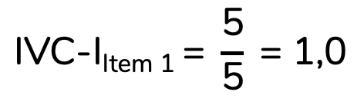
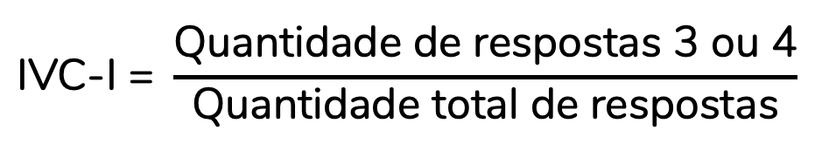
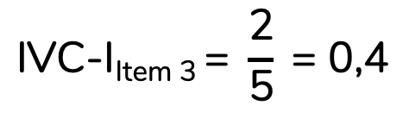
$$\text{IVC}\text{−}\text{I}\text{ = }\frac{\text{Quantidade} \text{de} \text{respostas}\text{ 3 }\text{ou}\text{ 4}}{\text{Quantidade} \text{total} \text{de} \text{respostas}}$$
Item | Aval. 1 | Aval. 2 | Aval. 3 | Aval. 4 | Aval. 5 | IVC-I
Item 1 | 3 | 4 | 4 | 3 | 4 | 1,0
Item 2 | 2 | 4 | 4 | 3 | 4 | 0,8
Item 3 | 4 | 2 | 1 | 1 | 3 | 0,4
$$\text{IVC}\text{−}\text{IItem}\text{ 1 = }\frac{\text{5}}{\text{5}} \text{= 1,0}$$
$$\text{IVC}\text{−}\text{IItem}\text{ 3 = }\frac{\text{2}}{\text{5}} \text{= 0,4}$$

Slide 2
Item | Aval. 1 | Aval. 2 | Aval. 3 | Aval. 4 | Aval. 5 | IVC-I
Item 1 | 3 | 4 | 4 | 3 | 4 | 1,0
Item 2 | 2 | 4 | 4 | 3 | 4 | 0,8
Item 3 | 4 | 2 | 1 | 1 | 3 | 0,4
Item 4 | 4 | 4 | 3 | 4 | 3 | 1,0
Item 5 | 3 | 4 | 2 | 3 | 4 | 0,8
Item 6 | 4 | 4 | 4 | 3 | 4 | 1,0
$$\text{IVC}\text{−}\text{S}\text{/}\text{UA}\text{ = }\frac{\text{3}}{\text{6}} \text{= 0,83}$$

Slide 3
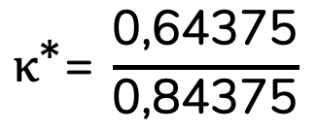

Item | Aval. 1 | Aval. 2 | Aval. 3 | Aval. 4 | Aval. 5 | IVC-I
Item 2 | 2 | 4 | 4 | 3 | 4 | 0,8
Item | Aval. 1 | Aval. 2 | Aval. 3 | Aval. 4 | Aval. 5 | IVC-I | p_{c}
Item 2 | 2 | 4 | 4 | 3 | 4 | 0,8 | 0,15625
$${\text{κ}}^{\text{∗}}\text{= }\frac{\text{0,8 }–\text{ 0,15625}}{\text{1 }–\text{0,15625}}$$
$${\text{κ}}^{\text{∗}}\text{=} \frac{\text{0}\text{,}\text{64375}}{\text{0}\text{,}\text{84375}}$$
= 0,763

Slide 4
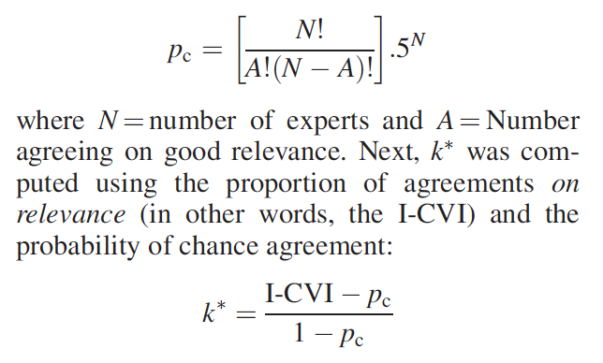
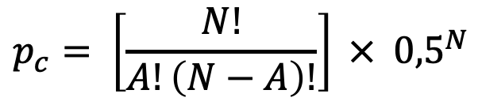
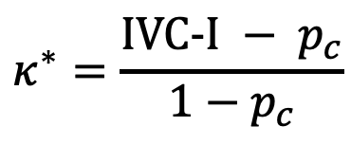
$$p_{c}= \left[\frac{N!}{A!\left(N−A\right)!}\right] × { 0,5}^{N}$$
$$κ^{∗}=\frac{\text{IVC}\text{-}\text{I} − p_{c}}{1−p_{c}}$$

Slide 5
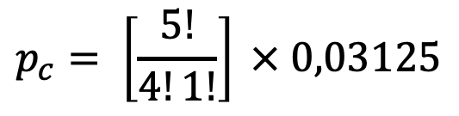

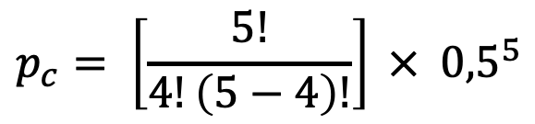
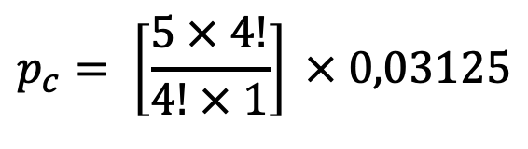
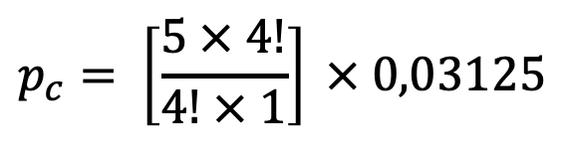
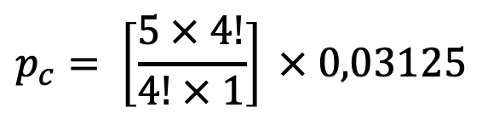
$$p_{c}= \left[\frac{5!}{4!\left(5−4\right)!}\right] × { 0,5}^{5}$$
$$p_{c}= \left[\frac{5!}{4!1!}\right] × 0,03125$$
$$p_{c}= \left[\frac{5 × 4!}{4! × 1}\right] × 0,03125$$
$$p_{c}= \left[\frac{5 × 4!}{4! × 1}\right] × 0,03125$$
$$p_{c}= \left[\frac{5 × 4!}{4! × 1}\right] × 0,03125$$
$$p_{c}=5 × 0,03125=0,15625$$

