Slide 1
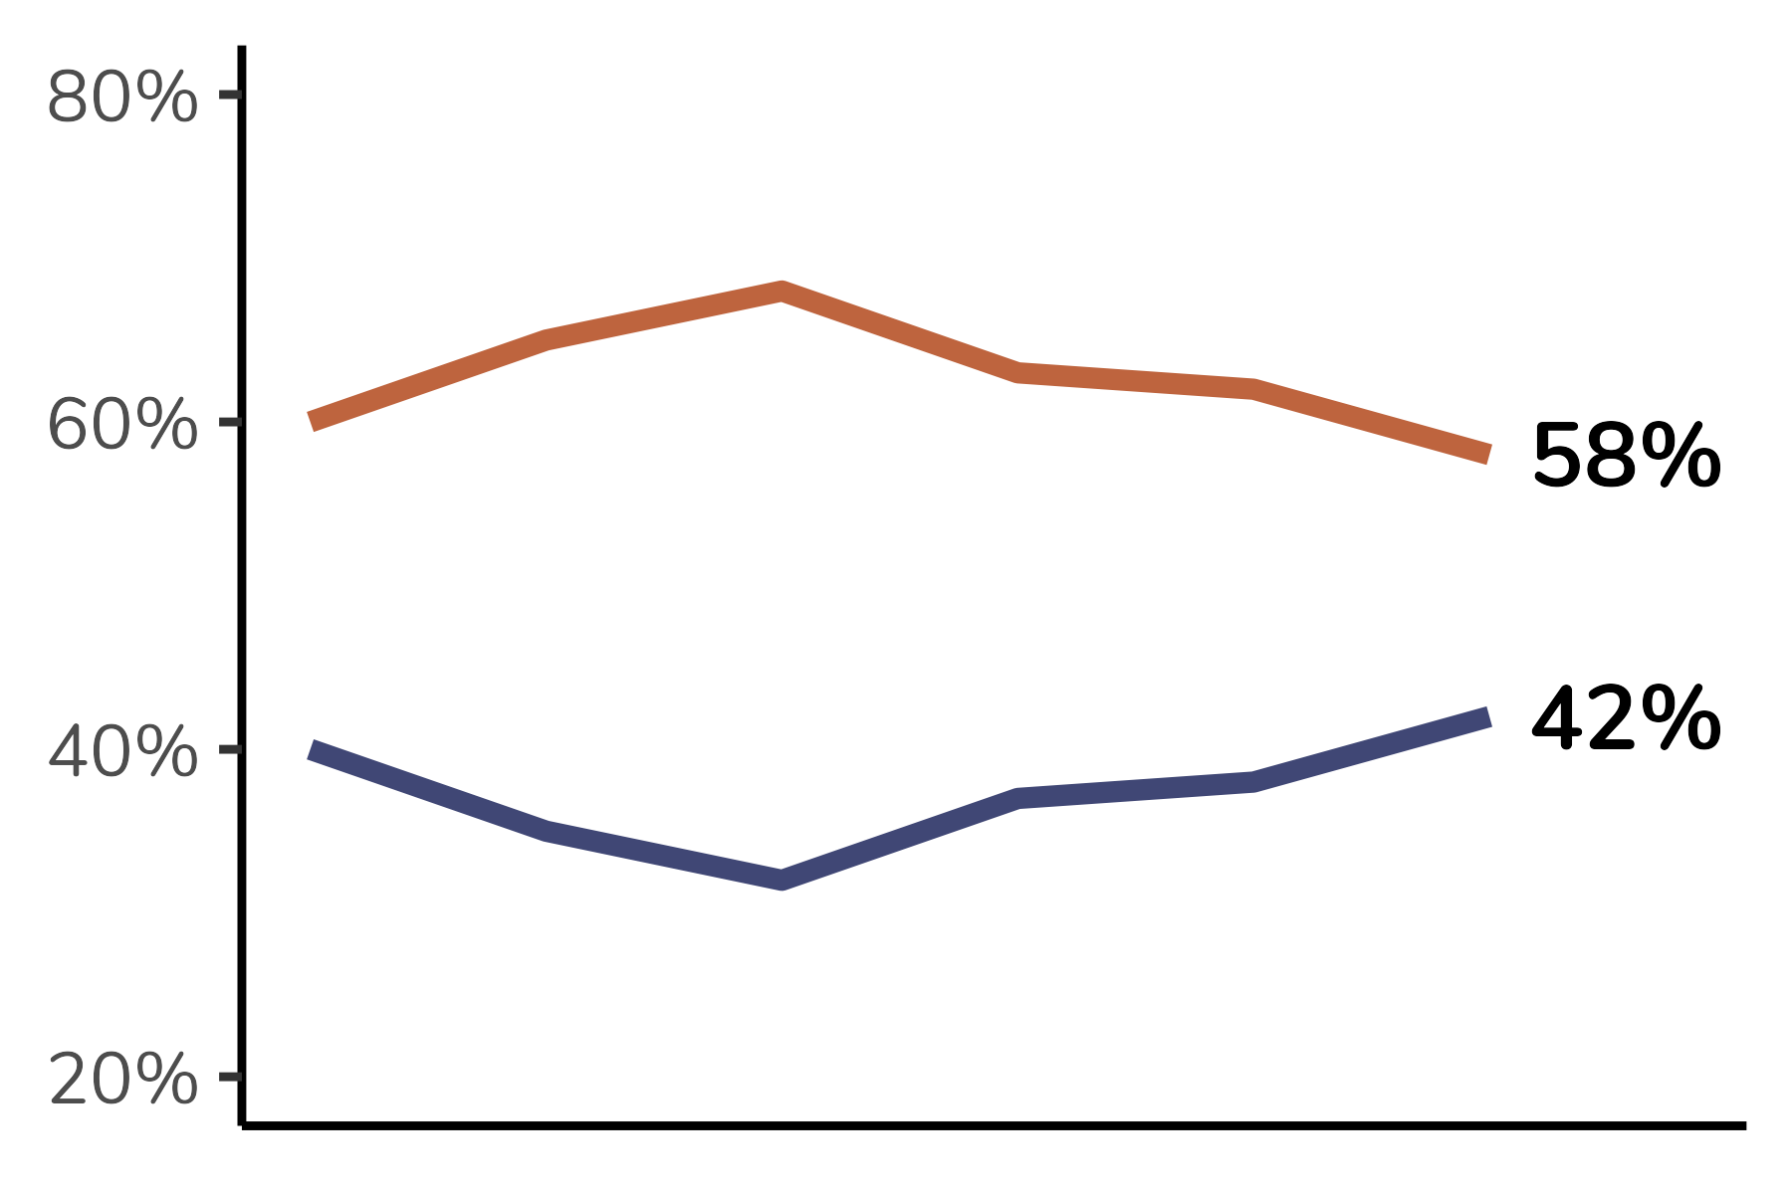
Imagem adaptada de Freepik.com
Image by <a href="https://www.freepik.com/free-vector/flat-brazil-elections-illustration_33793306.htm#query=election&position=5&from_view=keyword&track=ais_hybrid&uuid=639ea270-4b25-4e1e-8114-1637f1ec9425">Freepik</a>

