Slide 1
AGST 5014 Design of Experiments
Samuel B. Fernandes, Ph.D. E-mail: samuelbf@uark.edu

Slide 2
Location and Time
Lecture: Mon, Wed 10:45AM - 12:00PM (POSC 0117O)
Lab: Fri 10:45AM - 12:35PM (AFLS B108)
Office hours: AGRX 109 on Mon and Wed 1:00 PM to 2:00 PM or by appointment.

Slide 3
Course Objectives
To be able to plan an experiment in such a way that the statistical analysis results in valid and objective conclusions;
To learn a variety of experimental designs and be able to choose an appropriate design for a specific study;
To be able to perform the proper statistical analysis and draw valid conclusions from a specific experiment.
Lab Objectives:
To review class materials covered or demonstrated during the lectures;
To learn how to use R for design and analysis of experiments;
To practice for homeworks and exams.

Slide 4
Grading structure
15% (150 points) Weekly* Homework
15% (150 points) Weekly* Quizzes
20% (200 points) Exam1 End of PART I
20% (200 points) Exam2 End of PART II
20% (200 points) Final Exam
10% (100 points) Final Project

Slide 5
Homework
Every Monday
Submission – Next Monday at 11:59 PM
Homework should be saved as pdf/R/Rmd (or another format we agree in class) with lastname_hw# (e.g., “fernandes_hw1.R”). A single file!
Failure to follow this policy will result in an initial warning, followed by a 50% reduction in points, then a 100% reduction in points.
11 assignments; The lowest homework score will be dropped when computing the final homework grade.

Slide 6
Quizzes
Every week
Readings/chapters/homework
11 quizzes; The lowest quiz will be dropped
NO MADE UP QUIZ!

Slide 7
Student Project
Groups of TWO (one group of 3) students
The project should have:
1) exploratory data analysis (30%);
2) data analysis (30%);
3) discussion/conclusion (40%).
Indicate why and how a given statistical analysis is being conducted.
More details will be discussed in class after exam II.

Slide 8
Exams:
Include topics covered until that time.
Exams 1 and 2 will not necessarily be cumulative, but concepts covered in initial classes are essential to topics covered late in the semester.
The final exam can include any topic covered in class.
Final exam date and time TBD
Exams are closed book
You can bring your own formula’s sheet on a SINGLE paper (only 1 side and written with your OWN HAND, i.e. no printed pages)

Slide 9
Exams:
The exam could be hand-written or coded, you should be prepared for both.
No make up exams will be given under ANY circumstance!
If you cannot attend an exam at the assigned time because of an unplanned but legitimate reason (e.g., sickness, family emergency), a make-up exam will be scheduled.
I reserve the right to decide on the legitimacy of the reason and the possibility of rescheduling the exam.

Slide 10
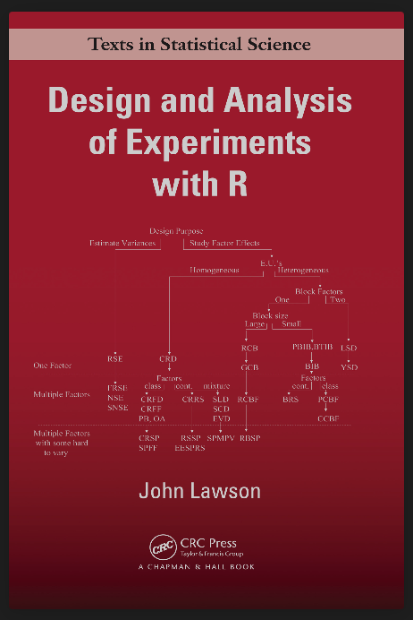
Text Book
Design and Analysis of Experiments with R. Lawson, 2015. ISBN 9781439868133
Biostatistical Design and Analysis Using R: A Practical Guide. Logan, 2010.
Design and Analysis of Experiments: (8h Ed.) by Douglas C. Montgomery

Slide 11
Tentative Schedule

Slide 12
Course Policies
Recording of Class Lectures
Unexcused Absences and Make-Up Work
Academic Integrity

Slide 13
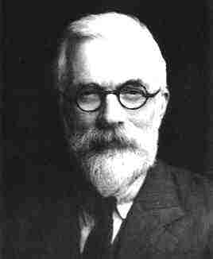
Design of Experiments
R. A. Fisher (1890 – 1962)

Slide 14
The elements of research
the hypothesis and objectives (https://www.gohy.org/);
the experimental treatments (Factorial);
the experimental units;
the allocation of treatments to units;
the response variables.

Slide 15
The Basic Principles of DOE
Randomization
Running the trials in an experiment in random order
Notion of balancing out effects of “lurking” variables
Replication
Sample size (improving precision of effect estimation, estimation of error or background noise)
Replication versus repeat measurements?
Blocking (Error Control)
Dealing with nuisance factors

Slide 16
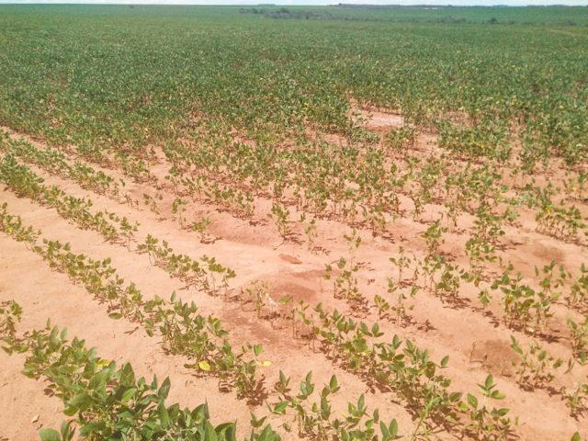
Principles of experimental design
What fertilizer results in the highest yield increase in soybean?

Slide 17
1- Replication
At least 3 reps!
What fertilizer results in the highest yield increase in soybean?

Slide 18
2- Randomization
What fertilizer results in the highest yield increase in soybean?

Slide 19
3- Control
What fertilizer results in the highest yield increase in soybean?
Notes:
an untreated control,
a control treated with a placebo, or
a control treated with ordinary practices.

Slide 20
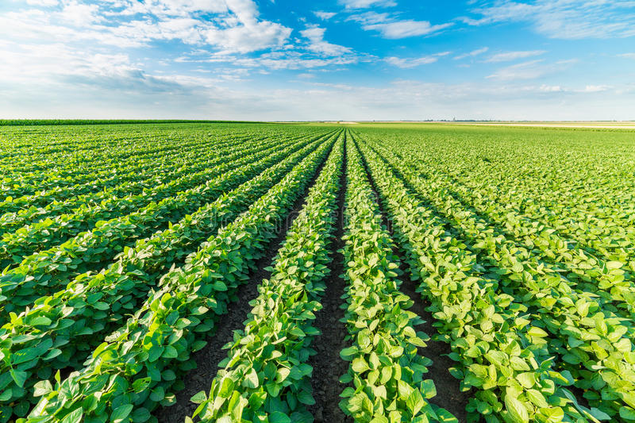
Completely randomized design (CRD)

Slide 21
randomized Complete Block design (RCBD)

Slide 22
Strategy of Experimentation
“Best-guess” experiments
Used a lot
More successful than you might suspect, but there are disadvantages…
One-factor-at-a-time (OFAT) experiments
Sometimes associated with the “scientific” or “engineering” method
Devastated by interaction, also very inefficient
Statistically designed experiments
Based on Fisher’s factorial concept

