Slide 1
Programming Language Concepts and Features
CS 671
Summer 2021

Slide 2
Outline
Goals/approach of the course
Course requirements, structure
Advice
Academic Integrity

Slide 3
What this course is not
A “programming languages” course that…
Considers many languages
Discusses their syntax and semantics
Covers lexical analysis and parsing
Includes detailed discussions of implementation issues, like…
Type checking
Exception handling
Inheritance, garbage collection, threads, …

Slide 4
What this course is
An exploration of the main (non-imperative) features of modern programming languages
Programming intensive
More pragmatic that theoretical
Centered around one language, not many
Usage-oriented (leaves most discussion about implementation to CS 712—Compilers)

Slide 5
Why do it this way?
Programming languages…
Are becoming more complex, difficult to use effectively (Java 16 is not Java 1!)
Are multiplying in niches (some are becoming very good at very specific kinds of things)
Have you seen the TIOBE Index recently?
Incorporate more programming patterns, even in mainstream languages (not just OO patterns, but also functional, concurrent, …)

Slide 6

Why does it matter?
A good programmer can…
Use a complex language effectively
Recognize/use classic features in a new language
Apply different programming styles to different problems
Illustration—Solve this problem…

Slide 7
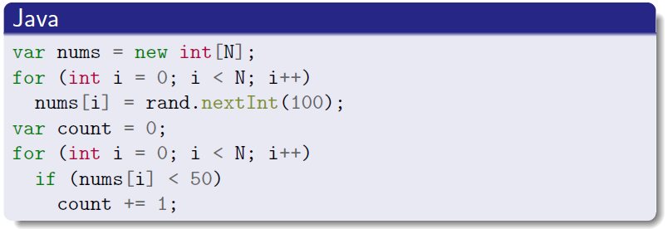
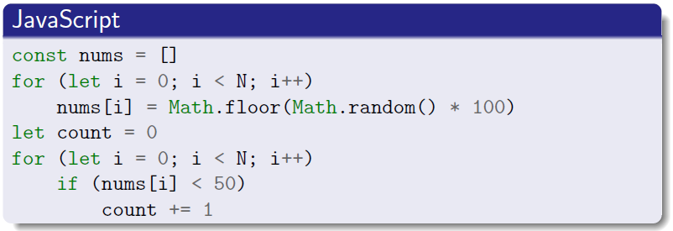
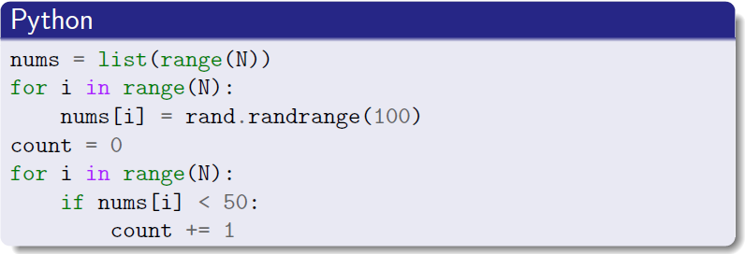
Why it matters (cont’d)
If taught course in Java, JavaScript, Python, might not get much further than this:
These all look the same!

Slide 8
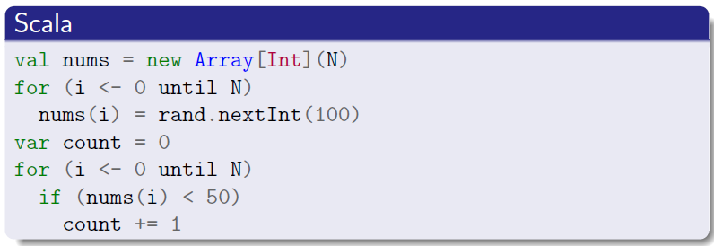
Why it matters (cont’d)
Teaching in Scala, we may start the same…

Slide 9
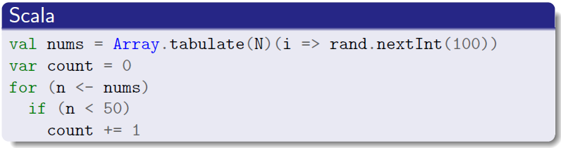
Why it matters (cont’d)
…but we can go deeper. Here’s a solution once you understand higher-order functions, lambdas, and for-comprehensions

Slide 10
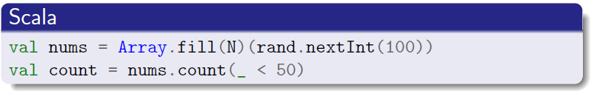
Why it matters (cont’d)
…and here’s another with lazy evaluation, η-abstraction, and more higher-order functions
Notes:
Eta-abstraction

Slide 11
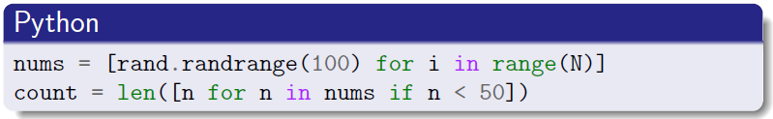
Why it matters (cont’d)
Once you have that, you can look for the same features and patterns in other languages!

Slide 12
Point again…
This is not an intro to Scala course
Learning outcomes are programming language features as exist in many languages
Closures, lazy evaluation, pattern matching
(Tail) recursion, persistent structures
Inheritance, polymorphism, data encapsulation,
“Mixins”, threads, futures, promises, …
We’re just focusing on Scala to do all this

Slide 13
Outline
Goals/approach of the course
Course requirements, structure
Advice
Academic Integrity

Slide 14
Prerequisites
Complete CS 515 & 520 w/ C- or better before taking this course*
Have some Java experience (CS 415/416, 619)
Have good skills in…
Procedural programming (incremental development)
Debugging (as you develop each part)
Testing (writing your own, as you go)
*or equivalent

Slide 15
Grading structure
5 Programming assignments (~50%)
First due-date starts at Wednesday (may move)
Resubmissions possible for partial credit
Focus on Scala so have enough time to get to more powerful language features(!)
Quizzes nearly weekly (~30%)
Final exam on July 29 (~20%)

Slide 16
Assignments as teaching tool
May involve aspects not covered in class
You are expected to face difficulties and use the resources you have to overcome them
Discord, office hours, class time
Submit pretty-printed PDF code w/ question on Canvas, I’ll answer afterward
Solutions to assignments discussed afterward
Please do not record, screenshot, etc.
Notes:
Questiton

Slide 17
Assignment structure
Main design/algorithms provided via GitLab
Sub-design/algorithms left to you
Tentative plan:
1. Simple object-oriented (using Scala objects)
2/3. Simple/Advanced functional
4. Advanced object-oriented
5. Concurrency

Slide 18
Assignment grades (~50%)
Based on functional testing & performance
Grading tests become public after 1st submit
Resubmission allowed…
Grading calculation (F = 1st grade, S = 2nd grade):
If F ≥ S, keep F
Otherwise, it’s S ∙ 80% + F ∙ 20%
No late submissions!
Any submission that passes no test gets zero!

Slide 19
Quizzes (~30%)
Quizzes will likely be…
Online, during class time
Formatted like a written, in-class quiz
Short
Although you may have some time to check some coding-oriented answers, count on answering the questions based on your understanding and quick references to your notes

Slide 20
Final Exam (20%)
Final exam will also likely be…
Online, during class time (last scheduled day)
Formatted like a written, in-class exam
Somewhat long & detailed, still…
Although you may have some time to check some coding-oriented answers, count on answering the questions based on your understanding and quick references to your notes

Slide 21
Outline
Goals/approach of the course
Course requirements, structure
Advice
Academic Integrity

Slide 22
Advice for getting a good grade
Write code efficiently
No distractions (TV, phone notifications, etc.)
Start coding early, break time into chunks (<2 hrs)
Keep fed, hydrated, rested
Avoid guess-and-check
Consider keeping a coding journal
Don’t copy-and-paste code (refactor)
Read assignment specs & handouts carefully

Slide 23
More good-grade advice
Stop me in class and ask questions
Log in, keep camera on if feasible
Stay focused on course content
Speak up (voice and/or chat)
Use Discord to ask more questions
Use public text channels as often as possible
So others may answer and all can benefit from answer
Schedule voice chat for specific tech. issues

Slide 24
Yet more advice
See somebody to discuss any (academic or non-academic) problem before it gets out of hand
Me
Your academic advisor
Department chair
Counselor (PACS)
Associate Dean
Even if you pick the wrong person to start!
Notes:
Problems: academic or not—want to address things before they get out of hand.

Slide 25
Course Resources
Canvas
GitLab (see documents from Canvas)
Discord
My contact info
E-mail: Matthew.Plumlee@unh.edu
Office: Kingsbury W253, but mostly Discord

Slide 26
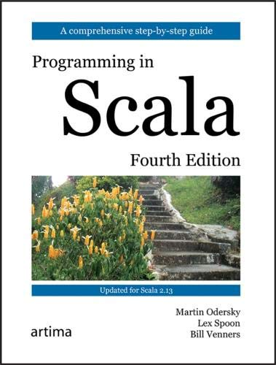
Reference Book
Not a course text, just a reference
For something more like a textbook, see the HTML section in GitLab
Make sure you have these handy, and that you look at them each week

Slide 27
Outline
Goals/approach of the course
Course requirements, structure
Advice
Academic Integrity

Slide 28
Academic Integrity
Quizzes, exam must be done individually
Assignments must be solved individually
It is ok to discuss specifications (“What does he mean by, ‘The method returns the last entry?’ ”)
It is ok to discuss sources where you found general info on how to do things in Scala
It is not ok to discuss implementations, even informally. (“How do you return the last entry?”)

Slide 29
Academic dishonesty
Academic dishonesty includes…
Submitting code from another student (or even something that looks structurally similar)
Submitting code from a sample solution (or even something that looks structurally similar)
Using code w/out proper attribution of its source
Giving code to another student (even as a “template”)

Slide 30
Consequences of dishonesty
When dishonesty is uncovered…
You will receive a penalty. It could be as light as a 0 for the assignment or as severe as a failing grade for the course (regardless of your grades).
A letter that explains the case will be sent to the Department Chair and to the Associate Dean
Especially on 2nd offense, you may be suspended and/or excluded from the CS major and/or the College
A copy of the letter will be put in your file

Slide 31
Some perspecitve
Scala…
Is inspired by Java, with similarities in syntax
Is compiled into Java bytecode, run on JVM
Integrates OO with functional programming
Is small, but complex and powerful
I am relatively new to Scala as well
Please share what you learn (esp. via Piazza)
I’ll try to point out similarities in other languages

