Slide 1
Mitigating Threats with Artificial Intelligence for the Transportation Security Administration (TSA)
An Accenture Federal Services Technology Showcase Presentation by Grace Fernandez

Slide 2
TABLE OF CONTENTS
1
2
3
INTRODUCTION
CHOSEN
TECHNOLOGY
APPLICATION
A look into the Transportation Security Administration (TSA) & their practices.
Introduction to Artificial Intelligence.
How Accenture could use Artificial Intelligence for the TSA.

Slide 3
INTRODUCTION
1
What is the Transportation Security Administration (TSA)?

Slide 4
Transportation Security Administration (TSA)
Agency under the Department of Homeland Security (DHS)
Created in response to the 9/11 Attacks
Their mission: “Protect the nation’s transportation systems to ensure freedom of movement for people and commerce.”
They tend to focus more on air travel and airports

Slide 5
Notable Technology Advancements
The TSA installs Advanced Imaging Technology a.k.a. Full Body Scanners to detect non-metallic weapons and related threats that are concealed by clothing.
The TSA deploys explosives detection systems to screen all bags for explosives nationwide.
Dec.
2002
Aug.
2006
Mar. 2010
Dec. 2011
The TSA requires every passenger to remove their shoes to be screened for explosives.
The TSA integrates TSA PreCheck which is a screening process that assesses risk regarding passengers prior to their airport arrival, it is for known and trusted travelers.

Slide 6
Security Procedures
The TSA begins their security detail before passengers arrive at the airport by collaborating with law enforcement and intelligence communities to share information.
Physical Screening Procedures include: Carry-on & Checked Baggage Screening, Pat-Down Screening, Standard & PreCheck Screenings.
Secure Flight – a prescreening process that compares passengers names to trusted traveler and watch lists.

Slide 7



Emerging Technology
Computed Tomography
Biometrics Technology
Automated Screening Lanes (ASLs)
Checkpoint X-Ray scanning equipment to enhance threat detection on carry-on baggage. This is only implemented in 18 airports in the U.S.
Facial identification and facial matching technologies that can enhance security effectiveness, operational efficiency, and improve the current manual ID verification process.
Checkpoint technology that decreases the security screening process time while enhancing security.

Slide 8


Biometrics Technology
In August, 2020, Ronald Reagan Washington National Airport (DCA) implemented a piloted self-service Credential Authentication Technology (CAT) machine with a camera. Passengers will be able to scan their own identification for biometric identity/facial matching and authentication.
Facial Matching – The one-to-one identity test.
Facial Identification – The one-to-n identity test.
All information in this section was found at tsa.gov

Slide 9
2
CHOSEN TECHNOLOGY
An introduction to Artificial Intelligence

Slide 10

Artificial Intelligence (AI)
Artificial Intelligence is an umbrella term defined as the collection of technologies that are comprised of the two core concepts:
Machine Learning – A type of artificial intelligence that enables systems to learn patterns from data and subsequently improve from experience.
Deep Learning – A machine learning methodology where a system discovers the patterns in data by automatically learning a hierarchical layer of features.
AI
Machine Learning
Deep Learning
Definitions provided by Accenture.com

Slide 11

Computer Vision
Computer vision is about enabling machines to “see” images as humans do, to process and identify objects and even activities within a still frame or a video sequence.
Information provided by Accenture.com

Slide 12
Geographic Information System (GIS) & Location Intelligence (LI)
Geographic Information System (GIS)
Analyzes spatial location
Organizes layers of information
Patterns, relationships, and situations
Location Intelligence (LI)
Visualization and analysis of geospatial data
Empowers understanding, insight, decision-making, and prediction.
Why things happen where they do.
Definitions provided by esri.com

Slide 13

AI + GIS + LI = Business Analytics
Business planners can utilize LI and AI to analyze their customers demographics
Object classification and detection
Separate sedans from SUV’s from pickup trucks and brands
Infer customer demographics and habits without using personal identifiable factors
GIS incorporates time and location to monitor parking lot traffic flow
Case study provided by esri.com

Slide 14

APPLICATION
3
How Accenture can use AI to help the TSA

Slide 15
Accenture and GIS
In the Accenture Article, “3 benefits of using GIS and artificial intelligence in the utility world,” the authors discuss how the utility world can benefit from using AI and GIS. Object detection, or image recognition is mentioned to be one of the three examples of how the utility world can use GIS and AI.
On top of identifying an image or asset, the discussed image recognition software is able to inspect attributes and read photos.
As an Esri Gold Partner, Accenture has the knowledge and access to the technology to utilize ArcGIS AI capabilities such as Image Analyst and deep learning techniques.
Information provided by Accenture.com

Slide 16
Accenture & TSA
Accenture can utilize Artificial Intelligence, Geospatial Information Systems, and Location Intelligence to help analyze airport parking lot demographics to mitigate threats.
Only 18 airports in the U.S. have TSA regulated X-ray screening machines for carry-on baggage
Smaller airports lack the proper security procedures to mitigate threats and may be targeted

Slide 17
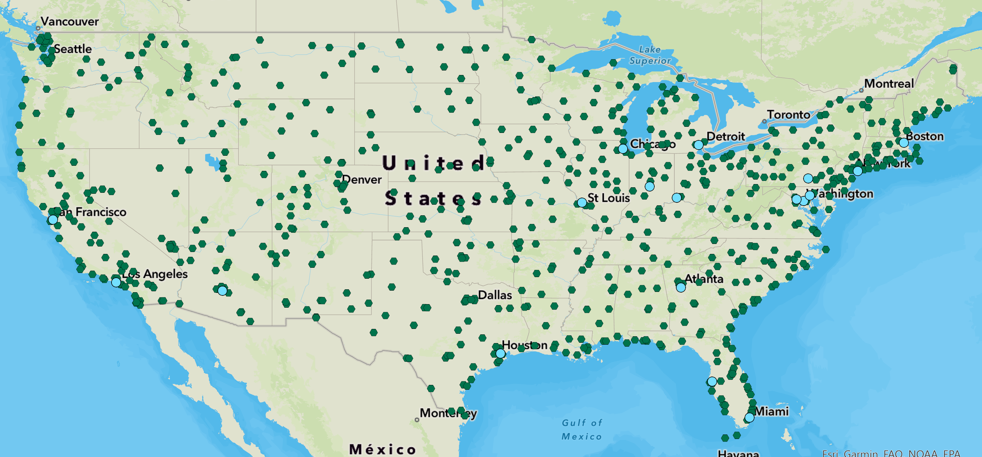
Light Blue = 18 Airports with CT
Dark Green = All Airports
Information sourced on github.com and map created by Grace Fernandez in ArcPro

Slide 18
Accenture & TSA Cont.
Combined with TSA biometric technology, computer vision, object classification and detection, and possible drone investment
Accenture can assess the demographics of airport parking lots
Determine potential threats before airport check in
Mitigate threats for airports of all sizes around the nation

Slide 19
Business Benefits
Computer vision can recognize and classify with a 3% error rate
Markets:
Location Intelligence $32.8 billion by 2027
Computer Vision $18.2 billion by 2025
Artificial Intelligence $733.6 billion by 2027
Geographic Information Systems $14.5 billion by 2025
Information provided by Accenture.com, Grandviewresearch.com & Marketsandmarkets.com

Slide 20
Based on the numbers we just discussed, AI, GIS, LI, and Computer Vision prove to be a smart investment for Accenture, the Intelligence Community, and to the TSA to deliver high-quality intelligence for better security implementation.
Computer Vision
LI
AI
GIS

Slide 21
THANKS!
Do you have any questions?
gracekf@vt.edu
(571) 439 - 4588

