Slide 1

Identity Fusion NG
[Next-Gen Identity Fabric] Map, Define, Match: Consolidating Multi-Source Accounts into One Identity Story
Enterprise SaaS Connector for SailPoint Identity Security Cloud | Architecture & Operations Guide
Notes:
Identity Fusion NG is an enterprise SaaS connector for SailPoint Identity Security Cloud. It consolidates managed-source accounts, computes derived attributes, and fuzzy-matches identities so you are no longer limited to brittle exact-match correlation.
It supersedes the legacy v1.x architecture. Today's presentation establishes the definitive mental model: how the Map-Define-Match pipeline functions, who participates, how governance review operates, and how to roll it out safely.

Slide 2
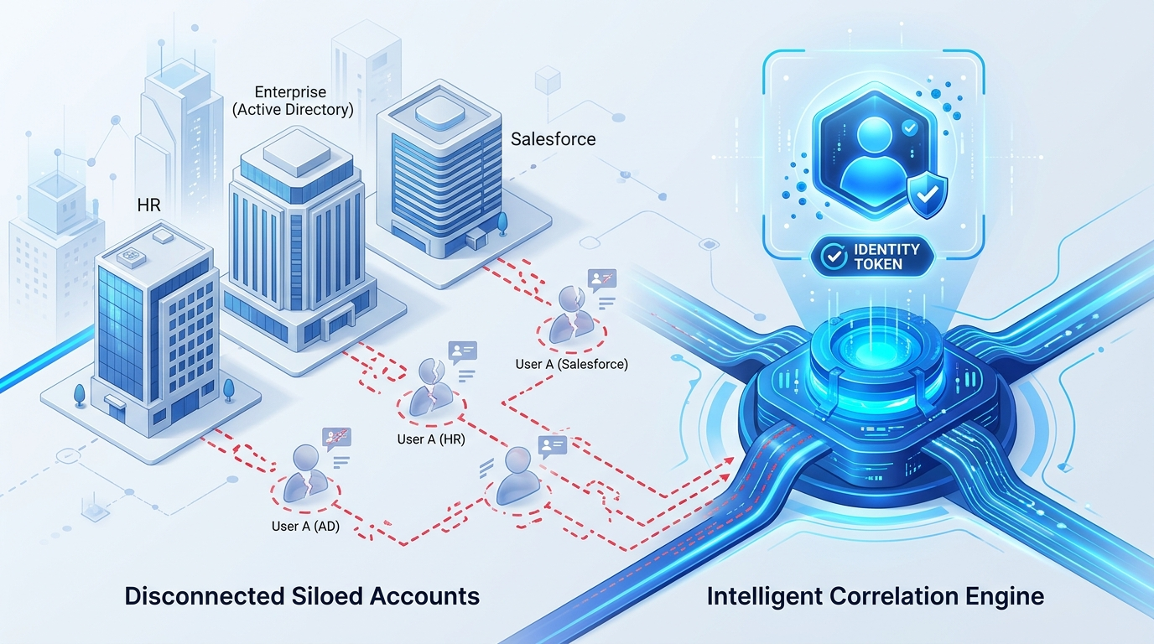
Why Identity Fusion NG?
[The Correlation Gap] Solving identity fragmentation where brittle exact-match correlation rules fail
Notes:
The core failure mode in modern IGA is one person in HR and Active Directory becoming two identities when correlation finds nothing.
Map aligns schemas and can keep several values. Define mints identifiers and normalises names and dates before comparison. Match scores near-duplicates and sends the grey zone to a reviewer.
Importantly, Map and Define still pay off even with Match turned off. Records and Orphan source modes let you solve specialized lifecycle problems without full fuzzy matching.

Slide 3
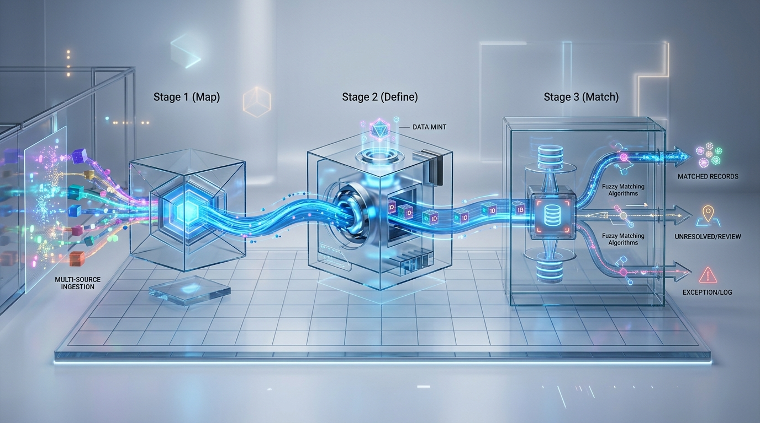
The Map, Define, Match Pipeline
[Core Architecture] One strictly ordered processing stream with four distinct lifecycle exits
■ 1. Map
• Walks all participating sources and identities in scope.
• Harmonizes disparate vendor schemas into standard attributes.
• Consolidates multi-role values via deterministic merge strategies.
■ 2. Define
• Executes dynamic Velocity expression rules.
• Phase 1 (Pre-Match): Normalizes names, phone numbers, and dates.
• Phase 2 (Post-Match): Mints unique usernames and employee numbers.
■ 3. Match & Exits
• Scores uncorrelated accounts against the established baseline.
• Exit 1: Return authoritative Fusion Account.
• Exit 2: Generate interactive human Review Form.
• Exit 3: Automatic merge upon high-confidence match.
• Exit 4: Silent drop for unlinked Records or Orphan accounts.
Notes:
The execution order is always Map, then Define, then Match. You can enable any individual step, but the architectural sequence is immutable.
Inputs are accounts from managed sources, plus existing ISC identities when identity scope is enabled. After Match executes, there are four exits: Fusion account, review form, automatic merge, or drop for Records and Orphan.
Normal definitions run before Match to improve scoring fidelity; unique values wait until Match decides.

Slide 4
Who Participates, and in Which Step?
[Source Mechanics] Seeding, scoring, contributing attributes, and exiting are four separate responsibilities
■ Identities in Scope: Originate baseline Fusion accounts. Map evaluates their attributes, but they never enter Match scoring as candidates; they form the reference target.
■ Uncorrelated Managed Accounts: The only accounts that enter Match scoring. Evaluated against the baseline. On positive match, they merge; on miss, they exit per source type rules.
■ Records Sources: Register unique values (e.g. employee ID pools) and contribute attributes without generating standalone Fusion accounts on a non-match.
■ Orphan Sources: Match attempts to attach orphaned accounts to existing identities. Unmatched accounts are dropped and can be automatically disabled at the source.
Notes:
Walk the matrix left to right. 'Seed' describes who originates the Fusion account, not who merely participates.
The baseline consists of identities in scope, existing Fusion accounts, and already-correlated accounts. Only uncorrelated managed accounts enter Match. Map still walks every participant, so contributing attributes is not a Match privilege.
Records register unique values and emit no Fusion account on a miss. A matching Orphan attaches to an existing identity; a miss is dropped and can optionally be disabled on the managed source.

Slide 5
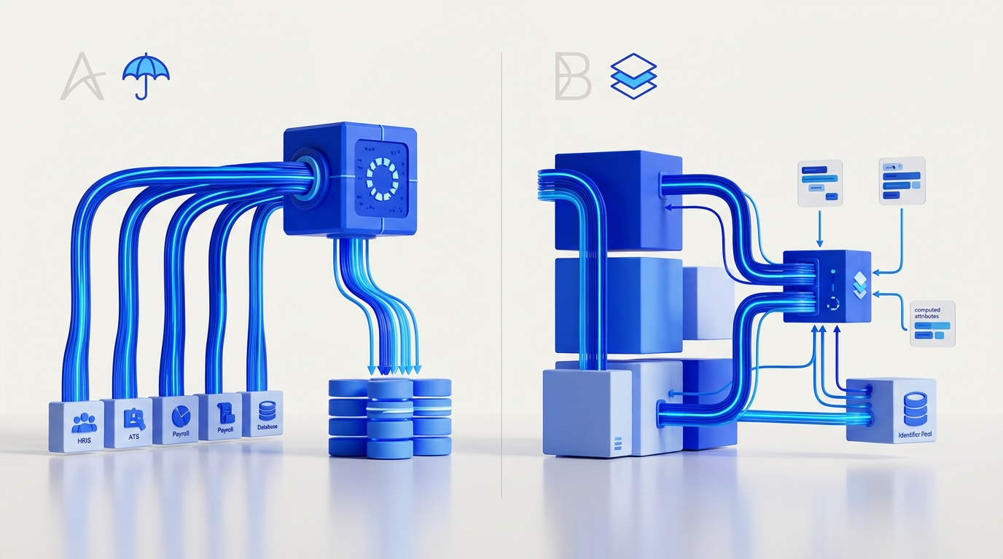
Umbrella vs. Side-Car Deployment
[Authority Strategy] Determined by the Fusion source's authoritative status, not whether matching runs
Notes:
Umbrella versus side-car is governed strictly by the Fusion source's Authoritative flag, not whether Match runs. Matching runs identically in both modes.
Use umbrella mode when Fusion itself must create identities. Use side-car for generated usernames, merged attributes, or Records and Orphan sources.
Remember: Authoritative, Records, and Orphan name each managed source. Umbrella and side-car name the Fusion source itself.

Slide 6
How Map Resolves Conflicting Attributes
[Map Engine] Schema harmonization first, then deterministic multi-source merge strategies
■ First Found & Priority
• Takes the first non-empty value in the configured source priority order.
• New configurations default to Main Account priority.
• Ensures stable, deterministic attribute fallback across secondary accounts.
■ List & Concatenation
• Preserves legitimately multi-valued personas (e.g. dual titles or roles).
• Concatenation formats distinct values in clean brackets: [Sales Engineer] [Consultant].
• Automatically deduplicates values across contributing sources.
■ Source Name Anchor
• Designates a specific named source to always win for a chosen attribute.
• Overrides global priority order for sensitive fields (e.g. security clearance).
• Guarantees domain ownership across disparate source feeds.
Notes:
Map runs first. Many source attribute names become one standardized Fusion attribute. First found takes the first non-empty value in configured source order.
Keep a list or concatenate when several values are legitimate; concatenate renders distinct values in brackets, space-separated, with duplicates removed. Source name forces one source to win whatever the global priority order says.
Main account uses that snapshot then origin, with no further fallback. Identity scope adds $identity to the context; the merge walk stays on configured sources.

Slide 7
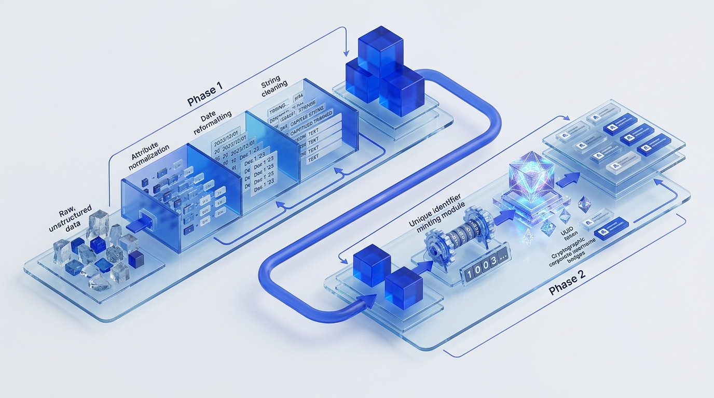
What Does Define Compute, and When?
[Define Engine] Two distinct execution phases: normal attributes before scoring, unique values after
■ Phase 1: Normal Definitions (Pre-Match)
• Velocity expressions read mapped values, identity fields, and source snapshots.
• Normalizes dirty source attributes: standardizes given names, formats dates, strips whitespace.
• Executes before Match so high-quality, normalized attributes drive similarity scoring.
• Utilizes $previous state caching to prevent clearing values when inputs are unchanged.
■ Phase 2: Unique Definitions (Post-Match)
• Executes strictly after Match establishes whether an identity is new or merged.
• Mints globally unique values: usernames, corporate emails, employee IDs, and UUIDs.
• Collision handling: Retries automatically with incrementing $counter up to configured max.
• Avoids wasting identifier pool numbers on candidates that merge into existing accounts.
Notes:
Normal definitions run after Map and before Match so that normalised names and dates improve scoring accuracy.
Unique definitions run strictly after Match: usernames, employee numbers, counters, and UUIDs. If a generated identifier collides, Define retries using $counter up to the configured maximum attempts.
Static attributes write once and persist. Always recalculate runs every aggregation cycle. If normal definition output is empty, it clears the stored value; use $previous to retain the last known good value.

Slide 8

What Happens to an Account in Match?
[Match Engine] Scoring against the reference baseline splits candidates into three operational outcomes
• Only uncorrelated managed accounts are scored, evaluated strictly against the known Fusion baseline.
• Deferred Candidates: When the only potential match is another new account from the same run, creation defers safely to the next cycle.
• Reviewer Safety Gate: Borderline scores require active reviewers or valid auto-merge; otherwise, unreviewed accounts drop safely to non-matched.
Notes:
Only uncorrelated managed accounts are scored against the baseline. A combined score at or above the auto-merge threshold executes an immediate merge. Scores between the review floor and auto-merge threshold generate an ISC review form. Scores below the review floor trigger non-match exits.
Deferred candidates handle the race condition where two new accounts for the same person arrive in the same aggregation run: identity creation waits cleanly for the next cycle.
Scoring runs when automatic merge is on or when manual review is active with valid reviewers.

Slide 9
How is a Match Score Built?
[Scoring Mechanics] Weighted mathematical similarity combined with hard mandatory veto rules
■ Weighted Similarity Mean: Each rule compares one attribute with a chosen algorithm. The rule's minimum threshold serves as its mathematical weight in the combined composite score.
■ Mandatory Veto Rules: A failed mandatory rule immediately rejects the candidate regardless of how high the overall composite score is (e.g. clearance or location conflict).
■ Specialized Matchers: Enhanced Name Matcher handles nicknames and phonetic typos. Binary enforces exact IDs. Jaro-Winkler, Dice, and custom Velocity rules handle edge cases.
■ Noise Reduction: 'Skip if missing' prevents empty optional source attributes from dragging scores down. Recommended starting review floor is 80; tune using dry-run.
Notes:
Each rule compares one attribute using an algorithm. The minimum similarity threshold is also that rule's mathematical weight; the combined score is the weighted mean.
A failed mandatory rule vetoes the candidate completely, regardless of the combined score. 'Skip if missing' prevents missing attributes from penalizing candidates.
Use Enhanced Name Matcher for human names and Binary for exact identifiers. Start the review floor around 80, and enable automatic merge only after tuning with dry-run reports.

Slide 10
Where Do Humans Fit In?
[Governance] Interactive review forms for decisions, background reports for non-invasive analysis
■ Interactive Review Forms
• Presents top matching candidates and attribute comparisons in native ISC Forms.
• Reviewers decide: Link account to an existing identity OR authorize a new identity.
• Decisions persist in review storage and execute during the subsequent aggregation run.
• Assigned globally to source owners or delegated via reviewer:<sourceId> entitlements.
■ Fusion Analytical Reports
• Evaluates match distributions and previews correlation outcomes without writing to ISC.
• Produces comprehensive CSV records of candidate pairs, scoring breakdowns, and grey zones.
• Essential for initial rule calibration, threshold tuning, and pre-production validation.
• Leaves clean operational statuses: activeReviews, candidate, authorized, manual, and auto.
Notes:
Review forms show the top candidate matches to assigned reviewers. Reviewers choose to link to an existing identity or create a new one; the decision applies on the next aggregation, not immediately.
Reviewers are source owners acting globally, or per-source reviewer entitlement holders. Fusion reports and dry-run preview Match without writing to the tenant.
Operational statuses left behind include activeReviews, candidate, authorized, manual, and auto. Without valid reviewers, borderline scores register safely as non-matched.

Slide 11
How is Correlation Different from Matching?
[Identity Linking] Matching asks 'Who is this person?'; Correlation creates the ISC platform link
Notes:
Matching decides who this account is. Correlation is the ISC platform link. You cannot link an account to an identity that does not exist yet, so Fusion creates it first.
Correlate on aggregation PATCHes links during the run. Reverse correlation writes an attribute for native ISC rules. Do not correlate stages the work while matching continues to run.
Correlation API calls are expensive; staging them with 'do not correlate' and using an enforced correlation role is best practice for large-scale initial loads.

Slide 12
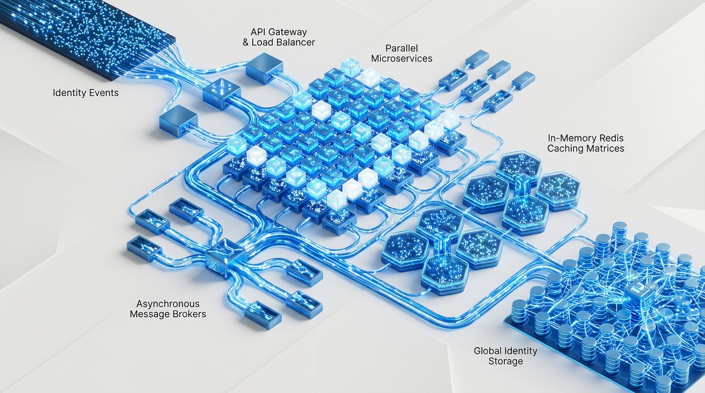
What Does a Fusion Account Give an Operator?
[Operations & v2.2.0] Full provenance traceability, dynamic entitlements, and v2.2.0 high-scale streaming
■ Immutable Provenance
• Carries standard attributes: contributing accounts, sources, origin source, and history.
• Native identity and account name are set at creation and never rewritten.
• Full cryptographic traceability back to original managed system records.
■ Calculated Entitlements
• Status entitlements calculated dynamically: new, activeReviews, nonMatched, unmerged, orphan.
• Action entitlements requestable in ISC: fusion:report and reviewer:<sourceId>.
• Searchable across ISC for rapid identity triage and audit reporting.
■ v2.2.0 Streaming Engine
• Peak aggregation memory footprint reduced via NDJSON streaming caches.
• Configurable host log levels (trace, debug, info, warn, error) for deep diagnostics.
• Integrated event loop watchdog prevents thread starvation and aggregation timeouts.
Notes:
Every Fusion account carries full provenance: contributing accounts, source origins, and modification history. Native identity and account name are locked at creation and never rewritten.
Status entitlements are calculated and searchable in ISC. Action entitlements are requestable, including report generation and source-level review permissions.
In v2.2.0, the aggregation engine features an NDJSON streaming memory cache that drastically reduces peak heap usage, alongside an event loop watchdog and configurable host log levels.

Slide 13
Enterprise External Processing & Resilience
[Reliability Gateway] One flexible gateway providing four enterprise operational capabilities
■ Proxy Mode: Executes connector logic on your private infrastructure (container or VM) and streams results back to ISC SaaS, eliminating tenant execution timeouts.
■ Scenario Recording: Captures live ISC tenant API interactions into compact NDJSON recordings on disk for offline replay, regression testing, and CI validation.
■ External Host Logging: Routes structured connector logs directly to local disk or remote syslog collectors with runtime configurable host log filtering.
■ Dry-Run Simulation: Executes the entire Map-Define-Match pipeline with tenant write operations suppressed, providing zero-risk verification before production rollout.
Notes:
External settings is one unified gateway, not a separate product. Proxy mode runs connector logic on your own infrastructure and streams results back to ISC.
Scenario recording captures live tenant API traffic for offline test replay. External logging posts from ISC or writes directly to disk in proxy mode.
Dry-run runs the entire pipeline with writes suppressed. Scheduled ISC aggregations never send dry-run input, so use spcx CLI or the proxy host to execute dry-run analysis.

Slide 14
Where Can You Plug in Your Own Code?
[Developer Seams] Declarative configuration first, backed by two clean architectural override seams
■ Seam 1: Service Registry Overrides
• Replace or extend core domain services (MappingService, MatchingService, DefinitionService).
• The Service Registry automatically wires your custom service into the pipeline.
• All supporting services and upstream/downstream dependencies remain intact.
• Service instances resolve per operation run: completely isolated with zero cross-tenant leakage.
■ Seam 2: Operation Handler Overrides
• Intercept standard SaaS connector operations (accountList, accountCreate, testConnection).
• Receives the fully wired Service Registry with all services pre-built.
• Enables bespoke source pagination, proprietary API transformations, or external event dispatching.
• Most enterprise projects need neither: configuration and Velocity cover 95% of use cases.
Notes:
Keep this concise unless presenting to developers. Declarative configuration covers most enterprise needs: attribute mappings, Velocity expressions, match rules, and custom algorithms.
Overrides live cleanly in your own connector build. A service override keeps the pipeline intact while swapping a domain algorithm. An operation override lets you customize connector entry points with the wired registry in hand.
Nine standard operations exist. Both seams resolve strictly per operation run, preventing memory leaks or state leakage between executions.

Slide 15
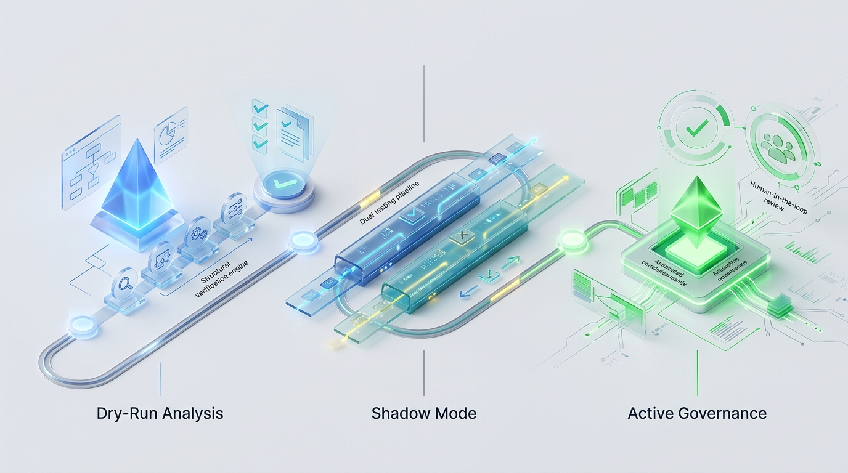
Which Path is Yours?
[Implementation] Four proven implementation archetypes and the standardized onboarding workflow
■ HR & AD Deduplication: Umbrella mode. Configure Authoritative sources, tune Enhanced Name Matcher, and calibrate auto-merge threshold to eliminate duplicate accounts.
■ Identifier Minting Pool: Records source type. Define Velocity rules for unique corporate usernames and employee IDs with automated collision retry counters.
■ Contractor Cleanup: Orphan source type. Score non-employee accounts against identity baseline; automatically detach and disable orphaned accounts at source.
■ Attribute Consolidation: Side-car mode. Harmonize divergent schemas and consolidate multi-persona job titles across systems without altering ISC identity ownership.
Notes:
Four peer starting points, all sharing the standardized onboarding path: create source, test connection, discover schema, aggregate entitlements, and run initial account aggregation.
No separate summary slide is needed: this archetype breakdown serves as the architectural recap and operational roadmap. Consult the Getting Started guide for setup checklists and configuration references.

