Slide 1
Testing Automation
Appium + Android Studio + App Center

Slide 2
Appium
Appim (http://appium.io/):
Download appium desktop (https://github.com/appium/appium-desktop/releases/tag/v1.13.0)
Dowload appium java client (http://appium.io/downloads.html)

Slide 3
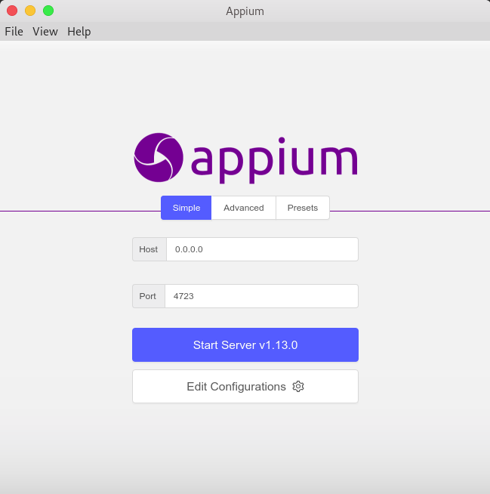
Appium Desktop
Create a local server to communicate with devices
Inspect app element
Create automation flow and export to JAVA

Slide 4
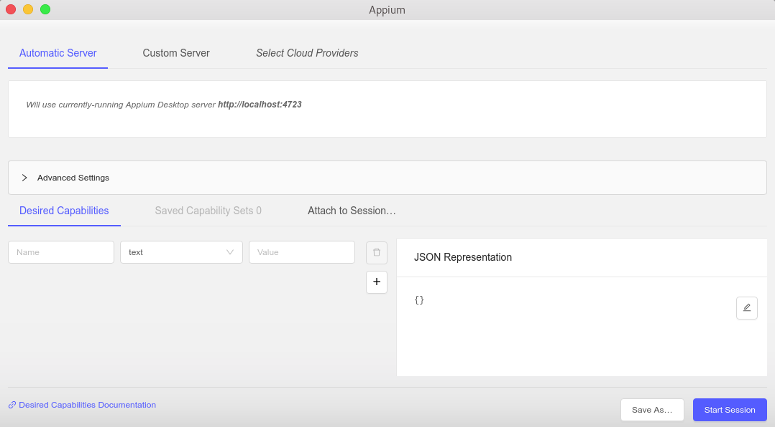
Appium inspect
Create desire capabilities form to connect. eg.:
{
"deviceName": "EMULATOR_ID",
"platformName": "ANDROID | IOS",
"appPackage": "PACKAGE_NAME",
"appActivity": "ACTIVITY_NAME",
"noReset": BOOLEAN
}

Slide 5

Appium Inspect

Slide 6
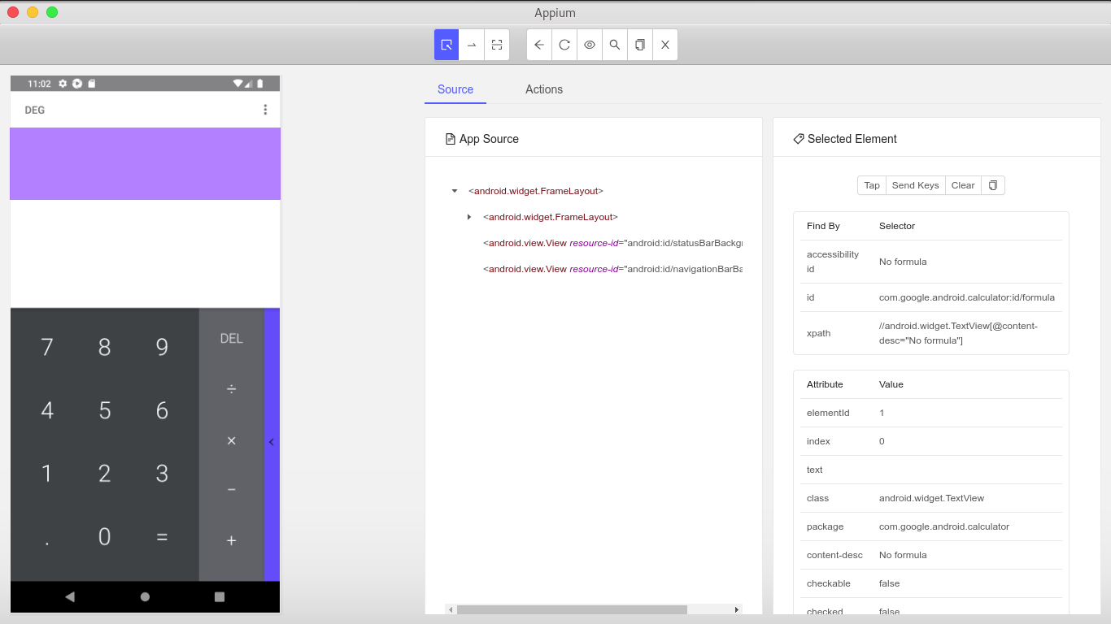
Appium Inspect

Slide 7
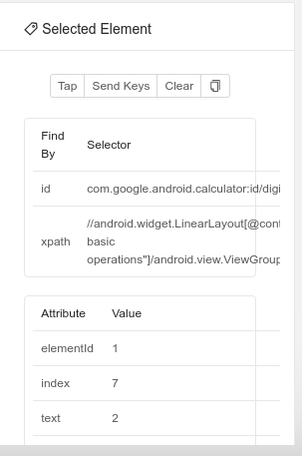

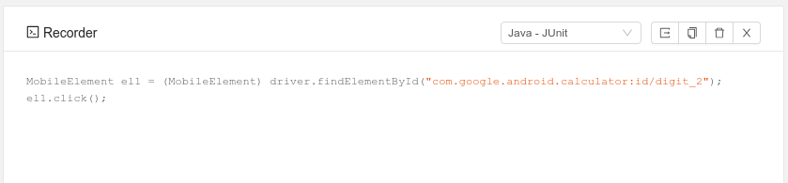
Appium Inspect
Back
Refresh Source and Screenshot
Search for element
Select Elements
Swipe by coordinates
Tap by coordinates
Start record
Copy XML source to clipboard
Language selector

Slide 8
Automation Template
There are fells concerns about the project template:
DriverFactory: is a java class to abstract Android driver create. It needs adapt for local environment
RunCucumberTest: is a java runner to enable cucumber in the project. It needs adjust feature folder to run local and refactor to run on app center
Driver is async: the driver run commands in async mode, if you need run in order put your code in a synchronized block

Slide 9
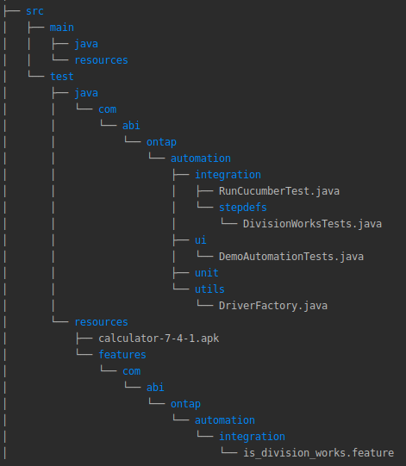
Automation Template Demo

Slide 10
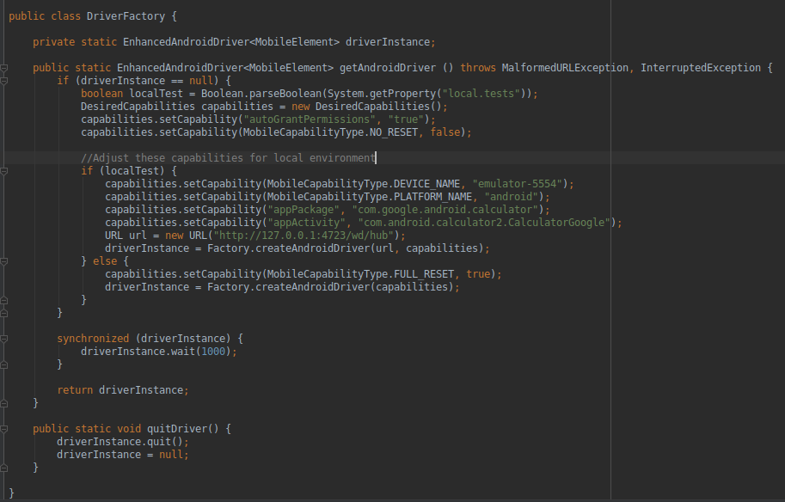
Automation Template Demo

Slide 11
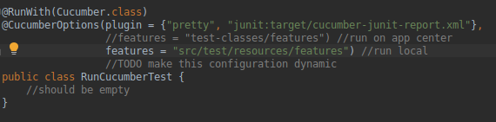
Automation Template Demo

Slide 12
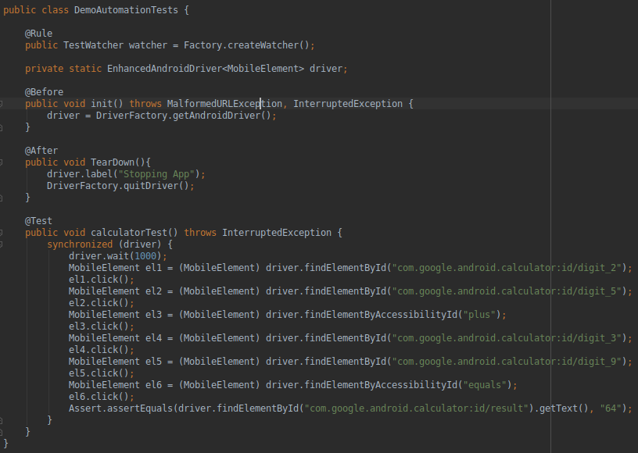
Automation Template Demo
Past record code

Slide 13
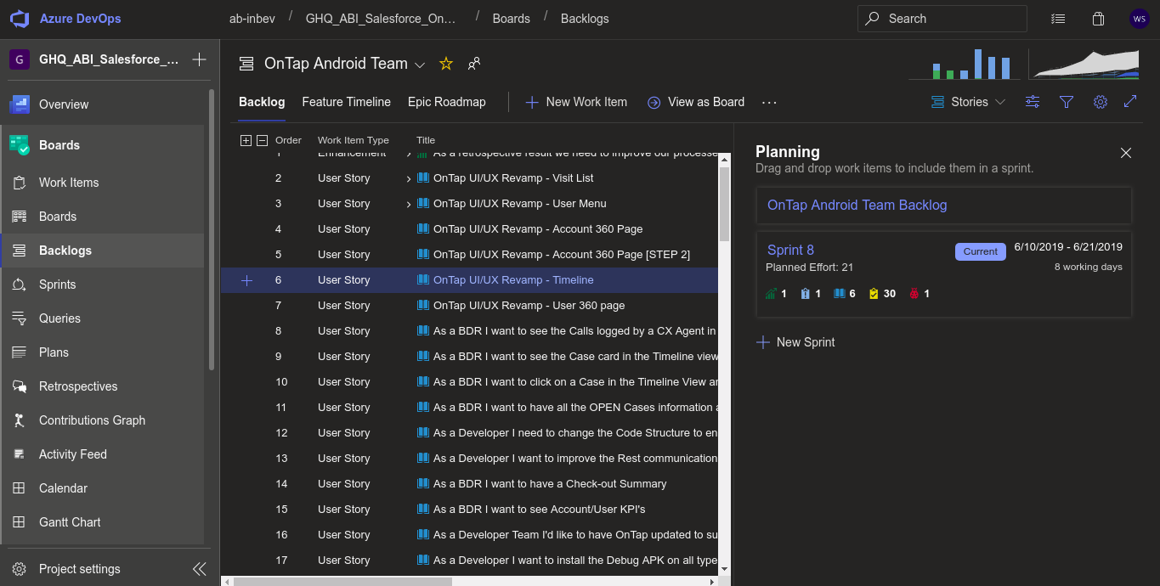
Automation Template Demo
access project backlog and click in a workitem

Slide 14
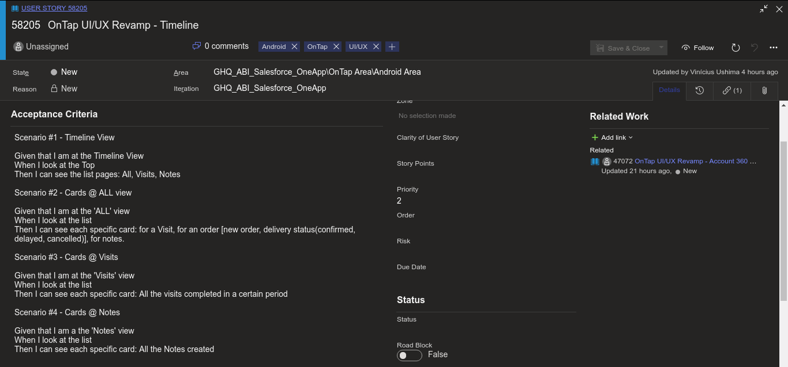
Automation Template Demo
In workitem acceptance criteria get test scenarios, write with BDD approach

Slide 15
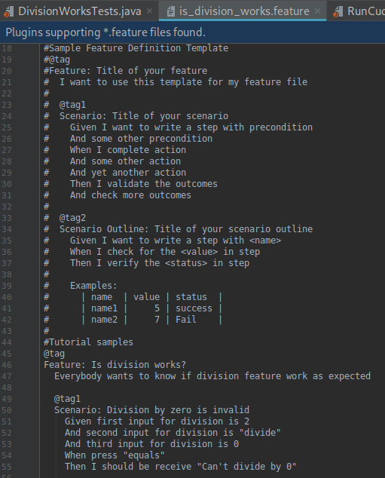
Automation Template Demo
Paste the acceptance criteria in feature files and refactor to cucumber sintax

Slide 16
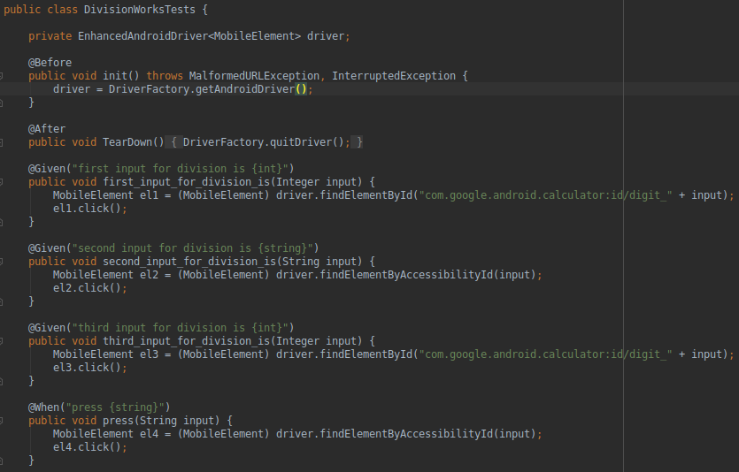
Automation Template Demo
slice record code into cucumber scenarios steps

Slide 17
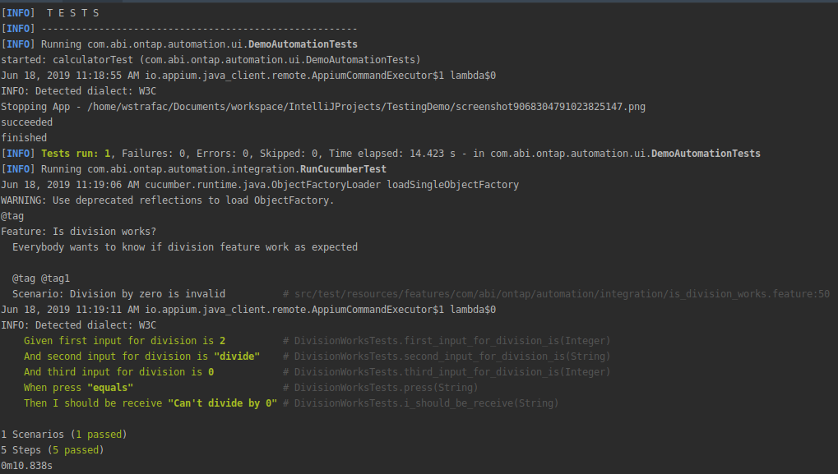
Automation Template Demo

