Slide 1
Redefining DDoS Attack Detection Using A Dual-Space Prototypical Network-Based Approach
Fernando Martinez Mariyam Mapkar Ali Alfatemi Mohamed Rahouti Yufeng Xin Kaiqi Xiong Nasir Ghani
Fordham University UNC Chapel Hill
RENCI University of South Florida

Slide 2
Introduction
Distributed Denial of Service (DDoS) attacks pose a significant and growing cybersecurity challenge, disrupting operations within organizations worldwide.
Traditional detection systems struggle to keep pace with evolving attack methods, underscoring the need for innovative solutions that adapt to the dynamic nature of cybersecurity threats.
Our work introduces a groundbreaking solution: a dual-space prototypical network that leverages geometric and angular spaces, effectively improving detection and adaptability to both known and novel DDoS patterns.

Slide 3
Problem
Statement
Evolving Attack Methods
DDoS attacks have become increasingly sophisticated, adapting to bypass traditional defense mechanisms.
Limitations of Static Models
Existing detection methods often rely on static models, which lack flexibility and fail to adapt to new attack strategies.
The sophistication of DDoS attacks outpaces traditional defense mechanisms
Dynamic Threat Landscape
The continuous adjustment of attack strategies by malicious actors renders static detection methods ineffective.
Need for Adaptive Solutions
There is a pressing need for adaptive, accurate, and robust detection methods that can dynamically adjust to evolving threat landscapes.

Slide 4
Objectives
Develop Adaptive Framework
Enhance Detection Accuracy
Comprehensive Evaluation
Create a DL framework using dual-space prototypical networks to adapt to evolving DDoS attack patterns
Improve detection accuracy by leveraging geometric and angular similarity measures in a dual-space framework
Evaluate the model under various data conditions, including scenarios with limited labeled data, to validate robustness and adaptability

Slide 5
Related Work
Recent advancements in AI have propelled the use of deep learning in intrusion detection, significantly enhancing detection efficiency and effectiveness
Traditional Approaches
Recent Advancements
Conventional methods at the network layer, like analyzing packet headers or traffic flow patterns, might not be adequate for effectively identifying and mitigating contemporary DoS/DDoS attacks.
These methods lack adaptability to new and evolving DDoS attack patterns, making them less effective in dynamic threat environments.
Recent advancements have focused on leveraging machine learning and deep learning techniques to improve detection accuracy and response times. Start editing your presentation.
Approaches like CNNs, RNNs, and LSTMs have been applied to parse and analyze network traffic, offering improved precision in identifying DDoS attacks over traditional signature-based and anomaly-based detection systems.
Gaps & Limitations
Few-shot learning methods rely on static models and single-space representation. Our dual-space prototypical network leverages geometric and angular measures to enhance detection and adaptability to both known and novel DDoS patterns

Slide 6
Methodology
We Introduce a dual-space prototypical network that leverages geometric and angular similarity measures to produce an adaptive and robust design to detect cyber threads.
By incorporating multifaceted data, our model gains a detailed understanding of network behaviors, allowing it to detect subtle signs that might indicate an attack.

Slide 7
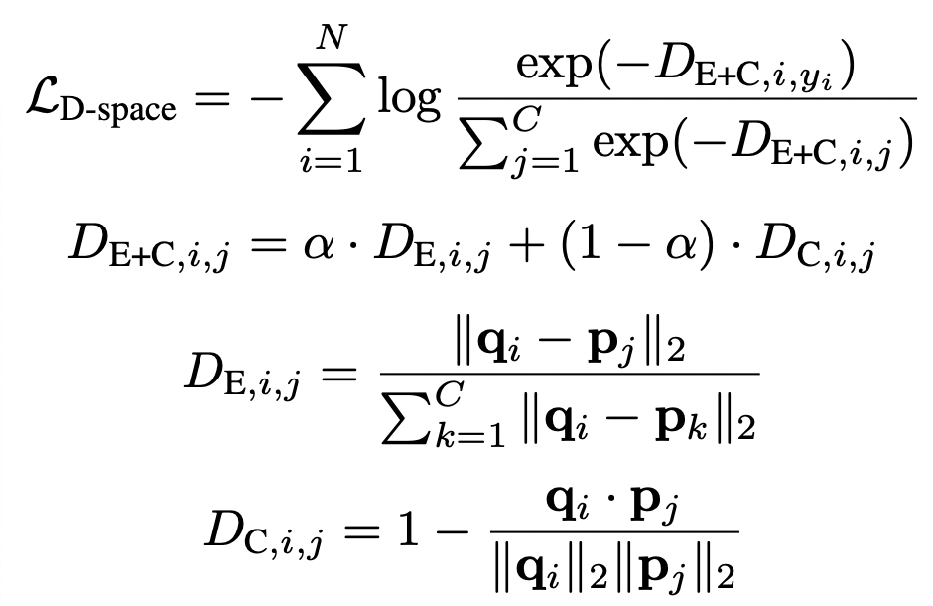
Dual-Space
Loss Function

Slide 8
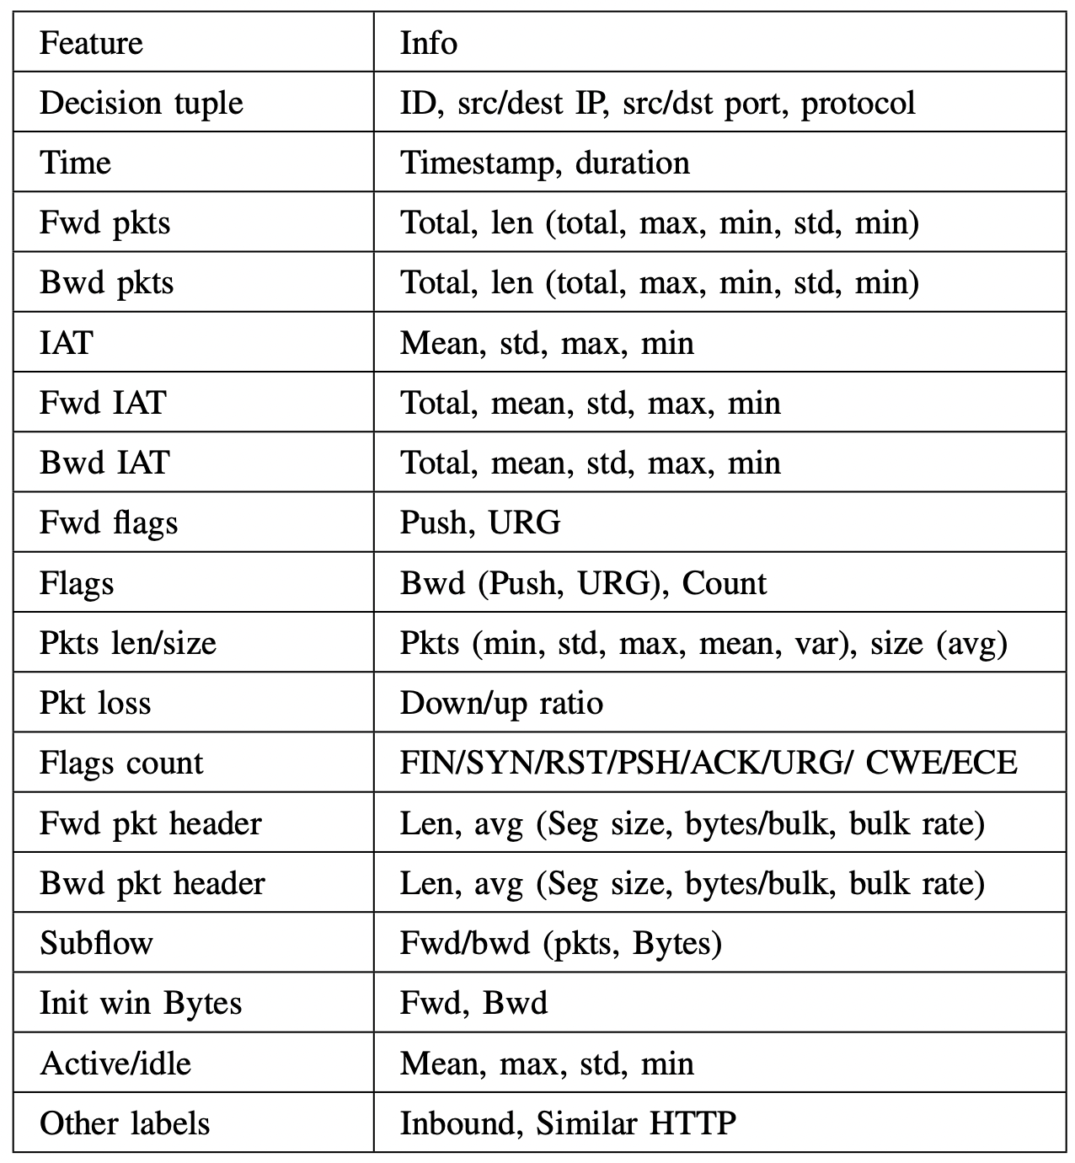
Data & Preprocessing
We utilize the CICIDS dataset, which provides comprehensive network flow data
Preprocessing: Involves normalization
(with RobustScaler) and feature extraction to ensure the model focuses on the most predictive indicators of attacks.

Slide 9
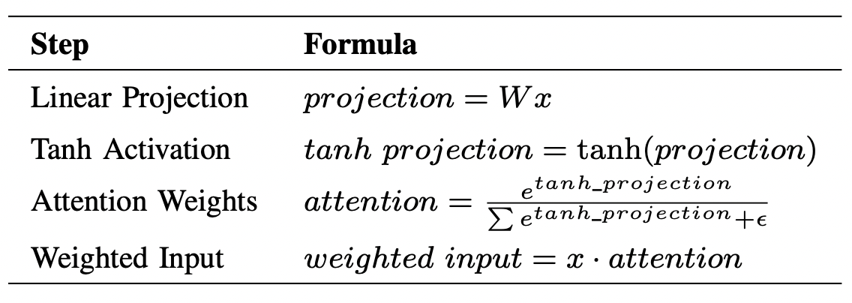
Attention Mechanism
Our model architecture includes two neural network designs: a foundational MLP and an enhanced version with an attention mechanism. The attention mechanism focuses on the most important features among a large number of attributes. The architecture integrates these mechanisms within our dual-space prototypical network framework, enabling dynamic and robust detection of DDoS attacks.

Slide 10
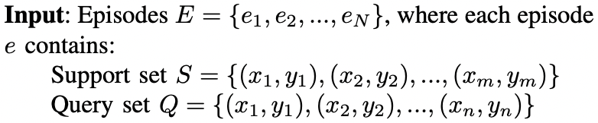
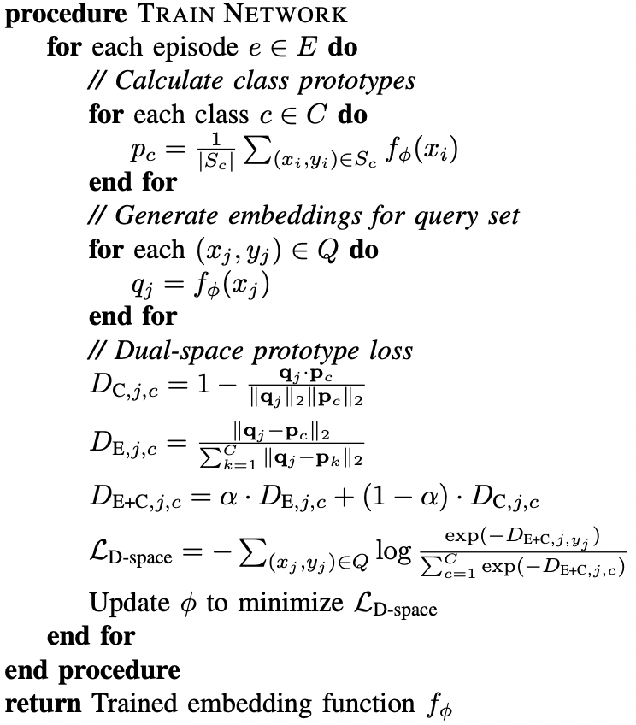
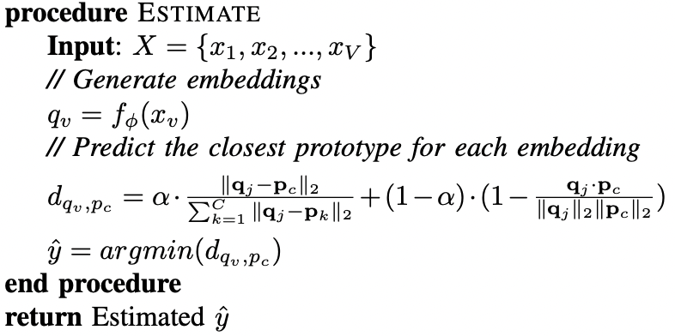
Dual-Space Prototypical Network
for DDoS Detection

Slide 11
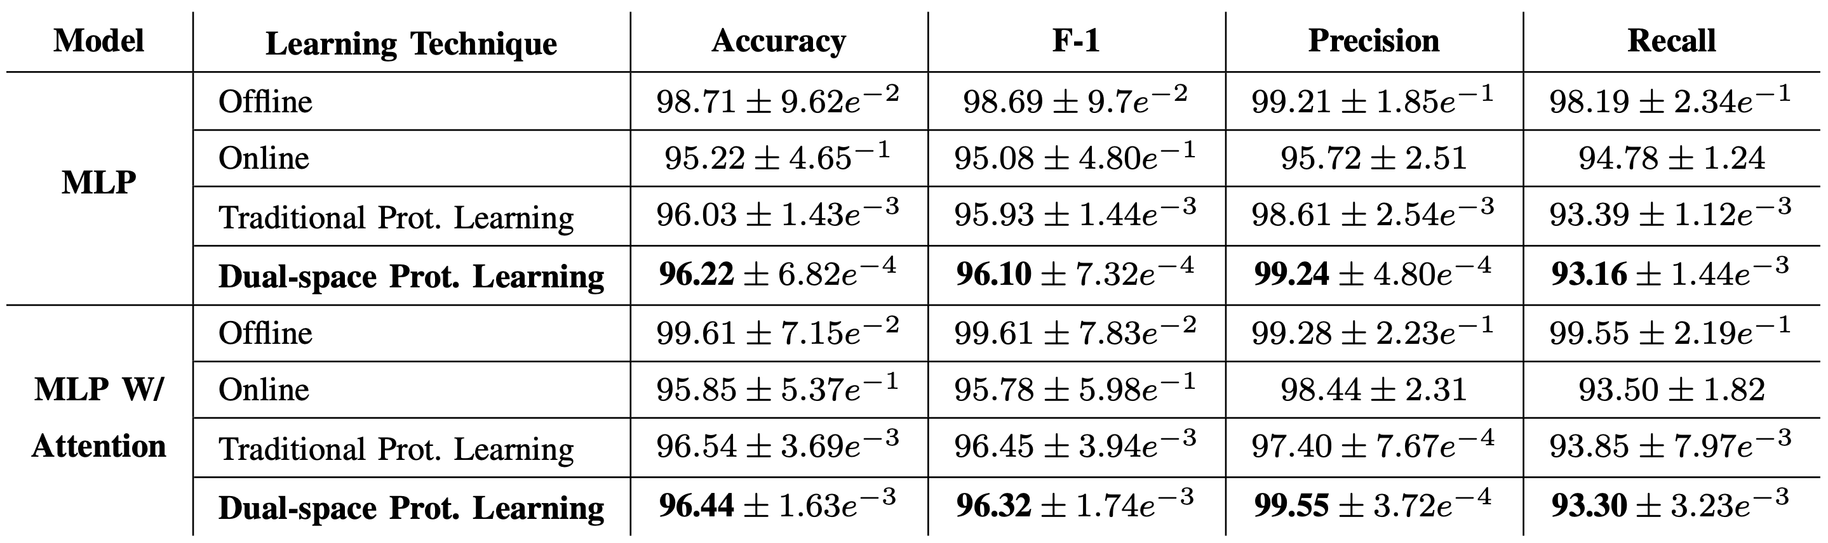
Results (I)
Model Performance (Whole dataset) – Metrics in rates (%)

Slide 12
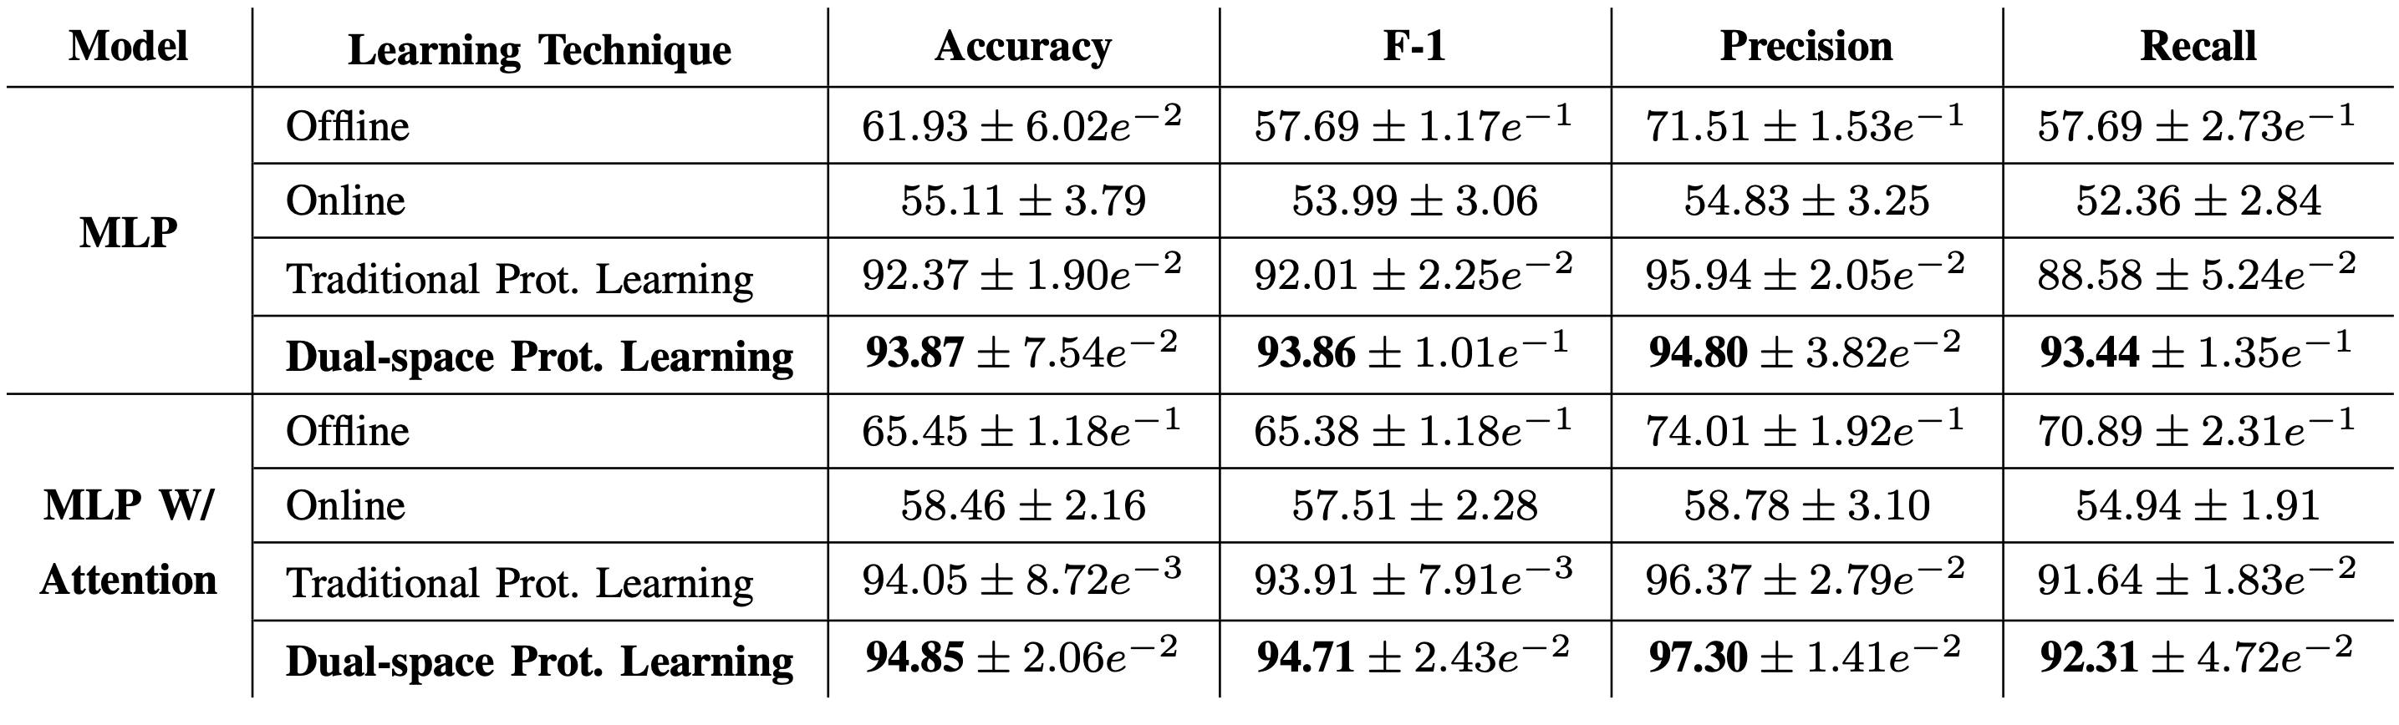
Results (II)
Model Performance (Train N : 100) – Metrics in rates (%)

Slide 13
Conclusion

