Slide 1





Hamster:
an AOP solution for Fault Tolerance in grid middleware
Francisco Soares-Neto¹, João Paulo Borges², Rafael Farias¹, Fernando Castor²
¹ University of Pernambuco
² Federal University of Pernambuco

Slide 2
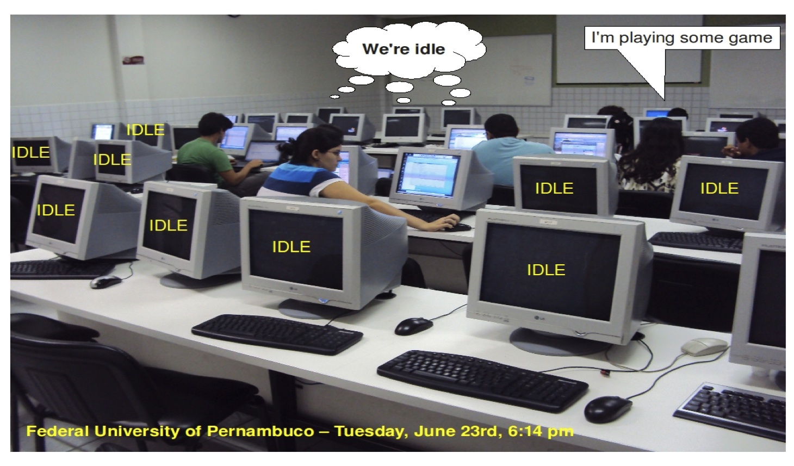
What is a computational grid?
Set of heterogeneous clusters
  Interconnected by a WAN
Coordinated by a grid Middleware
Aiming to perform intensive computations
  At a low cost
Opportunistic vs. Dedicated

Slide 3
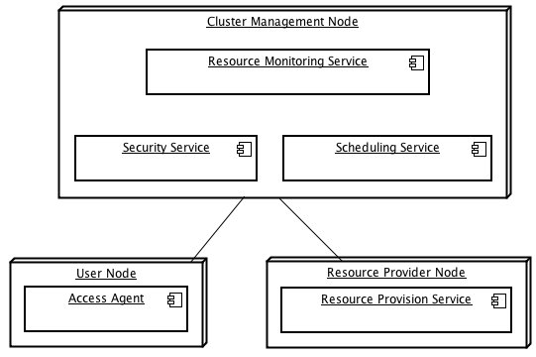
Components of a grid middleware
Application Broker
Scheduling Service
Resource Providers
Communication substrate
A typical Grid Middleware deployment [1]
Notes:
We have three main grid components:
- Application broker, or access agent, for requesting execution and submitting apps;
- Scheduling service, which manages the global grid resources and schedules which machines will work for whom;
- Resource providers, which actually run submitted apps and return their results.

Slide 4
OurGrid
Middleware for opportunistic grid computing
  Designed and developed at UFCG
Written in Java
Mature project
  Currently at version 4.x
  Cloud computing back-end
Notes:
OurGrid is a middleware platform for grid computing created at UFCG as a FOSS project. It can create an opportunistic grid where jobs are submitted in the form of Bag-of-Tasks applications.
OurGrid's main grid network (xmpp.ourgrid.org) has users and contributers all over the world, and as a middleware platform it is used to power private PaaS clouds.

Slide 5
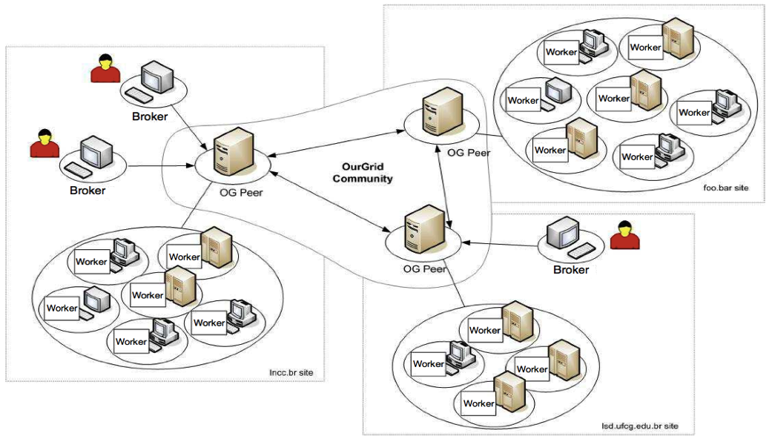
OurGrid
A typical OurGrid deployment scenario [2]
Notes:
This picture denotes a typical deployment scenario of an OurGrid grid. We would just like to point out its main components:
- Broker: for the application brokerage;
- Peer: for scheduling resources;
- and Worker: for resource provision.

Slide 6
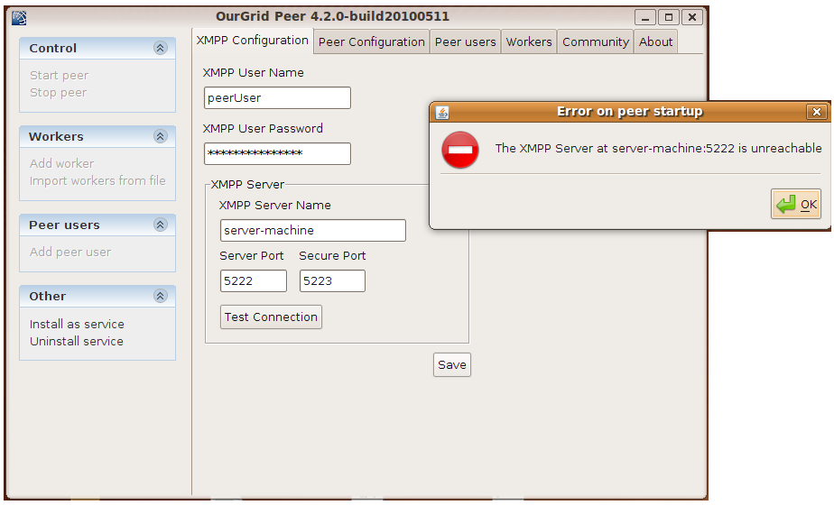
Grid middleware failures
In general, the grid breaks down...
  When the application broker fails
  When the scheduling service fails
  When the communication substrate fails

Slide 7
Fault Tolerance Requirements
High availability
  Self-healing grid monitoring nodes
Scalability
Low computing footprint
Ease of deployment
Notes:
Fault Tolerance, as you all may know, is the property which allows a system to sustain proper behavior after the event of a failure.
We have evaluated some grid middleware systems for their fault-tolerance capabilities. They shared the need of an additional infrastructure which would allow the their service to be highly available – as none dealt with the grid's management nodes – and still maintain high availability.
Our system shared the grid's requirement for low memory and processing footprint, as all computing power must be directed at actually managing the grid or running applications.
As we were build an extension to an already complex system, ease of deployment mattered as to not make the user's life any harder.

Slide 8
Fault Tolerance Requirements
High availability
  Self-healing grid monitoring nodes
Scalability
Low computing footprint
Ease of deployment
Most importantly: the grid should keep on working
Notes:
Fault Tolerance, as you all may know, is the property which allows a system to sustain proper behavior after the event of a failure.
We have evaluated some grid middleware systems for their fault-tolerance capabilities. They shared the need of an additional infrastructure which would allow the their service to be highly available – as none dealt with the grid's management nodes – and still maintain high availability.
Our system shared the grid's requirement for low memory and processing footprint, as all computing power must be directed at actually managing the grid or running applications.
As we were build an extension to an already complex system, ease of deployment mattered as to not make the user's life any harder.

Slide 9
Hamster
A fault tolerance architecture for grid computing middleware
Focus on management components
  Supports recovery of distributed app. brokers, scheduling service, and comm. substrate
  Fault tolerance for resource providers is well-understood
Notes:
We developed, an present in this paper, Hamster: an architecture for enabling fault-tolerance to grid computing middleware platforms such as OurGrid.s
The difference about Hamster is its focus on the management components of the grid, which, in the event of a failure, break the whole grid. Despite their importance, our studied use cases didn't support it.

Slide 10
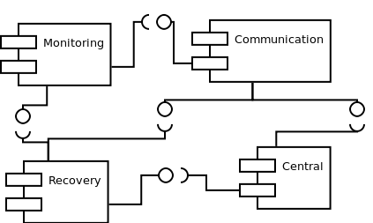
Implementation: OurHamster
Hamster architecture implemented alongside OurGrid
Modest computing and memory requirements
Self-healing
Tunable for high scalability
Notes:
Hamster's initial implementation (named OurHamster) was done alongside OurGrid code. As FOSS, OurGrid's source-code was edited to initialize Hamster with each component, which would communicate with each other and monitor OurGrid's components, for events such as submitting jobs to the grid and adding workers to the grid. All that data is stored for fault tolerance purposes.
As the figure shows, Hamster is composed of four main modules for leveraging fault tolerance. We kept in mind the OOP purpose of keeping the coupling as low as possible. Still, Hamster's initial integration required scattered and tangled code. That was made worse by the release of a couple of new OurGrid versions while Hamster was being developed. We had an out-dated implementation.

Slide 11
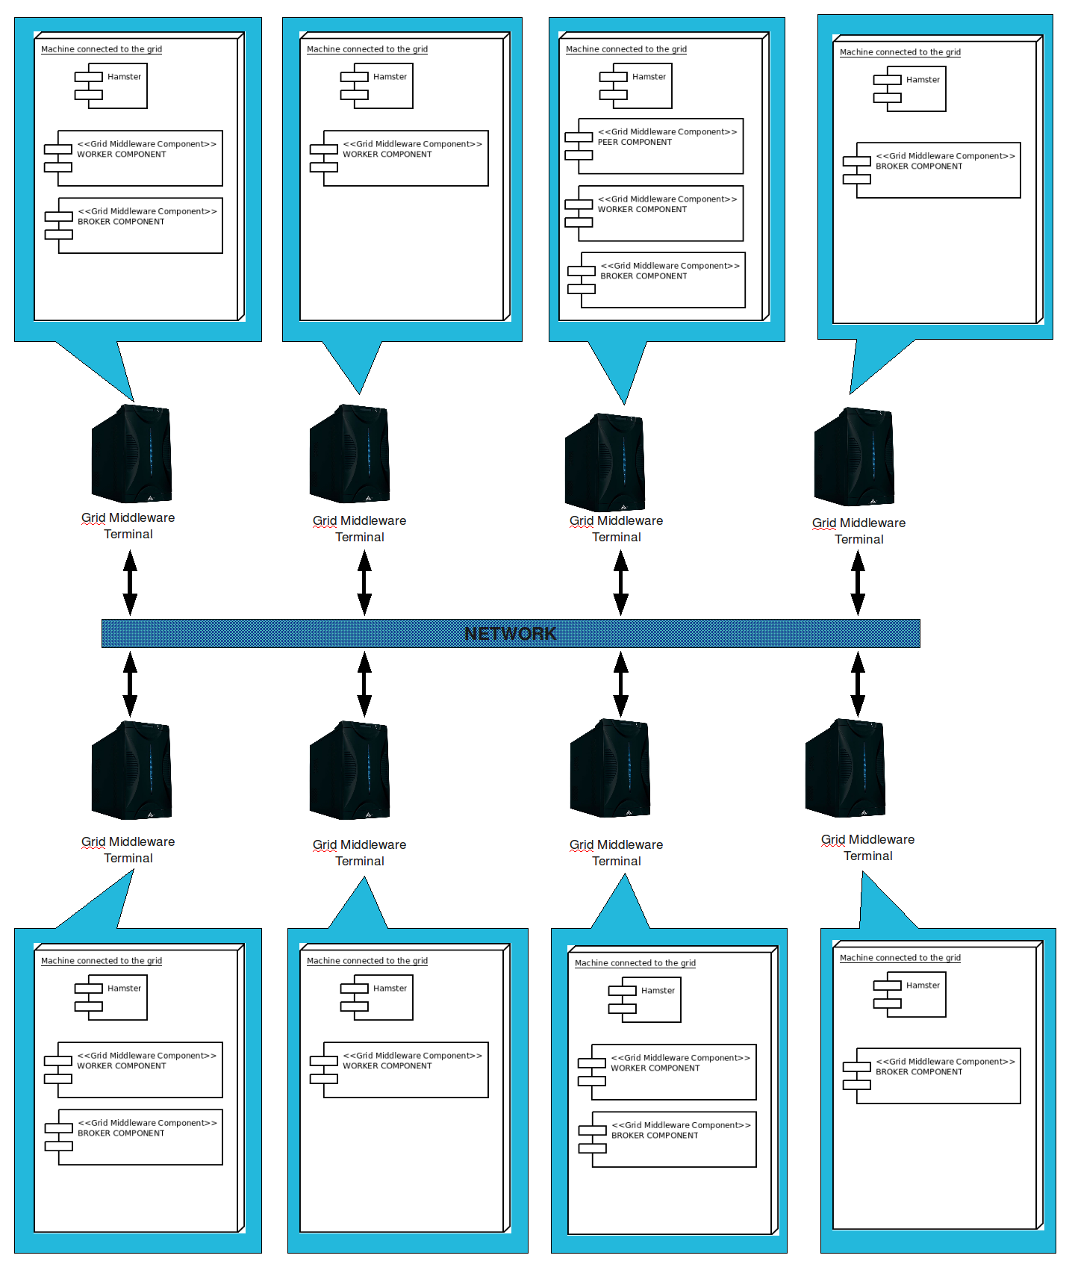

Slide 12
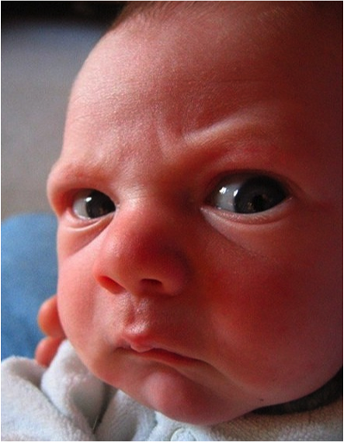
But...
The implementation of OurHamster required small modifications to OurGrid
Big drawback
  New versions of OurGrid could not be used
We needed something to separate Hamster and OurGrid code

Slide 13
Aspectized OurHamster
Refactoring of the OurHamster implementation
Scattered and tangled code moved into Aspects
  All that was needed to call the actual implementation
Notes:
Refactoring Hamster's integration to AOP was a success. Scattered code was moved to the created aspects. Also, we were able to easily integrate Hamster with various OurGrid version, ranging from 4.1.5 to 4.2.3, using Load-time Weaving

Slide 14
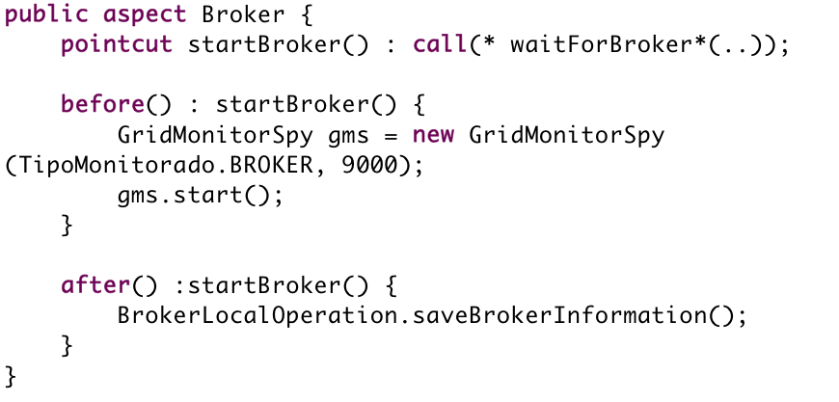
Broker aspect
Notes:
Here I believe the Broker's refactored aspect is possibly self-explanatory.

Slide 15
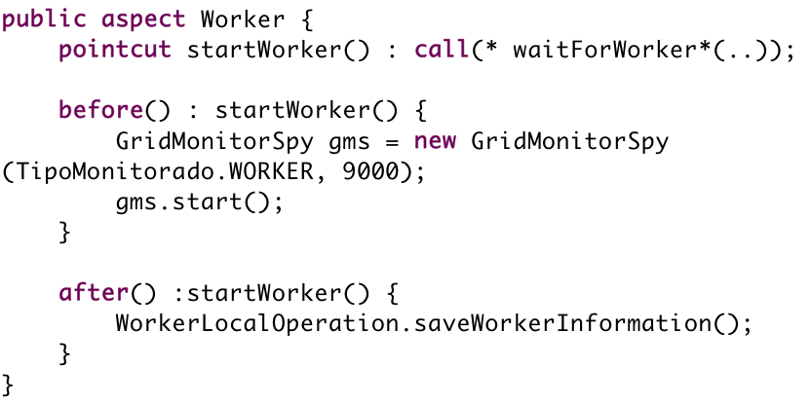
Worker aspect
Notes:
Also here, we have the Worker's refactored aspect.

Slide 16
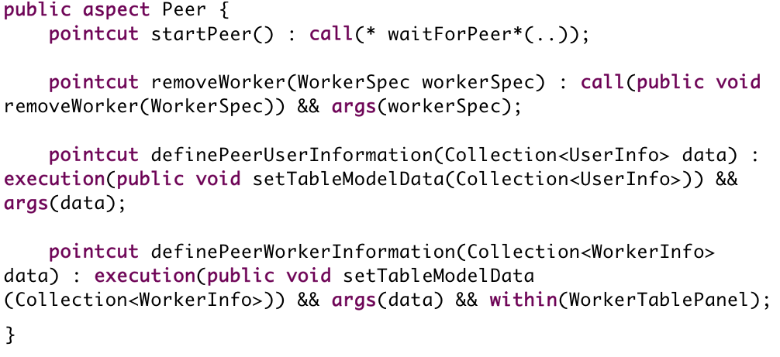
Peer aspect
Notes:
For lack of space, here we present only the refactored pointcuts of the Peer's aspect – as its advises were too long.

Slide 17
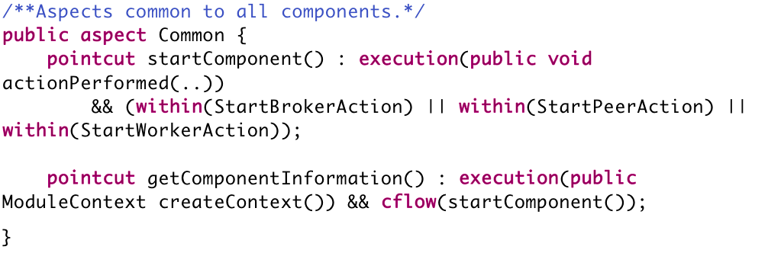
Common aspect
Notes:
As in the previous slide, we present here only the refactored pointcuts of the refactored Common aspect, which involved code used by all components.

Slide 18
Evaluation
Memory and CPU consumption
Comparisons between:
  OurGrid
  OurHamster
  Aspectized OurHamster
  Usage of Load-time Weaving
Integration with multiple versions of OurGrid
Notes:
Now, after the refactoring process, we did a little evaluation on the impact of Hamster on OurGrid, and of the AOP approach on the whole system as well. The evaluation was based on memory and CPU consumption of the running applications. Going further, we also compared an AOP implementation using source-code weaving against one using load-time weaving.

Slide 19
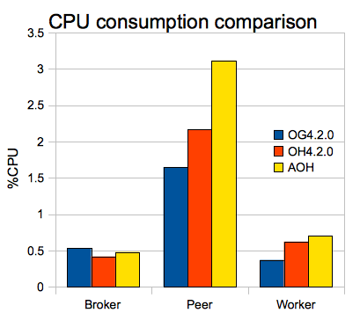
CPU consumption
Notes:
It is clear by this picture the impact of AOP, which contributed to CPU consumption proportionally to what Hamster was already contributing. In components in which Hamster costs more, AOP has put an extra cost to the whole, but possibly not an unnafordable one.

Slide 20
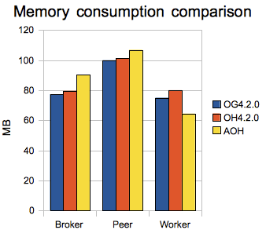
Memory consumption
Notes:
With memory consumption, we saw again a small increase in consumption for the AOP version, except in the Worker's case. That decrease may have been phased out with more executions.
Still, it seems reasonable to say that the overall cost of Hamster is low.

Slide 21
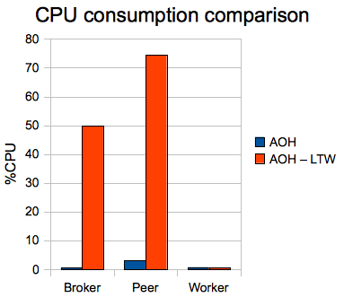
LTW CPU consumption
Notes:
The usage of LTW helped testing our implementation against several versions of OurGrid, which is in fact quite helpful on a development life-cycle. Nevertheless, the cost of running AOP with LTW – using a ”Weaving class loader” at runtime – seems to make CPU and memory consumptions rise to inappropriate amounts compared to regular source-code weaved AOH.

Slide 22
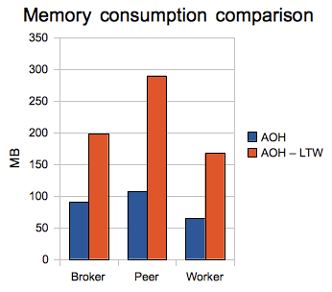
LTW Memory consumption

Slide 23
OurHamster pluggability
We could combine Hamster with 5 versions of OurGrid
  Between versions 4.15 and 4.23

Slide 24
OurHamster pluggability
We could combine Hamster with 5 versions of OurGrid
  Between versions 4.15 and 4.23
Clear benefits in terms of ease of maintenance
  No changes to OurGrid are required
  For source-code weaving, the freely-available source code of OurGrid is necessary
No fragility:
  Stable architecture and interfaces

Slide 25
Concluding Remarks
We used AOP to refactor a major crosscutting concern
Achieved ease of maintenance against several middleware versions
Evaluated the impact of LTW on a complex project.
We would like to integrate Hamster with another middleware platform, such as InteGrade

Slide 26
Thank you!
Contact info: castor@cin.ufpe.br

