Slide 1

Facultatea de Matematică şi Informatică Universitatea din Bucureşti
Programare orientată pe obiecte
- suport de curs -
Andrei Păun
Anca Dobrovăț
An universitar 2024 – 2025
Semestrul II
Seriile 13, 14 şi 15
Curs 12
Notes:
1
1
V2
22.4.2020

Slide 2
Facultatea de Matematică şi Informatică Universitatea din Bucureşti
Agenda cursului
1. Cod sigur: MISRA C, The Power of 10 Rules
2. Design principles: SOLID
3. Şabloane de proiectare (Design Patterns)
- Definiţie şi clasificare.
- Exemple de şabloane de proiectare (Singleton, Abstract Object Factory, Observer, Strategy Pattern).
Obs: Prezentare bazata pe GoF
(Erich Gamma, Richard Helm, Ralph Johnson si John Vlissides – Design Patterns, Elements of Reusable Object-Oriented Software (cunoscuta si sub numele “Gang of Four”), 1994)
2
Notes:
2
2

Slide 3
Facultatea de Matematică şi Informatică Universitatea din Bucureşti
Cod sigur in C: MISRA C
MISRA-C:2004 contains 142 rules, of which 122 are "required" and 20 are "advisory"; they are divided into 21 topical categories, from "Environment" to "Run-time failures".
Cel mai recent MISRA C:2023
Exista si MISRA C++: 2023
Sa vedem MISRA 2004

Slide 4
Facultatea de Matematică şi Informatică Universitatea din Bucureşti
Cod sigur in C: The Power of 10 Rules
Avoid complex flow constructs, such as goto and recursion.
All loops must have fixed bounds. This prevents runaway code.
Avoid heap memory allocation after initialization.
Restrict functions to a single printed page.
Use a minimum of two runtime assertions per function.
Restrict the scope of data to the smallest possible.
Check the return value of all non-void functions, or cast to void to indicate the return value is useless.
Use the preprocessor only for header files and simple macros.
Limit pointer use to a single dereference, and do not use function pointers.
Compile with all possible warnings active; all warnings should then be addressed before release of the software.

Slide 5
Facultatea de Matematică şi Informatică Universitatea din Bucureşti
2. Design principles: SOLID
Principiile proiectarii de clase (S.O.L.I.D) – Robert C. Martin
Single-responsibility principle
A class should only have a single responsibility, that is, only changes to one part of the software's specification should be able to affect the specification of the class.
Open–closed principle
"Software entities ... should be open for extension, but closed for modification."
Liskov substitution principle
"Objects in a program should be replaceable with instances of their subtypes without altering the correctness of that program."
Interface segregation principle
"Many client-specific interfaces are better than one general-purpose interface.”
Dependency inversion principle
One should "depend upon abstractions, [not] concretions.”

Slide 6
Facultatea de Matematică şi Informatică Universitatea din Bucureşti
Sabloane de proiectare (Design patterns)
Principiile proiectarii de clase
Principiul “inchis-deschis”
“Entitatile software (module, clase, functii etc.) trebuie sa fie deschise la extensii si inchise la modificare” (Bertrand Meyer, 1988).
“deschis la extensii” = comportarea modulului poate fi extinsa pentru a satisface noile cerinte.
“inchis la modificare” = nu este permisa modificarea codului sursa.
6
Notes:
6
6

Slide 7
Facultatea de Matematică şi Informatică Universitatea din Bucureşti
Sabloane de proiectare (Design patterns)
Principiile proiectarii de clase
Principiul substituirii
Functiile care utilizeaza pointeri sau referinte la clasa de baza trebuie sa fie apte sa utilizeze obiecte ale claselor derivate fara sa le cunoasca.
Principiul de inversare a dependentelor
“Modulele de nivel inalt nu trebuie sa depinda de modulele de nivel jos. Amandoua trebuie sa depinda de abstractii.”
“Abstractiile nu trebuie sa depinda de detalii. Detaliile trebuie sa depinda de abstractii.”
programele OO bine proiectate inverseaza dependenta structurala de la metoda procedurala traditionala
• metoda procedurala: o procedura de nivel inalt apeleaza o procedura de nivel jos, deci depinde de ea
7
Notes:
7
7

Slide 8
Facultatea de Matematică şi Informatică Universitatea din Bucureşti
Sabloane de proiectare (Design patterns)
Definitie si clasificare
Aplicarea principiilor pentru a crea arhitecturi OO → se ajunge repetat la aceleasi structuri, cunoscute sub numele de sabloane de proiectare (design patterns).
Un sablon de proiectare descrie
o problema care se intalneste in mod repetat in proiectarea programelor
solutia generala pentru problema respectiva
Solutia este exprimata folosind clase si obiecte.
Cand si unde a aparut ideea?
Arhitectura
1977: “A pattern language: Towns, Buildings, Constructiron”
Christopher Alexander
https://en.wikipedia.org/wiki/Pattern_language
8
Notes:
8
8

Slide 9
Facultatea de Matematică şi Informatică Universitatea din Bucureşti
Sabloane de proiectare (Design patterns)
Definitie si clasificare
Clasificarea şabloanelor după scop:
- creaţionale (creational patterns) privesc modul de creare al obiectelor.
- structurale (structural patterns) se referă la compoziţia claselor sau al obiectelor.
- comportamentale (behavioral patterns) caracterizează modul în care obiectele şi clasele interacţionează şi îşi distribuie responsabilităţile.
Clasificarea şabloanelor dupa domeniu de aplicare:
sabloanele claselor se referă la relaţii dintre clase, relaţii stabilite prin moştenire şi care sunt statice (fixate la compilare).
sabloanele obiectelor se referă la relaţiile dintre obiecte, relaţii care au un caracter dinamic .
9
Notes:
9
9

Slide 10
Facultatea de Matematică şi Informatică Universitatea din Bucureşti
Sabloane de proiectare (Design patterns)
Definitie si clasificare
In general, un sablon are 4 elemente esentiale:
nume
descrierea problemei. (contextul in care apare, cand trebuie aplicat sablonul).
descrierea solutiei. (elementele care compun proiectul, relatiile dintre ele, responsabilitatile si colaborarile).
consecintele si compromisuri aplicarii sablonului.
Un sablon de proiectare descrie de asemenea problemele de implementare ale sablonului si un exemplu de implementare a sablonului in unul sau mai multe limbaje de programare.
10
Notes:
10
10

Slide 11
Facultatea de Matematică şi Informatică Universitatea din Bucureşti
Sabloane de proiectare (Design patterns)
Structura unui sablon
In cartea de referinta (GoF), descrierea unui sablon este alcatuita din urmatoarele sectiuni:
Numele sablonului si clasificarea Intentia Alte nume prin care este cunoscut, daca exista. Motivatia - scenariu care ilustreaza o problema de proiectare si rezolvarea ; Aplicabilitatea Structura - reprezentata grafic prin diagrame de clase si de interactiune (UML) ;
Participanti - clasele si obiectele si responsabilitatile lor; Colaborari Consecinte - compromisurile si rezultatele utilizarii sablonului. Implement are - tehnici de implementare, aspectele dependente de limbaj Exemplu de cod Utilizari cunoscute Sabloane corelate
11
Notes:
11
11

Slide 12
Contents:
What does the term Design Pattern stand for?
Why should we study design patterns?
List of design patterns and categories
Presented patterns:
Singleton
Builder
Factory and Abstract Factory
Adapter
Iterator
Observer

Slide 13
Design Patterns
What are those?
First time the term of Design pattern was introduced by Christopher Alexander.
Acording to him, a pattern:
Describes a recurring problem
Describes the core of a solution
Is capable of generating many distinct designs

Slide 14
“Gang of Four” Pattern Structure
Gang of Four (GoF): Gamma, Johnson, Helm, Vlissides
Authors of the popular “Design Patterns” book
A pattern has a name
e.g., the Singleton pattern
A pattern documents a recurring problem
e.g., Issuing requests to objects without knowing in advance what’s to be requested or of what object

Slide 15
“Gang of Four” Pattern Structure
A pattern describes the core of a solution
e.g., class roles, relationships, and interactions
Important: this is different than describing a design
A pattern considers consequences of its use
Trade-offs, unresolved forces, other patterns to use

Slide 16
Why study Design Patterns?
reuse solutions that have worked in the past; why waste time reinventing the wheel?
shared vocabulary around software design
tell a software engineer “I used the X pattern”
don’t have to waste time explaining what you mean since you both know the X pattern

Slide 17
Why study Design Patterns?
Design patterns provide you not with code reuse but
with experience reuse
Knowing concepts such as abstraction, inheritance
and polymorphism will NOT make you a good designer, unless you use those concepts to create flexible designs that are maintainable and that can cope with change
Design patterns can show you how to apply those
concepts to achieve those goals

Slide 18
Design Pattern Categories
Creational patterns
Structural patterns
Behavioral patterns
Concurrency patterns

Slide 19
Creational patterns
Deal with object creation mechanisms, trying to create objects in a manner suitable to the situation by somehow controlling this object creation.
Two dominant ideas:
encapsulating knowledge about which classes the system uses.
hiding how instances of these classes are created and combined.
Further categorized into Object-creational patterns and Class-creational patterns, where Object-creational patterns deal with Object creation and Class-creational patterns deal with Class-instantiation.

Slide 20
Structural patterns
Ease the design by identifying a simple way to realize relationships between entities
Behavioral patterns
Identify common communication patterns between objects and realize these patterns. By doing so, these patterns increase flexibility in carrying out this communication

Slide 21
Singleton
Problem : Want to ensure a single instance of a class, shared
throughout a program
Context : Need to address initialization versus usage ordering
Solution :
Provide a global access method (static in C++)
First use of the access method instantiates the class
Constructors for instance can be made private(actually must C++)
Consequences :
Object is never created if it’s never used
Object is shared efficiently among all uses

Slide 22
Singleton
template <class T> class Singleton {
public:
static T *instance();
private:
Singleton();
static T *instance_;
};
// Initialize the static instance pointer
template <class T>
T *Singleton::instance_ = 0;
// Global access point
template <class T>
T *Singleton::instance() {
// check for existing instance
if (Singleton<T>::instance_ == 0) {
// may want a try/catch here
Singleton<T>::instance_ =
new Singleton<T>;
}
return Singleton<T>::instance_;
};

Slide 23
Singleton
Parameterized by a concrete type
Notice constructor and variable are private
Initialization of static s_instance variable
Outside class declaration
Outside method definition
Done before any method in compilation unit is called
Instance accessor method can then check
For a 0 instance pointer
And create a new instance if so
Same object is always returned by accessor

Slide 24
Singleton
Foo *f1 = Singleton<Foo>::instance();
Foo *f2 = Singleton<Foo>::instance();
//SAME OBJECT for both f1 and f2
Need a single instance
E.g., a common buffer of text tokens from a file
Shared across multiple points in the code
Need to share buffer
Copying is wasteful
Need to refer to same object instance
What about deleting these instances?

Slide 25
Builder
Intent:
Separate the construction of a complex object from its representation so that the same construction process can create different representations.
Parse a complex representation, create one of several targets.

Slide 26
Builder
Example:
This pattern is used by fast food restaurants to construct children's meals. Children's meals typically consist of a main item, a side item, a drink, and a toy (e.g., a hamburger, fries, Coke, and toy dinosaur). Note that there can be variation in the content of the children's meal, but the construction process is the same.

Slide 27
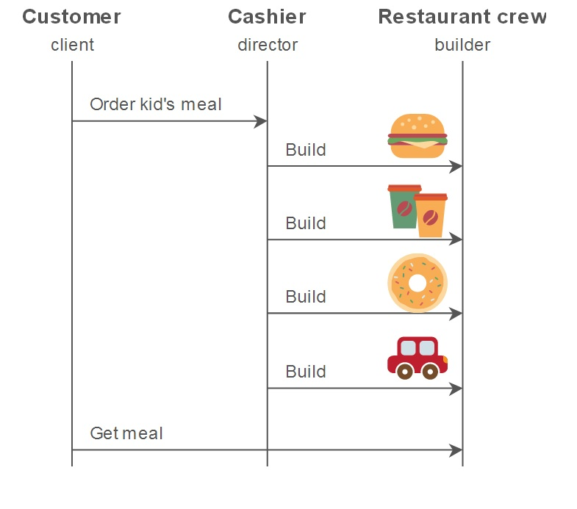
Builder
Example:

Slide 28
Builder
Example:
Whether a customer orders a hamburger, cheeseburger, or chicken, the process is the same. The employee at the counter directs the crew to assemble a main item, side item, and toy. These items are then placed in a bag. The drink is placed in a cup and remains outside of the bag. This same process is used at competing restaurants.

Slide 29
Builder
How to use a builder?
Decide if a common input and many possible representations (or outputs) is the problem at hand.
Encapsulate the parsing of the common input in a Reader class.
Design a standard protocol for creating all possible output representations. Capture the steps of this protocol in a Builder interface.

Slide 30
Builder
How to use a builder?
Define a Builder derived class for each target representation.
The client creates a Reader object and a Builder object, and registers the latter with the former.
The client asks the Reader to "construct".
The client asks the Builder to return the result.

Slide 31
Builder
Code:
http://en.wikibooks.org/wiki/C%2B%2B_Programming/Code/Design_Patterns/Creational_Patterns

Slide 32
(Abstract) Factory
Factory:
A utility class that creates an instance of a class from a family of derived classes
Abstract Factory:
A utility class that creates an instance of several families of classes. It can also return a factory for a certain group.

Slide 33
(Abstract) Factory
Intent:
Provide an interface for creating families of related or dependent objects without specifying their concrete classes

Slide 34
(Abstract) Factory
Example: pasta maker
The code is the pasta maker .Different disks create different pasta shapes . These are the factories.
All disks have certain properties in common so that they will work with the pasta maker.
All pastas have certain characteristics in common that are inherited from the generic “Pasta” object.

Slide 35
(Abstract) Factory
Code:
http://en.wikibooks.org/wiki/C%2B%2B_Programming/Code/Design_Patterns/Creational_Patterns#Factory

Slide 36
Adapter
Problem :
Have an object with an interface that’s close to but not exactly what we need.
What do we do?
Context:
Want to re-use an existing class
Can’t change its interface
Impractical to extend class hierarchy more generally

Slide 37
Adapter
Solution:
Wrap a particular class or object with the interface needed (2 forms: class form and object forms)
Consequences:
Implementation you’re given gets the interface you want

Slide 38
Iterator
Intent:
Want to access aggregated elements sequentially, like traverse a list of names and print them out.
Don’t want to know details of how they’re stored, in a linked list, or an array, or a balanced binary tree
Solution core:
Provide a separate interface for iteration over each container

Slide 39
Iterator
Consequences:
Frees user from knowing details of how elements are stored
Decouples containers from algorithms (crucial in C++ STL)
Examples:
C++ pointers, C++ STL list<int>::iterator

Slide 40
Iterator
Specifications:
Each container may have a different iterator type
Iterator knows the internals of the container
Object-oriented form shown below (for user-defined types)
Slightly different with built-in types, templates
E.g., no inheritance relationship, may use traits, etc.

Slide 41
Iterator
Implementation:
Object-oriented version of iterator is natural to implement as a class in C++.
Constructor stores passed pointer to C-style string s, positions current_ at s (string),
first (re)positions iterator at the start of the string
next moves iterator to the next position
is_done iterating whether iterator is at the end of the string
current_item returns a pointer to the character at the current iterator position

Slide 42
Iterator
Code:
class StringIterator {
public:
StringIterator (char * s)
: s_ (s), current_ (s) {}
void first () {
current_ = s_;
}
void next () {
++current_;
}
bool is_done () {
return *current_ == 0;
}
char * current_item () {
return current_;
}
private:
char *s_;
char *current_;
};

Slide 43
Iterator
unsigned int letter_count
(StringIterator& si, char c)
{
unsigned int count = 0;
for (si.first ();
! si.is_done ( );
si.next ())
if (*si.current_item () == c)
++count;
return count;
}
Iterators naturally support use in looping constructs
first is used to initialize
is_done used for loop test
next used to increment
current_item is used in loop comparison
Usually stl data structures have an “end()” function. We should compare iterator to that
loop completes => function shown has
Iterated through entire string
Counted occurrences of the character value in the string
Returned the occurrence count

Slide 44
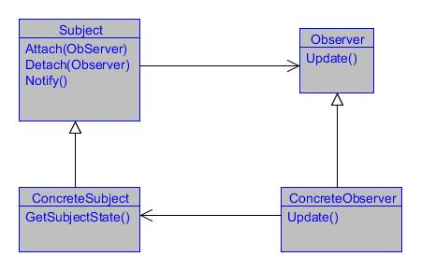
Observer
The Observer Pattern defines a one-to-many dependency between objects so that when one object changes state, all its dependents are notified and updated automatically.
one part of our application updated with the status of some other part of the application.
class diagram for Observer Pattern(Reference: GoF Design Patterns)

Slide 45
Observer
Subject:
keeps track of all the observers
provides the facility to add or remove the observers.
responsible for updating the observers when any change occurs
ConcreteSubject:
the real class that implements the Subject.
is the entity whose change will affect other objects.
Observer:
an interface that defines the method that should be called whenever there is any change
ConcreteObserver:
needs to keep itself updated with the change.
needs to implement the Observer
register itself with the ConcreteSubject and it is all set to receive the updates.

Slide 46
Facultatea de Matematică şi Informatică Universitatea din Bucureşti
Sabloane de proiectare (Design patterns)
Unele dintre sabloanele de proiectare cele mai folosite sunt descrise in cele ce urmeaza:
1. Abstract Server
Cand un client depinde direct de server, este incalcat principiul de inversare a dependentelor. Modificarile facute in server se vor propaga in client, iar clientul nu va fi capabil sa foloseasca alte servere similare cu acela pentru care a fost construit.
Situatia de mai sus se poate imbunatati prin inserarea unei interfete abstracte intre client si server,
Client -> Interfata <- Manager
46
Notes:
46
46

Slide 47
Facultatea de Matematică şi Informatică Universitatea din Bucureşti
Sabloane de proiectare (Design patterns)
2. Adapter
Cand inserarea unei interfete abstracte nu este posibila deoarece serverul este produs de o alta companie (third party ISV) sau are foarte multe dependente de intrare care-l fac greu de modificat, se poate folosi un ADAPTER pentru a lega interfata abstracta de server.
Client -> Interfata <- Adapter ->Manager.
47
Notes:
47
47

Slide 48
Facultatea de Matematică şi Informatică Universitatea din Bucureşti
Sabloane de proiectare (Design patterns)
3. Singleton (clase cu o singura instanta)
Intentia
proiectarea unei clase cu un singur obiect (o singura instanţă)
Motivatia
într-un sistem de operare:
exista un sistem de fişiere
exista un singur manager de ferestre
Aplicabilitate când trebuie să existe exact o instanta: clientii clasei trebuie sa aiba acces la instanta din orice punct bine definit.
48
Notes:
48
48

Slide 49
Facultatea de Matematică şi Informatică Universitatea din Bucureşti
Sabloane de proiectare (Design patterns)
Singleton (clase cu o singura instanta)
Consecinţe
acces controlat la instanta unica;
reducerea spaţiului de nume (eliminarea variab. globale);
permite rafinarea operaţiilor si reprezentării;
permite un numar variabil de insţante;
mai flexibila decât operaţiile la nivel de clasă (statice).
49
Notes:
49
49

Slide 50
Facultatea de Matematică şi Informatică Universitatea din Bucureşti
Sabloane de proiectare (Design patterns)
Singleton (clase cu o singura instanta) - exemplu cu referinte
int main()
{
Singleton& s1 = Singleton::instance();
cout << s1.getValue() << endl;
Singleton& s2 = Singleton::instance();
s2.setValue(9);
cout << s1.getValue() <<endl;
return 0;
}
class Singleton
{
public:
static Singleton& instance()
{
return uniqueInstance;
}
int getValue() { return data;}
void setValue(int value) { data = value;}
private:
static Singleton uniqueInstance;
int data;
Singleton(int d = 0):data(d) { }
Singleton & operator=(Singleton & ob){
if (this != &ob) data = ob.data; return *this; }
Singleton(const Singleton & ob) { data = ob.data; }
};
Singleton Singleton::uniqueInstance (0);
50
Notes:
50
50

Slide 51
Facultatea de Matematică şi Informatică Universitatea din Bucureşti
Sabloane de proiectare (Design patterns)
Singleton (clase cu o singura instanta) - exemplu cu pointeri
class Singleton
{
public:
static Singleton* instance()
{
if (uniqueInstance == NULL)
uniqueInstance = new Singleton();
return uniqueInstance;
}
int getValue() { return data;}
void setValue(int value) { data = value;}
private:
static Singleton* uniqueInstance;
int data;
Singleton(int d = 0):data(d) { }
Singleton & operator=(Singleton & ob){
if (this != &ob) data = ob.data; return *this; }
Singleton(const Singleton & ob) { data = ob.data; }
};
Singleton* Singleton::uniqueInstance = NULL;
int main()
{
Singleton* s1 = Singleton::instance();
cout << s1->getValue() << endl;
Singleton* s2 = Singleton::instance();
s2->setValue(9);
cout << s1->getValue() <<endl;
return 0;
}
51
Notes:
51
51

Slide 52
Facultatea de Matematică şi Informatică Universitatea din Bucureşti
Sabloane de proiectare (Design patterns)
Singleton (clase cu o singura instanta) - exemplu
#include <iostream>
using namespace std;
class Ceas_intern
{
static Ceas_intern* instanta;
int timestamp;
Ceas_intern(int d = 0):timestamp(d) { }
Ceas_intern & operator=(Ceas_intern & ob);
Ceas_intern(const Ceas_intern & ob);
public:
static Ceas_intern* get_instanta()
{
if (instanta == NULL) instanta = new Ceas_intern();
return instanta;
}
void adauga_zile(int);
void adauga_luni(int);
int get_timestamp();
};
Ceas_intern* Ceas_intern::instanta = NULL;
52
Notes:
52
52

Slide 53
Facultatea de Matematică şi Informatică Universitatea din Bucureşti
Sabloane de proiectare (Design patterns)
Singleton (clase cu o singura instanta) - exemplu
Ceas_intern & Ceas_intern::operator=(Ceas_intern & ob)
{
if (this != &ob)
timestamp = ob.timestamp;
return *this;
}
Ceas_intern::Ceas_intern(const Ceas_intern & ob)
{
timestamp = ob.timestamp;
}
void Ceas_intern::adauga_zile(int d)
{
timestamp+=d;
}
void Ceas_intern::adauga_luni(int m)
{
timestamp+=22*m;
}
int Ceas_intern::get_timestamp()
{
return timestamp;
}
0
10
10
20
20
int main()
{
Ceas_intern* ob1 = Ceas_intern::get_instanta();
cout<<ob1->get_timestamp()<<endl;
ob1->adauga_zile(10);
cout<<ob1->get_timestamp()<<endl;
Ceas_intern* ob2 = Ceas_intern::get_instanta();
cout<<ob2->get_timestamp()<<endl;
ob2->adauga_zile(10);
cout<<ob2->get_timestamp()<<endl;
cout<<ob1->get_timestamp()<<endl;
}
53
Notes:
53
53

Slide 54
Facultatea de Matematică şi Informatică Universitatea din Bucureşti
Sabloane de proiectare (Design patterns)
4. Observer
Intentia: Defineste o dependenta “unul la mai multi” intre obiecte, astfel incat atunci cand unul dintre obiecte isi schimba starea toate obiectele dependente sunt notificate si actualizate automat. Alte nume prin care este cunoscut: Dependents, Publish-Subscribe. Motivatia descrie cum sa se stabileasca relatiile intre clase.
Obiectele cheie in acest sablon sunt subiect si observator.
Un subiect poate avea orice numar de observatori dependenti.
Toti observatorii sunt notificati ori de cate ori subiectul isi schimba starea.
Ca raspuns la notificare, fiecare observator va interoga subiectul pentru a-si sincroniza starea cu starea subiectului.
54
Notes:
54
54

Slide 55
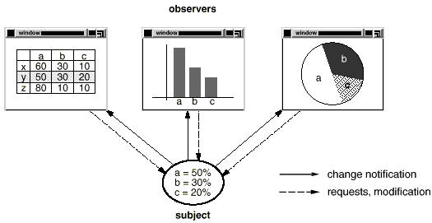
Facultatea de Matematică şi Informatică Universitatea din Bucureşti
Sabloane de proiectare (Design patterns)
Observer
55
Notes:
55
55

Slide 56
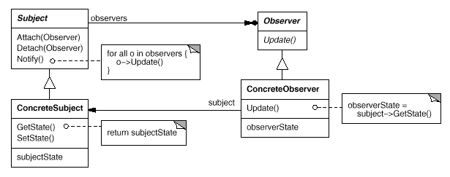
Facultatea de Matematică şi Informatică Universitatea din Bucureşti
Sabloane de proiectare (Design patterns)
Observer
Structura
56
Notes:
56
56

Slide 57
Facultatea de Matematică şi Informatică Universitatea din Bucureşti
Sabloane de proiectare (Design patterns)
Observer
Aplicabilitatea
Sablonul poate fi utilizat in oricare dintre urmatoarele situatii:
- cand o abstractie are doua aspecte, unul dependent de celalalt (daca sunt incapsulate in obiecte separate, ele pot fi reutilizate independent).
- cand modificarea unui obiect necesita modificarea altor obiecte si nu se stie cate obiecte trebuie sa fie modificate.
- cand un obiect trebuie sa notifice alte obiecte fara a face presupuneri despre cine sunt aceste obiecte.
57
Notes:
57
57

Slide 58
Facultatea de Matematică şi Informatică Universitatea din Bucureşti
Sabloane de proiectare (Design patterns)
Observer
Participantii
Subject
Cunoaste observatorii sai.
Un obiect Subject poate fi observat de orice numar de obiecte Observer
Furnizeaza o interfata pentru atasarea si detasarea obiectelor Observer. Observer Defineste o interfata pentru actualizarea obiectelor care trebuie sa fie notificate (anuntate) despre modificarile din subiect.
58
Notes:
58
58

Slide 59
Facultatea de Matematică şi Informatică Universitatea din Bucureşti
Sabloane de proiectare (Design patterns)
Observer
Participantii
ConcreteSubject Memoreaza starea de interes pentru obiectele ConcreteObserver. Trimite o notificare observatorilor sai atunci cand i se schimba starea. ConcreteObserver Mentine o referinta la un obiect ConcreteSubject. Memoreaza starea care trebuie sa ramana consistenta cu a subiectului. Implementeaza interfata de actualizare a clasei Observer
59
Notes:
59
59

Slide 60
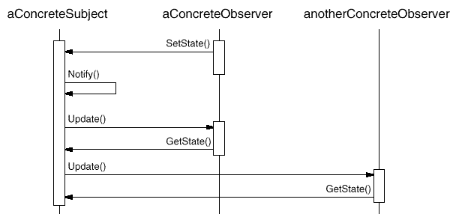
Facultatea de Matematică şi Informatică Universitatea din Bucureşti
Sabloane de proiectare (Design patterns)
Observer
Colaborari
60
Notes:
60
60

Slide 61
Facultatea de Matematică şi Informatică Universitatea din Bucureşti
Sabloane de proiectare (Design patterns)
Observer
Exemplu de cod
Interfata Observer este definita printr-o clasa abstracta:
class Observer {
public:
virtual ~ Observer();
virtual void Update(Subject* theChangedSubject) = 0;
protected:
Observer();
};
61
Notes:
61
61

Slide 62
Facultatea de Matematică şi Informatică Universitatea din Bucureşti
Sabloane de proiectare (Design patterns)
Observer
Exemplu de cod
Interfata Subject este definita prin urmatoarea clasa:
class Subject {
public:
virtual ~Subject();
virtual void Attach(Observer*);
virtual void Detach(Observer*);
virtual void Notify();
protected:
Subject();
private:
List<Observer*> *_observers;
};
void Subject::Attach (Observer* o) {_observers->Append(o); }
void Subject::Detach (Observer* o) {_observers->Remove(o); }
void Subject::Notify () {
ListIterator<Observer*> i(_observers);
//construieste un iterator, i, pentru containerul_observers
for (i.First(); !i.IsDone(); i.Next()) { i.CurrentItem()->Update(this);}
}
62
Notes:
62
62

Slide 63
Facultatea de Matematică şi Informatică Universitatea din Bucureşti
Sabloane de proiectare (Design patterns)
Observer
un subiect concret
class ClockTimer : public Subject {
public:
ClockTimer();
virtual int GetHour();
virtual int GetMinute();
virtual int GetSecond();
void Tick();
};
void ClockTimer::Tick () {
// update internal time-keeping state
// ...
Notify();
}
63
Notes:
63
63

Slide 64
Facultatea de Matematică şi Informatică Universitatea din Bucureşti
Sabloane de proiectare (Design patterns)
Observer
un observator concret care mosteneste in plus o interfata grafica
class DigitalClock: public Widget, public Observer
{
public:
DigitalClock(ClockTimer*);
virtual ~DigitalClock();
virtual void Update(Subject*);
// overrides Observer operation
virtual void Draw();
// overrides Widget operation;
// defines how to draw the digital clock
private:
ClockTimer* _subject;
};
64
Notes:
64
64

Slide 65
Facultatea de Matematică şi Informatică Universitatea din Bucureşti
Sabloane de proiectare (Design patterns)
Observer
un observator concret care mosteneste in plus o interfata grafica
DigitalClock::DigitalClock (ClockTimer* s) {
_subject = s;
_subject->Attach(this); }
DigitalClock::~DigitalClock () {_subject->Detach(this);}
void DigitalClock::Update (Subject* theChangedSubject) {
if (theChangedSubject == _subject) { Draw(); } }
void DigitalClock::Draw () { // get the new values from the subject
int hour = _subject->GetHour();
int minute = _subject->GetMinute();
// draw the digital clock
}
65
Notes:
65
65

Slide 66
Facultatea de Matematică şi Informatică Universitatea din Bucureşti
Sabloane de proiectare (Design patterns)
Observer
un alt observator
class AnalogClock : public Widget, public Observer {
public:
AnalogClock(ClockTimer*);
virtual void Update(Subject*);
virtual void Draw();
// ...
};
/* crearea unui AnalogClock si unui DigitalClock care arata acelasi timp: */
ClockTimer* timer = new ClockTimer;
AnalogClock* analogClock = new AnalogClock(timer);
DigitalClock* digitalClock = new DigitalClock(timer);
66
Notes:
66
66

Slide 67
Facultatea de Matematică şi Informatică Universitatea din Bucureşti
Sabloane de proiectare (Design patterns)
5. Abstract Object Factory
intentie
• de a furniza o interfata pentru crearea unei familii de obiecte intercorelate sau dependente fara a specifica clasa lor concreta.
aplicabilitate
• un sistem ar trebui sa fie independent de modul in care sunt create produsele, compuse sau reprezentate
• un sistem ar urma sa fie configurat cu familii multiple de produse
• o familie de obiecte intercorelate este proiectata pentru astfel ca obiectele sa fie utilizate impreuna
• se doreste furnizarea unei biblioteci de produse, dar se doreste accesibila numai interfata, nu si implementarea.
67
Notes:
67
67

Slide 68
Facultatea de Matematică şi Informatică Universitatea din Bucureşti
Sabloane de proiectare (Design patterns)
Abstract Object Factory
colaborari
• normal se creeaza o singura instanta
consecinte
• izoleaza clasele concrete
• simplifica schimbul familiei de produse
• promoveaza consistenta printre produse
• suporta noi timpul noi familii de produse usor
• respecta principiul deschis/inchis
68
Notes:
68
68

Slide 69
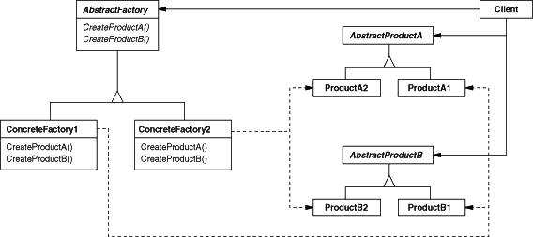
Facultatea de Matematică şi Informatică Universitatea din Bucureşti
Sabloane de proiectare (Design patterns)
Abstract Object Factory
structura
69
Notes:
69
69

Slide 70
Facultatea de Matematică şi Informatică Universitatea din Bucureşti
Sabloane de proiectare (Design patterns)
Abstract Object Factory
implementare
o functie delegat (callback) este o functie care nu este invocata explicit de programator; responsabilitatea apelarii este delegata altei functii care primeste ca
parametru adresa functiei delegat
Fabrica de obiecte utilizeaza functii delegat pentru crearea de obiecte: pentru fiecare tip este delegata functia carea creeaza obiecte de acel tip.
70
Notes:
70
70

Slide 71
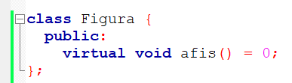
Facultatea de Matematică şi Informatică Universitatea din Bucureşti
Sabloane de proiectare (Design patterns)
Abstract Object Factory
solutia
- definim mai intai clasa de baza ca si clasa abstracta
- Definim grupurile de produse / tipurile de produse
71
Notes:
71
71

Slide 72
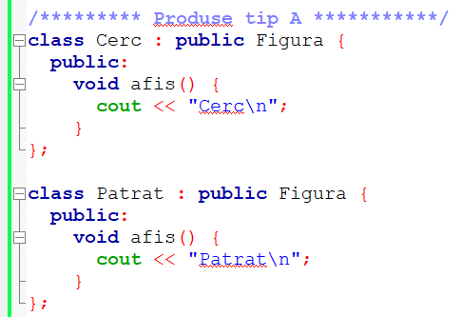
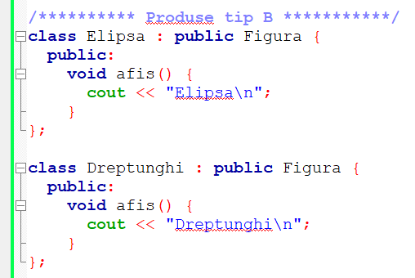
Facultatea de Matematică şi Informatică Universitatea din Bucureşti
Sabloane de proiectare (Design patterns)
Abstract Object Factory
solutia
- Definim grupurile de produse / tipurile de produse
72
Notes:
72
72

Slide 73
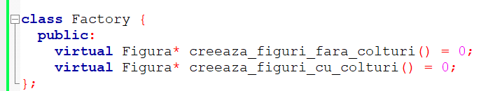
Facultatea de Matematică şi Informatică Universitatea din Bucureşti
Sabloane de proiectare (Design patterns)
Abstract Object Factory
solutia
definim apoi o fabrica de figuri, adica o clasa care sa gestioneze tipurile de figuri
73
Notes:
73
73

Slide 74
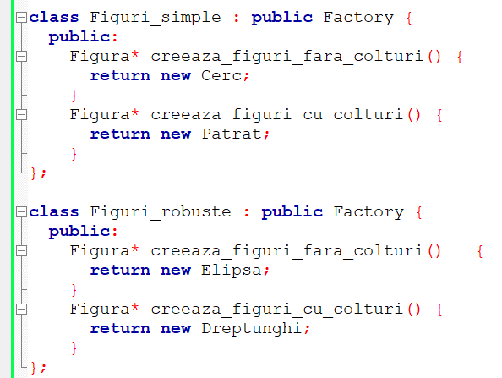
Facultatea de Matematică şi Informatică Universitatea din Bucureşti
Sabloane de proiectare (Design patterns)
Abstract Object Factory
solutia
Generam factory pentru grupuri de produse
74
Notes:
74
74

Slide 75
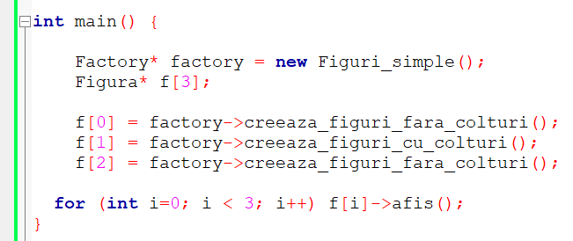
Facultatea de Matematică şi Informatică Universitatea din Bucureşti
Sabloane de proiectare (Design patterns)
Abstract Object Factory
solutia
Apel fara a numi efectiv figurile
75
Notes:
75
75

Slide 76
Facultatea de Matematică şi Informatică Universitatea din Bucureşti
Sabloane de proiectare (Design patterns)
6. Strategy pattern
intentie
• Presupune incapsularea separata a fiecarui algoritm dintr-o familie, facand astfel ca algoritmii respectivi sa fie interschimbabili.
aplicabilitate
- mai multe clase inrudite difera doar prin comportament;
sunt necesare mai multe variante ale unui algoritm, care difera intre ele, de exemplu, prin compromisul spatiu-timp adoptat;
un algoritm utilizeaza date pe care clientul algoritmului nu trebuie sa le cunoasca;
intr-o clasa sunt definite mai multe actiuni care apar ca structuri conditionale multiple. In loc de aceasta, se recomanda plasarea ramurilor conditionale inrudite in cate o clasa strategy separata.
76
Notes:
76
76

Slide 77
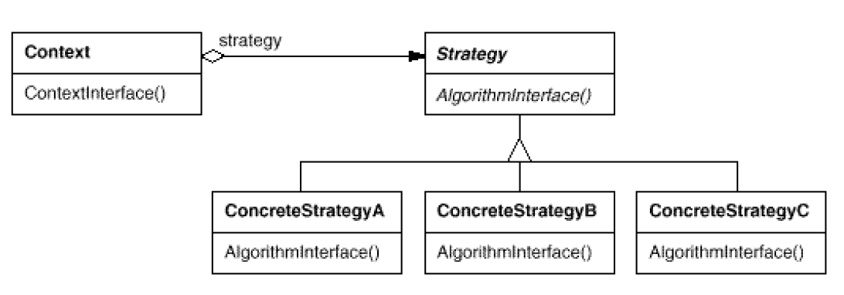
Facultatea de Matematică şi Informatică Universitatea din Bucureşti
Sabloane de proiectare (Design patterns)
Strategy pattern
structura
77
Notes:
77
77

Slide 78
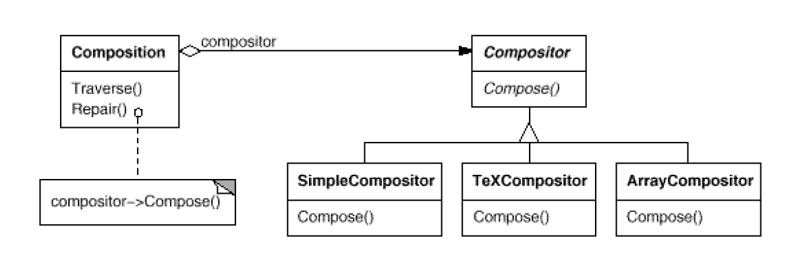
Facultatea de Matematică şi Informatică Universitatea din Bucureşti
Sabloane de proiectare (Design patterns)
Strategy pattern
exemplu
Algoritm care impart un text pe linii
SimpleCompositor – algoritm simplu cu \n
TeXCompositor – algoritm care grupeaza, mai eficient, pe paragrafe
ArrayCompositor – algoritm care imparte textul astfel incat, pe fiecare linie, sa existe acelasi nr de caractere
78
Notes:
78
78

Slide 79
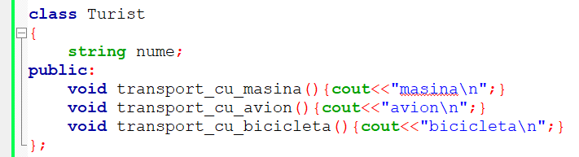
Facultatea de Matematică şi Informatică Universitatea din Bucureşti
Sabloane de proiectare (Design patterns)
Strategy pattern
Exemplu implementare
Problema!!
79
Notes:
79
79

Slide 80
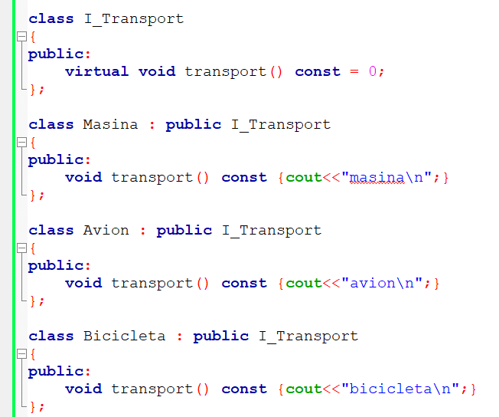
Facultatea de Matematică şi Informatică Universitatea din Bucureşti
Sabloane de proiectare (Design patterns)
Strategy pattern
Exemplu implementare
Strategiile de transport
80
Notes:
80
80

Slide 81
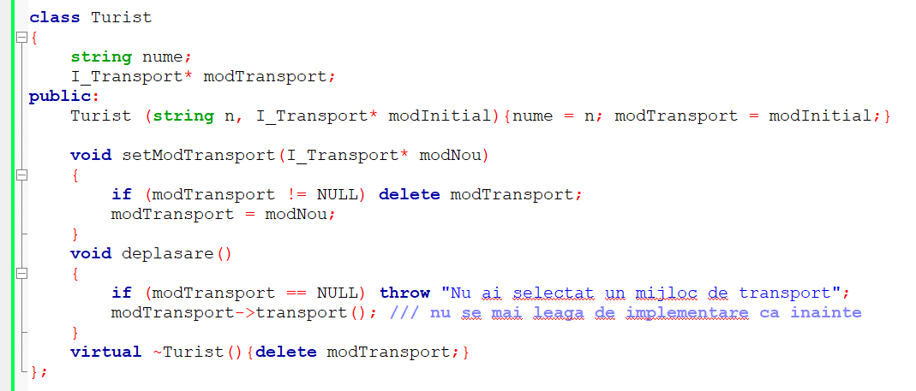
Facultatea de Matematică şi Informatică Universitatea din Bucureşti
Sabloane de proiectare (Design patterns)
Strategy pattern
Exemplu implementare
Noua clasa turist (care contine un pointer catre modul de deplasare)
81
Notes:
81
81

Slide 82
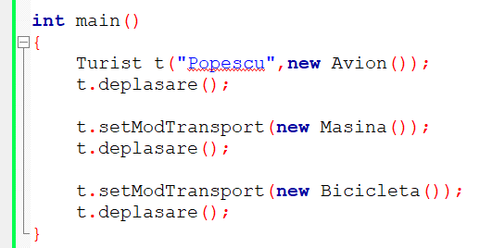
Facultatea de Matematică şi Informatică Universitatea din Bucureşti
Sabloane de proiectare (Design patterns)
Strategy pattern
Exemplu implementare
Apel
82
Notes:
82
82

Slide 83
Facultatea de Matematică şi Informatică Universitatea din Bucureşti
Curs 13
Recapitulare,
Exemple de probleme de colocviu
Exemple de examene anterioare
83
Notes:
83
83

