Slide 1

Harmonia - Music Streaming App
Fernando Flores, Reid Minton, Hieu Quang Tran, Juan Esquivel, Adawari Dappa, Yadiel Valentin Rios, Ubaid Mohammed

Slide 2

Project Objectives (1/2)
Create a collaborative music streaming platform.
Enable users to create and manage playlists together.
Support social features such as following and shared discovery.

Slide 3
Project Objectives (2/2)
Ensure scalable and reliable backend performance.
Provide secure authentication and data privacy.
Deliver an intuitive user interface for seamless collaboration.

Slide 4
Cost Estimation Method
Using the Function Point (FP) model.
Includes inputs, outputs, queries, data files, and external interfaces.

Slide 5
Gross Function Points (GFP)
Outputs: 7 × 5 = 35
Queries: 5 × 4 = 20
Data Files: 5 × 10 = 50
External Interfaces: 2 × 7 = 14
Total GFP = 155
(Average x Simple)
Inputs: 9 × 4 = 36

Slide 6
Processing Complexity Adjustment (PCA)
Processing Complexity Score (PC) = 30
PCA = 0.65 + 0.01 × PC
PCA = 0.95

Slide 7
Final Function Points
FP = GFP × PCA
FP = 155 × 0.95
Final FP ≈ 147

Slide 8
Effort and Personnel Cost
Productivity: 10 FP per person-month
Effort ≈ 147 / 10 = 15 person-months
Team size: 4 developers → ~4 months
Estimated labor cost ≈ $108,000

Slide 9
Hardware Cost Estimation
Cloud server: $720
Cloud storage: $300
Load balancer/traffic: $450
Backup systems: $180
Total: $1,650

Slide 10
Software & Licensing Costs
Auth0: $264
MongoDB Atlas: $420
Monitoring: $180
CI/CD (Building code/ Deployment) tools: $48
Music licensing (prototype): $8,000
Admin/rights fees: $2,000
Sample streaming license: $1,500
Total: $12,412

Slide 11
Total Project Cost Summary
Hardware: $1,650
Software & licensing: $12,412
Personnel: ~$110,020
Contingency (10%): ~$12,400
Estimated Total: ~$136,500
Notes:
Combining hardware, software and licensing, and personnel, and adding a 10% contingency for uncertainty, we estimate the Harmonia project cost at approximately $136,000.

Slide 12
Project Timeline
January 1 - April 30 (4 Months with 4 developers)
1st Month - UI/UX design and DB can be designed and setup at the same time
2nd Month - The backend API needs to be created to update data in the DB
3rd Month - The frontend can be created with the API endpoints created
4th Month - Continue on frontend development and add analytics

Slide 13
Functional Requirements
Users should be able to listen to music of their choosing, from playlists, libraries, or browsing available songs
Users should be able to create, share, and subscribe to playlists
Users should be able to follow other users and musicians
The system should provide recommendations on genres and musicians based on users’ listening history
The system should keep track of key metrics for songs and albums to measure popularity and trends
Musicians should be able to release songs and albums, and be able to announce when it is to be released
Users should be able to download songs in the app for offline listening, but not be able to have the songs’ files

Slide 14
Non-functional Requirements
Usability: Navigation should be straight-forward so anyone can use the app easily, even if they’ve never used it before
Performance: Transitions between the current song and the next song in the queue should not have any buffering.
Space: The app and its data should be relatively lightweight to be able to run on devices with less storage
Dependability: Streaming servers should have 99.9% uptime, other servers can have less uptime as they are less critical
Security: Users will sign in upon downloading the app, but should stay signed in if they close and reopen it. Streaming should also be encrypted for privacy
Environmental: Should be able to be downloaded on iOS, Samsung, and Windows devices
Operational: Music will be streamed from dedicated servers, and other lower-priority functionality will use separate servers
Development: The application will be developed in React Native using TypeScript to prevent runtime errors common with JavaScript
Regulatory: The system will acquire all necessary licenses and comply with federal and international regulations
Ethical: Data collected from users should not be sold or shared with third parties
Accounting: The system will track subscriptions and necessary data for accounting
Safety / Security: Users can put restrictions on explicit music for themselves or another account linked to them for underage listeners

Slide 15
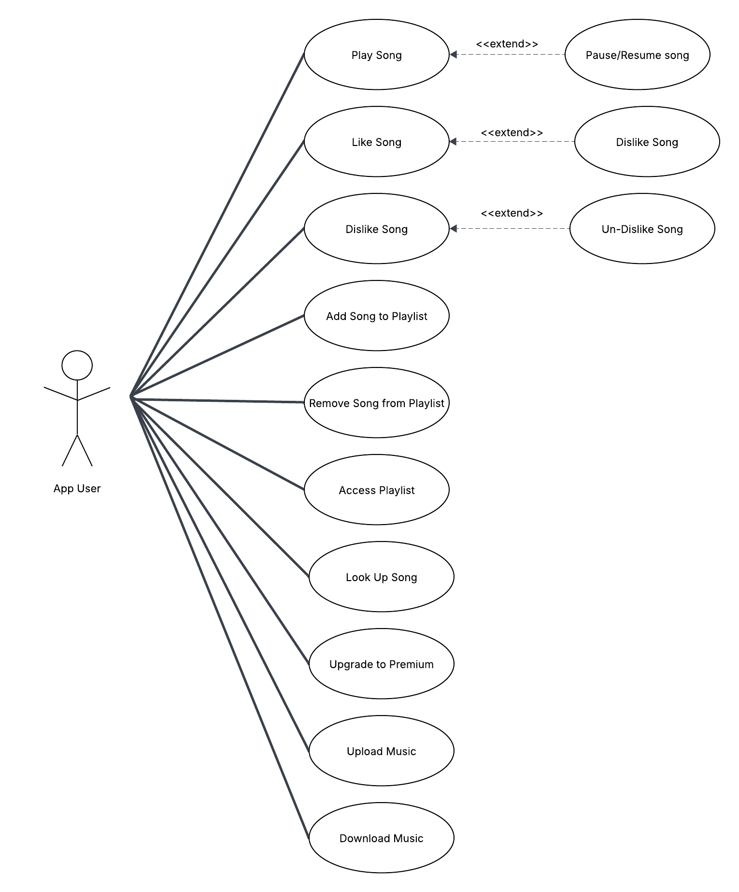
Use Case Diagram
Actions the user can take
Play, pause, & resume song
Like or dislike songs
Access, add and remove songs to playlist
Upload and download music
Upgrade to premium subscription

Slide 16
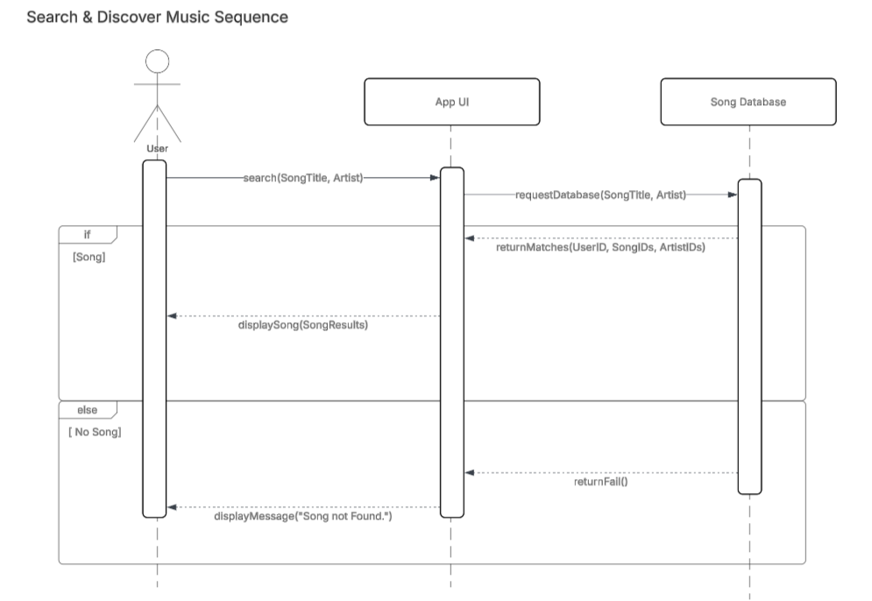
Sequence Diagram
Shows how the user searches for a song.
App UI sends the search request to the Song Database.
Database returns either matching songs or a failure message.

Slide 17
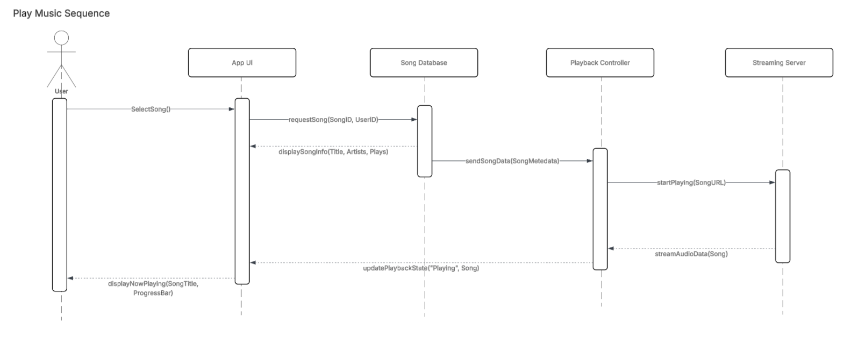
Sequence Diagram (continued)
User selects a song to play, App UI requests song data from the database.
Database returns song metadata (title, artist, plays), App UI updates with song information.
Database sends song data to playback controller.
Playback controller then sends song URL to streaming server to begin playing the song.
UI updates progress bar as song plays.

Slide 18
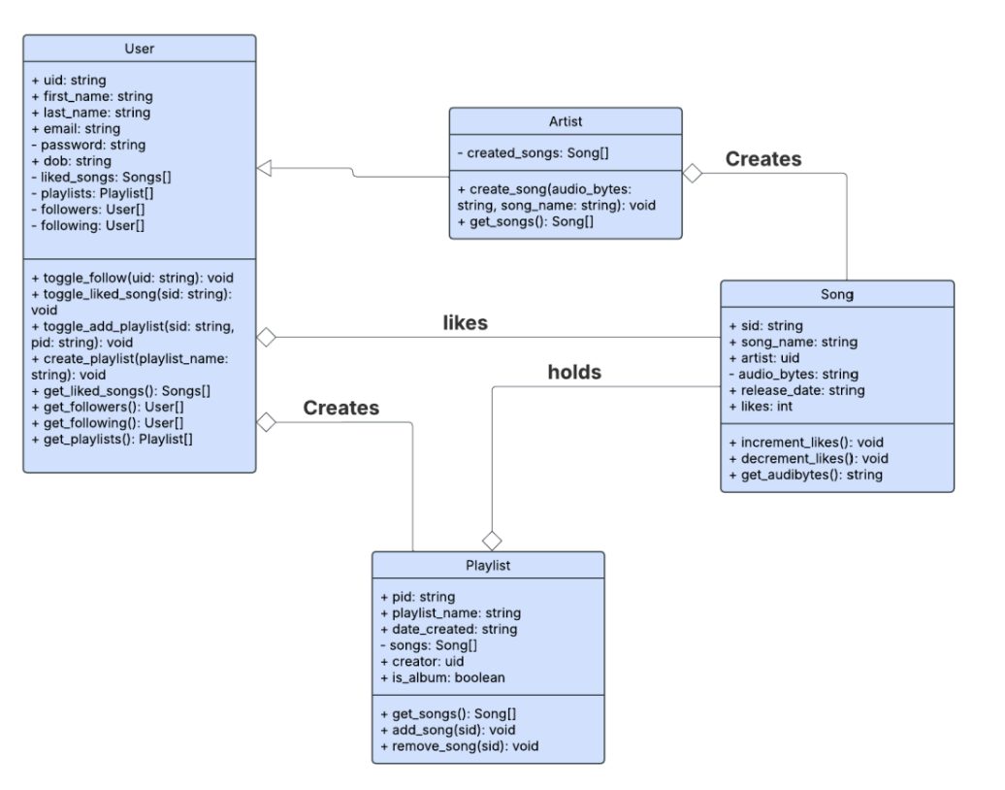
Class Diagram
A user can like a song
A user can create a playlist
A playlist can hold multiple songs
An artist is a subclass of a user
A user can create a song

Slide 19
Architectural Design
(Client-Server Architectural Pattern)
Our team has chosen to do the client/server architecture pattern for the system design for our music streaming app. We believe that this best fits our project’s needs because it allows all the different responsibilities to be separated into their respective sections.
Server responsibilities:
Handles the music library
Handles user auth and account data
Streams content over the internet to the clients
Client responsibilities:
UI and playback system
Handles user interaction
Sends requests to the server for music content

