Slide 1
AI AGENT ENGINEER CASE STUDY — PRODUCT & TECHNICAL SCOPING PACK
NEXUS
An AI-first agentic logistics operations layer
Observe → Understand → Decide → Act → Verify → Update → Escalate
Exception Recovery Agent
Dynamic Dispatch Agent
Communication & Coordination Agent
Prepared for the technical interview panel · github repository attached

Slide 2
EXECUTIVE SUMMARY
A working proof-of-concept, not a pitch
Every claim on this slide is demonstrated live in the attached repository — this is not a mockup.
The problem
WHAT'S BUILT
Tools tell operators a shipment is late. None of them fix it — that's still a phone call, every time.
Three working agents, wired together
A policy engine that limits what they can do
A human approval queue with full context
A repeatable, one-click demo scenario
A live dashboard — six screens
40 automated tests, all passing
The thesis
NEXUS decides what to do and does it — safely, with limits a human sets.
The proof
Three agents, a policy engine, an approval queue, and a live demo — all running today.
NEXUS — Agentic Logistics Platform
2

Slide 3
THE PROBLEM
Visibility isn't the gap. Coordinated action is.
Small and mid-sized carriers and 3PLs already know when a shipment is late.
What they don't have is a system that decides what to do about it and does it.
THE REAL QUESTION
“What is happening?”
“What should happen next — and can the system make it happen?”
A dispatcher has to notice the exception first
...then call the facility to rebook the appointment
...then call the customer with a new ETA
...then re-key the outcome into two or three systems
That's the shift from a visibility product to an operations layer — and it's the entire premise NEXUS is built to prove.
...repeated dozens of times a day, worst exactly when busiest
NEXUS — Agentic Logistics Platform
3

Slide 4
TARGET USER
Meet Dana
Operations Manager at a 60-truck regional carrier. We're building for her, not for a Fortune 500 shipper.
HER PROBLEM, IN ONE LINE
D
“I already know when a load is late. I need something that does more than tell me.”
Dana
Operations Manager
~80 shipments moving every day
Half her day is spent firefighting
Runs on a TMS, her phone, and spreadsheets
Won't trust a black box — she wants to see why, and to set the limits herself
WHAT SHE'S CHOOSING BETWEEN TODAY
No software
Flexible, but it doesn't scale — and leaves no record.
Enterprise platforms
Built for shippers 10x her size — and still won't act for her.
NEXUS — Agentic Logistics Platform
4

Slide 5
PRODUCT THESIS
NEXUS watches your shipments, figures out what's gone wrong, decides how to fix it, does it through a controlled set of tools, double-checks its own work, and brings a human in when it should.
Observe
→
Understand
→
Decide
→
Act
→
Verify
→
Update
→
Escalate
Not a generic AI chatbot. The system performs meaningful operational work — it acts, then proves it acted correctly.
NEXUS — Agentic Logistics Platform
5

Slide 6
MARKET & COMPETITIVE CONTEXT
A different job, not a new claim
“Agentic” isn't new. We're just aiming it at a job no one else is doing: acting on the exception, not reporting it.
 | What they're great at | What they don't do
project44 / FourKites | Real-time visibility, predictive ETAs | Tell you it's late. Don't fix it.
Manhattan Associates | Enterprise planning & warehouse ops | Built for planning cycles, not live exceptions.
Locus | Route optimization & dispatch | Optimizes the plan — not the recovery.
Chat copilots | Answer questions about your data | Still leave the fix to a human.
We act, not just explain
Autonomy you can see and set
Built for the operator no one else serves
We end in a real change to the shipment — not a message someone still has to go act on.
Every autonomy rule and cost limit is visible and editable — never a hidden setting.
Not a giant shipper. Not a spreadsheet. The 20–200-loads-a-day carrier in between.
NEXUS — Agentic Logistics Platform
6

Slide 7
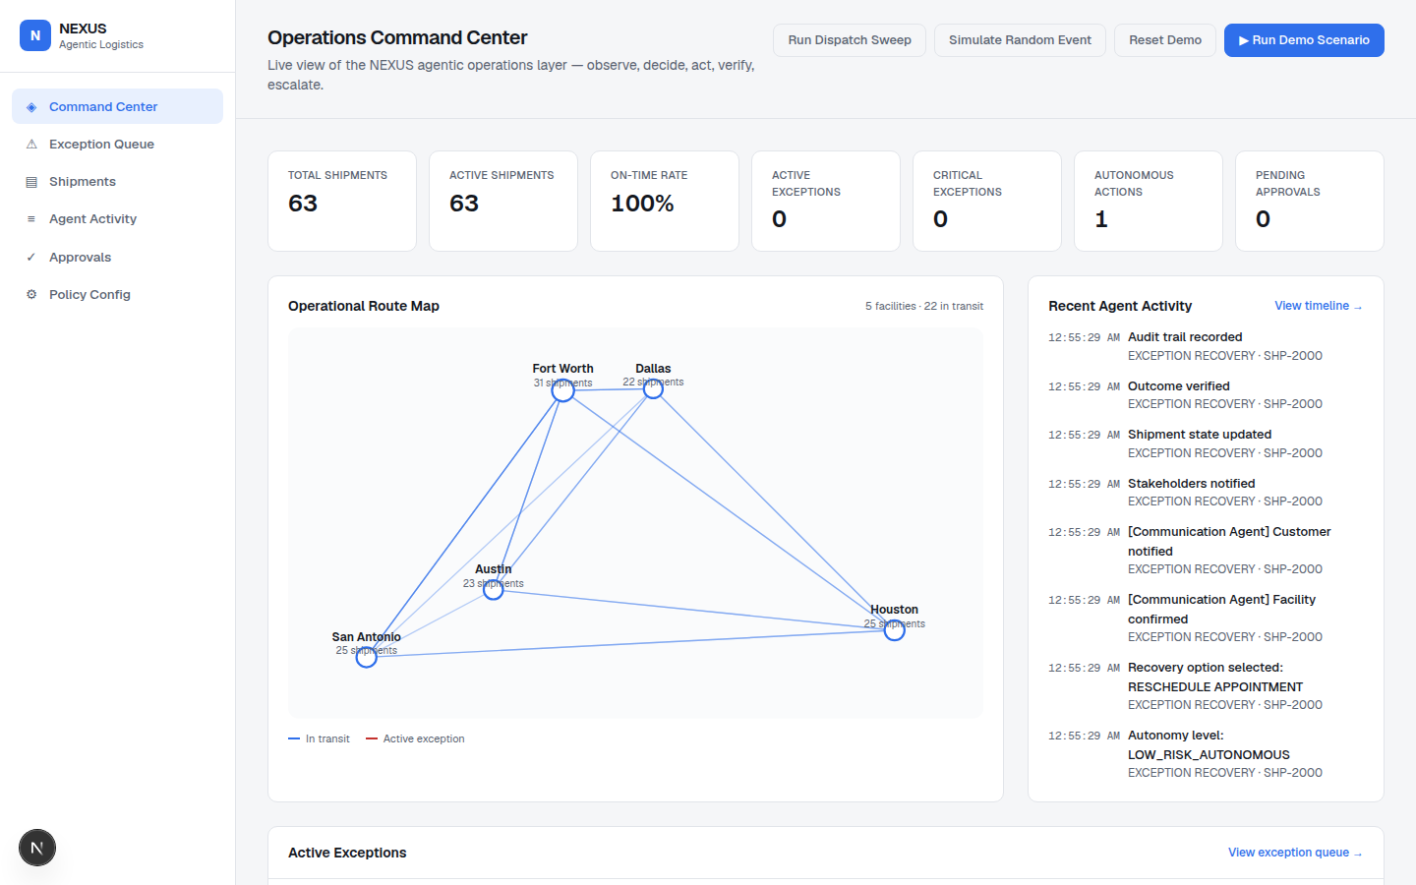
PRODUCT EXPERIENCE
A live operations dashboard, not a demo skin
Command Center
Exception Queue
Shipments
Agent Activity
Approvals
Policy Config
Command Center — live KPIs, route map, agent activity
NEXUS — Agentic Logistics Platform
7

Slide 8
TOP 3 AGENTIC FUNCTIONS
Three differentiated agents, cooperating on one timeline
01
02
03
THE HERO
ALWAYS WATCHING
STAYS IN TOUCH
Exception Recovery Agent
Dynamic Dispatch Agent
Communication Agent
Catches a delay, a missed window, a broken-down truck — and decides what to do about it.
Keeps checking: is this driver still the right call for this load?
Sends every message the other two agents' decisions require.
Scores the recovery options
Acts on its own, or asks first
Checks its own work, every time
Watches hours-of-service & availability
Suggests a better assignment
Never reassigns without a human's OK
Updates customers and facilities
Instructs drivers
Every message is logged
NEXUS — Agentic Logistics Platform
8

Slide 9
AGENT ARCHITECTURE
Every step is logged. Nothing is hidden.
From the moment something goes wrong to the moment it's fixed — no black box, no invisible reasoning.
Event
→
Context
Retrieval
→
Agent
Reasoning
→
Plan
→
Policy
Evaluation
↓ if required
Human
Approval*
→
Tool
Execution
→
Verification
→
State
Update
→
Audit +
Comms
The agent never touches the data directly. Every action goes through a checked, validated set of tools — and every one of those writes a record to the audit log.
NEXUS — Agentic Logistics Platform
9

Slide 10
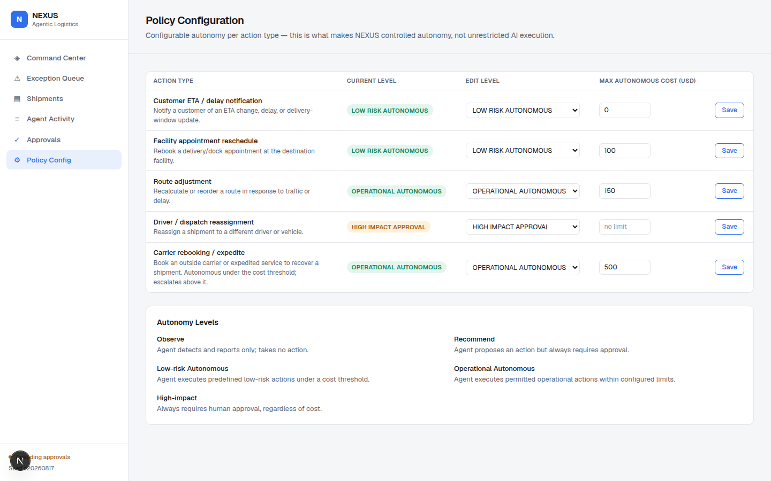
HUMAN OVERSIGHT & AUTONOMY
Five levels. The operator sets the dial.
Nothing runs on its own by default — every action type has a level, and Dana can turn it up or down herself.
Level | What it means | Example
Observe | Watches and reports only | —
Recommend | Suggests, always asks first | —
Low-risk auto | Acts on its own, under a $ limit | Reschedule ≤ $100
Operational auto | Acts on its own, within its lane | Rebook ≤ $500
High-impact | Always asks a human first | Reassign a driver
Live Policy Configuration screen
Every row is editable in the running app — change a level or a dollar limit and the next exception is governed by it immediately.
Every one of these is a setting on the Policy Configuration screen, not a line of code.
NEXUS — Agentic Logistics Platform
10

Slide 11
POC SCOPE
What's real today, and what we chose to skip
WORKING TODAY
ON PURPOSE, NOT YET
All three agents, wired together
Rules that limit what they can do
A human approval queue
60+ shipments, 10 drivers, 5 warehouses
A live 6-screen dashboard
One click: watch it solve a real problem
40 automated tests
Real TMS / GPS / routing connections
Real emails, texts, or EDI
Logins, billing, multiple companies
A driver mobile app
Predicting problems before they happen
Each one plugs into the same architecture later — none of it needs a rewrite.
NEXUS — Agentic Logistics Platform
11

Slide 12
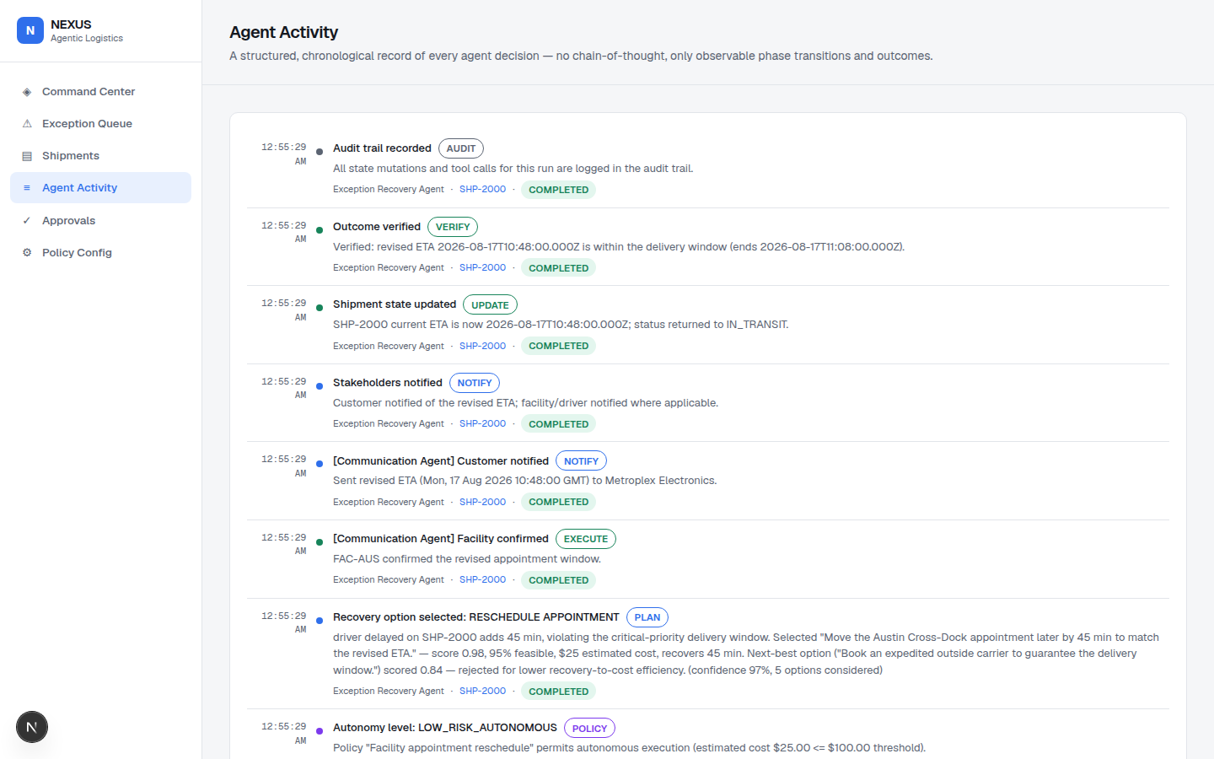
HERO DEMONSTRATION
Watch it happen in under two minutes
A driver runs 45 minutes late on a critical shipment. Here's the app catching it, fixing it, and proving it — with no one touching a keyboard.
1
The delay is caught
45 minutes late — enough to blow the delivery window.
2
It weighs the options
Five ways to fix it, ranked by cost and how well each works.
3
It checks the rules
$25 to fix it. Under the $100 limit — no need to ask.
4
It calls the warehouse
Confirms a new appointment time, on its own.
5
Done — customer told
The live Agent Activity feed, mid-run
Fixed, logged, and no one had to do a thing.
NEXUS — Agentic Logistics Platform
12

Slide 13
ROADMAP
Five phases, each shipping on the same architecture
1
2
3
4
5
POC
Production MVP
Integrations
Network Intelligence
Autonomous Operations
This repository
→
Persistent store, real comms, pilot operator
→
TMS, telematics, routing, carrier systems
→
Predictive detection, capacity forecasting
→
Expanded autonomy, governed throughout
Full milestones, dependencies, risks, and success measures per phase: docs/product/roadmap.md
NEXUS — Agentic Logistics Platform
13

Slide 14
KPIS
We measure results, not how smart the AI sounds
Exception Resolution Time
Autonomous Resolution Rate
On-Time Delivery Rate
Human Intervention Rate
How fast a problem goes from caught to fixed
How much gets fixed with no human needed
The number that actually matters to customers
How often we still need a person
Agent Action Success Rate
Cost Avoided
SLA Recovery Rate
What's not here
“How smart is the model?” That's not a business result — we don't track it.
How often the fix works on the first try
What a human would've spent fixing it by hand
How often we save a delivery that was about to miss
NEXUS — Agentic Logistics Platform
14

Slide 15
FUTURE VISION
Today it fixes one shipment. Someday, the network.
As it earns trust, NEXUS gets to make more calls on its own — but the guardrails never come off. Every new capability plugs into the same rules, the same approvals, the same audit log this POC already runs on.
It does real work — not a suggestion a person still has to act on
Every autonomous action is deliberate, and every one is logged
Every new integration is a plug-in, never a rewrite
Thank you — github.com/fernandogarzaaa/kpmg-nexus-prototype
NEXUS — Agentic Logistics Platform
15

