Slide 1

#LifeKoKaroLift
Lending Club Case Study
Fernando Guerra Bravo

Slide 2
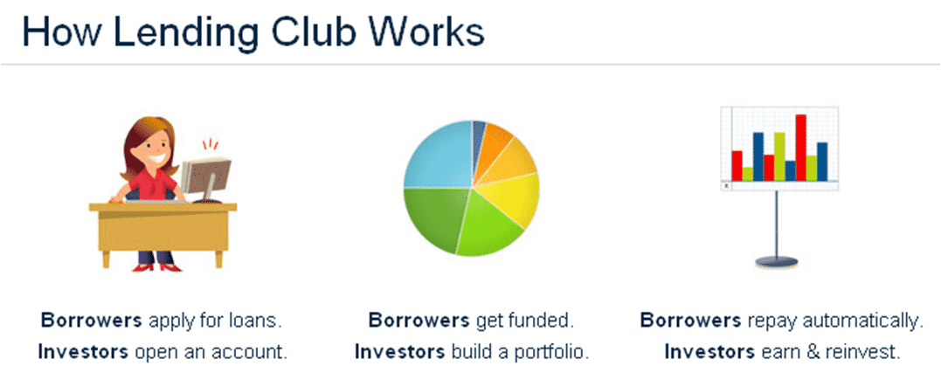
Lending Club: EDA Case Study
What is Lending Club?
Lending Club is a marketplace for personal loans that matches borrowers who are seeking a loan with investors looking to lend money and make a return.
When the company receives a loan application, the company has to make a decision for loan approval based on the applicant’s profile. Two types of risks are associated with the bank’s decision:
If the applicant is likely to repay the loan, then not approving the loan results in a loss of business to the company
If the applicant is not likely to repay the loan, i.e. he/she is likely to default, then approving the loan may lead to a financial loss for the company

Slide 3

Lending Club: EDA Case Study
In other words, the company wants to understand the driving factors (or driver variables) behind loan default, i.e. the variables which are strong indicators of default. The company can utilize this knowledge for its portfolio and risk assessment.

Slide 4
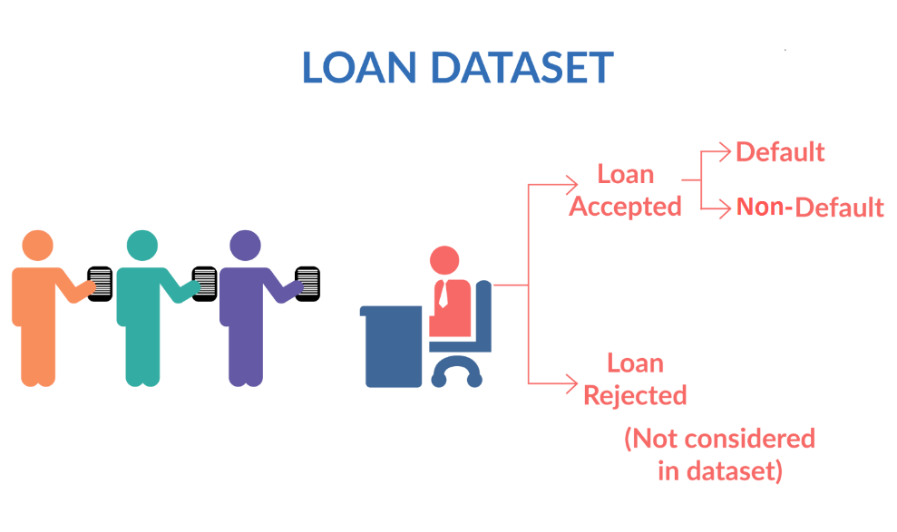
Lending Club: EDA Case Study
Fully paid: Applicant has fully paid the loan (the principal and the interest rate)
Charged-off: Applicant has not paid the instalments in due time for a long period of time, i.e. he/she has defaulted on the loan

Slide 5
Lending Club: EDA Case Study
Data Task done for this case study:
1. Data understanding
2. Data cleaning (cleaning missing values, removing redundant columns etc.)
3. Data Analysis
4. Recommendations

Slide 6
Lending Club: EDA Case Study
Relevant Insight
Mean Default Rate 14%
Mean Interest Rate 11,96%
Mean Emp Length 5 Years
Grade A, B, C - Good Payers
36 Month Terms – Good Payers
Home with Mortage – Good Payers
If propose is Small Business risk is the highest
If propose is wedding / major purchase and credit card is less risky
Loan Amount - Median is 10.000
Over the years, loan approvals have increased from 2007 to 2011.
The last two years have not changed significantly . Max 24.4% 2009
non-payment of debts can be noted in the highest amounts borrowed.
The same with high interest rates (default)
most of the loans are for debt consolidation.
More installment more risk to default

Slide 7
Recomendations
1. Lending to high-income individuals (Over 10,000)
2. Avoid high installment, acceptable between 200 and 400
3. Consider 36 Month Terms
4. Recommend loans for marriage, car purchase, credit card payments, and debt consolidation purposes. Small business loans are very risky.
5. Consider loans between 5000 and 15000 as the least risky default.
6. Focus on clients with A,b and C grades.

